Slide 1


University of Queensland
Thomas Guillerme
guillert@tcd.ie
@TGuillerme

Slide 2
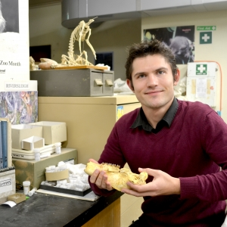
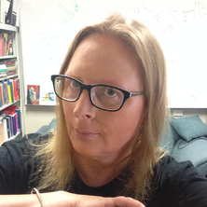
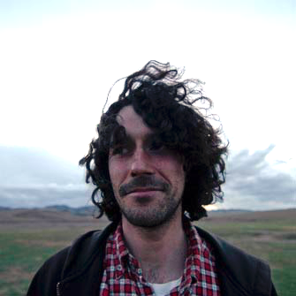
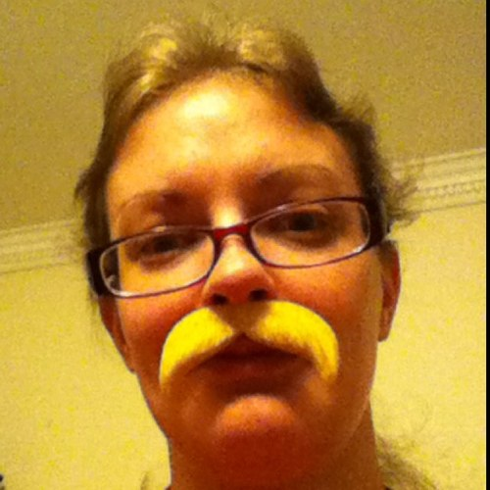
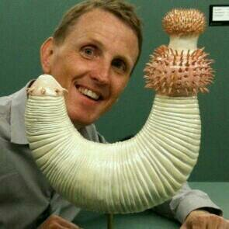
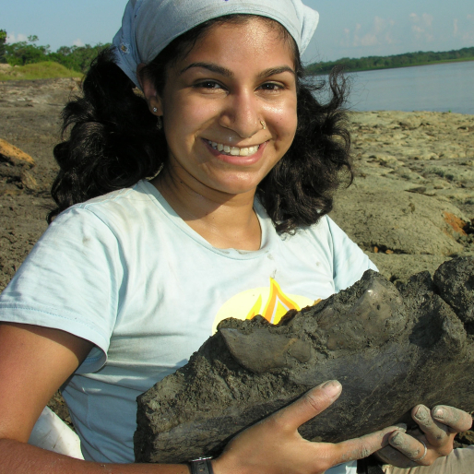
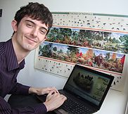

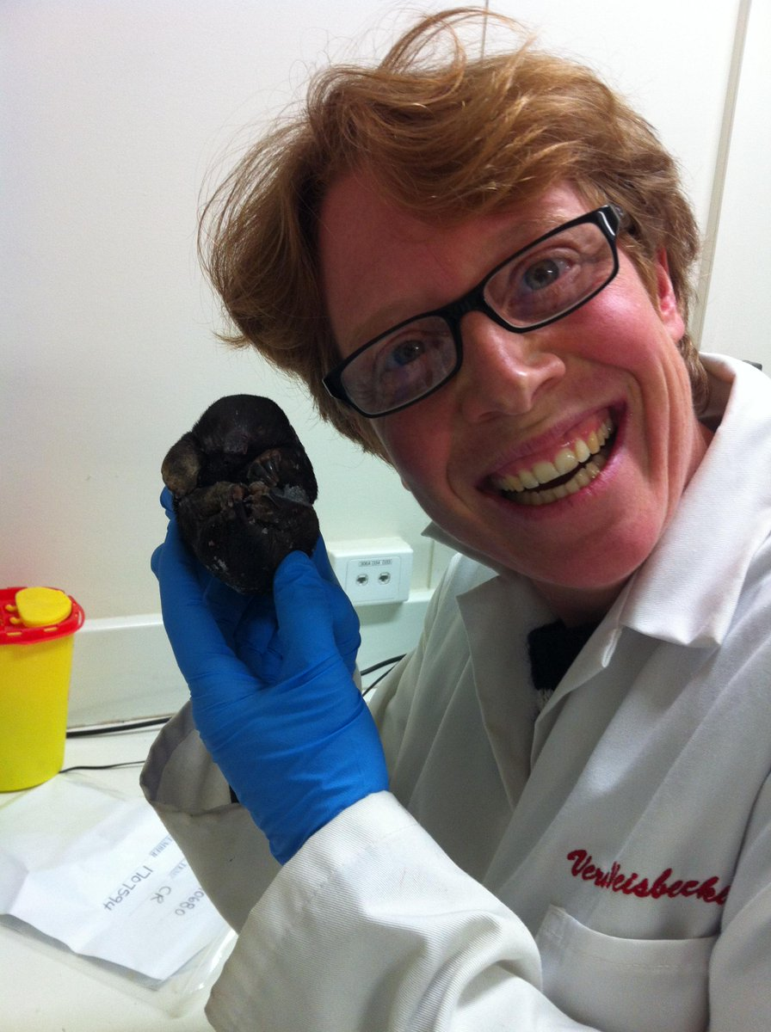

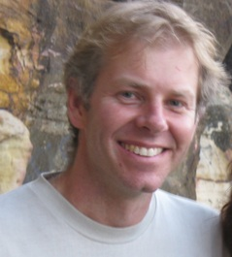

Acknowledgements
Robin Beck
Simone Blomberg
Martin Brazeau
Natalie Cooper
Phil Donoghue
Anjali Goswami
Thomas Halliday
Graeme Lloyd
Ariel Marcy
Matt Phillips
Mark Puttick
Vera Weisbecker

Slide 3
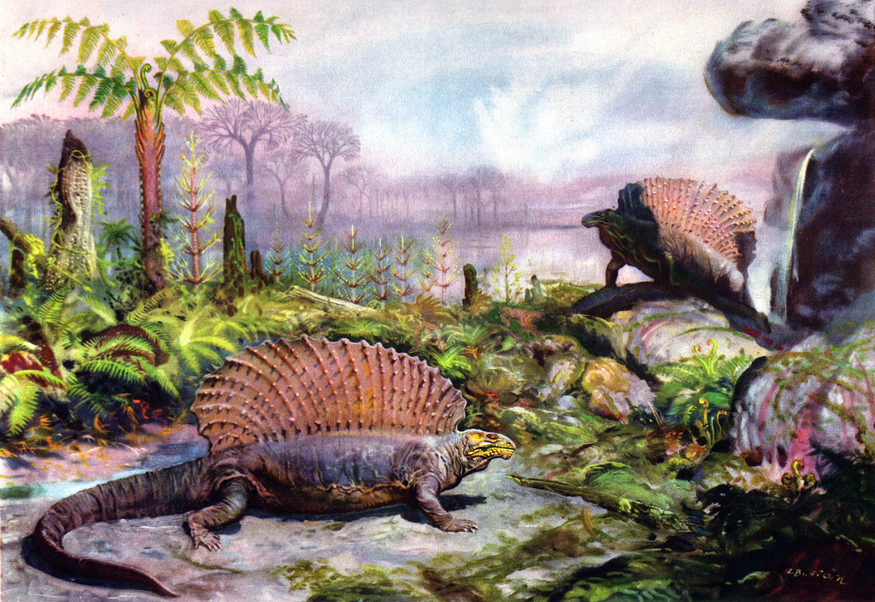
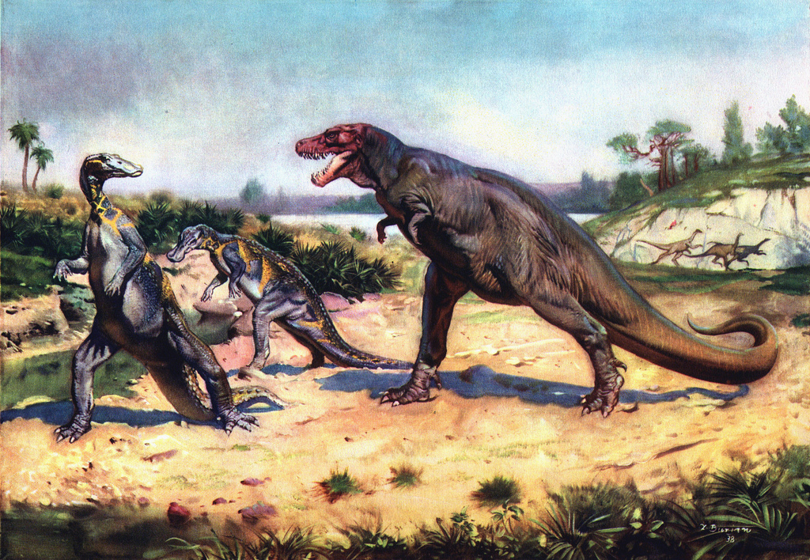
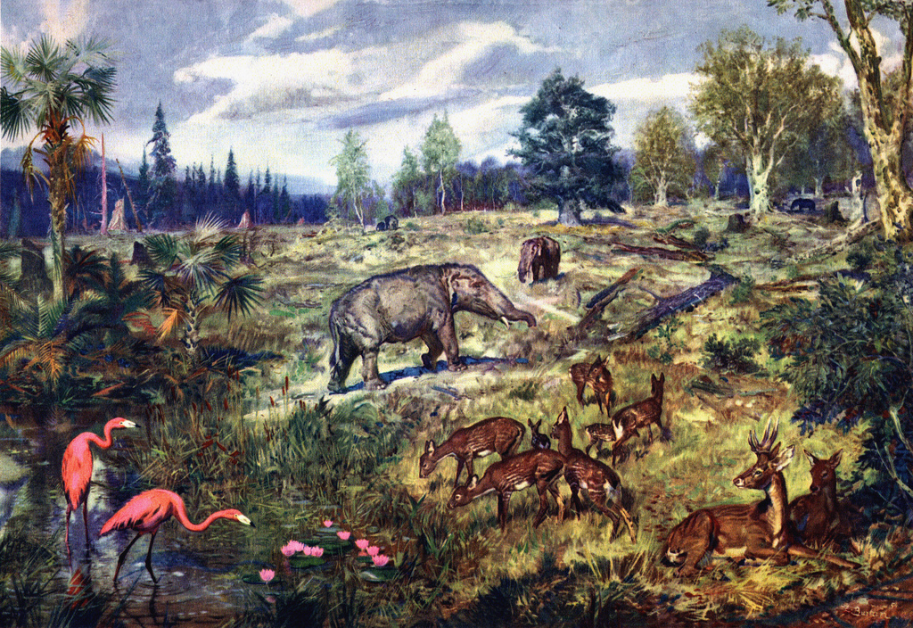
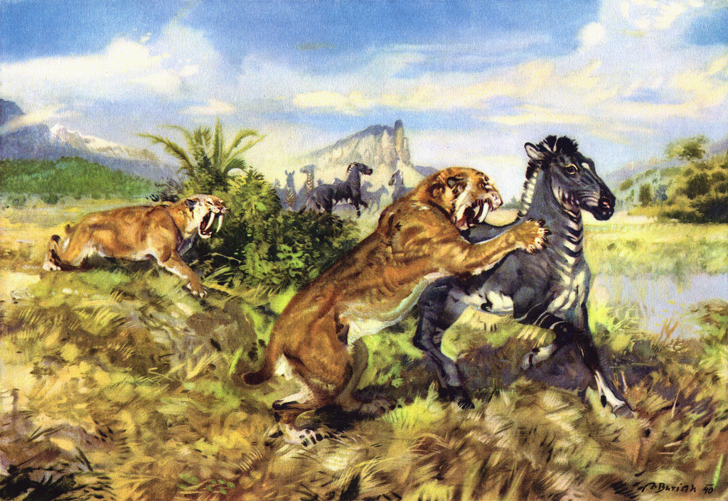
What mechanisms generate and maintain the diversity of traits through time?

Slide 4
mechanisms
= process

Slide 5
mechanisms
= process
diversity of traits
= pattern

Slide 6
mechanisms
= process
diversity of traits
= pattern
through time
= sparse fossil record

Slide 7
Diversity of traits through time?
Notes:
My approach to answer the question: “how does diversity of shapes arise?” is by taking a really broad methodological approach from understanding how to look at these patterns in phylogenetic inferences, up to macroevolution (disparity methods) and macroecology (mulTree). I’m just gonna focus on disparity here.

Slide 8
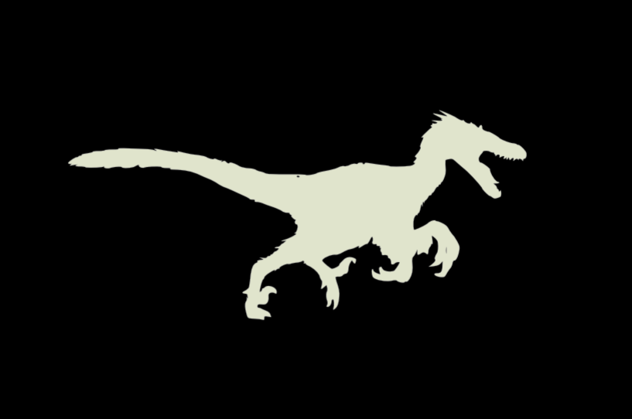

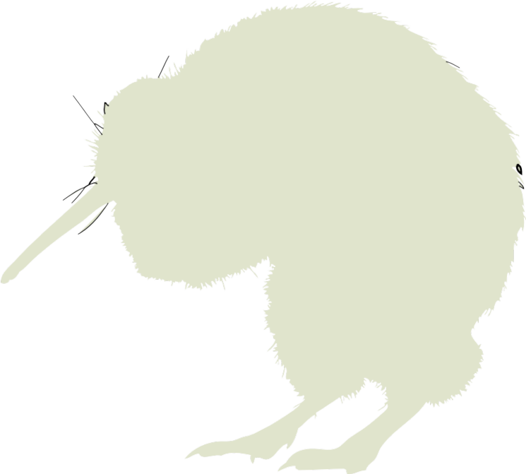


Diversity of traits through time?
Phylogenetic inference
Brazeau Guillerme Smith 2018 Syst. Biol.
Guillerme & Cooper 2016 Mol. Phyl. Evol.
Notes:
My approach to answer the question: “how does diversity of shapes arise?” is by taking a really broad methodological approach from understanding how to look at these patterns in phylogenetic inferences, up to macroevolution (disparity methods) and macroecology (mulTree). I’m just gonna focus on disparity here.

Slide 9
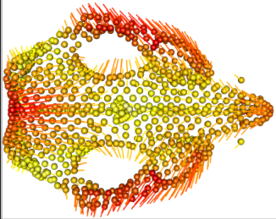
Diversity of traits through time?
Phylogenetic inference
Brazeau Guillerme Smith 2018 Syst. Biol.
Guillerme & Cooper 2016 Mol. Phyl. Evol.
Macroevolution
Weisbecker, Guillerme et al 2019 Front. Zool.
Guillerme 2018 Meth. Ecol. Evol.
Guillerme & Cooper 2018 Palaeontology
Notes:
My approach to answer the question: “how does diversity of shapes arise?” is by taking a really broad methodological approach from understanding how to look at these patterns in phylogenetic inferences, up to macroevolution (disparity methods) and macroecology (mulTree). I’m just gonna focus on disparity here.

Slide 10
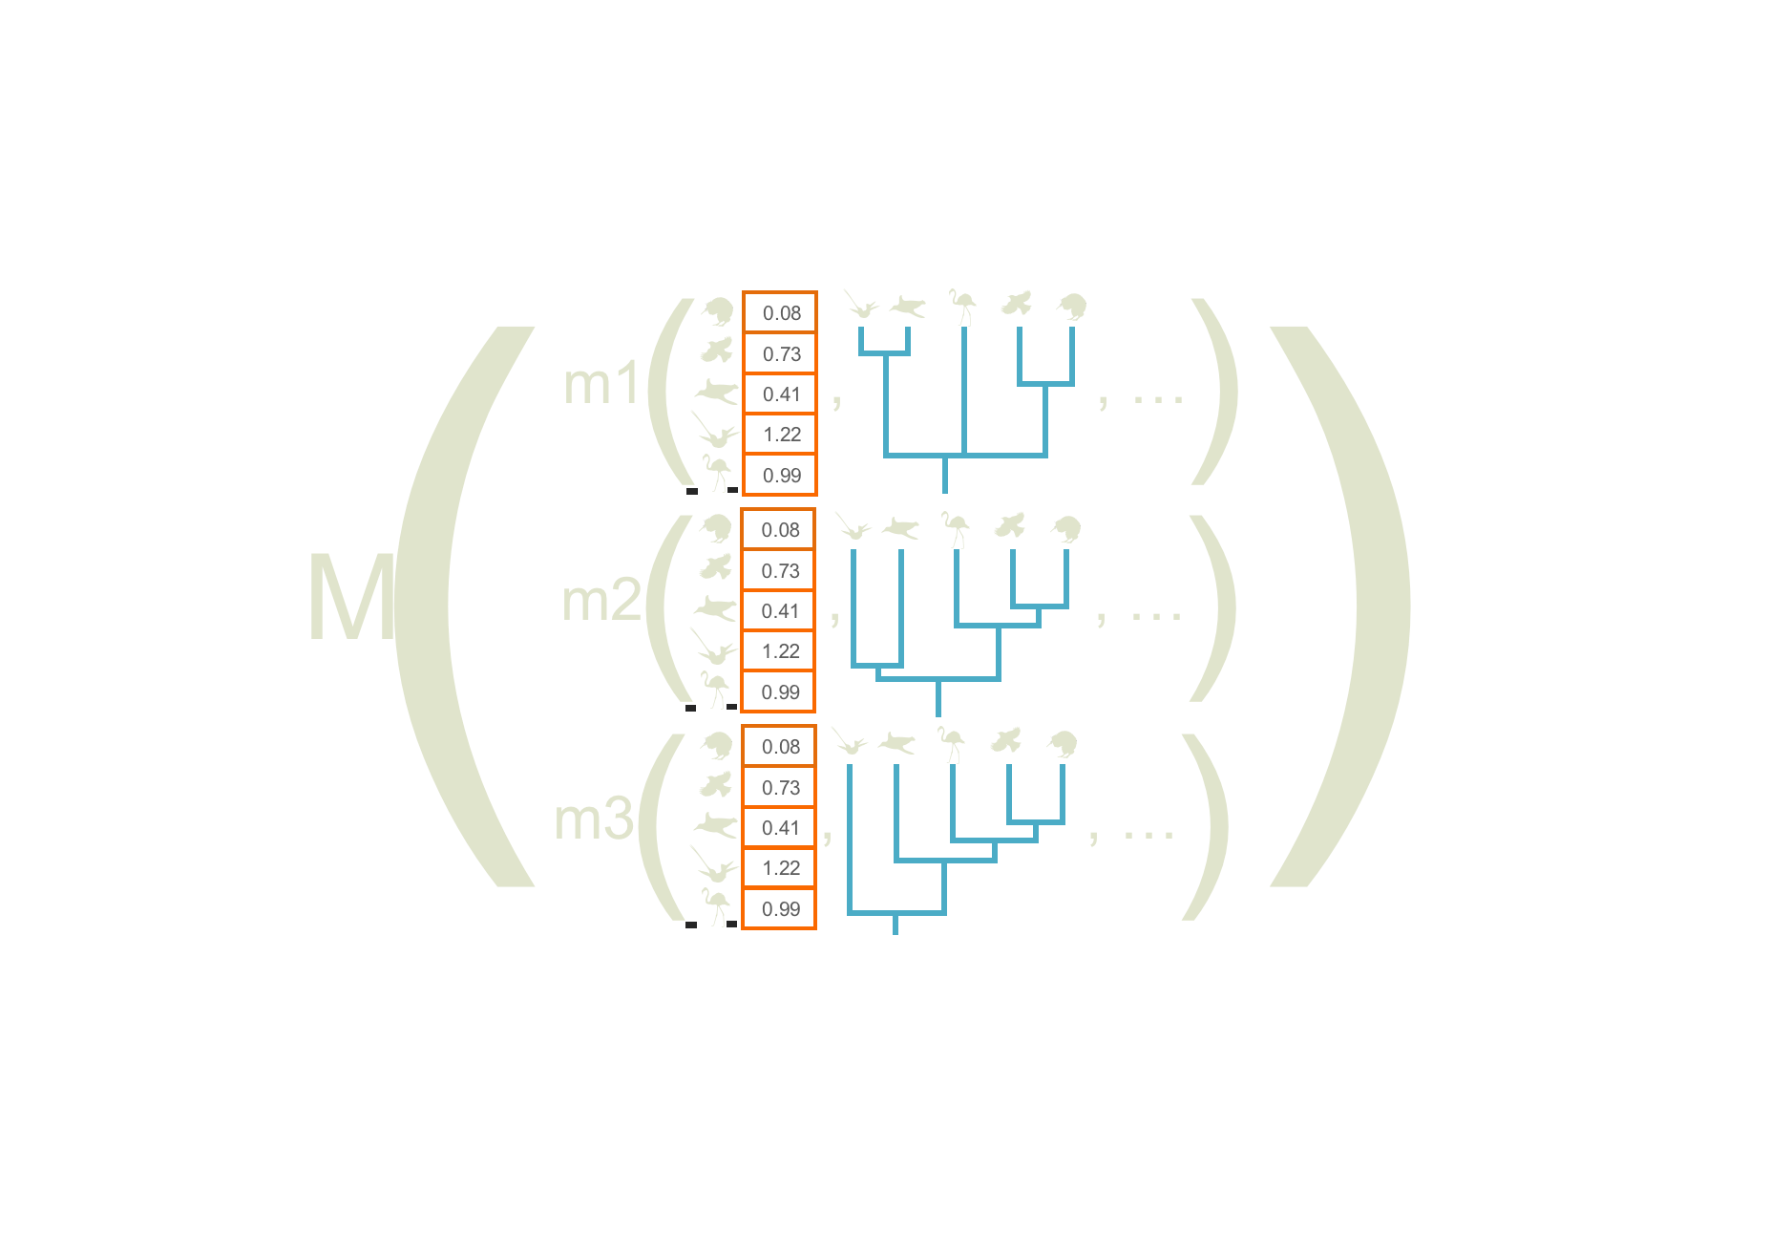
Diversity of traits through time?
Phylogenetic inference
Brazeau Guillerme Smith 2018 Syst. Biol.
Guillerme & Cooper 2016 Mol. Phyl. Evol.
Macroevolution
Weisbecker, Guillerme et al 2019 Front. Zool.
Guillerme 2018 Meth. Ecol. Evol.
Guillerme & Cooper 2018 Palaeontology
Macroecology
Healy, Guillerme et al 2014 Proc. B.
M
Notes:
My approach to answer the question: “how does diversity of shapes arise?” is by taking a really broad methodological approach from understanding how to look at these patterns in phylogenetic inferences, up to macroevolution (disparity methods) and macroecology (mulTree). I’m just gonna focus on disparity here.

Slide 11
Diversity of traits through time?
Phylogenetic inference
Brazeau Guillerme Smith 2018 Syst. Biol.
Guillerme & Cooper 2016 Mol. Phyl. Evol.
Macroevolution
Weisbecker, Guillerme et al 2019 Front. Zool.
Guillerme 2018 Meth. Ecol. Evol.
Guillerme & Cooper 2018 Palaeontology
Macroecology
Healy, Guillerme et al 2014 Proc. B.
M
Notes:
My approach to answer the question: “how does diversity of shapes arise?” is by taking a really broad methodological approach from understanding how to look at these patterns in phylogenetic inferences, up to macroevolution (disparity methods) and macroecology (mulTree). I’m just gonna focus on disparity here.

Slide 12




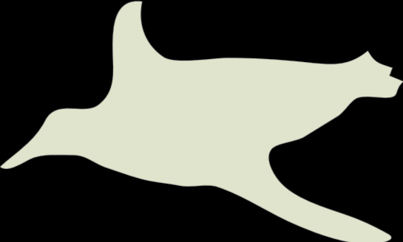
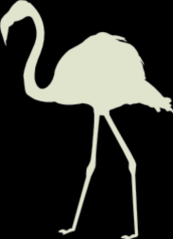

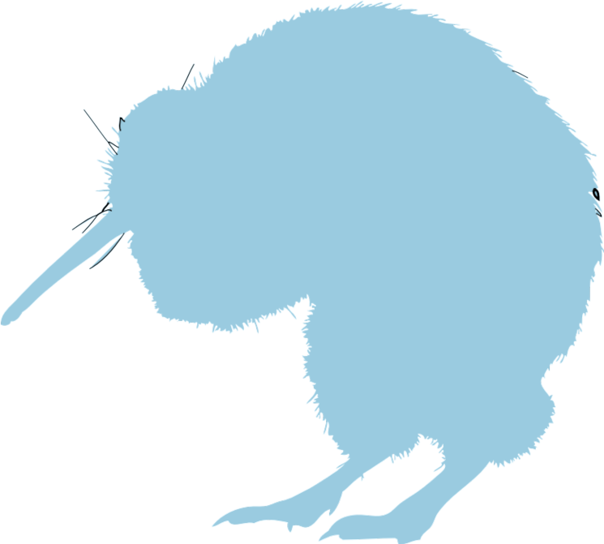

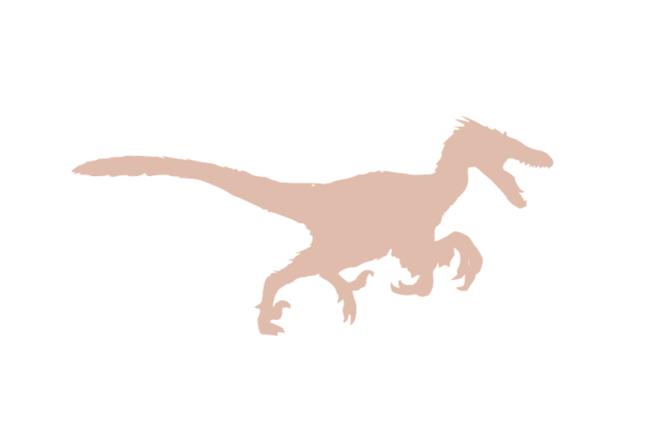
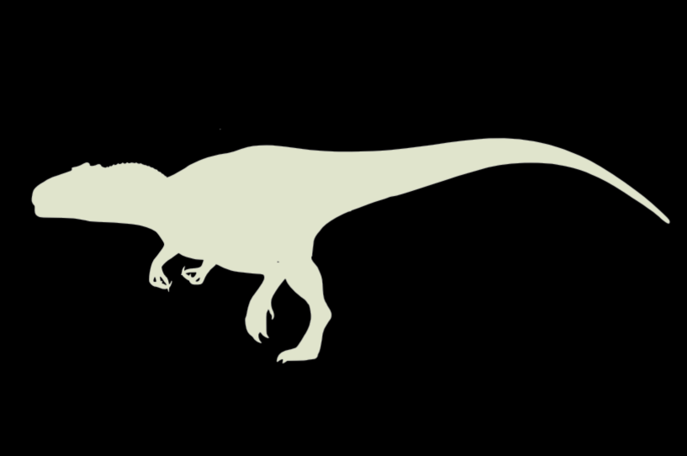
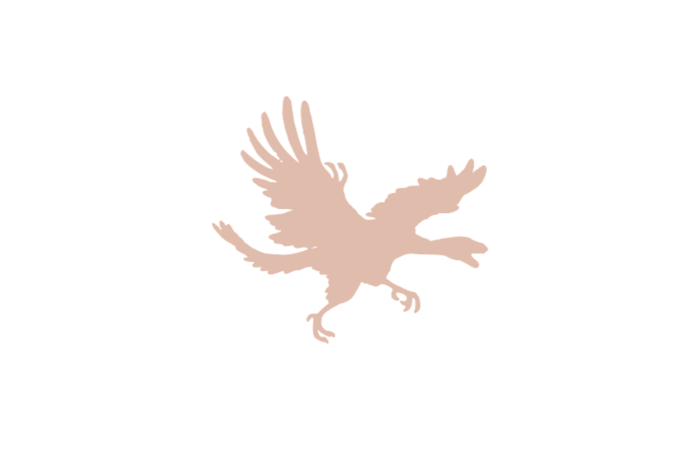


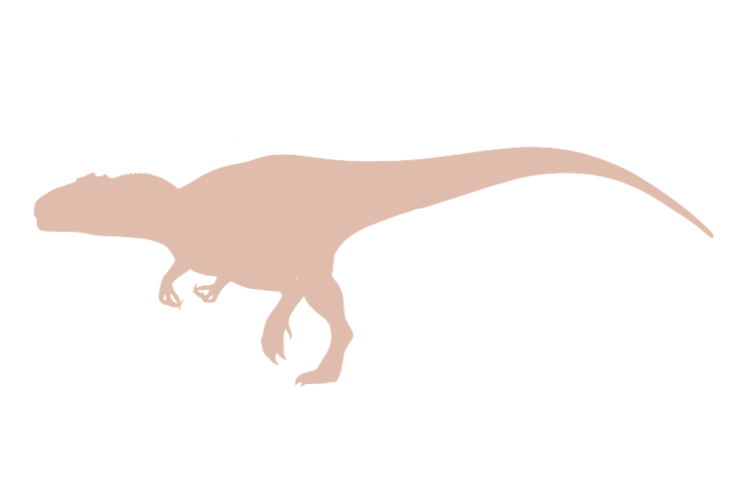
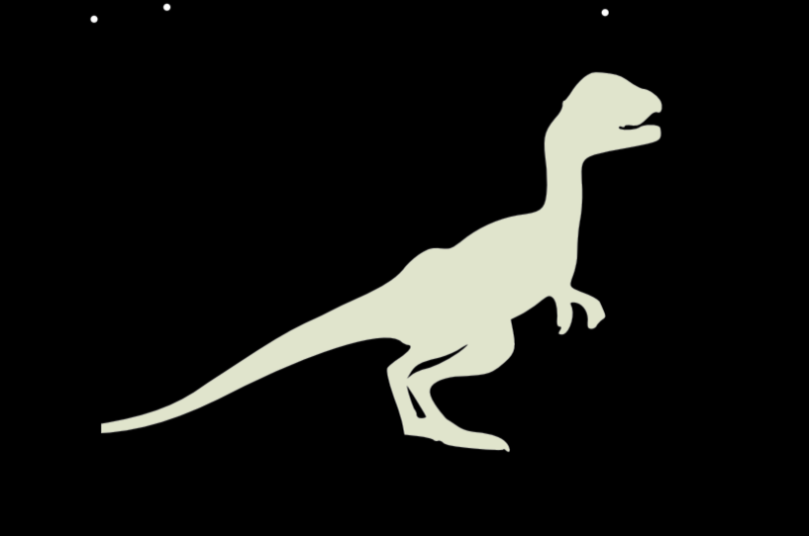
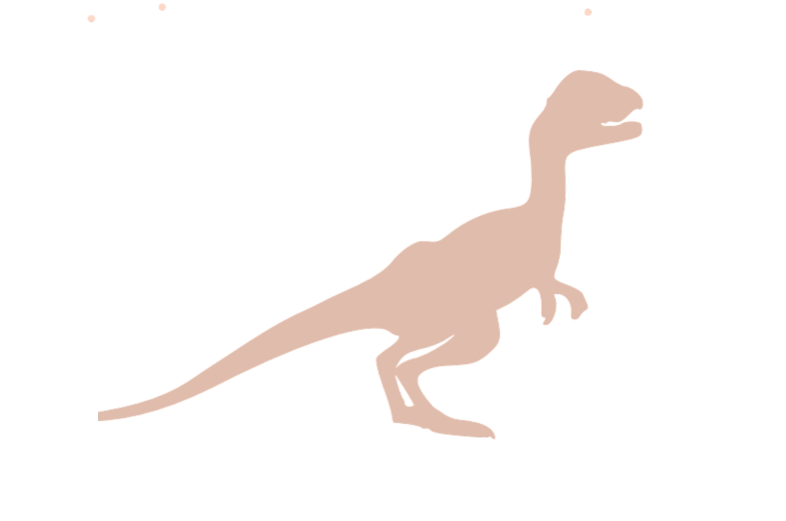
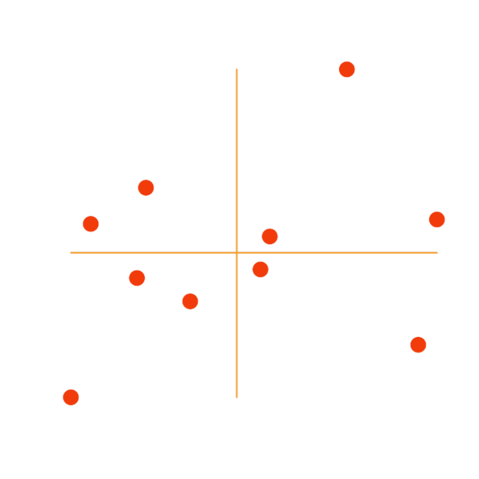
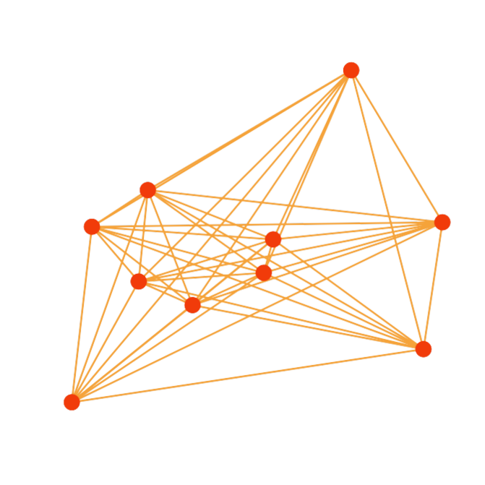
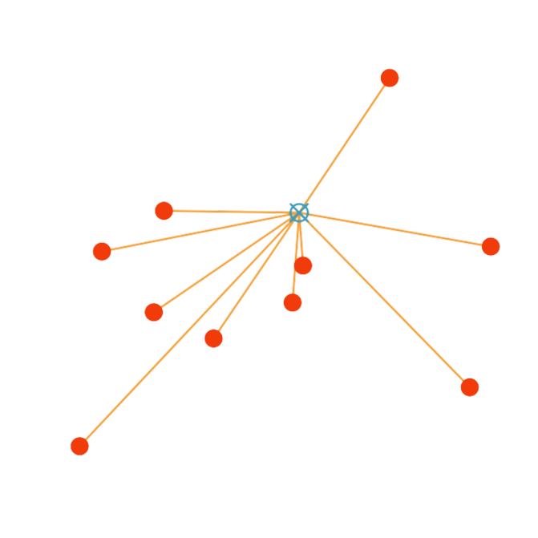
github.com/TGuillerme/dispRity
github.com/TGuillerme/moms
Notes:
Sort the silhouettes along the axis (e.g. body mass/color)

