Slide 1
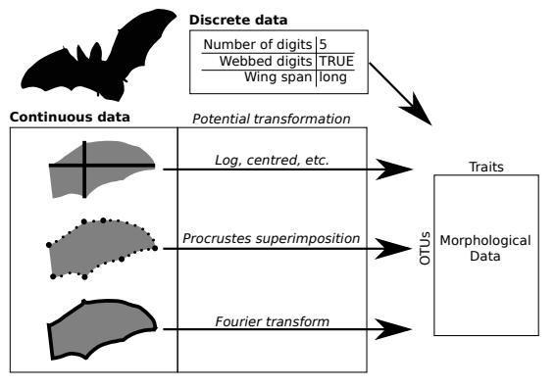
Types of traits
From Guillerme et al 2020 – Biology Letters
Notes:
I

Slide 2

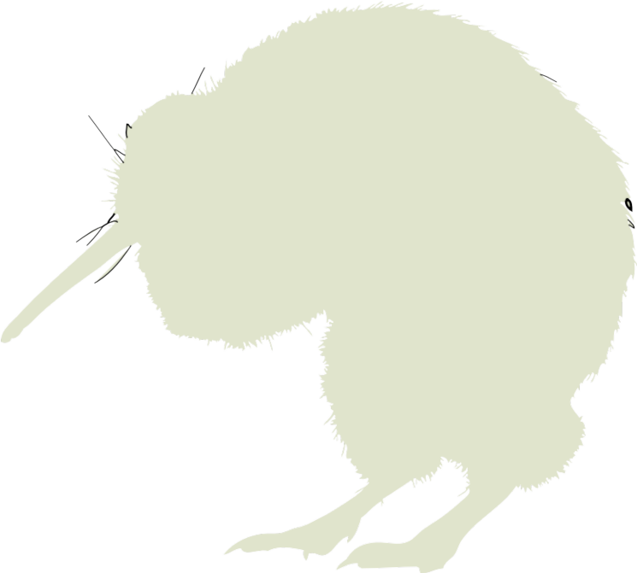


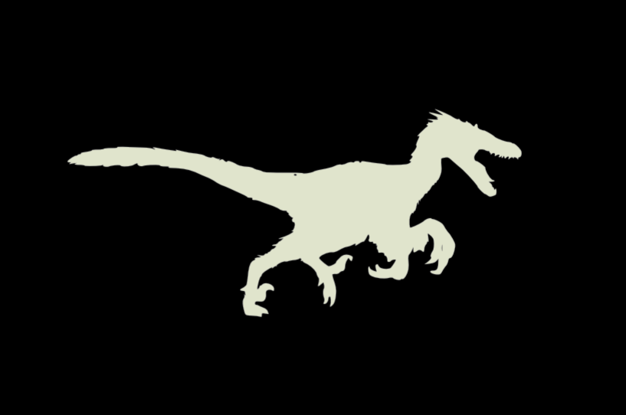
Notes:
I

Slide 3
Notes:
I

Slide 4
Ordinations
Notes:
I

Slide 5
Length of the beak
Length of the legs
Notes:
Sort the silhouettes along the axis (e.g. body mass/color)

Slide 6
Length of the beak
Length of the wings
Length of the legs
Notes:
Sort the silhouettes along the axis (e.g. body mass/color)

Slide 7
Length of the beak
Length of the wings
Length of the legs
Notes:
Sort the silhouettes along the axis (e.g. body mass/color)

Slide 8
Length of the beak
Length of the wings
Length of the legs
Notes:
Sort the silhouettes along the axis (e.g. body mass/color)

Slide 9
???
Length of the tail
Length of the beak
Length of the wings
Length of the legs
Notes:
Sort the silhouettes along the axis (e.g. body mass/color)

Slide 10
PCA

Slide 11
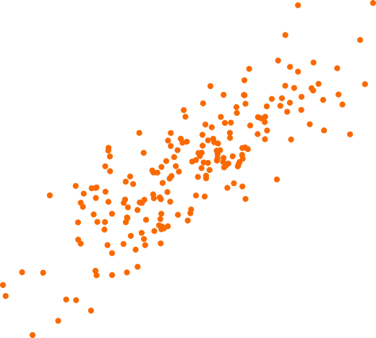
TL;DR:
PCA = rotating and stretching your data to maximise variance covariance
Trait 2
Trait 1

Slide 12
TL;DR:
PCA = rotating and stretching your data to maximise variance covariance
Trait 2
Trait 1

Slide 13
TL;DR:
PCA = rotating and stretching your data to maximise variance covariance
Trait 2
Trait 1

Slide 14
TL;DR:
PCA = rotating and stretching your data to maximise variance covariance
PC 2
PC1

Slide 15
The black box

Slide 16
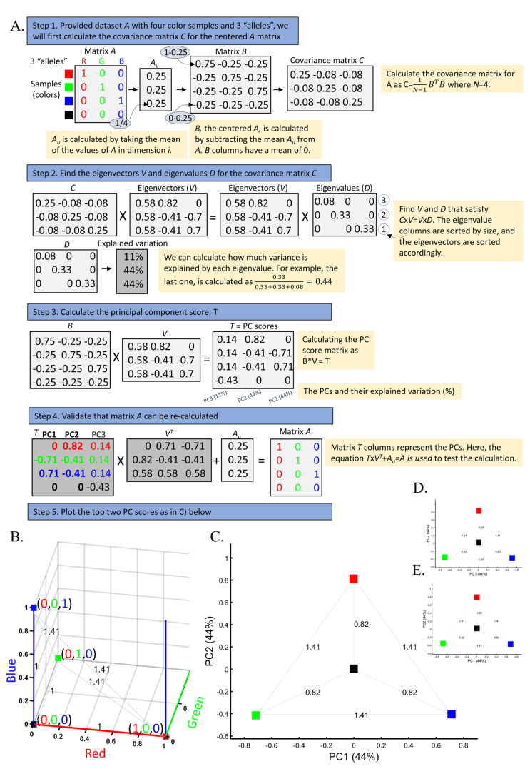
Elhaik, E. Principal Component Analyses (PCA)-based findings in population genetic studies are highly biased and must be reevaluated. Sci Rep 12, 14683 (2022). https://doi.org/10.1038/s41598-022-14395-4

Slide 17
Step 1: centre the matrix
Step 2: measure the variance covariance of the centred matrix

Slide 18
Keep this in a corner of your head, we’ll get back to this!
Step 1: centre the matrix
Step 2: measure the variance covariance of the centred matrix

Slide 19
Step 3: do a eigen decomposition.
Basically satisfy the equation:
VCV matrix * eigenvector = eigenvector * eigenvalue.

Slide 20
Step 3: do a eigen decomposition.
Basically satisfy the equation:
VCV matrix * eigenvector = eigenvector * eigenvalue.
The variance-covariance
between traits
The vector (direction) of change
The vector (direction) of change
The strength (length) of change

Slide 21
Step 3: do a eigen decomposition.
Basically satisfy the equation:
VCV matrix * eigenvector = eigenvector * eigenvalue.
This method is the core of the PCA. I think it’s OK to treat it as a black box since it varies between algorithms. R default’s is LAPACK but EISPACK or other algorithms can also be used. Also, these algorithms are explicitely approximations :“All you can hope for is a solution to a problem suitably close to x.” (base::eigen). This can explain differences between ordinations of the same data.

Slide 22
Step 4: multiply the centred matrix by the eigenvector

Slide 23
Step 4: multiply the centred matrix by the eigenvector
Step 5: that’s it.

Slide 25
PCA: what it’s good at?
- Ordinating your data (i.e. ranking all your variables and making them independent and orthogonal).

Slide 26
PCA: what it’s good at?
- Ordinating your data (i.e. ranking all your variables and making them independent and orthogonal).
- Reducing dimensionality (to some extend – e.g. going from 200D to 10D).

Slide 27
PCA: what it’s good at?
- Ordinating your data (i.e. ranking all your variables and making them independent and orthogonal).
- Reducing dimensionality (to some extend – e.g. going from 200D to 10D).
- Creating a “true” mathematical space (that contains all the possible trait combinations).

Slide 28
PCA: what it’s bad at (in my opinion)?
- Being interpreted by humans in 2D.

Slide 29
PCA: what it’s bad at (in my opinion)?
- Being interpreted by humans in 2D.
- Spreading data (the centre of your space is the average data value, not anything biological).

Slide 30
PCA: what it’s bad at (in my opinion)?
- Being interpreted by humans in 2D.
- Spreading data (the centre of your space is the average data value, not anything biological).
- Creating dimensions that are easy to interpret (e.g. PC1 = correlation between n-variables decided by the algorithm – these can sometimes map to biological things, sometimes not!).

Slide 31

PC2
5.93%
PC1 44
PC1 89.19%

Slide 32
0.2
0
-0.4
PC1 44
-3 0 1

Slide 33

1
0
-3
PC2
5.93%
-3 0 1
PC1 89.19%

Slide 34
PCO

Slide 35
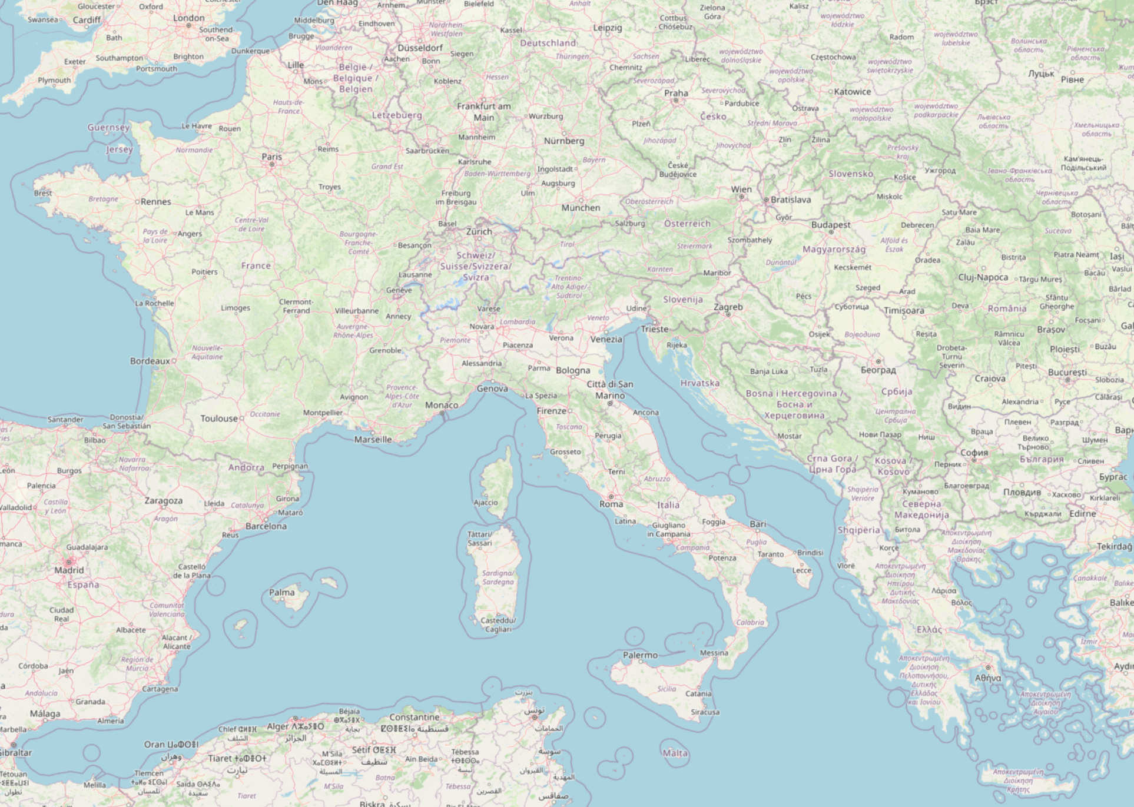
Distance matrix
Notes:
I

Slide 36
Distance matrix
Ath Bar Nur
Ath
Bar
Nur
Notes:
I

Slide 37
Linear distance matrix (km)
Ath Bar Nur
Ath 0 1880 1012
Bar 1880 0 1134
Nur 1012 1134 0
Notes:
I

Slide 38
Road distance matrix (km)
Ath Bar Nur
Ath 0 3084 1443
Bar 3084 0 2171
Nur 1443 2171 0
Notes:
I

Slide 39
Road distance matrix
(max hours – leaving on a Monday at 08:00)
Ath Bar Nur
Ath 0 38 26
Bar 37 0 18
Nur 27 17 0
Notes:
I

Slide 40
Metric distances?
km
km
h
Is positive? (and null)
Is symmetric?
d(A,B) = d(B,C)
No shortcuts!
(triangle inequality)
d(A,B) + d(B,C) ≥ d(A,C)
Notes:
I

