Slide 1


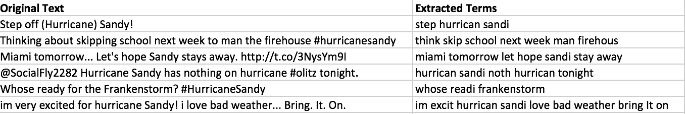
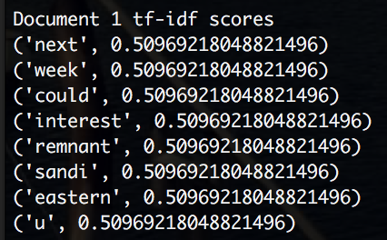
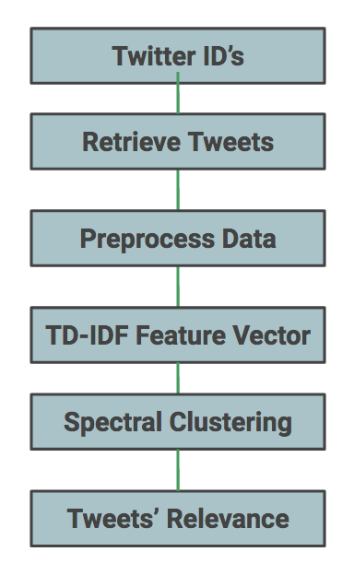
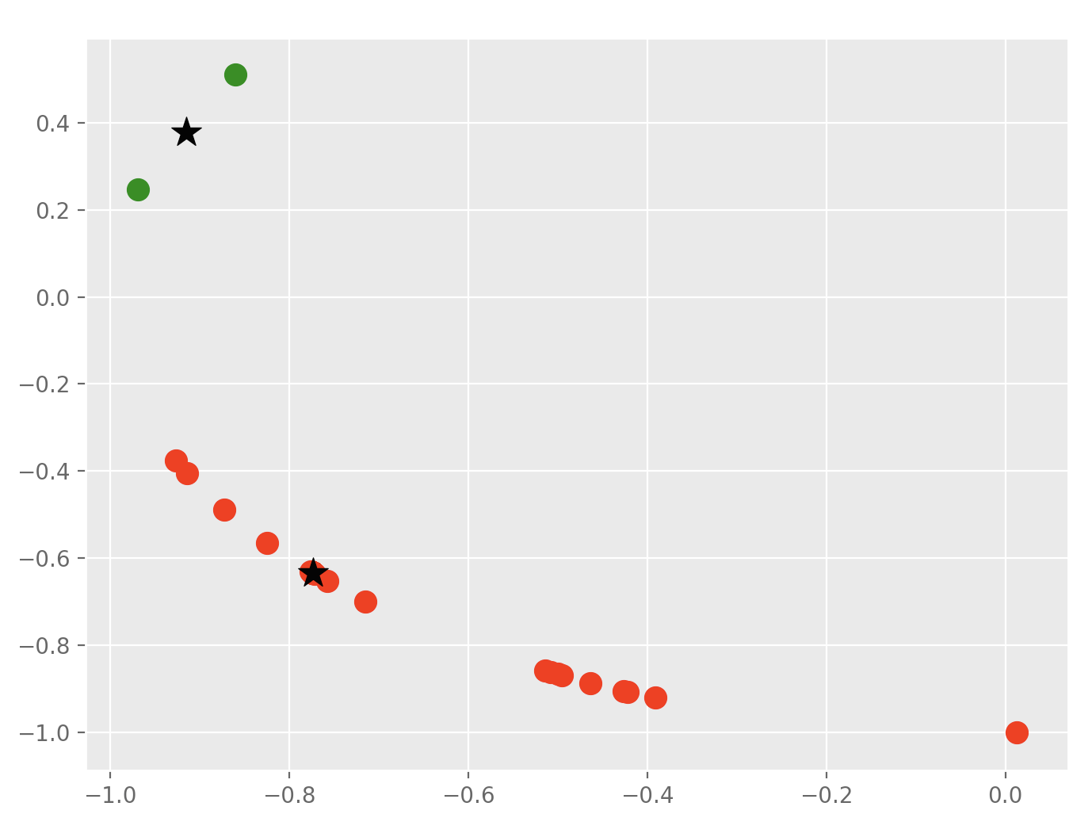

Classifying Text With Spectral Clustering to Aid Disaster Relief Planning
Tushita Gupta & Cody Yang
Department of Electrical and Computer Engineering, Carnegie Mellon University, Pittsburgh, PA
Introduction
Methods
Results
Motivation
Feature Vector
Each tweet is represented as a vector with values being the tf-idf scores for each token^{[2]}.
TF(t) = $\frac{Number of times token t appears in a tweet}{Total number of token in the tweet}$
IDF(t) = log( $\frac{Total number of tweets}{Number of tweets with token t in it}$)
Score = TF(t) * IDF(t)
Spectral Clustering
Spectral Clustering is used to reduce data points to a lower dimensional space and group them into clusters based on the similarity to points in the group and dissimilarity to points in other groups. These are the steps of the algorithm^{[3]}:
1) Form similarity matrix, A, using the Gaussian similarity function.
A_{ij} = exp (−||s_{i}−s_{j} ||² /2σ² ) if i ≠ j, and A_{ii} = 0
2) Let D be the diagonal matrix where the i^{th} element in the diagonal is the sum of the similarity matrix A’s i^{th} row. Calculate the Laplacian matrix, L.
L = D^{-1/2} A D^{-1/2}
3) Find the eigenvectors, V, and eigenvalues, λ, of L.
Lv = λv
4) Construct matrix X from the 2 eigenvectors v₁, v₂ with the largest eigenvalues such that X = [v₁,v₂].
5) Normalize each column in X to unit length.
$Y_{ij}$ = $X_{ij}$ / ${(\sum_{j}{X_{ij}^{2}}) }^{1/2}$
Use only 2 eigenvectors to induce the minimized normal cut of the similarity graph where the nodes are the data points and the edges are the similarity score between the 2 points.
K-Means Clustering
K-means clustering is used to partition the data into k groups based on a distance function. These are the steps of the algorithm^{[4]}:
1) Randomly select k centroids.
2) Assign each point to be in the cluster with the minimum distance from the center.
3) Reassign each centroid to be the mean of the points in that cluster.
4) Repeat steps 2 and 3 until no points are reassigned.
Data Collection & Cleaning
Natural disaster response planning can be difficult. Several problems resulting from the disaster, restrict the flow of information from victims to responders.
There is a lot of raw data on social media platforms from which information can be gathered about the extent of a disaster. This information can help responders form better relief plans.
Figure 1: Original tweet text on the left and cleansed, normalized tokens on the right.
Feature Vector & Spectral Clustering
Approach
Figure 2: tf-idf scores computed for an individual document
Figure 3: Eigenvectors corresponding to eigenvalues 1.002, 0.989.
Our goal is to build a system to classify tweets as being relevant or irrelevant to a disaster based on text from the tweets.
Use spectral clustering on the text of several tweets to determine tweet labels.
K-Means Clustering
Distribution of the data is noisy but we are still able to segment data into 2 groups with threshold zero for 2nd eigenvector
The labels assigned to the data points were compared to a set of 100 manually labeled points and the accuracy of the classifier is 75.0%
Data
Data Collection
We collected 7,000 tweets posted during Hurricane Sandy which occurred between October 22, 2012 and November 2, 2012 from https://goo.gl/Lz9ep8.
The Python Twitter API was used to pull other parameters such as the text and geolocation.
Figure 4: Stars represent centers of the red and green clusters.
Conclusion
Data Cleaning
Relevance & Future Work
Spectral clustering is a powerful tool for classifying unlabeled data but it is important to obtain a large dataset and properly clean it to get meaningful results.
With further refinement of spectral clustering, information such as the effects and epicenters of the disaster can be extracted from disaster relevant tweets using a conditional random field.
Tokenization – splits text into tokens based on whitespace and punctuation.
Stop word removal – removes functional words such as ‘and’ or ‘the’.
Stemming – removes prefixes and suffixes to get words in their root form.
Emoji, URL and hashtag symbol removal
[1] ARIAS, M. ,., ARRATIA, A. ,., & XURIGUERA,, R. (2012). Forecasting with Twitter Data. ACM Transactions on Intelligent Systems and Technology, V(N). Retrieved December 4, 2017, from http://www.lsi.upc.edu/~argimiro/mypapers/Journals/aax2012.pdf
[2] Class TFIDFSimilarity. (n.d.). Retrieved December 4, 2017, from https://lucene.apache.org/core/4_9_0/core/org/apache/lucene/search/similarities/TFIDFSimilarity.html
[3] Ameen, A., Unnisa, M., & Raziuddin,, S. (2016). Opinion Mining on Twitter Data using Unsupervised Learning Technique. International Journal of Computer Applications, 148(12). Retrieved December 4, 2017, from https://pdfs.semanticscholar.org/3e89/06938726a44698c0711b67798cf0ce9ca30c.pdf.
[4] NK, M. (2017, October 1). K-Means Clustering in Python. Retrieved December 4, 2017, from https://mubaris.com/2017-10-01/kmeans-clustering-in-python

