Slide 1

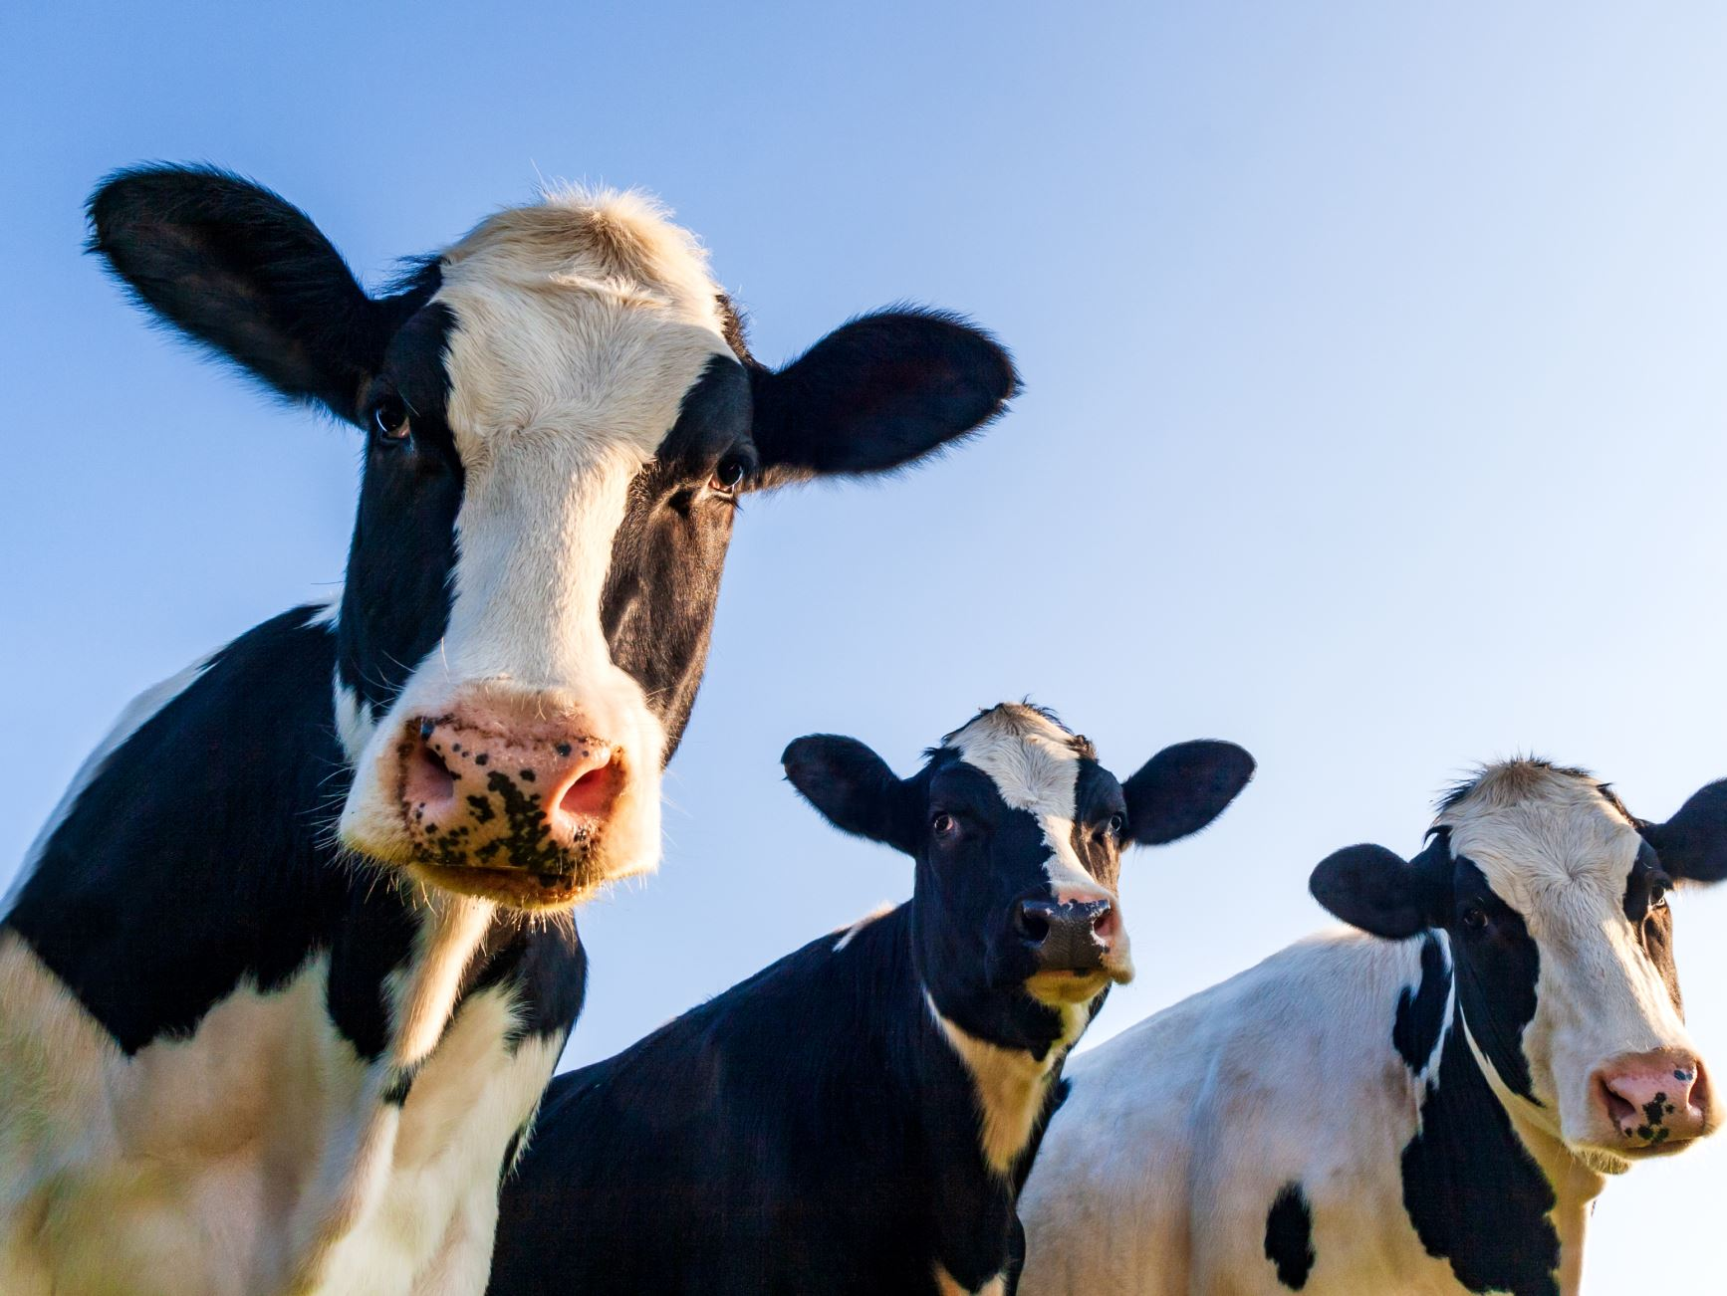
Livestock Daily Counting and Weight Comparison System
PLC-Based Automation Project
Presented by GreenTech Group

Slide 2
Project Overview
This project focuses on designing a PLC-based automated system for livestock management.
The system automatically counts livestock daily and measures individual animal weight.
It compares weight data against predefined thresholds to support decision-making.

Slide 3
Introduction
Modern livestock farming requires accurate data for productivity and animal health.
Manual counting and weighing are time-consuming and prone to errors.
Automation using PLCs provides reliable, real-time monitoring and control.

Slide 4
Problem Statement
Manual livestock counting and weight measurement lead to:
- Inaccurate records
- Increased labor costs
- Delayed decision-making
There is a need for an automated, accurate, and reliable system.

Slide 5
Aim and Mission
Aim:
To develop an automated PLC-based system for daily livestock counting and weight comparison.
Mission:
To improve farm efficiency, accuracy, and data-driven livestock management through automation.

Slide 6
Proposed Solution
A PLC-controlled system with:
- Sensors for animal detection
- Load cells for weight measurement
- PLC logic for counting and comparison
- HMI/display for results
- Automatic or manual daily reset functionality

Slide 7
Results
The system provides:
- Accurate daily livestock count
- Reliable individual weight measurement
- Automatic classification of animals (underweight, normal, overweight)
- Reduced manual work and human error

Slide 8
Challenges and Future Enhancement
Challenges:
- Sensor calibration accuracy
- Environmental conditions affecting sensors
- Initial system cost
Future Enhancements:
- Mobile monitoring
- Integration with farm management software
- AI-based animal health prediction

Slide 9
Conclusion
The Livestock Daily Counting and Weight Comparison System improves farm operations.
It ensures accuracy, efficiency, and reliable data collection.
PLC-based automation supports sustainable and smart livestock management.

Slide 10

Thank you for your attention

