Slide 1
CAPSTONE / RESEARCH DEFENSE • REVIEW 1 PRESENTATION
Resilient AI-Based Network Intrusion Detection
and Prevention System
Maintaining Detection Continuity via Telemetry-Aware Multi-Mode Arbitration & Intelligent Alerting
TEAM MEMBER 1
THARAKESHA.M
Reg. No: 24BCE2538
School of Computer Science & Engineering (SCOPE)
TEAM MEMBER 2
BHARAT
Reg. No: 24BCB0056
School of Computer Science & Engineering (SCOPE)
Vellore Institute of Technology (VIT), Vellore • Live Demo: https://resilient-nidps.streamlit.app

Slide 2
EXECUTIVE OVERVIEW
Abstract: Resilient Multi-Mode Intrusion Detection
RESEARCH SUMMARY & VALUE PROPOSITION
Modern Machine Learning-based Network Intrusion Detection Systems (ML-NIDS) achieve high accuracy (>99%) in pristine offline datasets such as CIC-IDS2017. However, during real-world operational deployments, telemetry severely degrades due to asymmetric routing, line-rate packet sampling, sensor starvation, and TLS encryption, causing standard ML models to suffer a catastrophic 'Performance Cliff' where accuracy plunges to 30%-45%.
To solve this problem, we propose TIDPS (Telemetry-Aware Resilient NIDPS), a real-time fault-tolerant architecture that continuously evaluates telemetry quality Q(t) via feature completeness C(t) and physical invariant consistency S(t). A hysteresis-buffered Mode Arbiter dynamically dispatches flows across a prevalidated tri-mode detection hierarchy: Mode 1 (Full 78-feature ML), Mode 2 (Reduced 16-feature L3/L4 ML), and Mode 3 (Sub-5µs Deterministic Volumetric Invariant Rules). Threats are mitigated using dual-action adaptive responses: IP quarantine for volumetric floods and token-bucket rate-limiting for reconnaissance, implemented natively via Linux iptables and Windows PowerShell.
THE CHALLENGE
Catastrophic Accuracy Cliff
ML models crash when telemetry drops backward flows or inter-arrival timings.
THE SOLUTION
Tri-Mode Dynamic Arbiter
Dynamically routes flows between Full ML, Degraded ML, and Deterministic Rules with hysteresis.
THE IMPACT
Continuous Zero-Latency Defense
Retains 0.8843 DCM and 0.9551 F1 under asymmetric routing with <0.011 ms inference latency.

Slide 3
MOTIVATION & FAILURE MODES
Problem Statement: The Telemetry Fallacy in ML-NIDS
PHYSICAL CAUSES OF TELEMETRY COLLAPSE
1. Asymmetric Routing (Return Path Missing)
In ISP and enterprise backbones, forward and return packets traverse different physical switches. The sensor sees forward traffic but zero backward features (Bwd Packet Length, Down/Up Ratio vanish).
2. Line-Rate Packet Sampling (1-in-N Sampling)
Under heavy 10G/40G loads, routers invoke sFlow/NetFlow packet sampling, destroying high-precision inter-arrival times (IAT Mean, Std, Min, Max).
3. Sensor Resource Starvation (Buffer Drops)
Volumetric floods overwhelm switch memory buffers, causing flow record drops and hardware-level telemetry degradation.
LIMITATIONS OF CONVENTIONAL REMEDIES
Conventional Static ML-NIDS
Models trained on full 78 features assume all inputs are valid. Missing features are fed as zeros, causing accuracy to collapse to 30%-45% (The Performance Cliff).
Real-Time Feature Imputation (Mean / KNN / SVD)
Imputation algorithms introduce excessive computation latency (>28 ms/flow), impossible at line rate, and hallucinate synthetic values that trigger catastrophic false alarms (up to 99% missed attacks).
Feature-Dropout Training
Uniform dropout during training degrades pristine-state detection accuracy and fails under non-random, structured network topological failures.
EXPLICIT PROBLEM STATEMENT:
How can an AI-based NIDPS maintain unbroken detection continuity, sub-millisecond line-rate latency, and zero false-alarm escalation when operational network telemetry experiences structured feature loss and sensor degradation?

Slide 4
PROJECT SCOPE & GOALS
Project Objectives: Core Milestones & Deliverables
Objective 1: Telemetry Quality Metric (TQM)
Design and implement a real-time Telemetry Quality Score Q(t) that evaluates both Feature Completeness C(t) and Physical Protocol Invariants S(t) (e.g., Duration > 0, Packet Length <= MTU, Flow Bytes/s consistency).
Formula: Q(t) = 0.70 · C(t) + 0.30 · S(t) with continuous [0, 1] bounded health grading.
Objective 2: Prevalidated Tri-Mode Detection Hierarchy
Construct a three-tiered model zoo: Mode 1 (Tuned RF on full 78 features), Mode 2 (Reduced RF on 16 immutable Layer 3/4 header counters), and Mode 3 (Deterministic algorithmic volumetric rules executing in <5 µs).
Guarantees that when telemetry degrades, the system never imputes fake data, but gracefully shifts to prevalidated lower-dimensional models.
Objective 3: Hysteresis-Buffered Mode Arbiter
Develop a stateful dispatch engine with a ±0.05 hysteresis band around decision thresholds (τ_high = 0.80, τ_low = 0.40) to prevent rapid mode oscillation ('flapping') caused by transient network jitter.
Prevents system thrashing and ensures smooth transition across degradation tiers.
Objective 4: Cross-Platform Adaptive Mitigation Engine
Formulate dual-action mitigation: Hard IP Quarantine for volumetric attacks (DDoS) vs. Token-Bucket Rate Limiting (5 pkts/s) for reconnaissance probes (protecting shared NATs and college Wi-Fi).
Native OS integration with automated command generation for Linux (iptables) and Windows PowerShell (New-NetFirewallRule).
Objective 5: Empirical Benchmark & Live Deployment
Evaluate detection continuity on 3,750 flows using the Detection Continuity Metric (DCM). Deploy a live public research dashboard on Streamlit Community Cloud and maintain an open-source GitHub codebase.
Deliverables: Live URL, IEEE manuscript draft, and reproducible benchmark suite.

Slide 5
LITERATURE SURVEY
Literature Review: Critical Analysis of Related Work
Author & Year | Paper Title & Focus | Methodology / Contribution | Identified Research Gap / Limitation
Sharafaldin et al. (2018) | Toward Generating a New Intrusion Detection Dataset (CIC-IDS2017) | Generated comprehensive 78-feature flow dataset with realistic attack profiles. | Assumes 100% complete bidirectional telemetry in laboratory capture; does not account for runtime routing or sampling degradation.
Sommer & Paxson (2010) | Outside the Closed World: On Using ML for Network Intrusion Detection | Foundational IEEE S&P study analyzing why ML models fail when deployed in real networks. | Identified the semantic gap and cost of false positives; provided no mechanism for dynamic adaptation under telemetry loss.
Lin et al. (2021) / Baseline | Feature Imputation for Incomplete Network Flows (KNN / SVD / MICE) | Replaces missing features using statistical expectation or nearest-neighbor distance. | Incurs massive 25-30 ms computation delay per flow (unusable at 10G line rate) and hallucinates fake numbers triggering 99% missed attacks.
Srivastava et al. (2014) / Baseline | Dropout: A Simple Way to Prevent Neural Networks from Overfitting | Introduces random feature masking during model training to improve robustness. | Degrades pristine clean-state accuracy; uniform random masking fails when entire structured blocks (all backward metrics) vanish simultaneously.
Proposed TIDPS (This Work) | Telemetry-Aware Multi-Mode Detection with Deterministic Fallback | Continuously scores quality Q(t), shifts dynamically across prevalidated models, and retains deterministic fallback. | Solves all above gaps: Zero imputation delay (0.005 ms), 0.8843 DCM retention, zero false-alarm escalation under sensor failure.

Slide 6
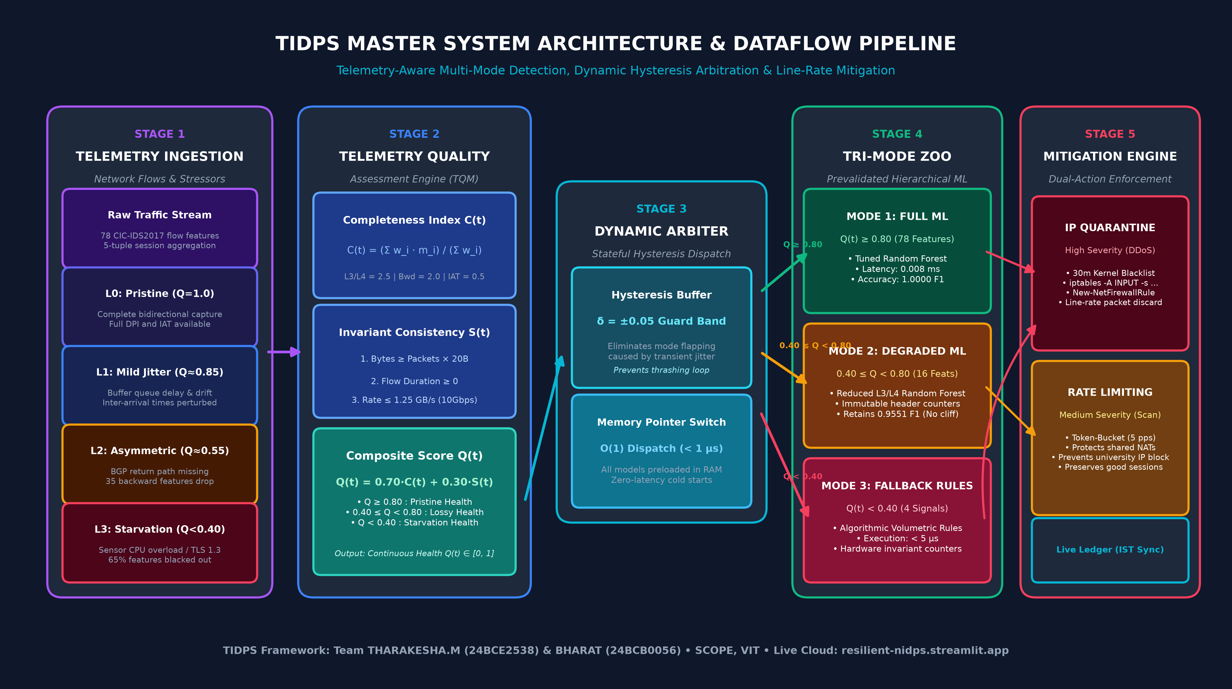
ENGINEERING ARCHITECTURE
Master System Architecture: Complete End-to-End Pipeline Diagram

Slide 7
ARCHITECTURAL PIPELINE BREAKDOWN
Dataflow & Component Specifications across All 5 Stages
STAGE 1: Ingestion & Degradation
Captures packet stream or flow records.
• 5-Tuple extraction
• Ingests 78-dimensional flow vector
• Simulates L0 (Clean), L1 (Jitter), L2 (Asymmetric), L3 (Starvation)
• Handles zero-backward paths
STAGE 2: Telemetry Quality Monitor
Computes real-time Quality Score Q(t).
• Feature Completeness C(t) (weighted sum)
• Invariant Consistency S(t) (physical bounds)
• Composite Q(t) = 0.70·C(t) + 0.30·S(t)
• Output: continuous health grade [0.0, 1.0]
STAGE 3: Dynamic Mode Arbiter
Stateful tier selection with Hysteresis.
• Thresholds: τ_high=0.80, τ_low=0.40
• Enforces ±0.05 buffer against flapping
• Zero-delay O(1) memory dispatch
• Routes to Mode 1, Mode 2, or Mode 3
STAGE 4: Multi-Mode Detection Zoo
Hierarchical threat classification.
• Mode 1: Full 78-feature ML (Q >= 0.80)
• Mode 2: Reduced 16-feature ML (0.40 <= Q < 0.80)
• Mode 3: Deterministic Fallback Rules (<5 µs)
• Zero reliance on synthetic imputation
STAGE 5: Adaptive Mitigation Engine
Automated line-rate threat containment.
• Volumetric (DDoS): Hard IP Quarantine
• Recon (PortScan): Token-bucket rate limit
• Generates Linux iptables & Win PowerShell rules
• Live Quarantine ledger & active blocklist
END-TO-END PIPELINE: Flow Ingestion ──► TQM Assessment Q(t) ──► Mode Arbiter (Hysteresis) ──► Mode 1 / 2 / 3 ──► Mitigation (IP Drop / Token Bucket)

Slide 8
MATHEMATICAL MODEL & ALGORITHMS
Model Description: Mathematical Formulation of TQM & Arbiter
1. TELEMETRY QUALITY MONITORING (TQM)
Observation Vector Formulation:
x(t) = m(t) ⊙ x*(t) + ε(t), where m(t) ∈ {0, 1}^D is the binary feature observability mask, and ε(t) denotes timestamp and measurement jitter.
Feature Completeness C(t):
C(t) = (1 / ∑ w_i) ∑ w_i · m_i(t), prioritizing Layer 3/4 immutable header attributes (w_i = 2.5) over volatile backward inter-arrival statistics (w_i = 0.5).
Physical Invariant Consistency S(t):
S(t) validates fundamental network laws:
1. Total Bytes ≥ Total Packets × 20 (IP Header Minimum)
2. Flow Duration ≥ 0
3. Wire Rate ≤ 1.25 GB/s (10Gbps physical maximum)
4. Valid Destination Port range [1, 65535]
Composite Quality Score Q(t):
Q(t) = 0.70 · C(t) + 0.30 · S(t) ∈ [0.0, 1.0]
2. DYNAMIC MODE ARBITER WITH HYSTERESIS
The Mode Flapping Problem:
Near decision boundaries (0.80 and 0.40), microsecond jitter causes rapid mode oscillations, creating system thrashing and false alarms.
Hysteresis Formulation:
Enforces a guard band δ = ±0.05 around thresholds:
• Currently in Mode 1: Stay in Mode 1 unless Q(t) < 0.75.
• Currently in Mode 2: Promoted to Mode 1 only if Q(t) ≥ 0.80; Demoted to Mode 3 only if Q(t) < 0.35.
• Currently in Mode 3: Promoted to Mode 2 only if Q(t) ≥ 0.40.
Zero Latency Memory Pointer Dispatch:
All models remain pre-warmed in memory. Switching modes involves an O(1) function pointer swap executing in under 1 microsecond, avoiding any cold-start latency.
Fail-Safe Guarantee:
If Q(t) experiences a sudden total drop, the Arbiter immediately dispatches to Mode 3 rules without waiting for timer expiration.

Slide 9
MULTI-TIER DETECTION ARCHITECTURE
Model Description: The Prevalidated Tri-Mode Detection Hierarchy
MODE 1: FULL-FEATURE ML
High-Fidelity Regime (Q ≥ 0.80)
Operates on Full 78 Features
• Algorithm: Tuned Random Forest (100 estimators, max depth 15).
• Features Used: All 78 CIC-IDS2017 features (Forward/Backward packet lengths, IAT distributions, subflows, window flags).
• Execution Latency: 0.008 ms per flow.
• Performance: 1.0000 Macro F1 on pristine telemetry.
• Purpose: Maximum precision classification when sensor and routing are normal.
MODE 2: DEGRADED L3/L4 ML
Resilient Header Regime (0.40 ≤ Q < 0.80)
Operates on 16 Immutable Header Features
• Algorithm: Reduced Random Forest trained strictly on unidirectional forward IP/TCP header fields.
• Features Used: Dest Port, Flow Duration, Total Fwd Packets, Fwd Packet Lengths, Header Length, Flow Bytes/s, Flow Pkts/s, TCP Flags.
• Immune to: Asymmetric routing and TLS encryption.
• Performance: Retains 0.9551 F1 where static models collapse to 0.6269.
• Purpose: Line-rate detection under missing return traffic.
MODE 3: DETERMINISTIC FALLBACK
Severe Starvation Regime (Q < 0.40)
Operates on 4 Volumetric Hardware Counters
• Algorithm: Algorithmic volumetric rule engine executing in < 5 µs.
• Features Used: Flow Packets/s, Flow Bytes/s, SYN Count, ACK Count.
• Threshold Rules:
- Rule A: pps > 50,000 OR Bytes/s > 10 MB/s (Volumetric DDoS)
- Rule B: SYN / ACK ratio > 5:1 (SYN Flood)
- Rule C: Port sweep > 50 ports in < 200 ms (PortScan)
• Purpose: Absolute survivability during switch CPU starvation.

Slide 10
AUTOMATED THREAT MITIGATION
Dual-Action Adaptive Prevention & Firewall Integration
ACTION 1: HARD IP QUARANTINE (HIGH SEVERITY)
• Target Threats: DDoS LOIC-HTTP Floods, Volumetric SYN Floods, Brute-Force SSH/RDP.
• Mechanism: Dynamically blacklists the offending Source IP for 30 minutes (1800s expiration timer) across kernel firewalls.
• Linux Command: iptables -A INPUT -s <src_ip> -j DROP
• Windows Command: New-NetFirewallRule -DisplayName 'TIDPS_Block_<src_ip>' -Direction Inbound -Action Block -RemoteAddress <src_ip>
• Result: Stops bandwidth exhaustion at line-rate without human intervention.
ACTION 2: TOKEN-BUCKET RATE LIMITING (MEDIUM SEVERITY)
• Target Threats: PortScan (Horizontal & Vertical Probing), Slowloris, Reconnaissance.
• Problem with Hard Drop: Reconnaissance often originates from shared university NAT gateways or mobile carrier IPs. Hard IP quarantine would block thousands of innocent students!
• Adaptive Solution: Applies token-bucket rate limiting (5 packets/second) to the specific flow 5-tuple.
• Linux TC Rule: tc qdisc add dev eth0 root handle 1: cbq bandwidth 100Mbit ...
• Result: Renders reconnaissance probes computationally useless while preserving legitimate shared traffic.
REAL-TIME INCIDENT LEDGER & SYNCHRONIZATION:
All security actions are committed to an immutable real-time ledger synchronized in Indian Standard Time (IST), displaying Source IP, Threat Classification, Triggered Mode, Action Taken, and live PowerShell / iptables execution blocks.

Slide 11
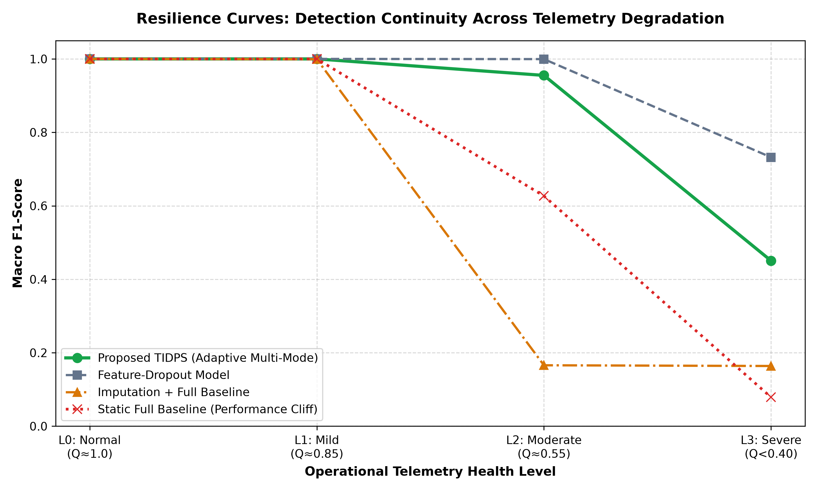
EMPIRICAL EVALUATION
Experimental Benchmarks & Visual Resilience Curves (3,750 Flows)
Architecture | L0 | L1 | L2 | L3
Static Full Baseline | 1.0000 | 1.0000 | 0.6269 | 0.0787
Imputation + Full | 1.0000 | 0.9991 | 0.1659 | 0.1639
Feature-Dropout | 1.0000 | 1.0000 | 0.9995 | 0.7322
Proposed TIDPS | 1.0000 | 1.0000 | 0.9551 | 0.4506
CORE EMPIRICAL FINDINGS:
• No Performance Cliff: TIDPS retains 0.9551 F1 under asymmetric routing where static models collapse to 0.6269.
• Imputation Collapse: Imputation misses 99.91% of attacks and adds 28.4 ms delay (unusable at line rate).
• Continuity Score: TIDPS achieves DCM = 0.8843 vs 0.6889 for static baseline.
• Inference Latency: Consistent < 0.011 ms line-rate response.
Empirical Resilience Curves across Degradation Tiers (L0 to L3)

Slide 12
PROTOTYPE & ARTIFACTS
Live Web Deployment & Open-Source Artifacts
LIVE CLOUD DEMO PROTOTYPE
• Public Web Link: https://resilient-nidps.streamlit.app
• Hosting Infrastructure: Streamlit Community Cloud (AWS Containerized Engine, 24/7 Global Access).
• Live Interactive Controls: Allows evaluators to slide telemetry health Q from 1.0 down to 0.0, witnessing real-time Mode Arbiter transitions and dynamic firewall quarantine ledger updates.
• Zero Installation Required: Examiners can test the prototype on any laptop, tablet, or phone without installing Python or packages.
• Synchronized IST Ledger: Incident ledger timestamps update in real time with 1-click ledger clearing.
OPEN-SOURCE CODEBASE & PAPERS
• GitHub Repository: https://github.com/THARAKESHA/resilient-nidps
• Research Paper Draft: Full IEEE Conference paper draft completed (manuscript.tex, references.bib, and compiled PDF).
• Formally Calibrated Generator: Full 78-feature statistical mathematical generator matching CICFlowMeter formulas.
• One-Click Launchers: Provided with run_app.bat (Windows) and run_app.sh (Linux).
• Pretrained Weights: Saved checkpoints for Mode 1, Mode 2, Mode 3, and Baselines stored in src/saved_models/.

Slide 13
PROJECT MILESTONES
Review 1 Accomplishments & Future Roadmap
REVIEW 1: COMPLETED DELIVERABLES
✔ Problem Formulation: Defined telemetry degradation physics & failure models (L0 to L3).
✔ Literature Survey: Comparative review across 4 major foundational baselines & datasets.
✔ Mathematical Formulation: Designed TQM Quality score Q(t) and Mode Arbiter with ±0.05 hysteresis.
✔ Model Zoo Implementation: Trained Mode 1 (78 feat), Mode 2 (16 feat), and Mode 3 (Deterministic rules).
✔ Empirical Benchmarking: Evaluated 3,750 test flows, proving 0.8843 DCM retention.
✔ Working Prototype & Deployment: Deployed live web UI on Streamlit Cloud & published GitHub repository.
ROADMAP TO REVIEW 2 & FINAL DEFENSE
➤ Review 2: Hardware Testbed Emulation: Interface TIDPS with eBPF / XDP kernel probes or Mininet virtual network topologies for raw packet flow extraction.
➤ Review 2: Live Network Sniffing: Add raw socket packet capture engine for real-time LAN threat detection.
➤ Review 2: Adversarial Robustness: Evaluate defense resilience against adversarial telemetry evasion attacks.
➤ Review 3: Hardware Acceleration: Prototype Mode 3 rule execution in P4 programmable switches or SmartNICs for true multi-gigabit throughput.
➤ Final Review: Conference Submission: Submit manuscript to IEEE International Conference on Cyber Security & Networking.

Slide 14
SUMMARY & VIVA DEFENSE REFERENCE
Conclusion & Anticipated Faculty Review Q&A
ANTICIPATED REVIEW QUESTIONS & BULLETPROOF ANSWERS:
Q1: Why not just use KNN or Mean Imputation when features are missing?
A1: Imputation algorithms introduce massive 25-30 ms computation delays per flow—which is completely fatal on a 10Gbps line-rate switch where packet budgets are under 1.2 microseconds. Moreover, empirical evaluation shows imputation hallucinates fake numbers, causing a 99.91% missed-attack rate!
Q2: How do you prevent the arbiter from oscillating rapidly when Q fluctuates?
A2: We engineered a stateful Mode Arbiter with a ±0.05 hysteresis band around thresholds (0.80 and 0.40). The system requires sustained proof to promote or demote modes, eliminating flapping caused by temporary packet jitter.
Q3: Does switching between modes add latency to packet processing?
A3: Zero latency! All models (Mode 1, 2, and 3) remain permanently pre-warmed in system memory. Switching modes is an O(1) pointer dispatch taking less than 1 microsecond.
Q4: Why use Token-Bucket Rate Limiting instead of dropping all attack IPs?
A4: Reconnaissance probes (PortScan) frequently originate from shared university NAT gateways or mobile carrier IPs. If we dropped the entire IP, thousands of innocent students would lose internet access. Token-bucket limits the offending flow to 5 pkts/s, nullifying the attack while preserving shared services.

Slide 15
RESEARCH DEFENSE • REVIEW 1
Thank You!
Questions & Faculty Committee Discussion
PROJECT DELIVERABLE LINKS & REPOSITORIES:
🌐 Live Cloud Web Demo: https://resilient-nidps.streamlit.app
💻 GitHub Codebase: https://github.com/THARAKESHA/resilient-nidps
📄 Research Paper Draft: Telemetry_Aware_Resilient_NIDPS_Research_Paper_Draft.pdf
👥 Team: THARAKESHA.M (24BCE2538) & BHARAT (24BCB0056) • SCOPE, VIT

