Slide 1
SALES FORECASTING USING TIME SERIES ANALYSIS
TASK 2
FLIPKART SALES FORECASTING USING TIME SERIES ANALYSIS

Slide 2
INTRODUCTION :
SALES FORCASTING PREDICTS FUTURE SALES BASED ON HISTORICAL DATA, ENABLING BUSINESSES TO MAKE INFORMED DECISIONS ABOUT INVENTORY,MARKETING ,RESOURCE ALLOCATION ,AND FINANCIAL PLANNING
ROLE OF TIME SERIES ANALYSIS : TIME SERIES ANALYSIS EXAMINES CHRONOLOGICAL DATA TO IDENTIFY trends, seasonality, patterns , helping businesses anticipate demand fluctuations and prepare for peak or low-sales periods
Accurate forecasting improves operational efficiency , reduces cost, maximizes profitability , and provides a competitive edge by supporting proactive decision making in dynamic markets.

Slide 3
Time series modeling
time series modeling analyzes sequential data overtime , capturing trends , seasonality , cyclic behavior, and random noise to understand patterns and make predictions .
Popular models include arima , sarima , exponential smoothing and advanced techniques like lstm for complex, non-linear patterns.
These models help predict future outcomes , improve decision making , and enhance efficiency by leveraging historical data insights.

Slide 4
Data preprocessing
Cleaning and handling missing data in historical sales records.
Normalizing and transforming data to improve model accuracy.
Identifying and removing outliers that may affect forecasting performance.

Slide 5
Forecasting techniques
Predicting future sales trends based on historical patterns .
Using tools like python ( pandas , statsmodels , scikit-learn ) and tableau for visualization .
Making data-driven business decisions to optimize inventory, pricing, and marketing strategies .

Slide 6
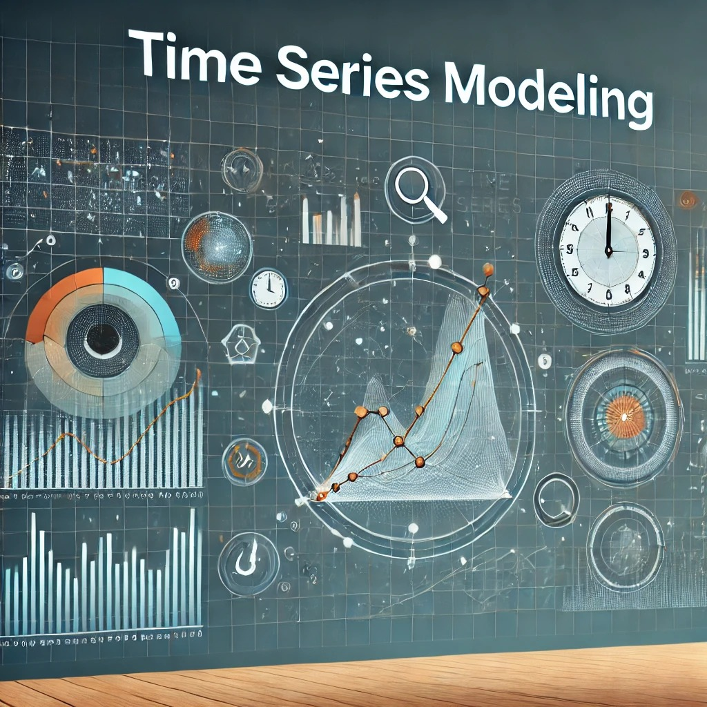

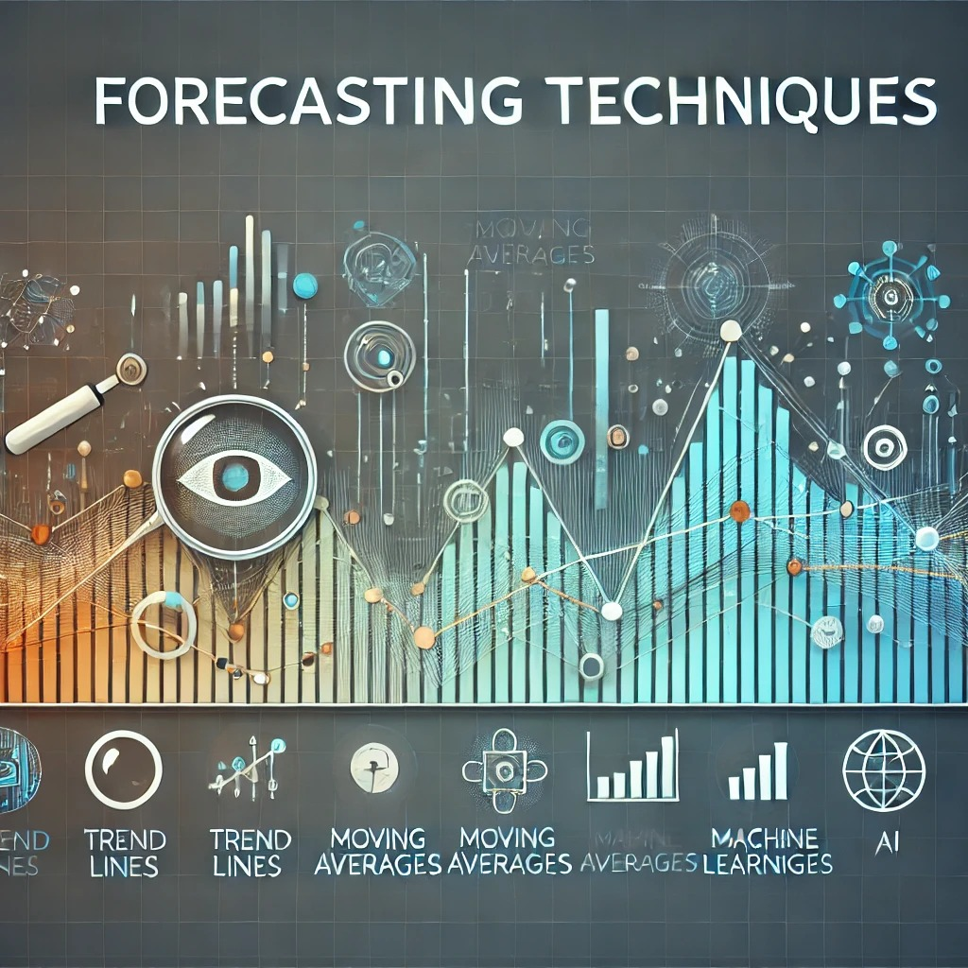

Slide 7
deliverables
Forecast model that predicts the sales trends.
Visualized trends over time .
Business insights from forecasting.
Recommendations for business growth

Slide 8



Slide 9
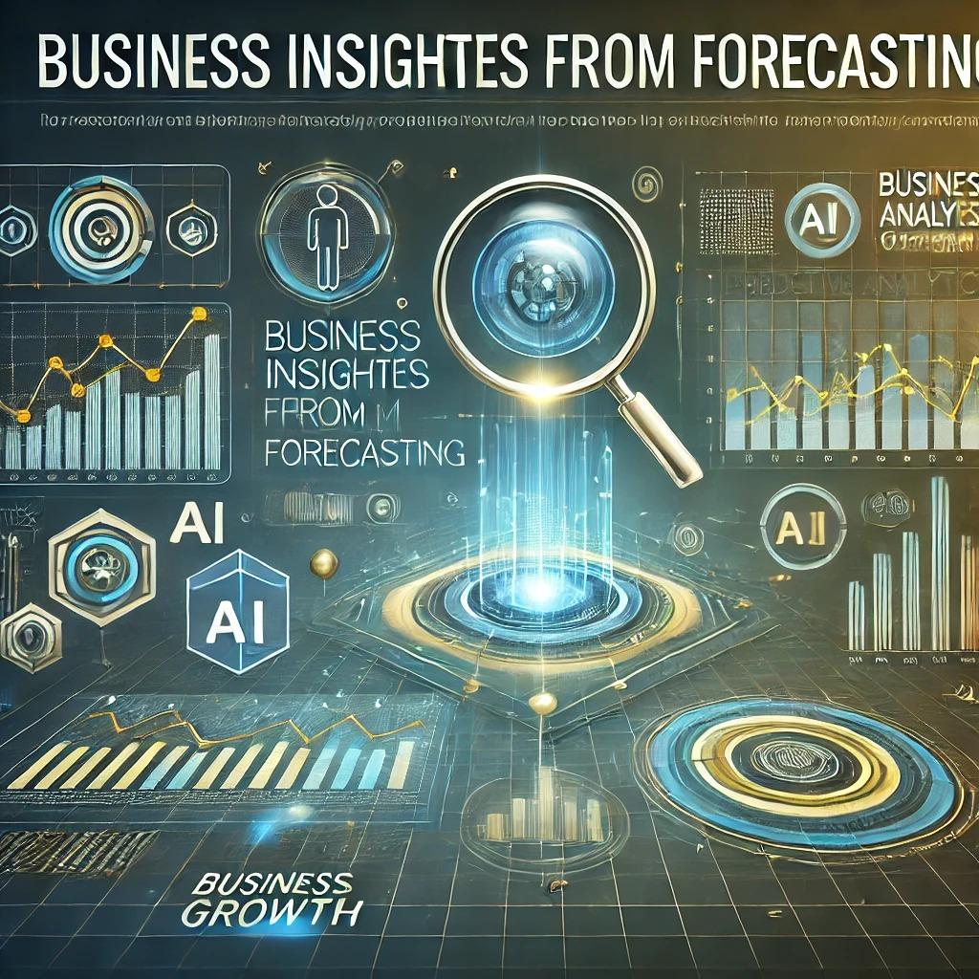


Slide 10
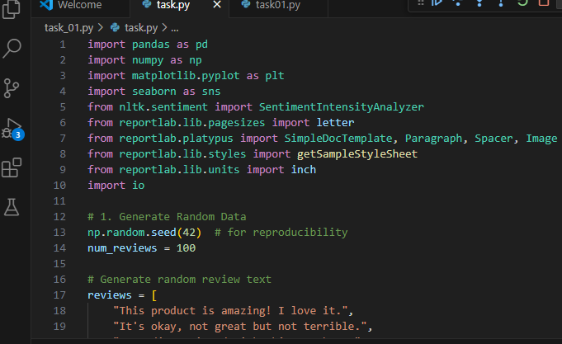
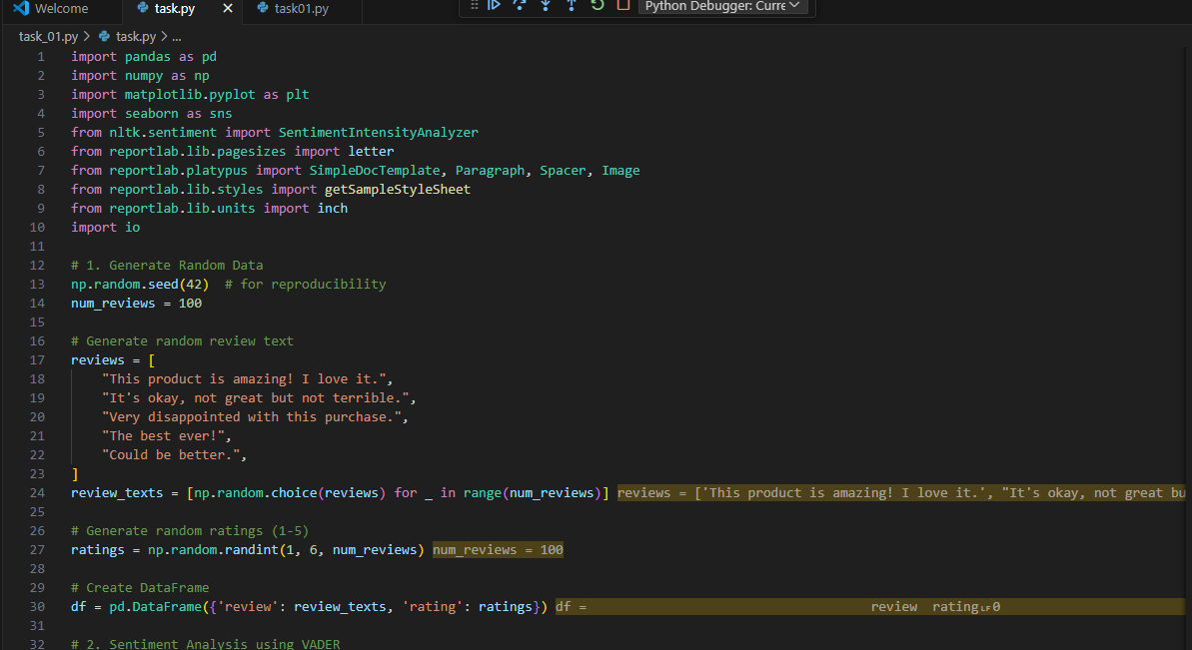
Coding python

Slide 11
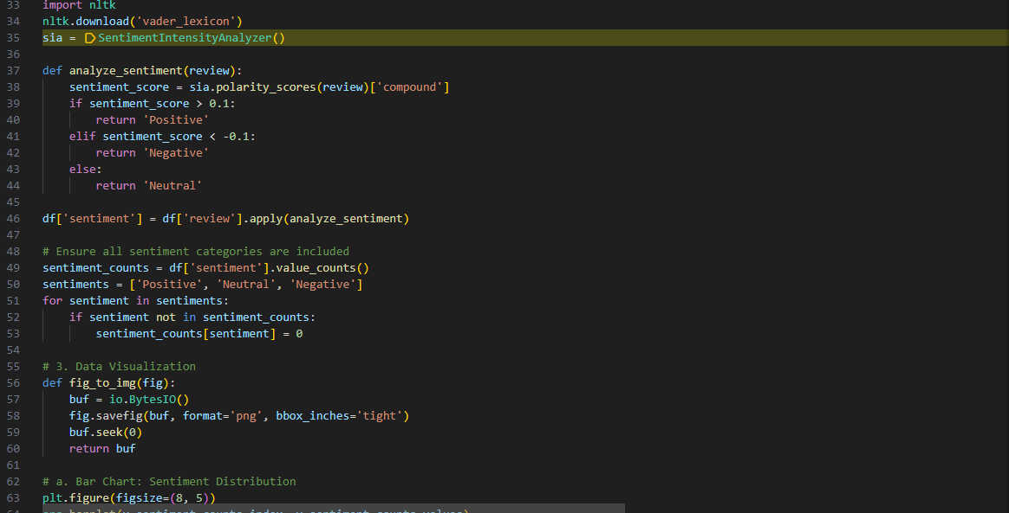
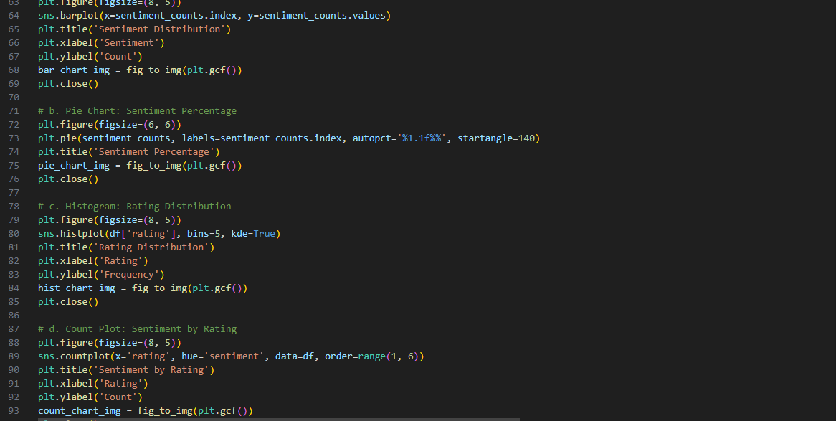

Slide 12
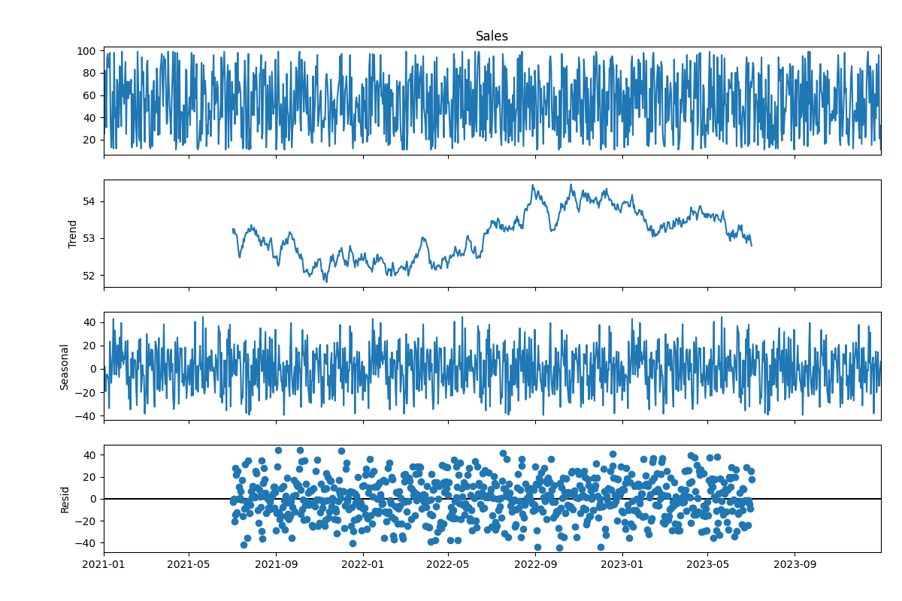
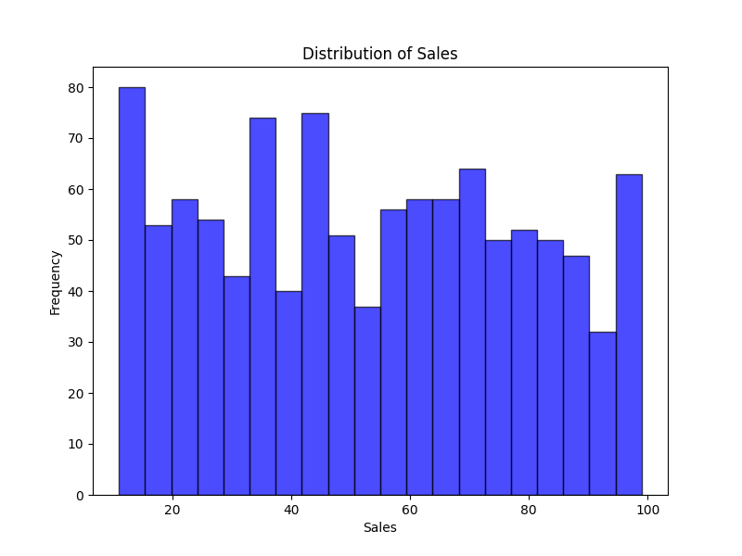
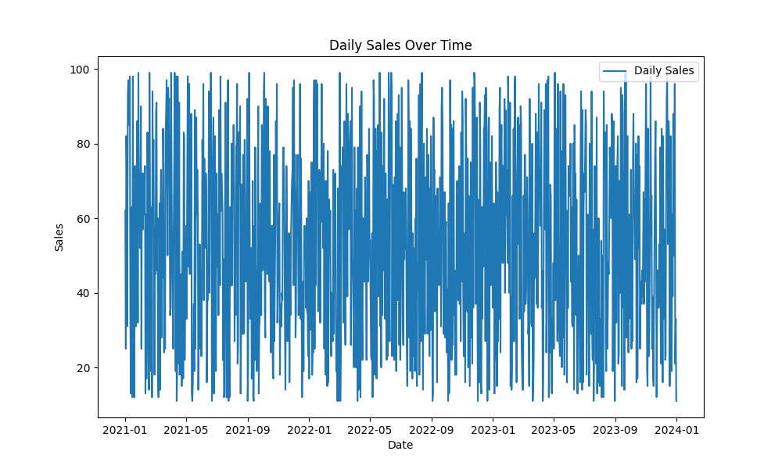
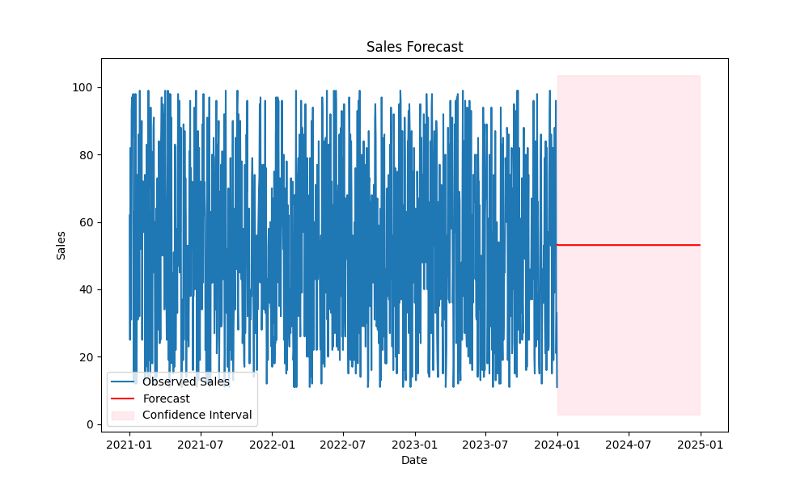
output

