Slide 1
Task-03
FINANCIAL PERFORMANCE ANALYSIS
TATA FINANCIAL PERFORMANCE ANALYSIS

Slide 2
INTRODUCTION
Financial performance analysis is crucial for evaluating a company’s financial health by examining income , expenses , profitability , and overall stability.
It helps businesses track revenue , control costs, and optimize financial strategies , enabling data –driven decision making .
Key performance indicator such as profit and loss statements cash flow analysis and expense breakdowns provide insights into strengths , weaknesses , and financial risks.
Investors ,analysts and business leaders use this analysis to measure profitability and enhance financial planning.
Advance tools like Power BI and Excel aid in visualizing financial data , making it easier to identify trends and drive strategic growth .

Slide 3
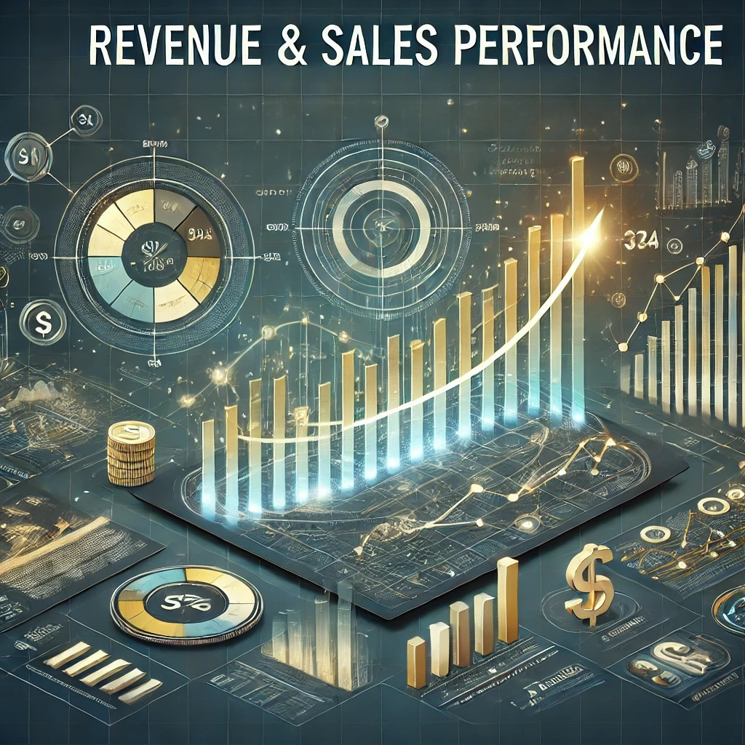
Revenue & sales performance
Evaluate total revenue from E – commerce sales, marketplace commissions and advertising .
Analyse growth trends over different periods

Slide 4
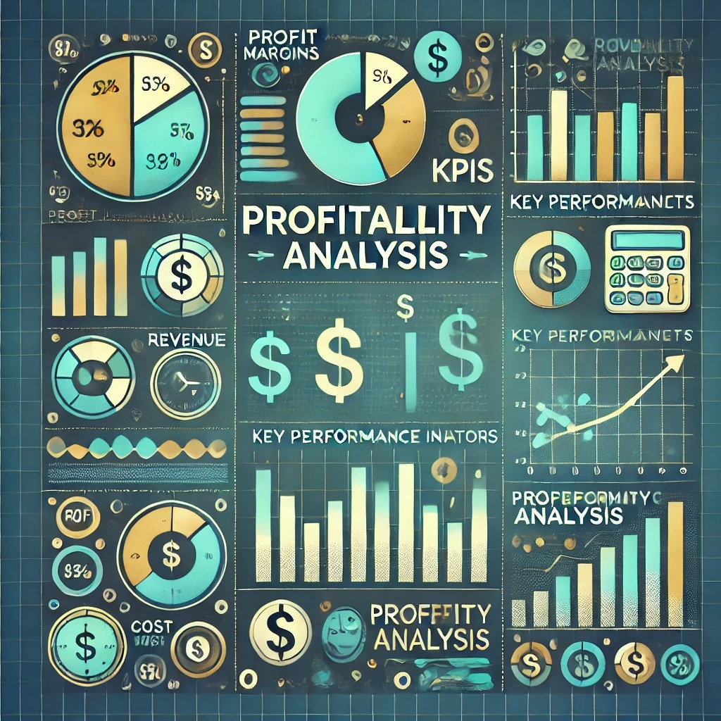
Profitability analysis
Assess net profit margins , gross margins , and operating profits .
Identify cost drivers affecting profitability , such as logistics , marketing , and technology investments .

Slide 5
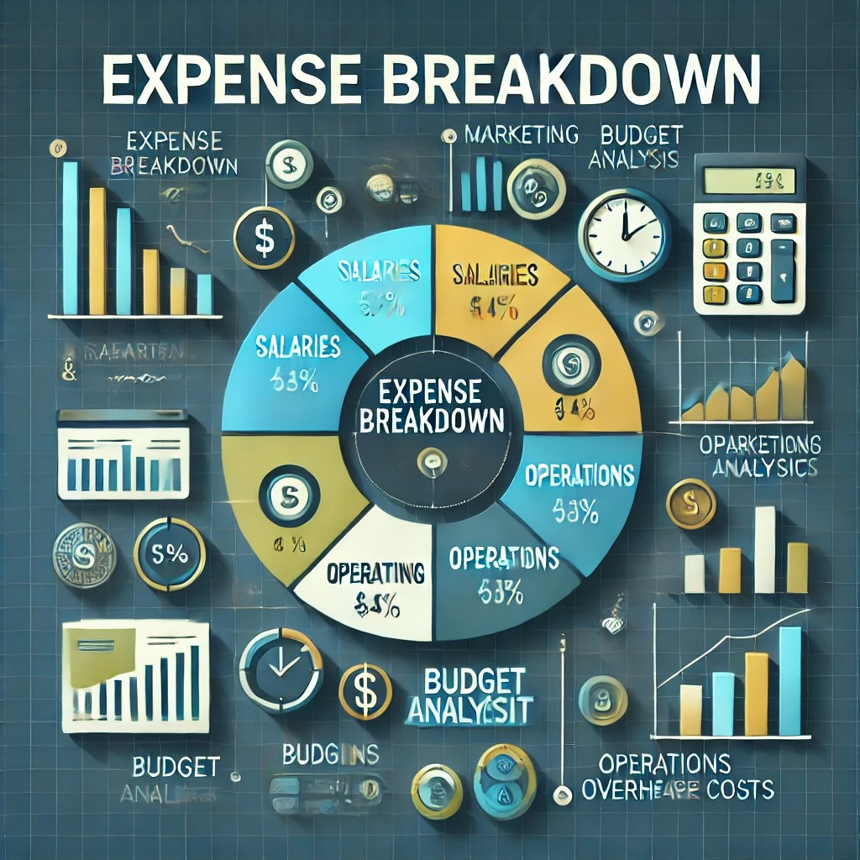
Expense breakdown
Track major expense categories like supply chain costs , marketing expenses , and operational overhead .
Compare costs with industry benchmarks to identify optimization opportunities

Slide 6

Cash flow & liquidity
Examine cash flow statements to assess TATA’s ability to manage operations and investments.
Identify trends in cash inflows and outflows

Slide 7

Financial forecasting & trends
Use historical data to predict future financial performance .
Leverage Power BI and Excel for data visualization and trend analysis

Slide 8


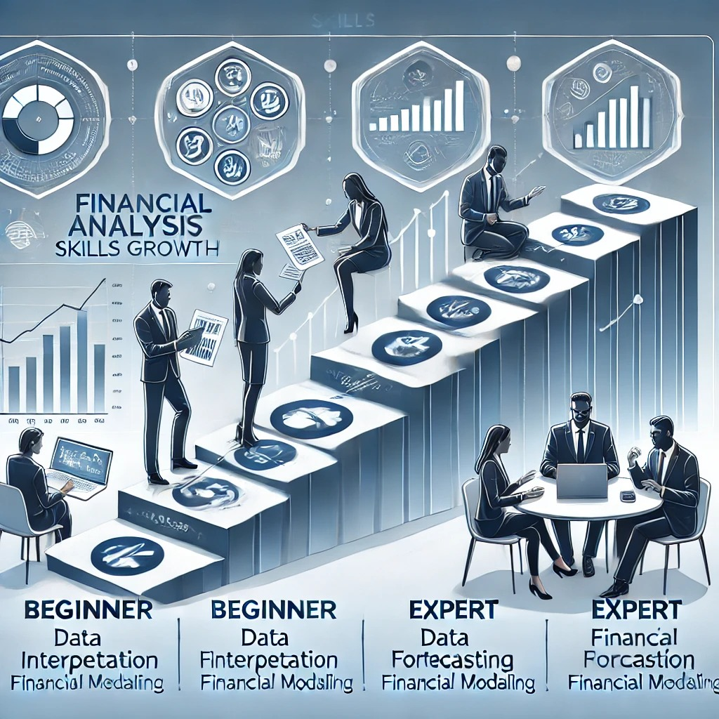
Skills gained financial performance analysis
Financial analysis – understanding financial statements, and profitability metrics , and cost structures to assess a company’s financial health .
Trend forecasting – historical data to predict future financial performance , market trends and business growth.
Reporting – creating detailed financial reports and dashboards using tools like Power BI and Excel to communicate insights effectively .

Slide 9
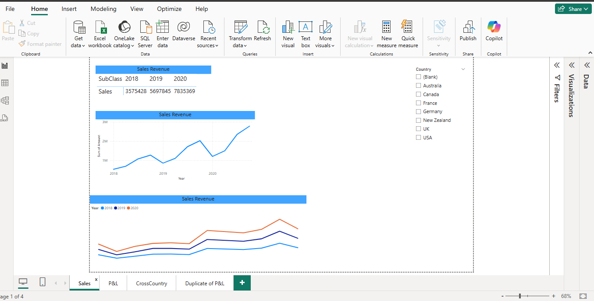
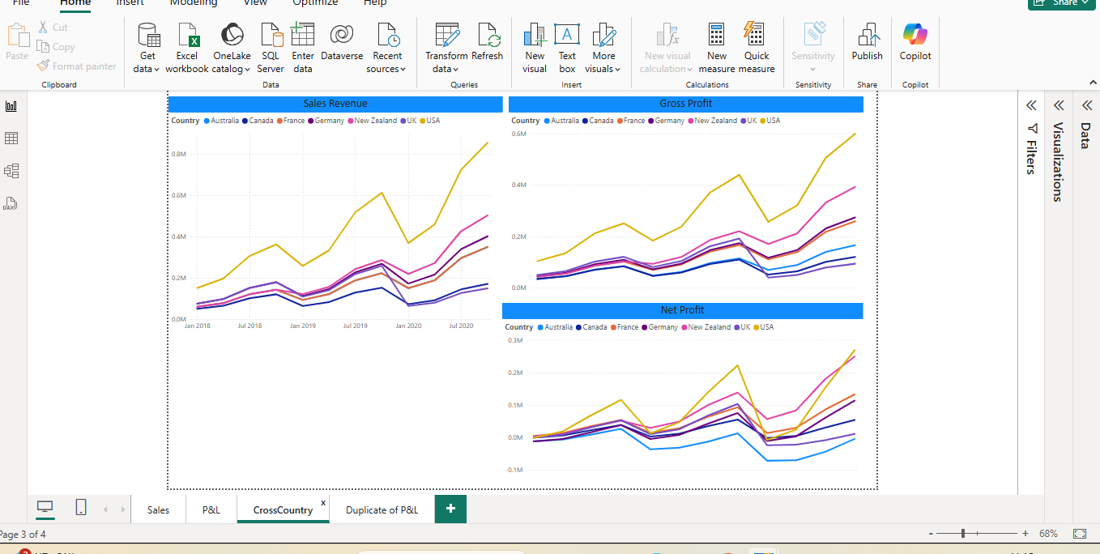
Tools power bi / excel

Slide 10
Dash board

Slide 11
