Slide 1
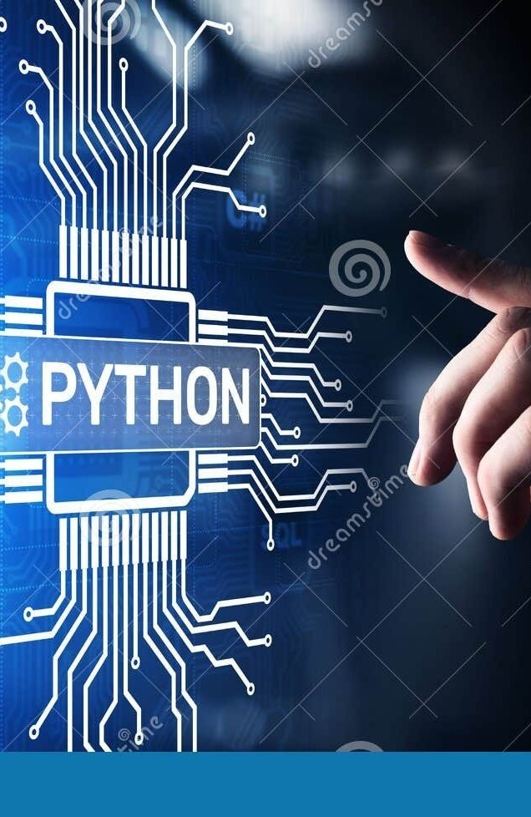
E ploring the Evolution and Impact of Python: Unraveling the Power of Functions & Modules

Slide 2
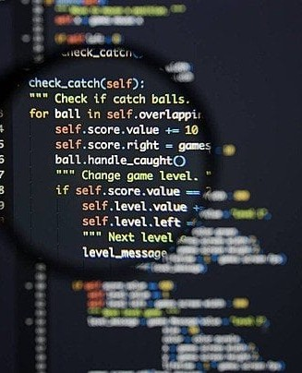
Introduction
Python is a high-level, general- purpose programming language known for its readability and simplicity. It was created by Guido van Rossum and ﬁrst released in 1991.
Python supports multiple programming paradigms, including procedural, object-oriented, and
functional programming, making it versatile and widely used in various domains.

Slide 3
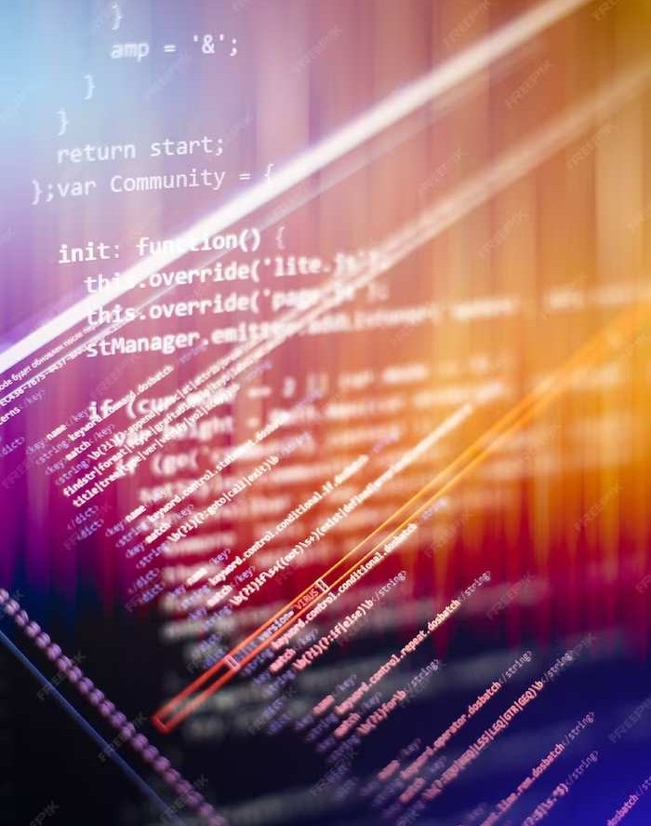
Early Evolution
l. Python 1.0 (1994): The initial release included features like lambda, map, ﬁlter, and reduce
2. Python 2.0 (2000): Introduced list comprehensions, garbage collection, and Unicode support.
5. Python 3.0 (2008): A major overhaul, not
backward-compatible with Python 2. It aimed to eliminate inconsistencies and improve the language.

Slide 4

Function Fundamentals
A function is a block of reusable code that performs a speciﬁc task. In Python, you deﬁne a function using the def keyword. Functions can take parameters, perform operations, and return values.
example:
def greet(name):
”″“Print a greeting message.”″” print(f”Hello, {name}!”)
greet(“Alice”)

Slide 5
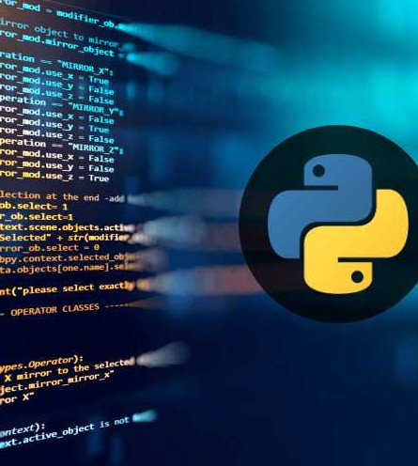
Module Mastery
A module is a ﬁle containing Python deﬁnitions and statements. It allows you to organize code logically into reusable units. You can create your modules or use built-in ones.
exapmle:
# Create a module named mymodule.py
def multiply(x, y):
”″“Return the product of two numbers.”″”
return x * y
# Use the module in another script import mymodule
result = mymodule.multiply(3, 4) print(result)

Slide 6

Impact on Industry
The simplicity, readability, and versatility of Python, along with its robust support for functions and modules, contribute to efﬁcient and scalable code development in various industries, fostering quicker application development and easier maintenance.

Slide 7
Conclusion
I, Python stands out as a powerful, versatile, and user-friendly programming language. Its clear syntax, extensive libraries, and broad applicability across diverse domains, including web development, data science, and artiﬁcial intelligence, make it a popular choice for both beginners and experienced developers, fostering rapid development and innovation.

Slide 8
Thanks!
-PADILAM THARUN

