Slide 1

Summai - Business summarisation

Slide 2
Group Members
• Member 1: Krishnasai
• Member 2: Aashish
• Member 3: Hemachandu
• Member 4: Tharun
•Member 5: Rishik

Slide 3
Problem Statement
Business documents such as reports, meeting transcripts, and policies are lengthy, complex, and time-consuming to read.
Manually analyzing content leads to reduced efficiency, information overload, and decision delays.
Objectives
•Automatically summarize long business documents
•Extract key insights and important terms
•Measure text readability and complexity
•Provide fast, accurate, and actionable output
•Track system usage and performance metrics

Slide 4
Objectives
• Develop an AI-based system to automatically summarize business texts
• Reduce time spent on reading long documents
• Provide short, accurate summaries without losing meaning
• Enable users to customize summary length
• Offer a simple and user-friendly web interface

Slide 5
Proposed Solution:
SummAI is a web-based NLP system that:
•Accepts business text as input
•Applies extractive summarization
•Generates concise summaries, keywords, and readability indicators
•Displays analytics and insights interactively
Workflow:
1.User inputs document
2.System preprocesses text
3.NLP pipeline scores sentences
4.Top sentences selected as summary
5.Keywords and readability metrics extracted
6.Output displayed with analytics

Slide 6
Methodology
•Text cleaning and preprocessing
•Stopword removal
•Sentence tokenization
•Frequency-based sentence scoring
•Extractive summarization
•Keyword extraction using TF-IDF
•Readability assessment

Slide 7
Technologies Used
Backend
•Python
•Flask
•NLTK
Frontend
•HTML5
•CSS3
•JavaScript
Data Storage
•JSON (analytics tracking)

Slide 8
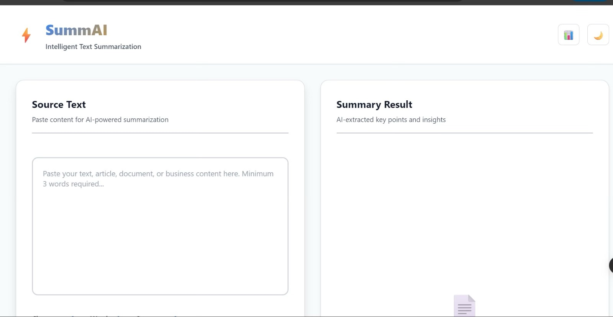
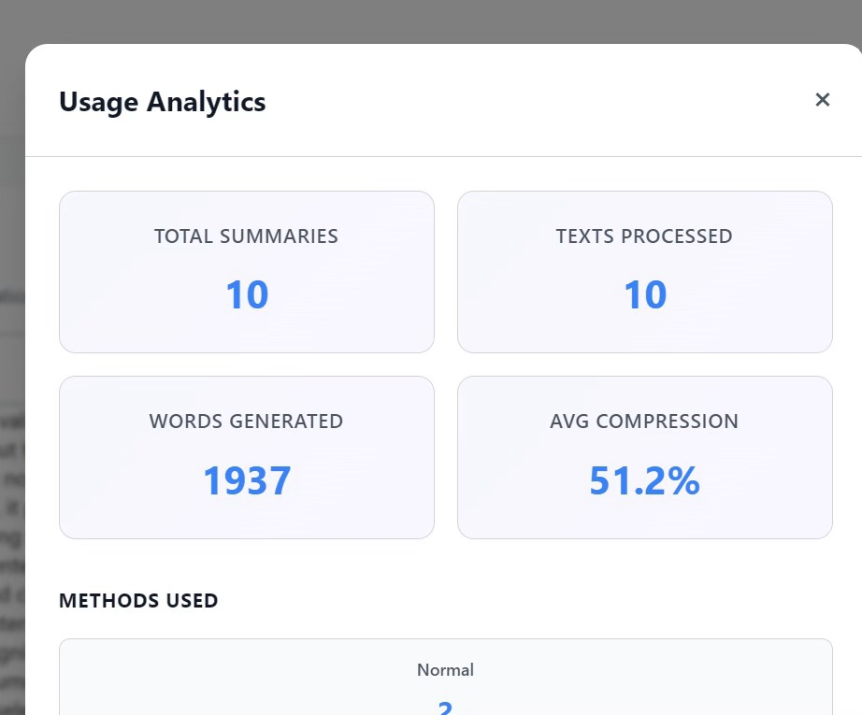
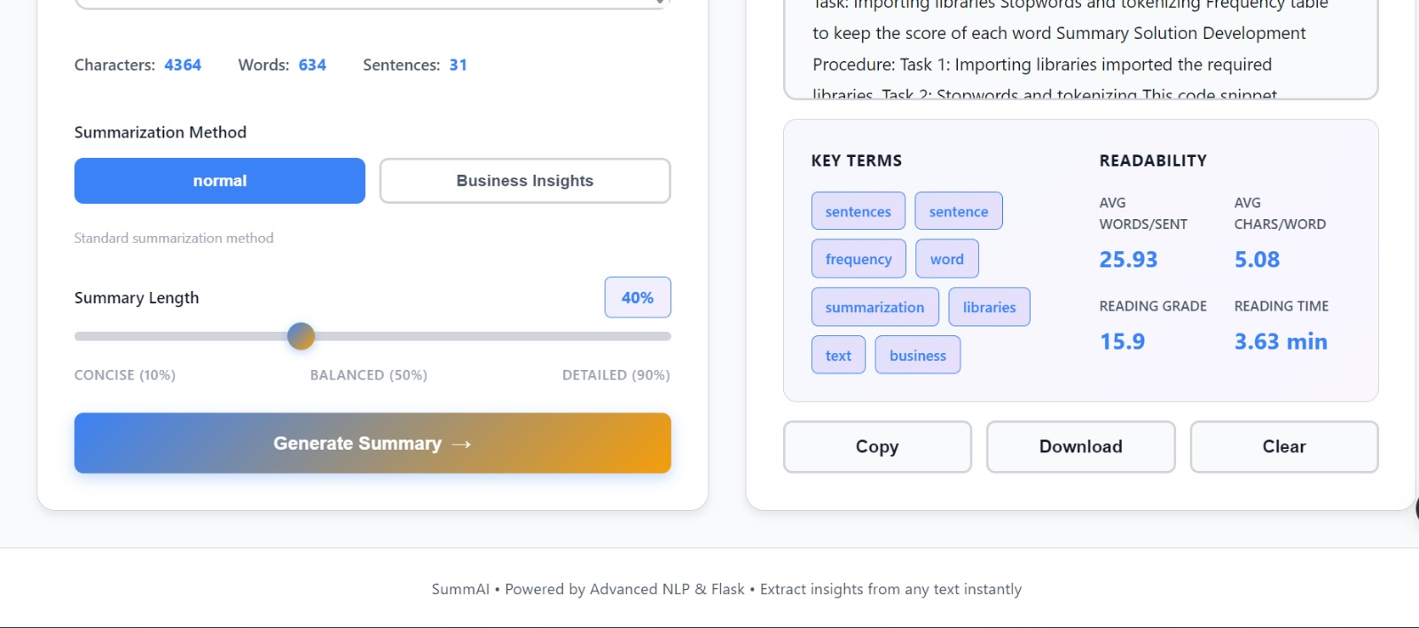
Results

Slide 9
Conclusion
SummAI successfully delivers fast, accurate, and user-friendly summarization of business documents.
It improves productivity by reducing manual reading and extracting key insights automatically.
Future Scope
•Support multilingual documents
•AI-powered abstractive summarization
•Integration with ERP/CRM tools
•Voice-to-text summarization
•Advanced business insight extraction

