Slide 1

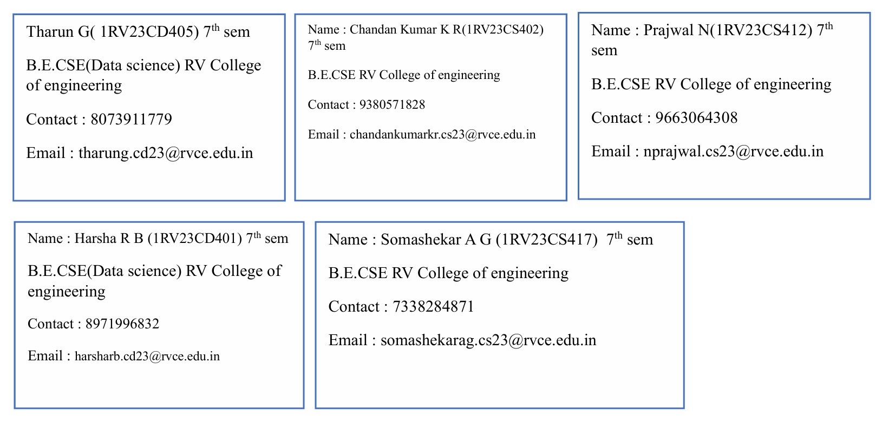
WEBPOISE INTERNSHIP PROJECT
PROJECT REPORT
Title : Event Affordability and Target Audience Segmentation

Slide 2
Executive Summary & Goal
The primary recommendation is to adopt segment-specific pricing and marketing strategies. The goal is to enhance targeting, optimize pricing, and improve attendance.
Key Finding: Affordability Index ($\frac{\text{Income}}{\text{Ticket Price}}$) is the Most Important Factor in predicting attendance.

Slide 3
Methodology: From Data to Segments
1. Feature Engineering: Creation of the Affordability Index.
2. Segmentation (Unsupervised Learning): K-Means Clustering identified 4 clusters.
3. Prediction (Supervised Learning): Used Logistic Regression and Decision Tree to forecast attendance.

Slide 4
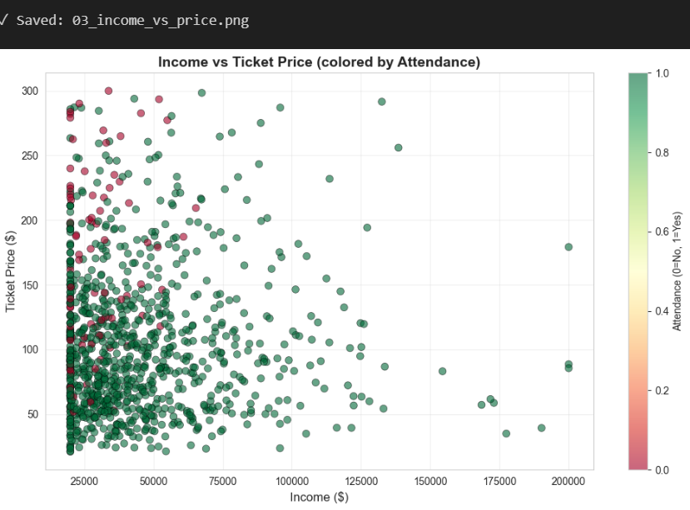
The Core Driver: Affordability Index
Highlight the central role of the Affordability Index. Explain the correlation observed in the data: Attendance is correlated with income level relative to ticket price
Decision Tree Feature Importance: Affordability_Index = 57% Importance.

Slide 5
Target Audience Segmentation (The 4 Clusters)
Present the key characteristics of the four identified customer segments:
Cluster 2 (Affluent/Price-Insensitive): Highest Avg. Income ($94.9K), 100% Attendance.
Cluster 3 (Budget-Stressed): Lowest Affordability Index (212.1), Lowest Attendance (77.4%).
Variable | Data Type | Description
Age | Integer | Customer age (18 to 65 years)
Gender | Categorical | Male, Female, Other
Income | Integer | Annual income ($20,000 to $200,000)
Event_Type | Categorical | Concert, Sports, Festival, Seminar, Exhibition
Ticket_Price | Float | Price of the event ticket
Attendance | Binary | Target Variable (0=Did Not Attend, 1=Attended)

Slide 6
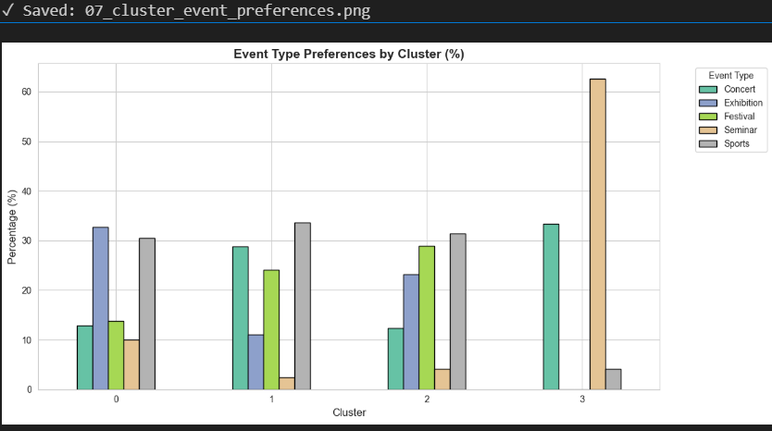
Segment Preferences & Risk
Cluster 3 (Budget-Stressed) highly favors Seminars (62.6%).
Observation: High-priced Seminars purchased by low-ratio customers lead to financial strain and high non-attendance risk.

Slide 7
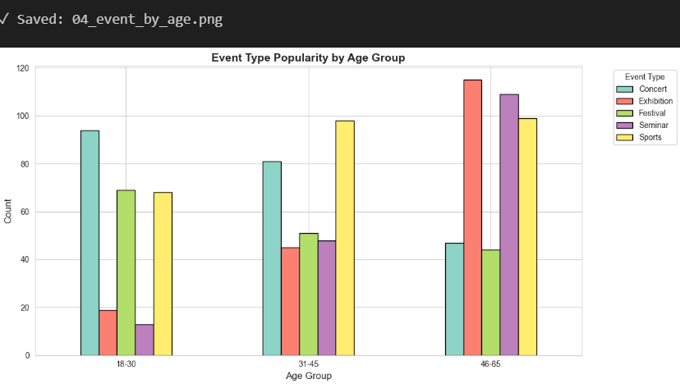
Age & Event Type Preferences
Younger (18-30): Prefer Concerts and Festivals.
Older (46-65): Prefer Seminars and Exhibitions.

Slide 8
Strategic Pricing & Attendance Threshold
Optimal Affordability Index: Between 200 and 500 for maximizing attendance.
Warning: Avoid prices that result in a ratio below 100 due to high non-attendance risk.

Slide 9
Strategic Recommendations (Segment-Specific
Segment | Strategy | Pricing Range
Low Budget ($0-$40K) | Volume Focus: Use group discounts and early bird pricing. Target with low-priced events like Festivals and Community Events. | $20 - $60
Medium Budget (~$40K-$60K) | Loyalty Focus: Use tiered pricing and package deals. Target with Concerts, Sports Events, and Exhibitions. | $50 - $120
High Budget ($60K+) | Premium Focus: Offer exclusive experiences, VIP packages, and networking opportunities. Target with Premium Seminars and VIP Concerts. | $100 - $300+
Low Budget ($20-$60): Volume Focus (Festivals).
High Budget ($100-$300+): Premium Focus (VIP Packages, Seminars).

Slide 10
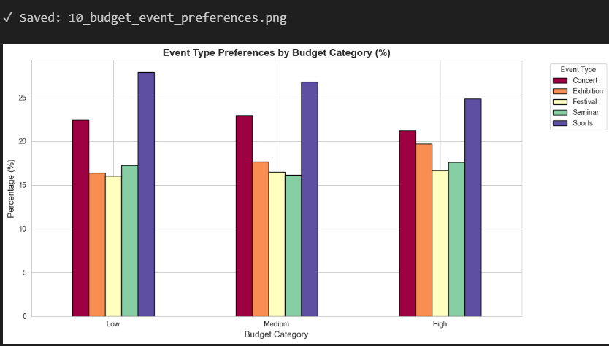
Conclusion & Next Steps
Reiterate the main conclusion: Financial Affordability is the single most important factor. The data provides a strong foundation for dynamic pricing and segment-focused marketing.

