Slide 1

Clustering analysis of restaurants in dhaka city
Tanzid Hasnain

Slide 2
Restaurants in Bangladesh
GDP increase
600% in 60 years
Dhaka
Most densely populated city in the world
Restaurant business is booming
2.1% of GDP by 2021

Slide 3
Data
1. List of postal codes is scraped using BeautifulSoup from . https://en.wikipedia.org/wiki/List_of_postal_codes_in_Bangladesh
2. Geocoder to collect latitudes and longitudes
3. Foursquare to collect the venues data around the addresses

Slide 4
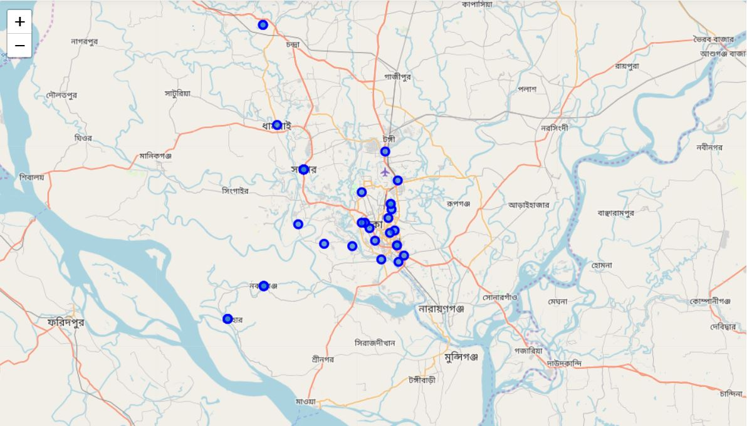
methodology
Initial map of Dhaka city neighborhoods
Folium map

Slide 5
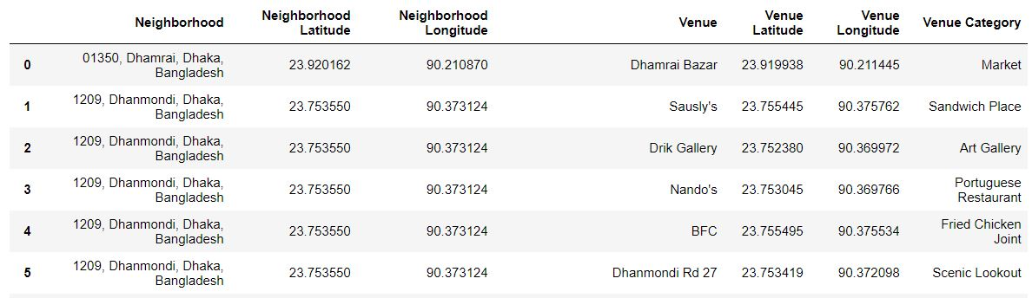
Methodology
A snapshot of latitudes and longitudes of the neighborhoods collected using Geocoder

Slide 6
Methodology
Venues information from FourSquare

Slide 7
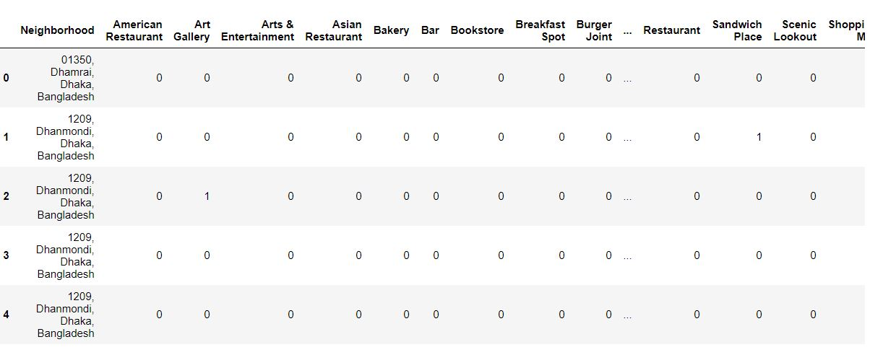
methodology
One-hot encoding

Slide 8
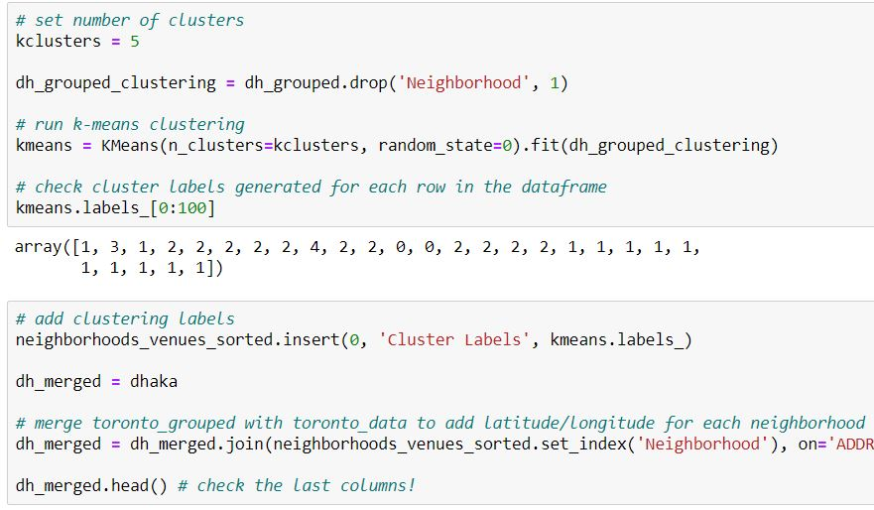
Methodology
Clustering

Slide 9
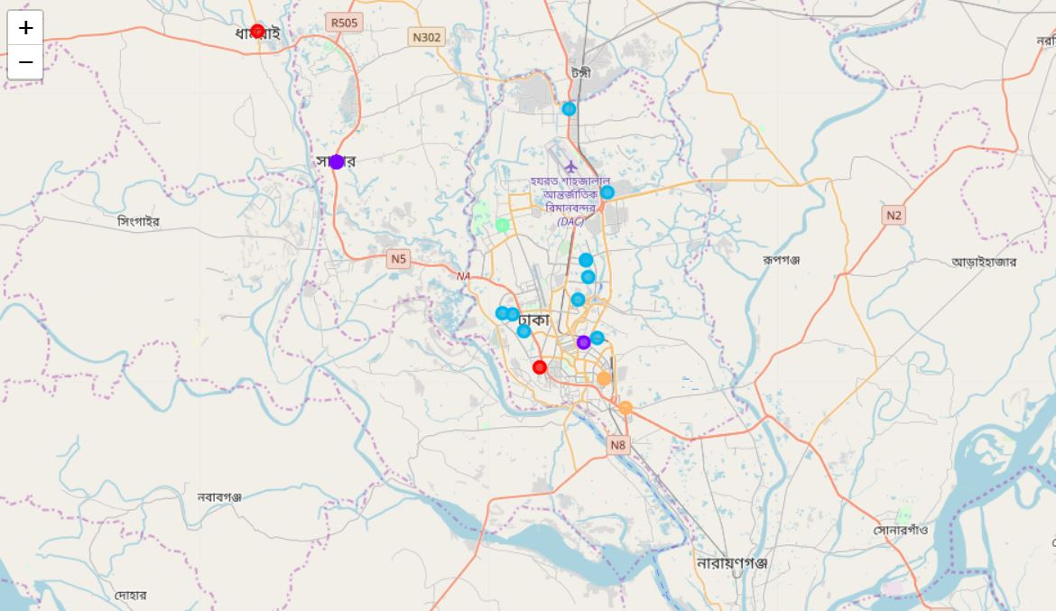
Result and Observations
1. Data is too sparse due to the non-familiarity of FourSquare in Bangladesh
2, Cluster 2 is the most spread-out cluster

Slide 10
Conclusions
1. Vary important exercise as it provides insights on the type of restaurants to invest on for a specific neighborhood around Dhaka city.
2. Future work includes the search for a good data source on the venue information around Dhaka city.

