Slide 1

Team Name :F-society Company Name : Sri Krishna College of engineering Team Members:Thavashankarraja,ValanAntony, Yamuna Devi,Yamini,Vinishah
Team Name:
Team Members Name:

Slide 2

Problem Statement?
Why did you decide to solve this Problem statement?
To bring whatsapp chat interaction to every single field and make things work simple . To enhance online shopping experiences
and increase sales through whatsapp.

Slide 3
User Segment & Pain Points
Which user/customer segment would be early adopter of your product & why?
One who is not familiar with the commercial site , One who needs a service without getting into much complications. To put it simple those who do not want to get their hands in would be early adopter of our product . It would be very useful for elder ones to get the required things very easily using the chatbot.

Slide 4
Competitor Analysis
What are the alternatives/competitive products for the problem you are solving?
1.agentbot
2.messengerpeople
3.botsociety
4.raphiwha

Slide 5
Key Differentiators & Adoption Plan
How is your solution better than alternatives and how do you plan to build adoption?
We have planned to make this bot with enhanced nlp with more key features including payment methods . This bot will be simple to set up and use.

Slide 6
Tools or Resources
Tools or resources which are likely to be used by you for the prototype, if your idea gets selected?
A Mantium Account
An OpenAI API Key
Twilio Account
Flask Framework ..etc

Slide 7
Any Supporting Functional Documents
Present your solution, talk about methodology, architecture & scalability in a product information document

Slide 8
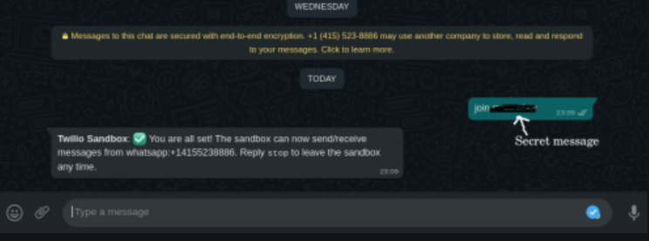
Link & Supporting Diagrams, Screenshots
How far it can go?
https://www.geeksforgeeks.org/building-whatsapp-bot-on-python/

Slide 9
Source File Link
https://github.com/THAVASHANKARRAJA/chatty

Slide 10
Additional Points
This product will offer you more flexibitity to make queries to the
ecommerce site and retrive the data . The payment included
whatsapp bot will make payment for the users
simple . Anyone can use the product with simple setup methods.

Slide 11
Thank You!

