Slide 1

Bitvis Utility Library
Concepts and usage
www.bitvis.no
Your partner for SW and FPGA

Slide 2
About Bitvis
Leading Vendor Independent Design Centre in Norway
  FPGA and Embedded SW services for customers
  From specification to final product – or any phase in between
  Good overview of pitfalls, time wasters and risks
  Focus on methodology, quality, efficiency and customers
  Located in Asker outside Oslo
Bitvis Utility Library - Concepts and Usage

Slide 3
Products and courses from Bitvis
Products from Bitvis
  'Bitvis Utility Library' (Free and Open source, Directly downloadable)
  - Currently being used world wide
  'UVVM' (Universal VHDL Verification Methodology) (UVL for VHDL)
  To be released 2014, Q4
  'RegisterWizard',
  For generation of SW, Doc. and VHDL (bus IF, regs, etc.)
  To be released 2014, Q4
Courses from Bitvis
  'FPGA Development Best Practices' - A two day course
  - A pragmatic approach to improving quality and efficiency.
  - So far Denmark, Sweden and Norway. May be held anywhere on request
  See our website for more offers
  http://bitvis.no/services/fpga-courses/
Bitvis Utility Library - Concepts and Usage

Slide 4
Prerequisites for understanding this presentation
This presentation assumes that the audience/reader is familiar with our presentation
'Making a Simple, Structured and Efficient
VHDL Testbench, Step-by-step'
  See bitvis.no for link to PPT and Webinar for this.
  PPT also provided with Bitvis Utility Library download
Bitvis Utility Library - Concepts and Usage

Slide 5
Agenda
Introduction
Verbosity control and alerts
Checks and awaits
String handling and Randomisation
Adaptations
BFM code and Advanced verbosity control
Restrictions
Package hierarchy & Compilation and scripts
Documentation
Modifying the library
Maintenance
Bitvis Utility Library - Concepts and Usage

Slide 6
Scope for Bitvis Utility Library
A library to support the most fundamental functionality of any structured VHDL testbench
  Sufficient for simple testbenches
  An essential plattform for more advanced TBs
A library to be used by Bitvis internally and externally (unless otherwise requested by customer)
An open source library – available to anyone
A library to be used as a platform for
  Add-ons like BFMs, Monitors, Analysers, etc
  Assertion libraries
  Multi-interface TB systems, using UVM-like methodology
Bitvis Utility Library - Concepts and Usage

Slide 7
Purpose
Standardise and qualify a set of good procedures
Improve TB readability, modifiability and extendability
Significantly reduce TB code size
Allow a more uniform TB methodology
Improve reuse
Make it easy to generate good simulation transcripts
  Force a more uniform log of events
Promote more single source (and less work)
Same code used as e.g.:
  Verification spec.
  Testbench comments
  Transcript to log
Improve quality and efficiency
Bitvis Utility Library - Concepts and Usage

Slide 8

Rocket science?
This is NOT rocket science,
BUT....
This is
  Simple
  Structured
  Flexible
  A working system
  A platform
  Documented
  Built on a well defined
  Philosophy
Bitvis Utility Library - Concepts and Usage

Slide 9
Philosophy and focus
Simplicity is essential
Possible to use in a very simple way for simple TBs
  Immediately after this course
  Just by going through the presentations and QR
More advanced usage – after detecting the need
  Typically through more parameters
Possibility for adaptation of layout and behaviour
Quick Reference (QR) provided as documentation
Bitvis Utility Library - Concepts and Usage

Slide 10
Concepts
Three main parts
  Logging mechanism and verbosity control concept
  Alert handling concept
  Methods based on one or both of the above concepts
Additional features
  Randomisation – as simple as possible
  String handling
  BFM support
Logging mechanism is intended for informative messages that require no attention.
Main purpose: Simulation progress reporting
Also very good support for debugging, when required.
Alerts are intended for messages that need or may need attention.
Could be any severity.
Concepts are important to fully understand.
The various methods are very easy to understand
➔ First focus on concepts
Bitvis Utility Library - Concepts and Usage

Slide 11
Verbosity control - overview
Used directly on all log() methods
Used indirectly via burried log-methods
on all provided check-routines
Alert switches may also be seen as verbosity control
  But is intended as direct alert-control
Verbosity control is dynamic
Verbosity control is only allowed from test sequencer
Bitvis Utility Library - Concepts and Usage

Slide 12
The log method
IRQC
TB
log(msg_id, msg, [scope]) -- Simple version
log(ID_HDR, "Check defaults on output ports");
log(ID_BFM, "SBI write is completed");
enable_log_msg(ID_BFM); -- allows message
disable_log_msg(ID_BFM); -- blocks message
report_msg_id_panel(VOID); -- reports enabling for all IDs
ID is mandatory in log method
Scope is an option
Predefined, but extendable set of IDs
Enable/disable work on a predefined, common message ID panel
  Panel elements are set to ENABLED or DISABLED
Log
file
SBI
bfm
Bitvis Utility Library - Concepts and Usage

Slide 13
log-method special features
May set default ENABLED/DISABLED for all IDs in adaptation package
Layout control via switches in adaptation package
  Widths of various fields
  Optional fields: Scope and ID
  Programmable Prefix
Line wrapping and alignment
  All messages are left aligned
  Wrapping is automatic or by linefeed (char 'lf') or '\n'
Special purpose IDs
  ID_HDR: Written as a header (blank line, header, underline)
  ALL_MESSAGES: enable/disable all messages in one operation
  ID_NEVER: Always disabled. (Typ. used as ID in burried checks)
Bitvis Utility Library - Concepts and Usage

Slide 14
Alerts and severities
IRQC
TB
alert(severity, msg, [scope]) -- Simple version
warning(msg, [scope]);
tb_error("address value does not fit target");
Directly initiates an alert
Normally not used stand-alone, but as a part of a method
Superset of VHDL severities (t_alert_level)
  note, warning, error, failure,
    Standard severities
  tb_note, tb_warning, tb_error, tb_failure,
    Use when certain the alert is caused by the TB
  manual_check
    To indicate that a manual check is required
Log
file
SBI
bfm
Bitvis Utility Library - Concepts and Usage

Slide 15
Alert handling and reporting
All alert severities are counted separately
  Correct counting is assured by using protected variables (2002)
set_alert_attention(alert_level, IGNORE|REGARD)
  Ignored alerts are not shown. Counted as IGNORED only.
  Dynamic & Applies globally (always)
set_alert_stop_limit(alert_level, N>=0)
  0 means no stop
  Dynamic & Applies globally (always)
increment_expected_alerts(alert_level, N)
  counted must equal expected for report_alert_counters()
report_alert_counters(VOID)
Bitvis Utility Library - Concepts and Usage

Slide 16
check_value()
IRQC
TB
checks value against expected (or boolean)
  Mandatory severity and message
  Triggers alert if fail – and reports mismatch + message
  Positive acknowledge depending on verbosity control
  Default ID = ID_POS_ACK
Overloads for sl, slv, u, s, int, bool, time
Provided as both a procedure and a function
Log
file
Bitvis Utility Library - Concepts and Usage

Slide 17
other checks
check_value_in_range
  minimum <= value <= maximum
  overloads for u, s, int, time, real
check_stable
  checks signal stable for minimum the given time
  overloads for sl, slv, u, s, bool, int
IRQC
TB
Log
file
Bitvis Utility Library - Concepts and Usage

Slide 18
await_*
await_change()
  expects (and waits for) a change on the given signal
    inside the given time window
    otherwise timeout
  a real change (event) is required on the signal
await_value()
  expects (and waits for) a given value on the signal
    inside the given time window
    otherwise timeout
  accepts value if already present and min = 0ns
IRQC
TB
Log
file
Bitvis Utility Library - Concepts and Usage

Slide 19
string handling
justify(string, width, justified, format)
  Format: AS_IS, TRUNCATE, SKIP_LEADING_SPACE
find_leftmost(char, string)
find_leftmost_non_zero(string)
to_upper(string)
fill_string(char, width)
replace(string, old char, new char)
to_string()
  for various new types
  for missing variants in ieee_proposed
Bitvis Utility Library - Concepts and Usage

Slide 20
randomisation
slv := random(7);
int := random(2,8); -- also for real
procedure: random(seed1, seed2, slv);
procedure: random(2, 8, seed1, seed2, int); -- +real
procedure: randomize(seed1, seed2);
For more advanced randomisation features we recommend to use OSVVM.
Bitvis Utility Library - Concepts and Usage

Slide 21
Re-cap: Major BFM quality differences
  Inside a ”normal” BFM
    Pure Read, Write or Check transaction
  Additionally - Inside some BFMs
    Syncronization of access to the relevant clock
  Additionally - Inside good BFMs
    Normalisation of inputs
    Sanity-check on inputs
    Configuration of behaviour
    Logging of all accesses – with parameters and result
    User message option for alle BFMs
    Severity control and alert handling
    Verbosity control to potentially suppress log
bitvis_vip_sbi
sbi_bfm_pkg
Bitvis Utility Library - Concepts and Usage

Slide 22
Advanced verbosity control
Multiple message ID panels
  For simple use, a global shared panel is used
    invisible to the user (as a default parameter)
  For multiple message ID panels
    Define new message ID panel in relevant scope
    Use log(msg_id, msg, scope, my_msg_id_panel);
    Use enable_log_msg(msg_id, my_msg_id_panel);
  E.g. allows a dedicated panel per process or entity handling an interface.
  I.e. ID_BFM may be set differently for various BFMs
Most methods support a dedicated panel
Bitvis Utility Library - Concepts and Usage

Slide 23
Important usage restrictions
Recommended:
Never use VHDL assert statements
➔ May ruin important parts of alert handling mechanism
Recommended:
Never use writeline
➔ May ruin important parts of logging and
verbosity mechanism
Bitvis Utility Library - Concepts and Usage

Slide 24
Package hierarchy
bfm_common
methods
license_open
protected_types
string_methods
adaptations
types
Library ieee_proposed (needed for VHDL '93 and 2002)
standard_additions, standard_textio_additions, std_logic_1164_additions, numeric_std_additions
Bitvis Utility Library - Concepts and Usage

Slide 25
Compilation and scripts
Simulator compatibility
  Compatible with all simulators
  Separate versions provided for VHDL 93, 2002, 2008
Scripts are provided for Modelsim
  May use scripts directly
  May open provided project files
  Scripts are hierarchical
  For other simulators
    Compilation order given in Quick Reference
    May also look at Modelsim scripts
Bitvis Utility Library - Concepts and Usage

Slide 26
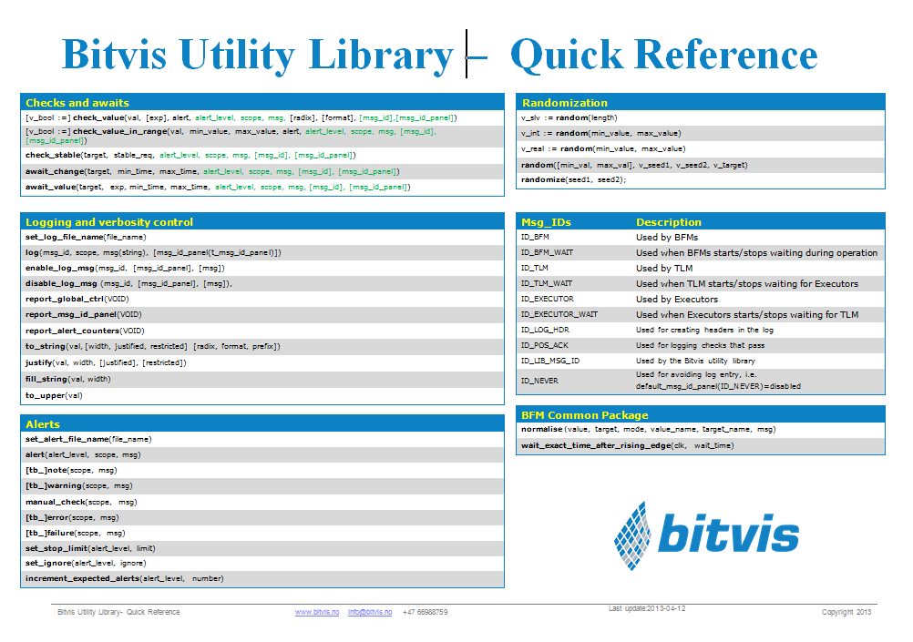
Documentation
'Making a simple, structured and efficient...'
will be available as PPT and Aldec Webinar
'Bitvis Utility Library – Concepts and usage'
(This PPT)
Quick Reference available as PDF
  Single page overview
  Plus full overview of all methods
Bitvis Utility Library - Concepts and Usage

Slide 27
Modifying Bitvis Utility Library?
May modify anything in Bitvis Utility Library – apart from
  Copyright heading
  License file
  Any call to the license file
Recommended approach
  Make any change to the adaptation package
  Do not make any changes to the other files
    Will make future updates more difficult
    Try to make modification/amendments outside the library
Bitvis Utility Library - Concepts and Usage

Slide 28
Bitvis Utility Library - Maintenance
Updates are planned for
  More overloads
  More functions and procedures
  Improving functionality and user friendliness even further
Updates will also occur
  when needed for our projects
  on request from customers - if feasible
  if bugs are detected
New versions will be released at regular intervals
Bitvis Utility Library - Concepts and Usage

Slide 29
Bitvis Utility Library
Concepts and usage
The end.
Your partner for Embedded SW and FPGA
www.bitvis.no
Bitvis Utility Library - Concepts and Usage

