Slide 1
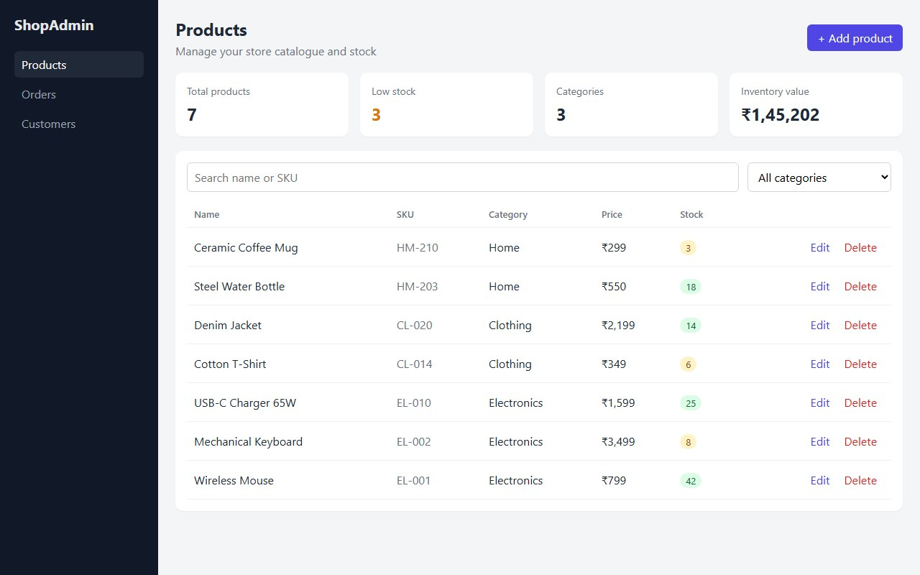
ShopAdmin
DEVOPS CAPSTONE
How I built an app that checks, ships and watches itself.
Ashutosh Kumar · 24bcs10111
github.com/THE-ASHUTOSH/shopadmin-capstone
Notes:
Hi, I'm Ashutosh. ShopAdmin is a small admin panel for an online shop. The app is simple on purpose - the interesting part is how it gets from my laptop to the internet without me doing anything by hand.

Slide 2



Meet ShopAdmin
A simple place to run a small online shop's stock.
Add and edit products
Name, price and stock in a few clicks.
Spot what's running low
Low-stock items stand out in orange.
Find anything fast
Search by name or filter by category.
Notes:
Three things it does: add and edit products, show what's running low, and find things quickly. Under the hood it's a React website, a Python API and a PostgreSQL database - but the rest of the talk is about how it gets shipped.

Slide 3



Why not just upload it by hand?
It's slow
It's easy to slip
“It works on my laptop”
Every update means repeating the same steps, again and again.
Skip one check and a bug reaches real users.
…and then it breaks somewhere else.
So I let the computer do the routine work.
Notes:
Doing releases by hand is slow, it's easy to forget a step, and something that works on my machine can break on a server. So the goal of the project was: make the computer do all of that for me, the same way every time.

Slide 4




From my laptop to the internet
I make a change
It gets checked
It gets packed
It goes live
I keep an eye on it
and save it to GitHub
tests and a security scan
into a box that runs anywhere
on servers in the cloud
on a live dashboard
No buttons to click. Every time I save a change, all of this happens on its own in about 3 minutes.
Notes:
This is the whole idea on one slide. I push a change to GitHub. GitHub Actions runs the tests and a security scan, Docker packs the app, it goes to Kubernetes in the cloud, and Grafana shows me how it's doing. About three minutes, no clicking.

Slide 5
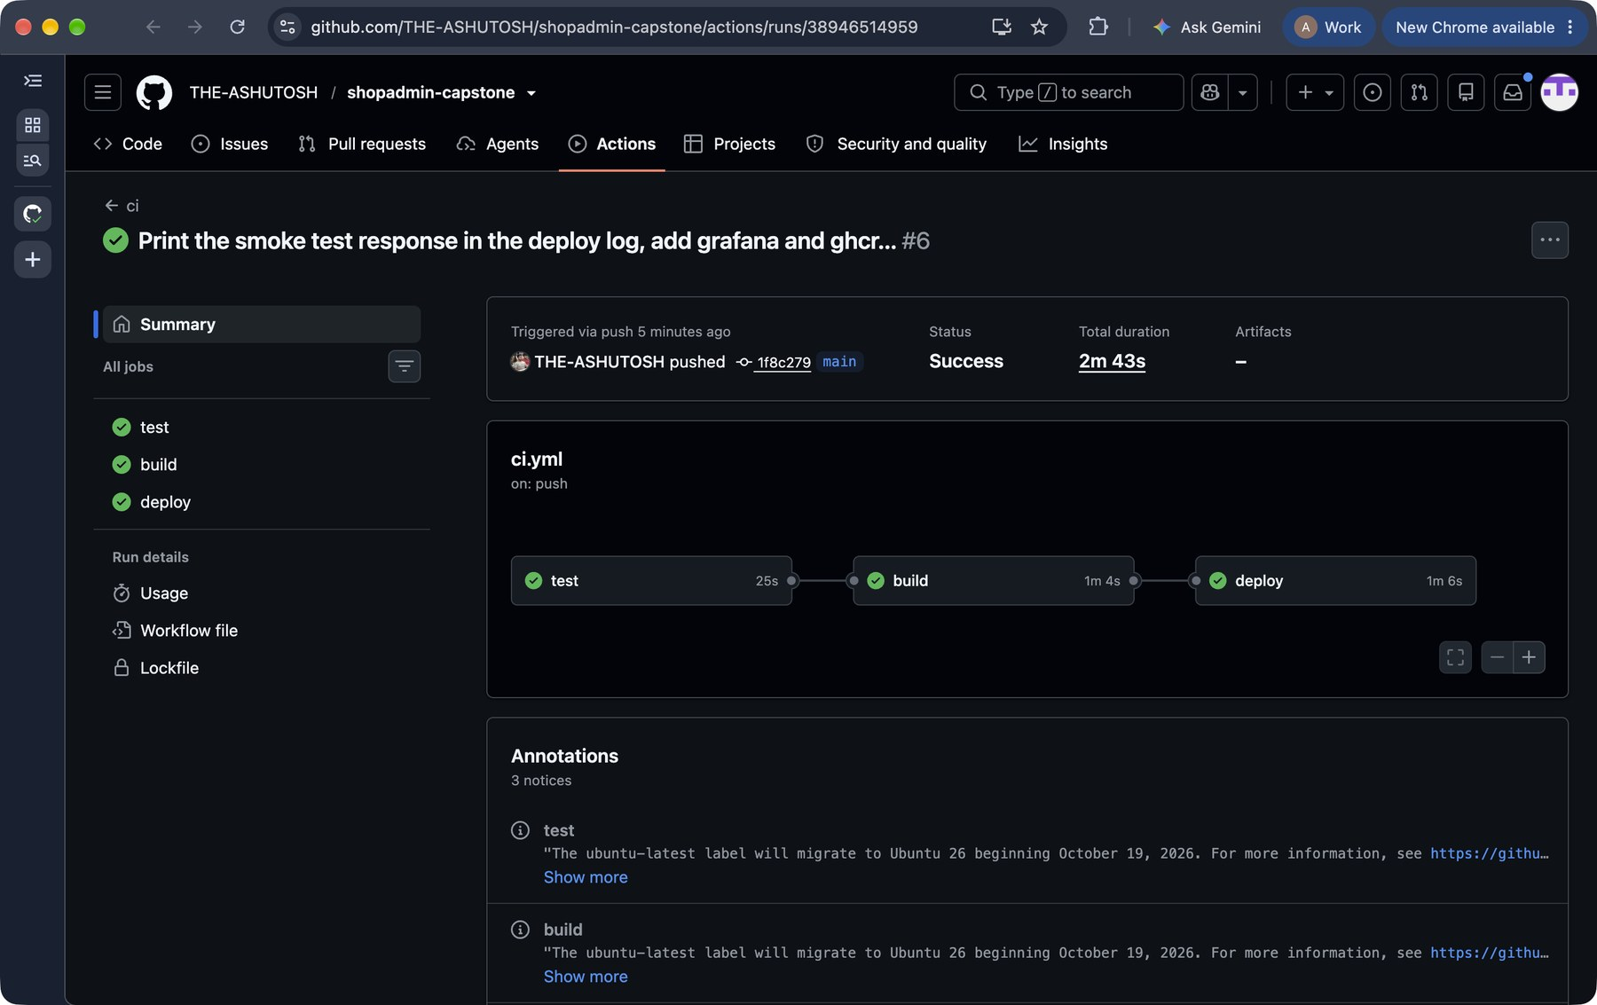
Checked before it goes live
9 / 9
automatic checks pass on every change
0
serious security problems found
Notes:
Nine tests check the important things the app does. Then a security scanner called Trivy looks for known problems. If anything fails, nothing goes live. Here's a real run - all green.

Slide 6
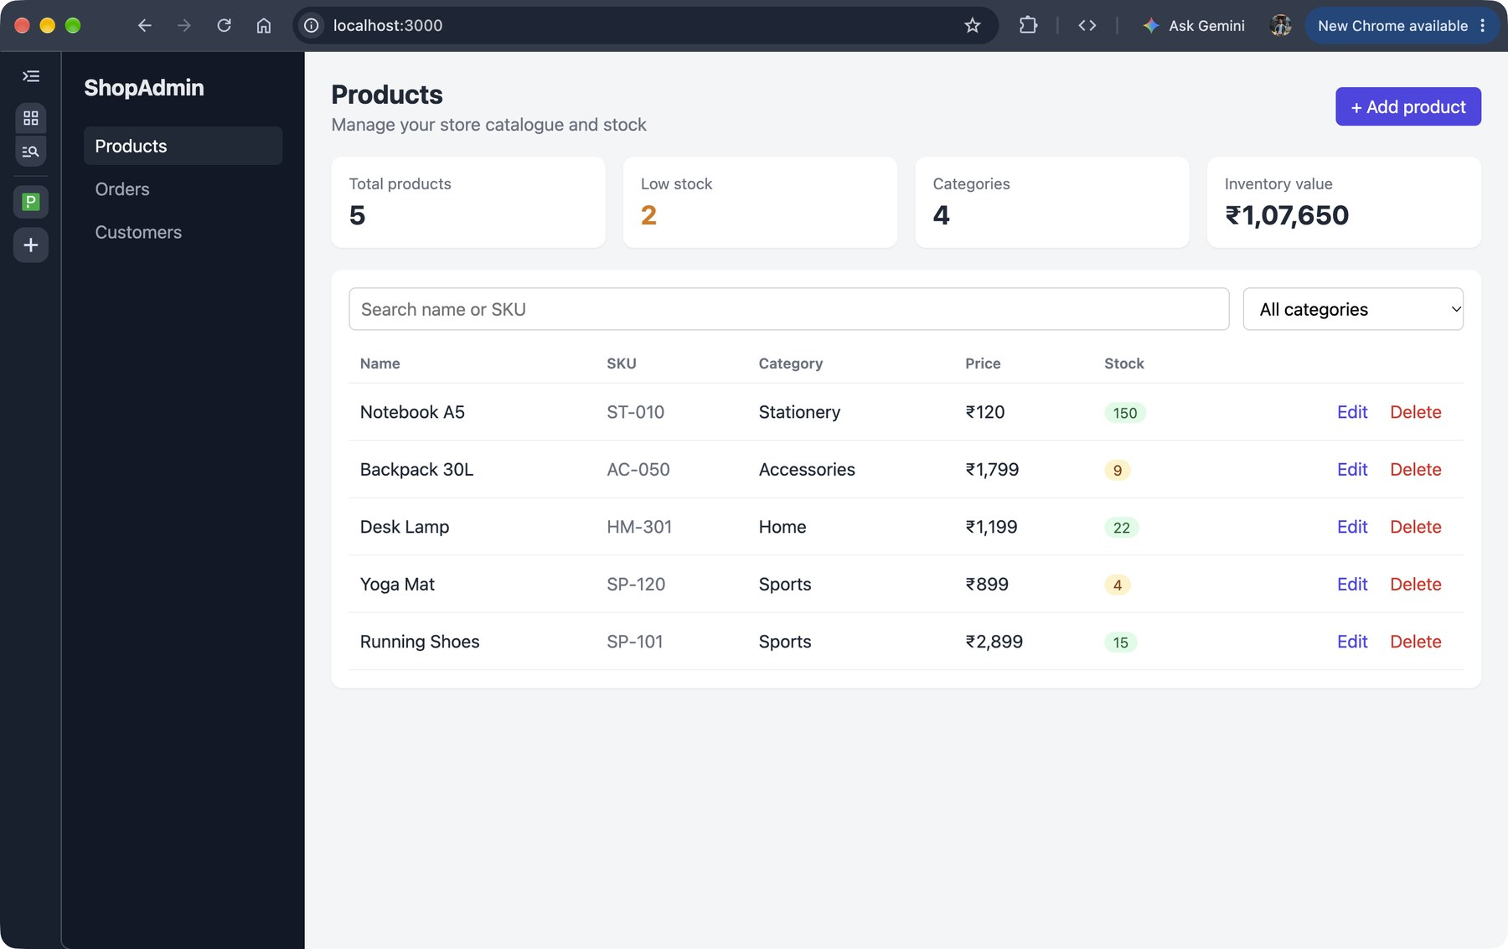
Packed once, runs anywhere
The website, the app and its database are packed into containers, like a lunchbox with everything inside.
Nothing to install, nothing to forget.
1
command starts the whole app on any computer
Notes:
This is Docker. Instead of setting up the database and the app by hand, everything is packed into containers. One command, docker compose up, and the whole app is running - here it is on my laptop.

Slide 7
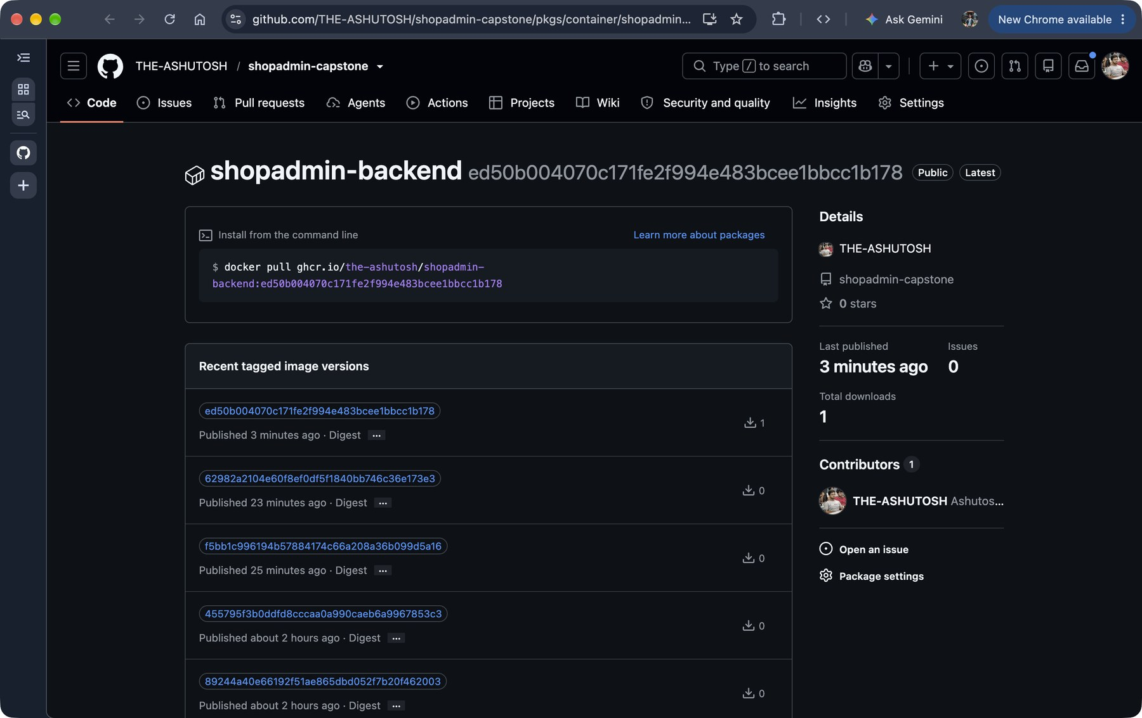


Every version is saved
Each version is stored with a label that points to the exact change it came from, a bit like version history in Google Docs.
Always know what's live
Easy to go back if something breaks
Notes:
Every packed version is saved on GitHub's registry, labelled with the ID of the change it came from. So I always know exactly what's running, and rolling back is just picking an older label.

Slide 8
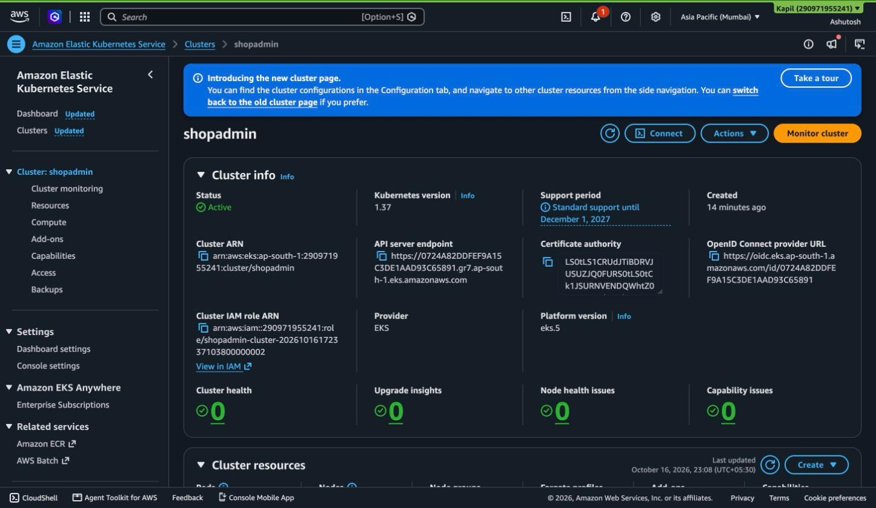
Servers built from a recipe
Instead of clicking around, I wrote down what the servers should look like. The same recipe builds them, and removes them.
12 min
to build everything on Amazon's cloud
< $0.20
total cost, removed the same day
Notes:
The cloud part is written as code with Terraform - think of it as a recipe. It built a private network and a Kubernetes cluster on AWS in Mumbai in about 12 minutes. After taking these screenshots I ran the same recipe in reverse and everything was removed. Total cost: under 20 cents.

Slide 9


Stays up, even when it's busy
Two copies of the app are always running, so if one stops, the other carries on.
A normal day
2 copies
When lots of people show up, more copies start on their own, and go away again when it's quiet.
A busy day
5 copies
Tested with heavy traffic: it grew from 2 to 5 copies by itself.
Notes:
This is Kubernetes. It keeps two copies of the app running all the time. During a load test the autoscaler noticed the CPU going up and added copies until there were five, then scaled back down when the test stopped.

Slide 10
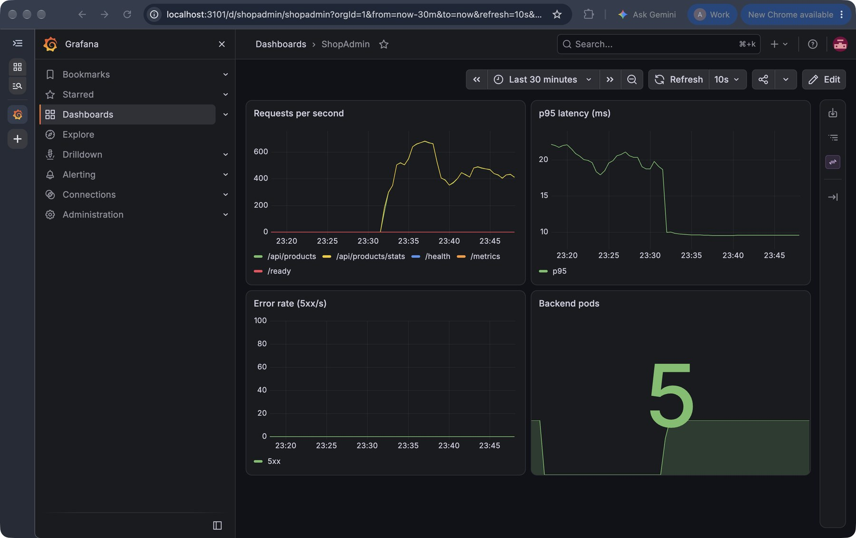



A live dashboard
Like a car's dashboard, it shows at a glance how the app is doing.
How many visitors
How fast it responds
Any errors
Notes:
Prometheus collects numbers from the app and Grafana draws them. You can see the traffic spike from the load test, response time staying low, no errors, and the number of copies going up to five.

Slide 11



What I learned
Let machines do the routine
Keep every version
Switch off what you don't use
A pipeline never forgets a step, even on a Friday evening.
Knowing exactly what's live makes problems quick to fix.
The cloud bills by the hour. Build it, use it, remove it.
Notes:
Three takeaways. Let machines do the repetitive work. Keep and label every version. And treat the cloud like a taxi meter - only run it while you need it.

Slide 12

Thank you
Now let's see it live: one small change, all the way to the app.
Ashutosh Kumar · 24bcs10111
github.com/THE-ASHUTOSH/shopadmin-capstone
Notes:
Thanks! For the demo I'll change some text in the app, push it, and we'll watch the pipeline check it, pack it and deploy it.

