Slide 1
Does a longer tool list hurt MCP tool selection?
5 vs 20 vs 50 tools in context on a 200-task MCPToolBench++ subset
AI465 Agentic AI | Research Project, Phase 2: implementation and evaluation
U23AI052 | Individual work | SVNIT Surat
AI465 Agentic AI | RP2 | U23AI052 1

Slide 2
Objective, and what changed from Phase 1
Approved objective
Declared deviations
Effect of tool-count context (5 vs 20 vs 50 tools) on MCP tool-selection accuracy and failure composition, on a stratified 200-task MCPToolBench++ subset (search, map, finance).
Metrics: AST accuracy, tokens, calls and latency per task, plus a failure taxonomy.
Fills the paper's gaps: no cost, no variance, no failure analysis.
• D1 Single-step only. Public data has no multi-step items for these domains, so no AST DAG.
• D2 Deterministic scorer instead of the GPT-4o judge; audited against my labels.
• D3 Missing required parameter counts as an error (stricter).
AI465 Agentic AI | RP2 | U23AI052 2

Slide 3
Design: the tool list is the only thing that changes
50 tools
20 tools
5 tools
gold tool + up to 2 labelled similar tools are always present; distractors come from one seeded permutation per task
Condition | What differs | Isolates
c05 / c20 / c50 | 5, 20, 50 tools in context | effect of tool count (the objective)
c50_goldfirst / goldlast | gold tool placed first or last at 50 tools | position of the right tool
c05_padded | 5 tools + neutral text to the 50-tool length | context length vs number of choices
c05_sc | 5 tools, 8 samples, majority vote | matched token budget
Same system and user prompt files in every condition (a test asserts it). Every run: 200 tasks x 3 repetitions, temperature and seed pinned.
AI465 Agentic AI | RP2 | U23AI052 3

Slide 4
What I built
Subset builder
Condition builder
Runner
Traces
Scorer
Aggregate
200 tasks, 87-tool pool
→
nested tool lists
→
model adapters, retries, resume
→
prompt, tools, response, usage
→
tool_ok, param_ok, 9 failure labels
→
mean±SD, bootstrap, figures
• Own code: runner, condition builder, scorer, statistics, report and slide generators, tests.
• Borrowed: the benchmark's task data and labels (commit 2bd35e5); its judge rules re-implemented, no code imported.
• Robustness: retries with backoff, rate limit, resume, jobs interleaved across conditions so model drift hits all of them.
• Checked: oracle test (200 gold labels score 100%), perturbation tests, 20-task audit against my own labels.
AI465 Agentic AI | RP2 | U23AI052 4

Slide 5
Experimental protocol
Requirement | How it is met
Repetition | 3 full passes per condition; mean ± SD over runs; paired bootstrap over tasks
Pinned configuration | configs/config.yaml, manifest.json per run: model string asked and returned, temperature, top-p, seed, dates
Prompts as artefacts | prompts/*.txt; conditions differ only in the tool list (padding arm adds neutral text)
Metrics | tool and AST accuracy; model calls, input and output tokens, latency per task
Traces | every call: full prompt, tool list, raw response, usage, score, failure label
Judging | no LLM judge; deterministic scorer checked on 20 tasks against my labels
Reproducibility | one command per table; README states runtime and token cost
AI465 Agentic AI | RP2 | U23AI052 5

Slide 6
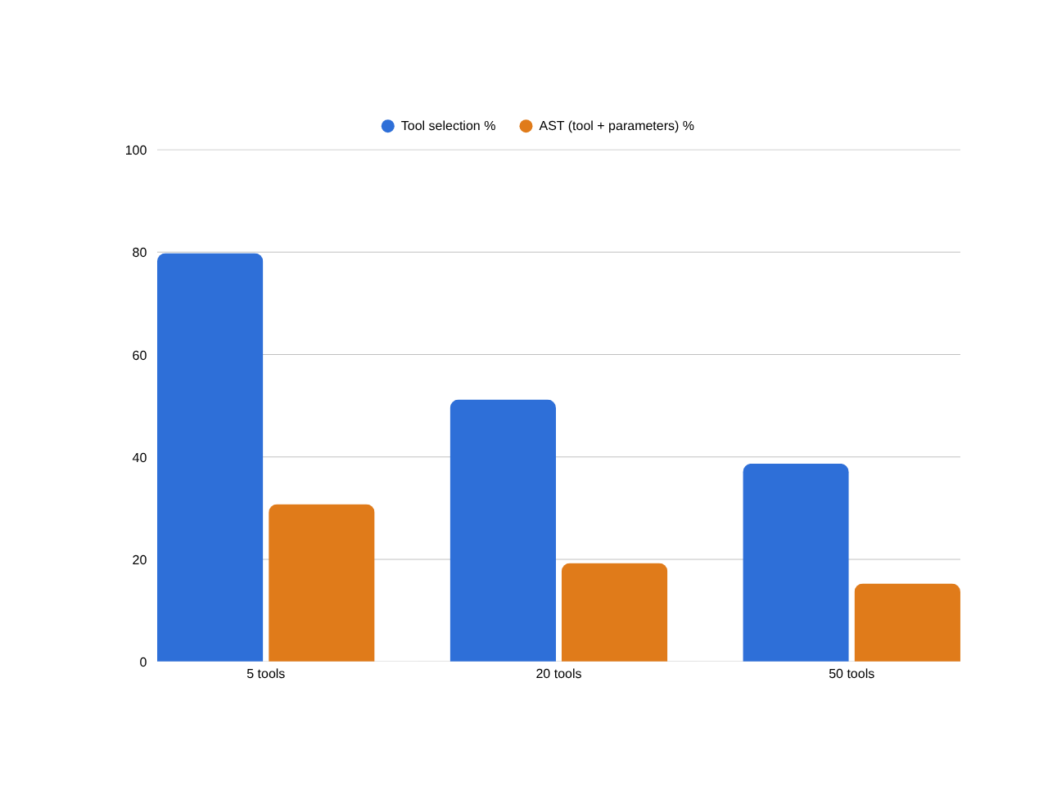
Results: accuracy vs number of tools
AST accuracy
30.8% -> 19.3% -> 15.3%
run-to-run SD 2.8 / 1.5 / 1.2 pp
5 to 50 tools, paired bootstrap
-15.5 pp
95% CI [-20.0, -11.2]
outside noise
Mean over 3 runs x 200 tasks.
AI465 Agentic AI | RP2 | U23AI052 6

Slide 7
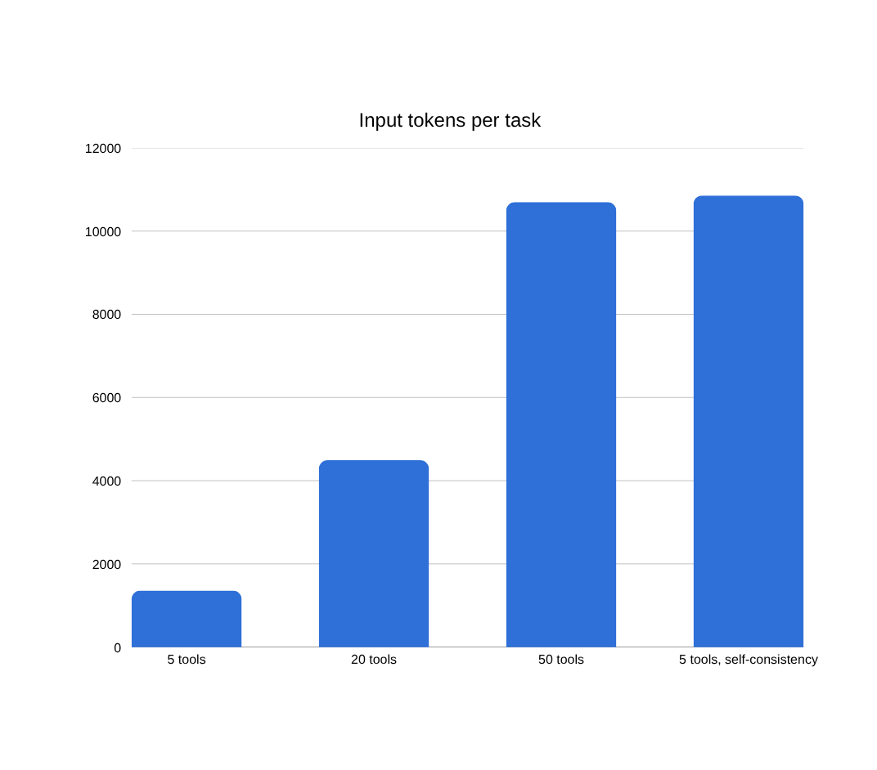
Results: what the extra tools cost
Condition | AST % | Latency s | Tok / correct
5 tools | 30.8 | 0.00 | 4517
20 tools | 19.3 | 0.00 | 23421
50 tools | 15.3 | 0.00 | 69975
5 tools, self-consistency | 36.0 | 0.00 | 30965
Calls per task: 1 in every condition except self-consistency (k votes).
AI465 Agentic AI | RP2 | U23AI052 7

Slide 8
Ablations: what explains the effect?
Comparison (AST accuracy) | Factor | Diff (pp) | 95% CI (pp) | Beyond noise
50 tools: gold first vs shuffled | position | +0.3 | [-2.5, +3.2] | no
50 tools: gold last vs shuffled | position | +0.5 | [-2.5, +3.7] | no
5 tools padded to 50-tool length vs plain 5 | context length | +0.0 | [+0.0, +0.0] | no
5 tools, 8 votes vs plain 5 | budget | +5.2 | [+2.7, +7.7] | yes
50 tools vs 5 tools with 8 votes | matched budget | -20.7 | [-26.0, -15.8] | yes
Differences are computed per task (mean over runs) and bootstrapped over the 200 tasks.
AI465 Agentic AI | RP2 | U23AI052 8

Slide 9
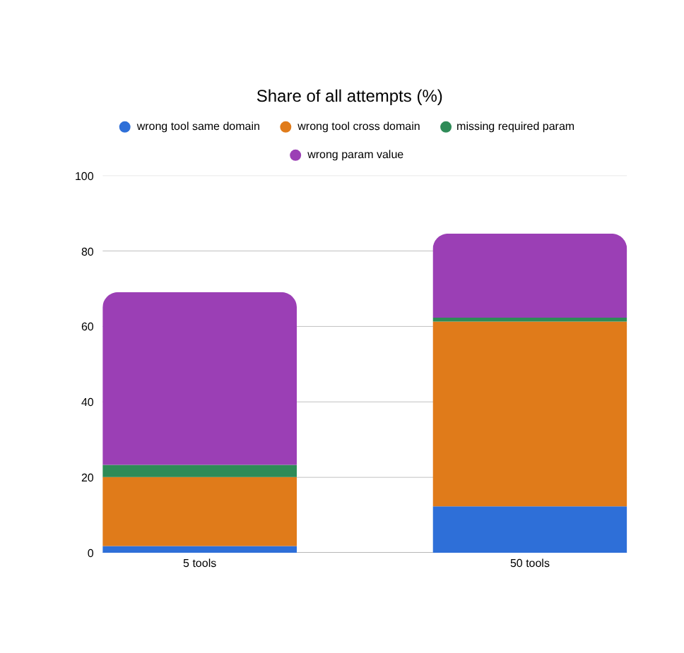
Why it fails: taxonomy and a traced case
Task 3ec01417 (search): solved in every 5-tool run, failed in every 50-tool run
Query: Can you extract the content from the URL https://www.wikipedia.org with basic depth and markdown format?
Gold: tavily-extract
Called: puppeteer_navigate -> wrong tool cross domain
Gold at position 15 of 50
Picked tool: Navigate to a URL
Gold tool: A powerful web content extraction tool that retrieves and processes raw content from specified URLs, ideal for data coll...
Cause: (state after reading the trace)
AI465 Agentic AI | RP2 | U23AI052 9

