Slide 1
Advanced Encryption Standard
(AES)

Slide 2
The Advanced Encryption Standard (AES) is a symmetric-key block cipher published by the National Institute of Standards and Technology (NIST)inDecember2001.

Slide 3
Objectives
To define the basic structure of AES
To define the transformations used by AES
To define the key expansion process

Slide 4
Contd..
AES has defined three versions, with 10, 12, and14 rounds. Each version uses a different cipher key size (128, 192, or 256), but the round keys are always 128 bits.

Slide 5
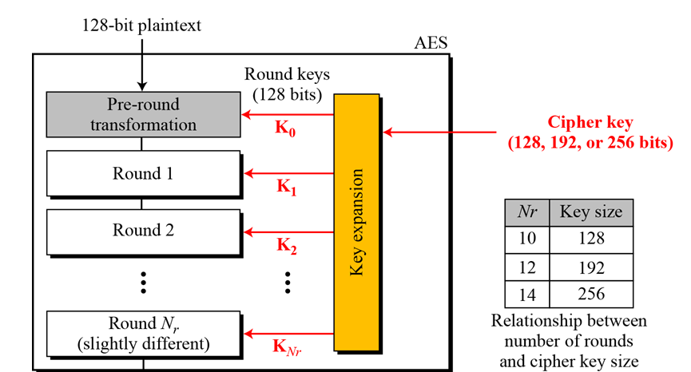
General design of AES encryption cipher ..

Slide 6
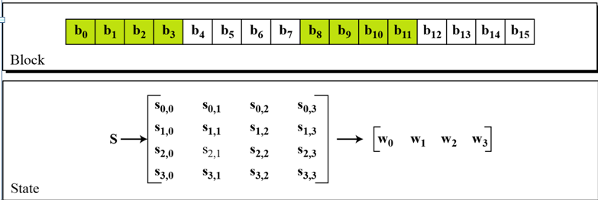
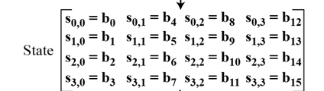
Contd..

Slide 7
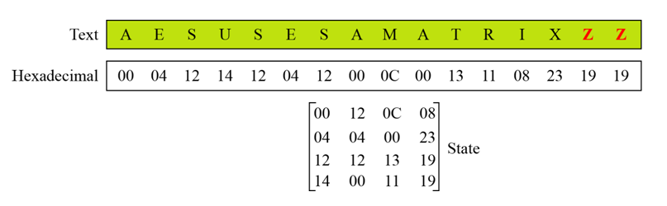
Contd..

Slide 8
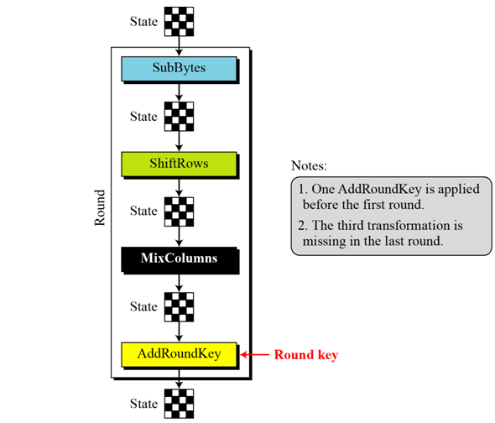
Structure of each round at the encryption site

Slide 9
Contd..
To provide security, AES uses four types of transformations: substitution, permutation, mixing, and key-adding.

Slide 10
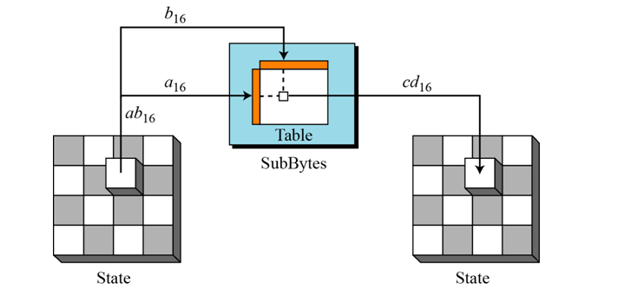
Contd..
To substitute a byte, we interpret the byte as two hexadecimal digits.

Slide 11
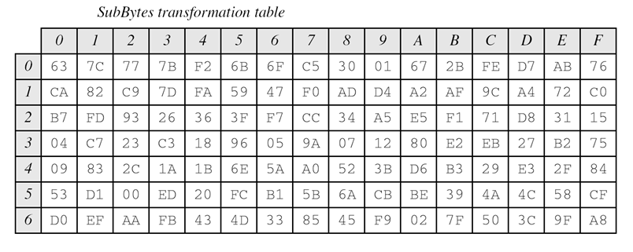
Contd..

Slide 12
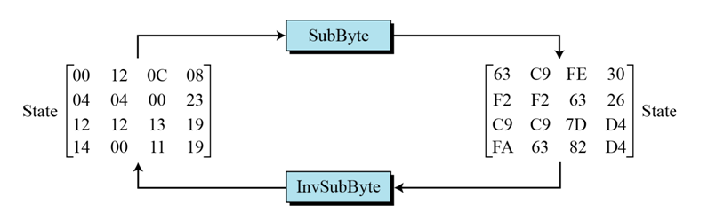
InvSubBytes transformation creates the original one

Slide 13
Transformation Using the GF(2⁸) Field
AES also defines the transformation algebraically using the GF(2⁸) field with the irreducible polynomials
(x⁸ + x⁴ + x³+ x + 1)

Slide 14
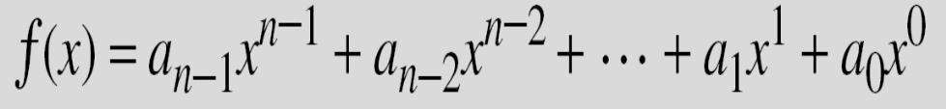
Polynomials
A polynomial of degree n − 1 is an expression of the form
where x^{i} is called the i^{th} term and a_{i} is called coefficient of the i^{th} term.
The degree of a polynomial is the highest degree of its terms. The degree is the value of the greatest exponent of any expression (except the constant ) in the polynomial.
Notes:
This list includes the various "classic" security services which are traditionally discussed.
Note there is a degree of ambiguity as to the meaning of these terms, and overlap in their use.
See Stallings Table 1.2 for details of the 5 Security Service categories and the 14 specific services given in X.800.

Slide 15
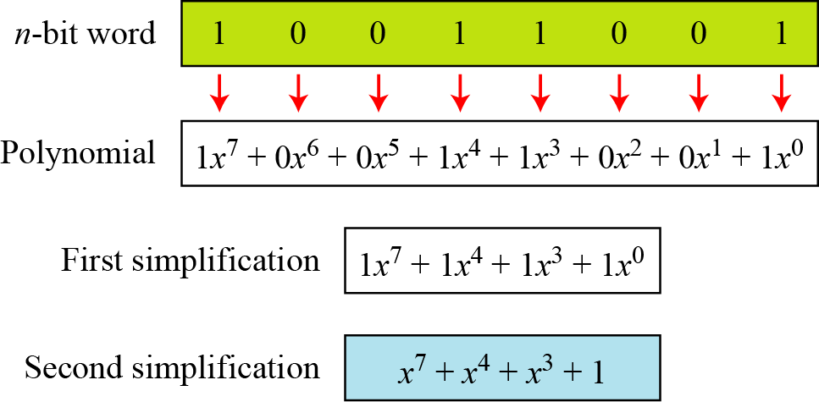
Contd.
Below figure show how we can represent the 8-bit word (10011001) using a polynomials.
Notes:
This list includes the various "classic" security services which are traditionally discussed.
Note there is a degree of ambiguity as to the meaning of these terms, and overlap in their use.
See Stallings Table 1.2 for details of the 5 Security Service categories and the 14 specific services given in X.800.

Slide 16
Contd.
To find the 8-bit word related to the polynomial x⁵ + x² + x, we first supply the omitted terms. Since n = 8, it means the polynomial is of degree 7. The expanded polynomial is
This is related to the 8-bit word 00100110
Notes:
This list includes the various "classic" security services which are traditionally discussed.
Note there is a degree of ambiguity as to the meaning of these terms, and overlap in their use.
See Stallings Table 1.2 for details of the 5 Security Service categories and the 14 specific services given in X.800.

Slide 17
Arithmetic in GF(2^{n})
We may add, subtract polynomials in as we do for ordinary arithmetic . Even though the coefficients are elements of GF(2) instead of actual integers, it is easy to do the calculations so long as we remember to always reduce coefficients mod 2.

Slide 18
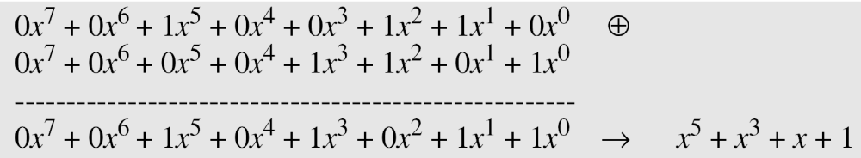
Contd.
Note: Addition and subtraction operations on polynomials are the same operation in
(mod 2) arithmetic.
Let us do (x⁵ + x² + x) ⊕ (x³ + x² + 1) in GF(2⁸). We use the symbol ⊕ to show that we mean polynomial addition. The following shows the procedure:
Notes:
This list includes the various "classic" security services which are traditionally discussed.
Note there is a degree of ambiguity as to the meaning of these terms, and overlap in their use.
See Stallings Table 1.2 for details of the 5 Security Service categories and the 14 specific services given in X.800.

Slide 19
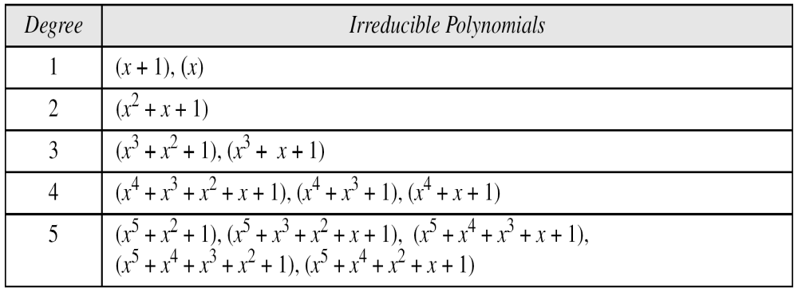
Irreducible polynomials ( modulus polynomials).
A polynomial is said to be irreducible if it cannot be factored into polynomials of lower positive degrees over the same field.
Notes:
This list includes the various "classic" security services which are traditionally discussed.
Note there is a degree of ambiguity as to the meaning of these terms, and overlap in their use.
See Stallings Table 1.2 for details of the 5 Security Service categories and the 14 specific services given in X.800.

Slide 20
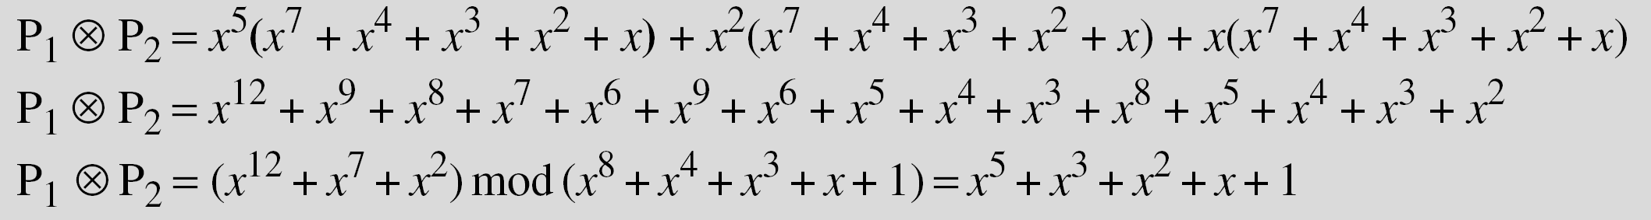
Contd.
Find the result of (x⁵ + x² + x) ⊗ (x⁷ + x⁴ + x³ + x² + x) in GF(2⁸) with irreducible polynomial (x⁸ + x⁴ + x³ + x + 1). Note that we use the symbol ⊗ to show the multiplication of two polynomials.
To find the final result, divide the polynomial of degree 12 by an irreducible polynomial of degree 8 (the modulus) and keep only the remainder. Next shows the process of division.
Notes:
This list includes the various "classic" security services which are traditionally discussed.
Note there is a degree of ambiguity as to the meaning of these terms, and overlap in their use.
See Stallings Table 1.2 for details of the 5 Security Service categories and the 14 specific services given in X.800.

Slide 21
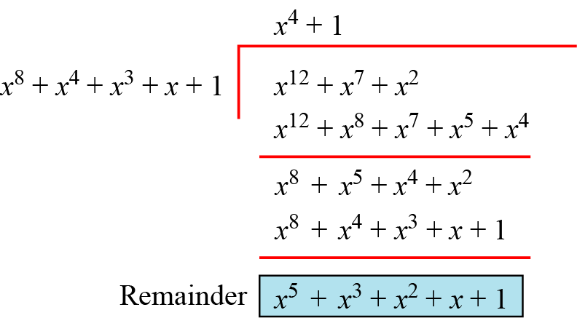
Contd.
Polynomial division with coefficients in GF(2)
Notes:
This list includes the various "classic" security services which are traditionally discussed.
Note there is a degree of ambiguity as to the meaning of these terms, and overlap in their use.
See Stallings Table 1.2 for details of the 5 Security Service categories and the 14 specific services given in X.800.

Slide 22
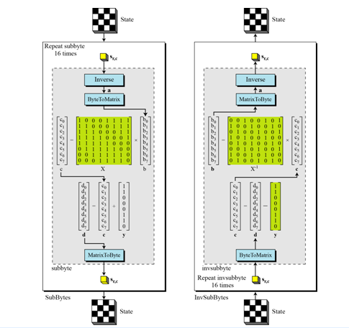
SubBytes and InvSubBytes processes

Slide 23
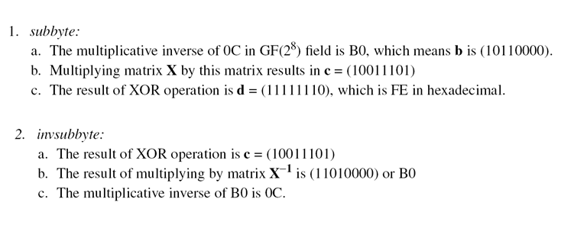
Example

Slide 24
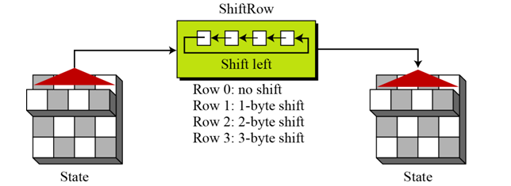
Permutation
Another transformation found in a round is shifting, which permutes the bytes.
‘Shift Rows’ transformation
( Left circular shift)
Note: In the decryption, the transformation is called InvShiftRows and the shifting is to the right.

Slide 25
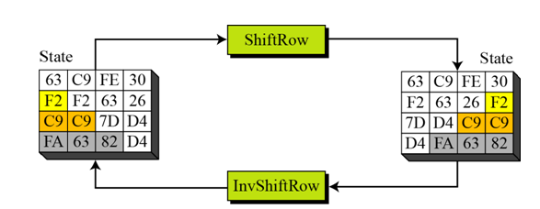
ShiftRow Transformation

Slide 26
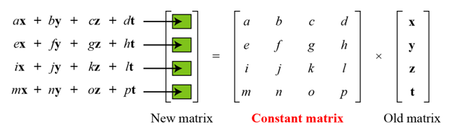
Mixing
We need an interbyte transformation that changes the bits inside a byte, based on the bits inside the neighboring bytes. We need to mix bytes to provide diffusion at the bit level.
Mixing bytes using matrix multiplication

Slide 27
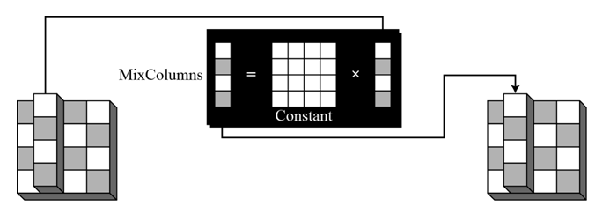
MixColumns
The MixColumns transformation operates at the column level; it transforms each column of the state to a new column.

Slide 28
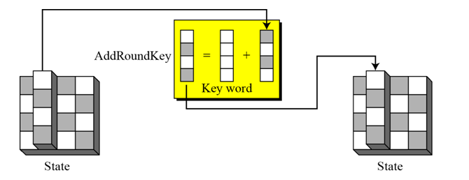
Key Adding
AddRoundKey proceeds one column at a time. AddRoundKey adds a round key word with each state column matrix; the operation in AddRoundKey is matrix addition.

Slide 29
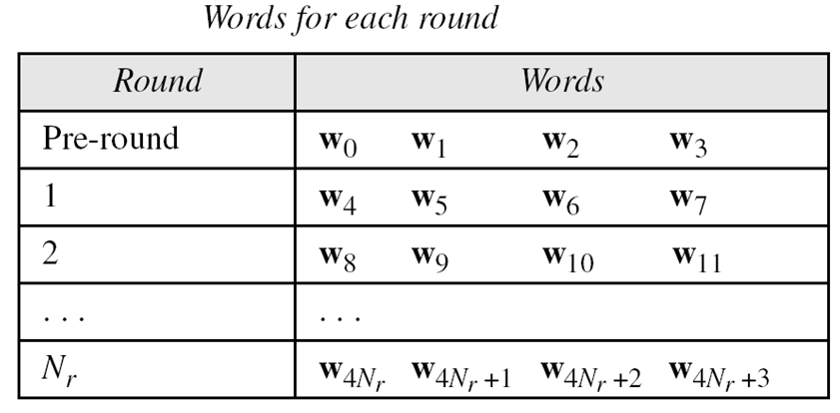
KEY EXPANSION
To create round keys for each round, AES uses a key-expansion process. If the number of rounds is N_{r} , the key-expansion routine creates N_{r} + 1 128-bit round keys from one single 128-bit cipher key.

Slide 30
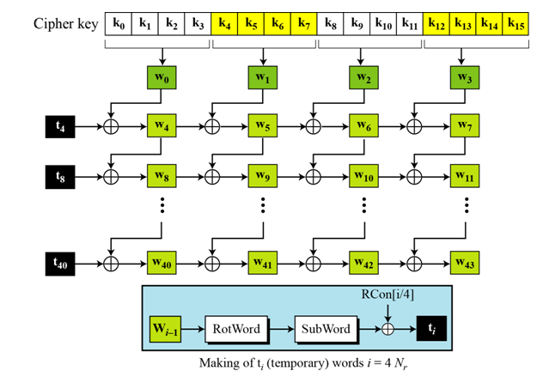
Key Expansion in AES-128

Slide 31
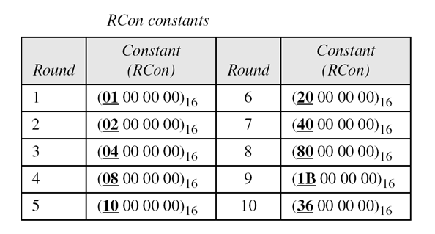
Contd..

Slide 32
Contd..
Each round key in AES depends on the previous round key. The dependency, however, is nonlinear because of SubWord transformation. The addition of the round constants also guarantees that each round key will be different from the previous one.

Slide 33
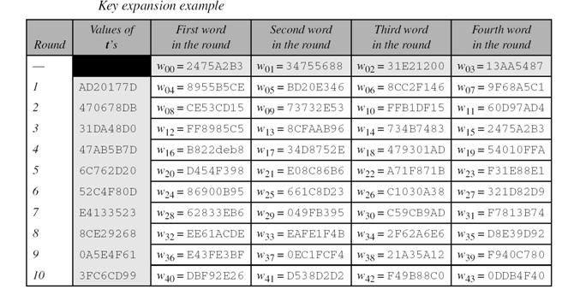
Contd..
The keys for each round are calculated assuming that the 128-bit cipher key agreed upon by Alice and Bob is (24 75 A2 B3 34 75 56 88 31 E2 12 00 13 AA 54 87)16.

