Slide 1
Digital Signatures
Notes:
Opening quote.

Slide 2
Signing the Digest
Can we use Symmetric key to both sign & verify a signature?
In Digital signature system, the messages are normally long and we have to use asymmetric-key schemes.
A digest is made out of the message at Alice site.
The Digest then goes for signing process
Notes:
The most important development from the work on public-key cryptography is the digital signature. Message authentication protects two parties who exchange messages from any third party. However, it does not protect the two parties against each other. A digital signature is analogous to the handwritten signature, and provides a set of security capabilities that would be difficult to implement in any other way. It must have the following properties:
• It must verify the author and the date and time of the signature
• It must to authenticate the contents at the time of the signature
• It must be verifiable by third parties,to resolve disputes
Thus, the digital signature function includes the authentication function.

Slide 3
Direct Digital Signatures
Involve only sender & receiver
assumed receiver has sender’s public-key
digital signature made by sender signing entire message or hash with private-key
can encrypt using receivers public-key
important that sign first then encrypt message & signature
security depends on sender’s private-key
Notes:
Direct Digital Signatures involve the direct application of public-key algorithms involving only the communicating parties. A digital signature may be formed by encrypting the entire message with the sender’s private key, or by encrypting a hash code of the message with the sender’s private key. Confidentiality can be provided by further encrypting the entire message plus signature using either public or private key schemes. It is important to perform the signature function first and then an outer confidentiality function, since in case of dispute, some third party must view the message and its signature. But these approaches are dependent on the security of the sender’s private-key. Will have problems if it is lost/stolen and signatures forged. Need time-stamps and timely key revocation.

Slide 4
Services via Digital Signatures
Message Authentication
Message Integrity
Nonrepudiation
Confidentiality…………………..?
Notes:
The most important development from the work on public-key cryptography is the digital signature. Message authentication protects two parties who exchange messages from any third party. However, it does not protect the two parties against each other. A digital signature is analogous to the handwritten signature, and provides a set of security capabilities that would be difficult to implement in any other way. It must have the following properties:
• It must verify the author and the date and time of the signature
• It must to authenticate the contents at the time of the signature
• It must be verifiable by third parties,to resolve disputes
Thus, the digital signature function includes the authentication function.

Slide 5
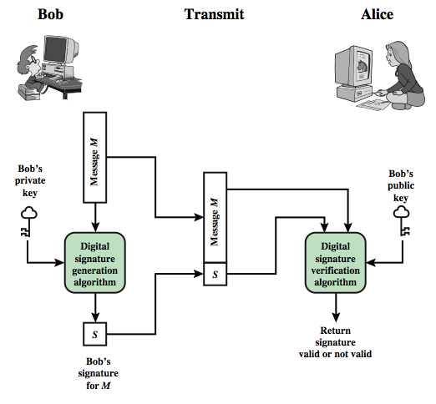
Digital Signatures Process

Slide 6
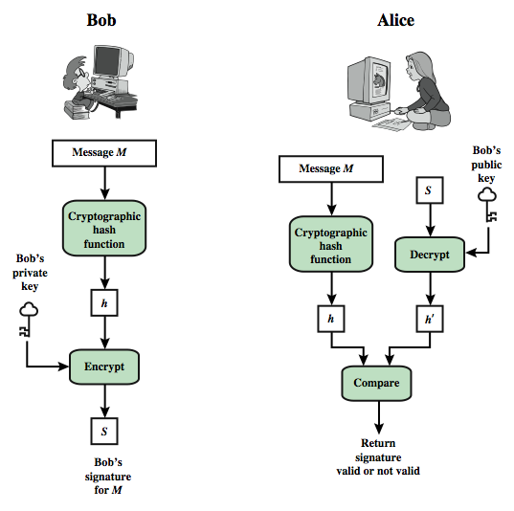
Contd.

Slide 7
RSA based Digital Signature Schemes
In digital signature scheme the private and public keys of the sender, not the receiver, are used.
The sender uses own private key to sign the document; the receiver uses the sender’s public key to verify it.
Notes:
Up untill now, have been concerned with protecting message content (ie secrecy) by encrypting the message. Will now consider how to protect message integrity (ie protection from modification), as well as confirming the identity of the sender. Generically this is the problem of message authentication, and in eCommerce applications is arguably more important than secrecy. Message Authentication is concerned with: protecting the integrity of a message, validating identity of originator, & non-repudiation of origin (dispute resolution). There are three types of functions that may be used to produce an authenticator: message encryption, message authentication code (MAC), or a hash function.

Slide 8
Key Generation
Each user generates a public/private key pair by:
Selecting two large primes at random p, q
Computing their Product n=p.q
  note ø(n)=(p-1)(q-1)
Selecting at random the key e
    where 1<e<ø(n), gcd(e,ø(n))=1
Solve following equation to find Signing key d
  e.d=1 mod ø(n) and 0≤d≤n
Publish their public key: PU={e,n}
Keep secret private signing key: PR={d,n}
Notes:
RSA key setup is done once (rarely) when a user establishes (or replaces) their public key, using the steps as shown. The exponent e is usually fairly small, just must be relatively prime to ø(n). Need to compute its inverse mod ø(n) to find d. It is critically important that the factors p & q of the modulus n are kept secret, since if they become known, the system can be broken. Note that different users will have different moduli n.

Slide 9
Signing
to sign a message, the sender, used his/her private key exponent:
  i.e. {d,n}
  And computes: S = M^{d} mod n
to verifying the sign, receiver applies public exponent ( of the sender) to the signature to create a copy of the message M’
i.e. M’ = S^{e} mod n
And compares the value of M’ with the value of M. If the two values are same , receiver accept the message.
Notes:
The actual RSA encryption and decryption computations are each simply a single exponentiation mod (n). Note that the message must be smaller than the modulus. The “magic” is in the choice of the exponents which makes the system work.

Slide 10
Verifying
M’≡ M (mod n)
S^{e} ≡ M (mod n)
M ^{d*e} ≡ M (mod n) ( because d*e = 1 mod n)
Notes:
The actual RSA encryption and decryption computations are each simply a single exponentiation mod (n). Note that the message must be smaller than the modulus. The “magic” is in the choice of the exponents which makes the system work.

Slide 11
Attacks on RSA Signature
Key only attack
Eve intercept the pair (M,S) and tries to create another message M’ such that M’≡ S^{e}(mod n)
Difficult to solve as leads to Discrete logarithm problem
Notes:
Can show that RSA works as a direct consequence of Euler’s Theorem, so that raising a number to power e then d (or vica versa) results in the original number!

Slide 12
Attacks on RSA Signature Contd.
Known Message Attack
Eve intercepted two message-signature pairs (m1,S1) and (M2,S2) created using the same private key.
If M = (M1*M2)mod n, then S = (S1*S2)mod n
Because S = (S1*S2)= (M1^{d}*M2^{d}) = (M1*M2)^{d}=M^{d}
As the message M is a multiplication of two previous messages created by alice; thus M is normally useless
Notes:
Can show that RSA works as a direct consequence of Euler’s Theorem, so that raising a number to power e then d (or vica versa) results in the original number!

Slide 13
Attacks on RSA Signature Contd.
Chosen-Message Attack
Eve can ask Alice to sign two legitimate message, M1 and M2 for her.
Eve latter creates a new message M = M1 * M2.
Eve can claim that Alice has signed M.
Notes:
Can show that RSA works as a direct consequence of Euler’s Theorem, so that raising a number to power e then d (or vica versa) results in the original number!

