Slide 1
Hash Function
Notes:
Opening quote.

Slide 2
Hash Function
A cryptographic hash function takes a message of arbitrary length and creates a message digest of fixed length.
  h = H(M)
h
Notes:
A variation on the message authentication code is the one-way hash function. As with the message authentication code, a hash function accepts a variable-size message M as input and produces a fixed-size output, referred to as a hash code H(M). Unlike a MAC, a hash code does not use a key but is a function only of the input message. The hash code is also referred to as a message digest or hash value.

Slide 3
Hash Function Properties
a Hash Function produces a fingerprint of some file/message/data
  h = H(M)
  condenses a variable-length message M
  to a fixed-sized fingerprint

Slide 4
Requirements for Hash Functions
can be applied to any sized message M
produces fixed-length output h
is easy to compute h=H(M) for any message M
given h it is infeasible to find x s.t. H(x)=h
  one-way property or preimage resistant
given x is infeasible to find y s.t. H(y)=H(x)
  weak collision resistance or Second preimage resistant
is infeasible to find any x,y s.t. H(y)=H(x)
  strong collision resistance

Slide 5
Random Oracle Model
A function based on this model behaves as follows:
  When a new message of any length is given , the oracle creates and gives a fixed length message digest that is a random string of 0s and 1s. The oracle records the message and the message digest.
  When a message is given for which a digest exists, the oracle simply gives the digest in the record.
  The digest for a new message needs to be chosen independently form all previous digests. This implies that the oracle cannot use a formula or an algorithm to calculate the digest.
Notes:
Up untill now, have been concerned with protecting message content (ie secrecy) by encrypting the message. Will now consider how to protect message integrity (ie protection from modification), as well as confirming the identity of the sender. Generically this is the problem of message authentication, and in eCommerce applications is arguably more important than secrecy. Message Authentication is concerned with: protecting the integrity of a message, validating identity of originator, & non-repudiation of origin (dispute resolution). There are three types of functions that may be used to produce an authenticator: message encryption, message authentication code (MAC), or a hash function.

Slide 6
Pigeonhole Principle
If n pigeonholes are occupied by n+1 pigeons, then at least one pigeonhole is occupied by two pigeons.
  Assume that the message in a hash function are 6 bit long and the digest are only 4 bits long...........
Notes:
Up untill now, have been concerned with protecting message content (ie secrecy) by encrypting the message. Will now consider how to protect message integrity (ie protection from modification), as well as confirming the identity of the sender. Generically this is the problem of message authentication, and in eCommerce applications is arguably more important than secrecy. Message Authentication is concerned with: protecting the integrity of a message, validating identity of originator, & non-repudiation of origin (dispute resolution). There are three types of functions that may be used to produce an authenticator: message encryption, message authentication code (MAC), or a hash function.

Slide 7
Birthday attack
Birthday attack works thus
conclusion is that need to use larger hash
Notes:
All hash functions operate using the following general principles. The input (message, file,etc.) is viewed as a sequence of n-bit blocks, processed one block at a time in an iterative fashion to produce an n-bit hash function. Can construct a range of possible simple hash functions by just XOR’ing blocks with rotates etc. None of these are secure, since can predict how changes to message affect the resulting hash.

Slide 8
Birthday attack
Birthday attack works thus
conclusion is that need to use larger hash
………………..
……………………………….
We have a uniformly distributed random variable with N possible values over instances
We are interested to know minimum number of instances K, such that it is likely that at least one instance is equal to a required one i.e. P>=1/2.
Notes:
All hash functions operate using the following general principles. The input (message, file,etc.) is viewed as a sequence of n-bit blocks, processed one block at a time in an iterative fashion to produce an n-bit hash function. Can construct a range of possible simple hash functions by just XOR’ing blocks with rotates etc. None of these are secure, since can predict how changes to message affect the resulting hash.

Slide 9
Birthday attack
  opponent need to generates 2n list of digest in Preimage and second Preimage Attack.
  (.69* 2^{n} ) and (.69* 2^{n} + 1)
  opponent need to generates 2n/2 list of digest in Collision Attack.
  (1.18* 2^{n/2} ) and (.83* 2^{n/2} )
Notes:
All hash functions operate using the following general principles. The input (message, file,etc.) is viewed as a sequence of n-bit blocks, processed one block at a time in an iterative fashion to produce an n-bit hash function. Can construct a range of possible simple hash functions by just XOR’ing blocks with rotates etc. None of these are secure, since can predict how changes to message affect the resulting hash.

Slide 10
Hash Algorithms
Hash Functions
  Condense arbitrary size message to fixed size
  Instead of using a hash function with variable-size input, a function with fixed-size input is created
  By processing message in blocks
Notes:
Now look at important examples of both secure hash functions and message authentication codes (MACs).
Traditionally, most hash functions that have achieved widespread use rely on a compression function specifically designed for the hash function. Another approach is to use a symmetric block cipher as the compression function.
MACs also fall into two categories: some use a hash algorithm such as SHA as the core of the MAC algorithm, others use a symmetric block cipher in a cipher block chaining mode.

Slide 11
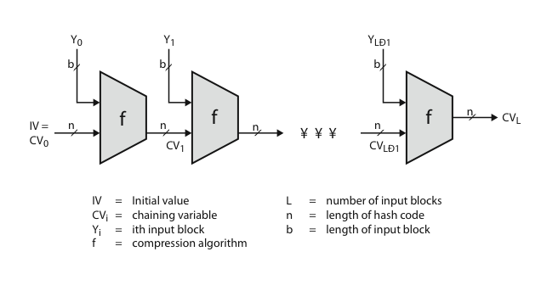
Hash Algorithm Structure
Notes:
Most important modern hash functions follow the basic structure shown in this figure, Stallings Figure 11.9. This has proved to be a fundamentally sound structure, and newer designs simply refine the structure and add to the hash code length. Within this basic structure, two approaches have been followed in the design of the compression function, as mentioned previously, which is the basic building block of the hash function.

Slide 12
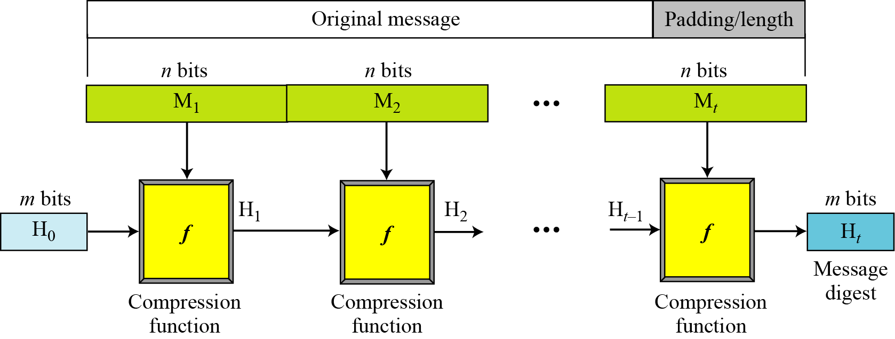
Hash Algorithm Structure
Notes:
Most important modern hash functions follow the basic structure shown in this figure, Stallings Figure 11.9. This has proved to be a fundamentally sound structure, and newer designs simply refine the structure and add to the hash code length. Within this basic structure, two approaches have been followed in the design of the compression function, as mentioned previously, which is the basic building block of the hash function.

Slide 13
Hash Algorithms Contd..
  The message length and padding are appended to the message to create an augmented message that can be evenly divided into blocks of n bits, where n is the size of the block
  The message is then considered as m blocks, each of n bits
  Digest created at m iterations H₁, H₂,..............H_{t}
  Before starting the iteration, the digest H₀ is set to a fixed value, normally called ‘Initial Vector’
Notes:
Now look at important examples of both secure hash functions and message authentication codes (MACs).
Traditionally, most hash functions that have achieved widespread use rely on a compression function specifically designed for the hash function. Another approach is to use a symmetric block cipher as the compression function.
MACs also fall into two categories: some use a hash algorithm such as SHA as the core of the MAC algorithm, others use a symmetric block cipher in a cipher block chaining mode.

Slide 14
Hash Algorithms Contd..
The compression function at each iteration operates on H_{i-1} and M_{i} to create a new H_{i}. In other words, we have H_{i} = f(H_{i-1}, M_{i}), where f is the compression function.
H_{t} is the hash function of the original message, i.e. H(M)
Notes:
Now look at important examples of both secure hash functions and message authentication codes (MACs).
Traditionally, most hash functions that have achieved widespread use rely on a compression function specifically designed for the hash function. Another approach is to use a symmetric block cipher as the compression function.
MACs also fall into two categories: some use a hash algorithm such as SHA as the core of the MAC algorithm, others use a symmetric block cipher in a cipher block chaining mode.

Slide 15
SHA-512
SHA-512 is the version of SHA with a 512-bit message digest.
It works over multiple block messages. Each block is 1024 bits in length.
Notes:
Now look at important examples of both secure hash functions and message authentication codes (MACs).
Traditionally, most hash functions that have achieved widespread use rely on a compression function specifically designed for the hash function. Another approach is to use a symmetric block cipher as the compression function.
MACs also fall into two categories: some use a hash algorithm such as SHA as the core of the MAC algorithm, others use a symmetric block cipher in a cipher block chaining mode.

Slide 16
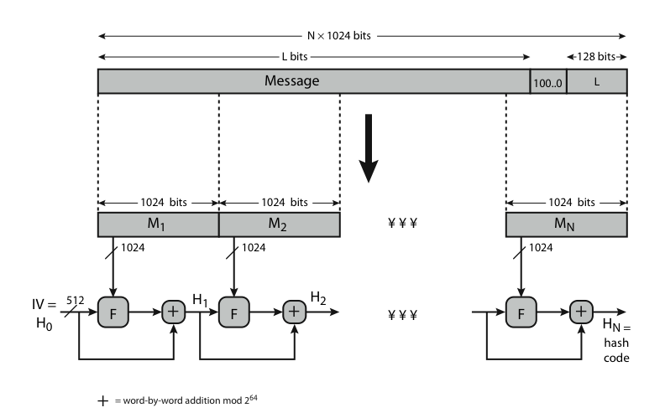
SHA-512 Overview
Notes:
Now examine the structure of SHA-512, noting that the other versions are quite similar.
SHA-512 follows the structure depicted in Stallings Figure 12.1. The processing consists of the following steps:
• Step 1: Append padding bits
• Step 2: Append length
• Step 3: Initialize hash buffer
• Step 4: Process the message in 1024-bit (128-word) blocks, which forms the heart of the algorithm
• Step 5: Output the final state value as the resulting hash
See text for details.

Slide 17
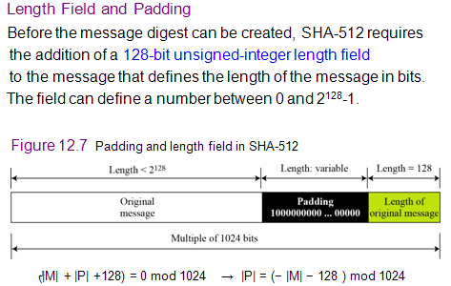
SHA-512 Overview
Notes:
Now examine the structure of SHA-512, noting that the other versions are quite similar.
SHA-512 follows the structure depicted in Stallings Figure 12.1. The processing consists of the following steps:
• Step 1: Append padding bits
• Step 2: Append length
• Step 3: Initialize hash buffer
• Step 4: Process the message in 1024-bit (128-word) blocks, which forms the heart of the algorithm
• Step 5: Output the final state value as the resulting hash
See text for details.

Slide 18
Example
Notes:
Now examine the structure of SHA-512, noting that the other versions are quite similar.
SHA-512 follows the structure depicted in Stallings Figure 12.1. The processing consists of the following steps:
• Step 1: Append padding bits
• Step 2: Append length
• Step 3: Initialize hash buffer
• Step 4: Process the message in 1024-bit (128-word) blocks, which forms the heart of the algorithm
• Step 5: Output the final state value as the resulting hash
See text for details.

Slide 19
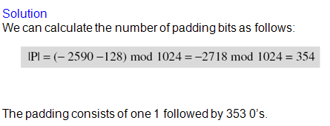
Notes:
Now examine the structure of SHA-512, noting that the other versions are quite similar.
SHA-512 follows the structure depicted in Stallings Figure 12.1. The processing consists of the following steps:
• Step 1: Append padding bits
• Step 2: Append length
• Step 3: Initialize hash buffer
• Step 4: Process the message in 1024-bit (128-word) blocks, which forms the heart of the algorithm
• Step 5: Output the final state value as the resulting hash
See text for details.

Slide 20
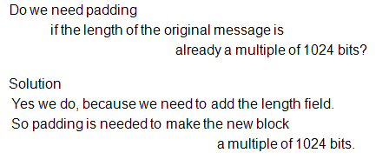
Contd..
Notes:
Now examine the structure of SHA-512, noting that the other versions are quite similar.
SHA-512 follows the structure depicted in Stallings Figure 12.1. The processing consists of the following steps:
• Step 1: Append padding bits
• Step 2: Append length
• Step 3: Initialize hash buffer
• Step 4: Process the message in 1024-bit (128-word) blocks, which forms the heart of the algorithm
• Step 5: Output the final state value as the resulting hash
See text for details.

Slide 21
SHA-512 Compression Function
Heart of the algorithm
Processing message in 1024-bit blocks
Consists of 80 rounds
  updating a 512-bit buffer
  using a 64-bit value, derived from the current message block
  and a round constant based on cube root of first 80 prime numbers
Notes:
The SHA-512 Compression Function is the heart of the algorithm. In this Step 4, it processes the message in 1024-bit (128-word) blocks, using a module that consists of 80 rounds, labeled F in Stallings Figure 12, as shown in Figure 12.2. Each round takes as input the 512-bit buffer value, and updates the contents of the buffer. Each round t makes use of a 64-bit value Wt derived using a message schedule from the current 1024-bit block being processed. Each round also makes use of an additive constant Kt, based on the fractional parts of the cube roots of the first eighty prime numbers. The output of the eightieth round is added to the input to the first round to produce the final hash value for this message block, which forms the input to the next iteration of this compression function, as shown on the previous slide.

Slide 22
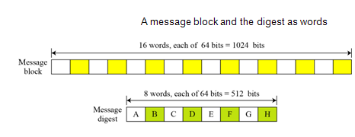
Contd..
Notes:
Now examine the structure of SHA-512, noting that the other versions are quite similar.
SHA-512 follows the structure depicted in Stallings Figure 12.1. The processing consists of the following steps:
• Step 1: Append padding bits
• Step 2: Append length
• Step 3: Initialize hash buffer
• Step 4: Process the message in 1024-bit (128-word) blocks, which forms the heart of the algorithm
• Step 5: Output the final state value as the resulting hash
See text for details.

Slide 23
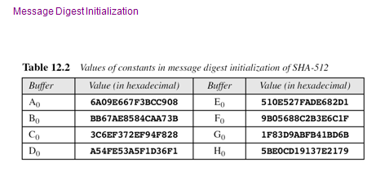
SHA-512 Overview Contd..
Notes:
Now examine the structure of SHA-512, noting that the other versions are quite similar.
SHA-512 follows the structure depicted in Stallings Figure 12.1. The processing consists of the following steps:
• Step 1: Append padding bits
• Step 2: Append length
• Step 3: Initialize hash buffer
• Step 4: Process the message in 1024-bit (128-word) blocks, which forms the heart of the algorithm
• Step 5: Output the final state value as the resulting hash
See text for details.

Slide 24
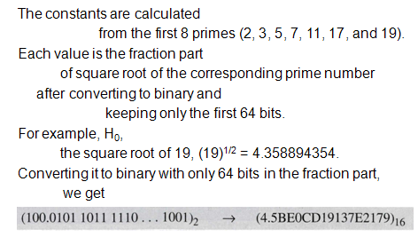
Message Digest Initialization
Notes:
Now examine the structure of SHA-512, noting that the other versions are quite similar.
SHA-512 follows the structure depicted in Stallings Figure 12.1. The processing consists of the following steps:
• Step 1: Append padding bits
• Step 2: Append length
• Step 3: Initialize hash buffer
• Step 4: Process the message in 1024-bit (128-word) blocks, which forms the heart of the algorithm
• Step 5: Output the final state value as the resulting hash
See text for details.

Slide 25
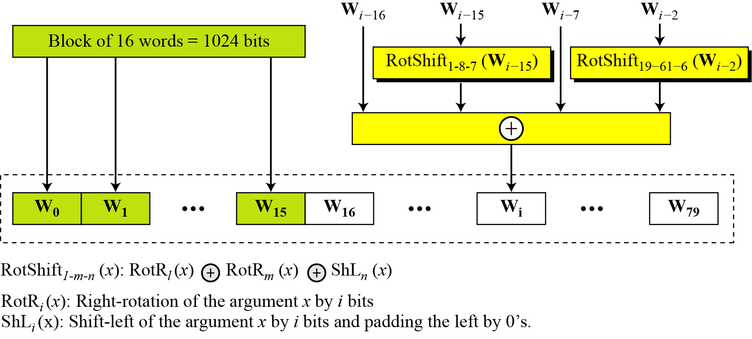
SHA-512 Overview Contd..
Word expansion in SHA-512
12.<number>

Slide 26
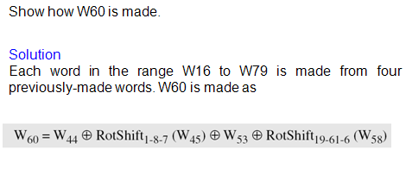
Example
Notes:
Now examine the structure of SHA-512, noting that the other versions are quite similar.
SHA-512 follows the structure depicted in Stallings Figure 12.1. The processing consists of the following steps:
• Step 1: Append padding bits
• Step 2: Append length
• Step 3: Initialize hash buffer
• Step 4: Process the message in 1024-bit (128-word) blocks, which forms the heart of the algorithm
• Step 5: Output the final state value as the resulting hash
See text for details.

Slide 27
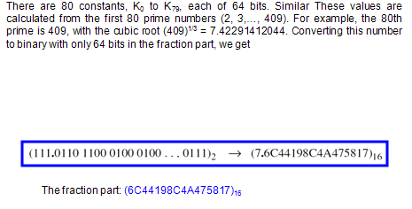
Additive Constants
Notes:
Now examine the structure of SHA-512, noting that the other versions are quite similar.
SHA-512 follows the structure depicted in Stallings Figure 12.1. The processing consists of the following steps:
• Step 1: Append padding bits
• Step 2: Append length
• Step 3: Initialize hash buffer
• Step 4: Process the message in 1024-bit (128-word) blocks, which forms the heart of the algorithm
• Step 5: Output the final state value as the resulting hash
See text for details.

Slide 28
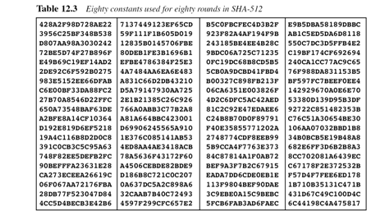
Contd..
Notes:
Now examine the structure of SHA-512, noting that the other versions are quite similar.
SHA-512 follows the structure depicted in Stallings Figure 12.1. The processing consists of the following steps:
• Step 1: Append padding bits
• Step 2: Append length
• Step 3: Initialize hash buffer
• Step 4: Process the message in 1024-bit (128-word) blocks, which forms the heart of the algorithm
• Step 5: Output the final state value as the resulting hash
See text for details.

Slide 29
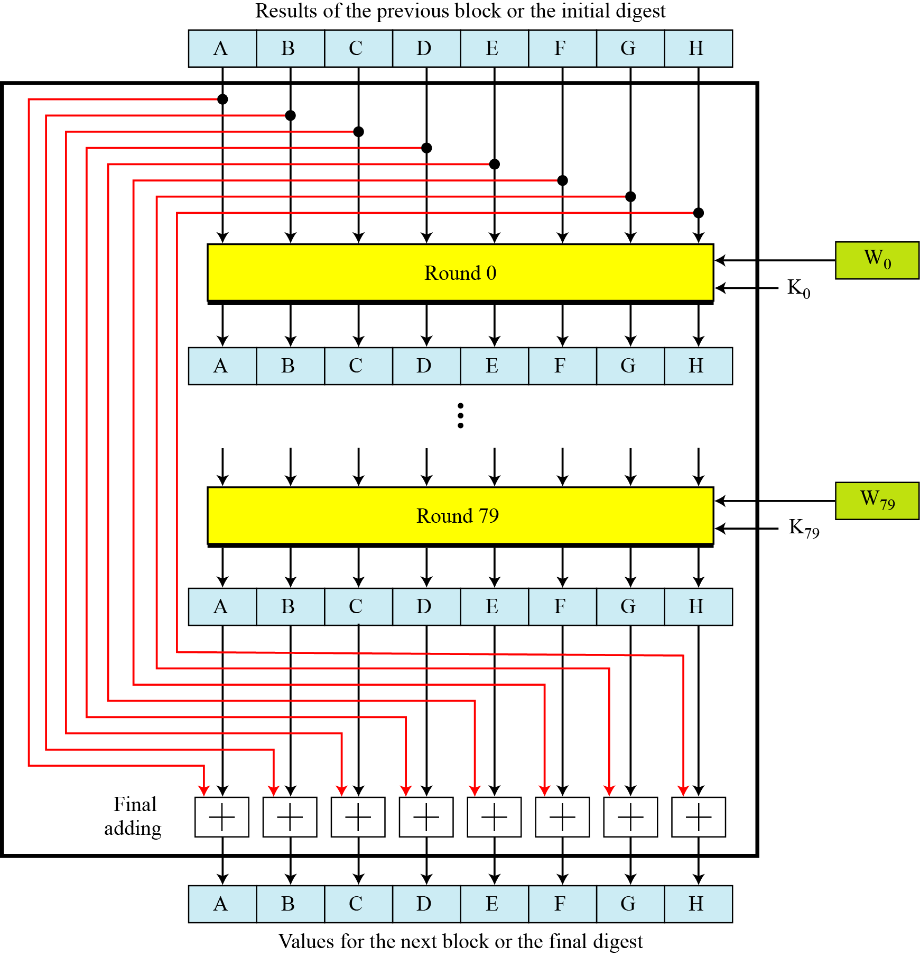
Compression function in SHA-512
12.<number>

Slide 30
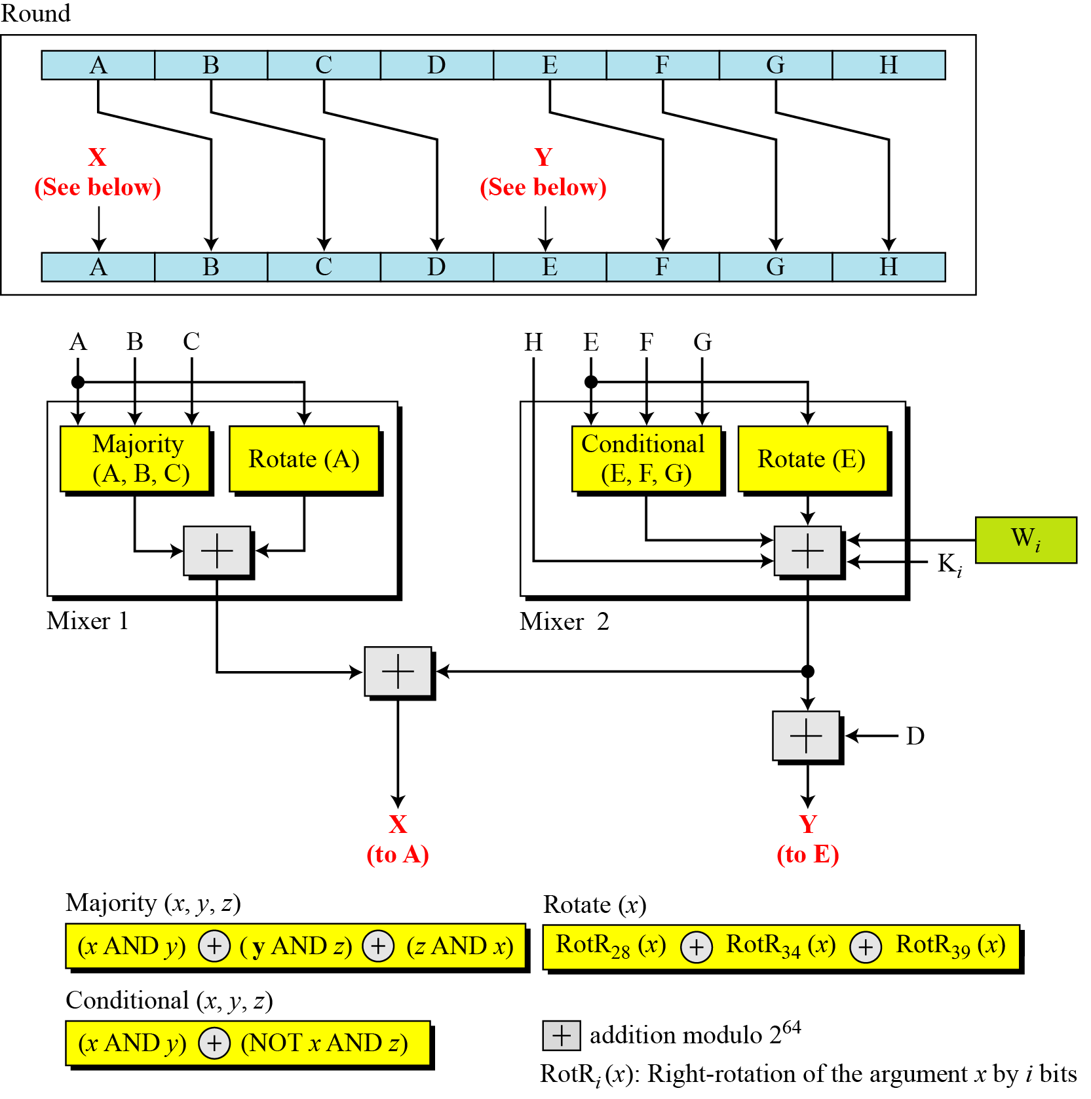
Structure of each round in SHA-512
12.<number>

Slide 31
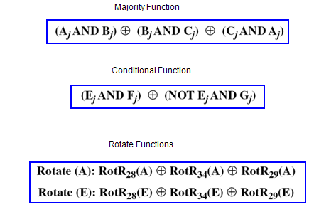
Contd..
Notes:
Now examine the structure of SHA-512, noting that the other versions are quite similar.
SHA-512 follows the structure depicted in Stallings Figure 12.1. The processing consists of the following steps:
• Step 1: Append padding bits
• Step 2: Append length
• Step 3: Initialize hash buffer
• Step 4: Process the message in 1024-bit (128-word) blocks, which forms the heart of the algorithm
• Step 5: Output the final state value as the resulting hash
See text for details.

Slide 32
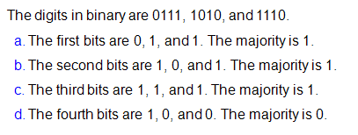
Examples
Notes:
Now examine the structure of SHA-512, noting that the other versions are quite similar.
SHA-512 follows the structure depicted in Stallings Figure 12.1. The processing consists of the following steps:
• Step 1: Append padding bits
• Step 2: Append length
• Step 3: Initialize hash buffer
• Step 4: Process the message in 1024-bit (128-word) blocks, which forms the heart of the algorithm
• Step 5: Output the final state value as the resulting hash
See text for details.

