Slide 1
Hash Function
Notes:
Opening quote.

Slide 2
Hash Function
A cryptographic hash function accepts a message of any length and generates a message digest of fixed length.
  h = H(M)
  A variable-length message M to a fixed-sized fingerprint
h
Notes:
A variation on the message authentication code is the one-way hash function. As with the message authentication code, a hash function accepts a variable-size message M as input and produces a fixed-size output, referred to as a hash code H(M). Unlike a MAC, a hash code does not use a key but is a function only of the input message. The hash code is also referred to as a message digest or hash value.

Slide 3
Conditions for Hash Functions
It can be applied to any length message M
Generates fixed-length output h
It is easy to compute h=H(M) for any message M
Given h, it is impractical to find x s.t. H(x)=h
  one-way property or preimage resistant
Given x is impractical to find y s.t. H(y)=H(x)
  weak collision resistance or Second preimage resistant
It is impractical to find any x,y s.t. H(y)=H(x)
  strong collision resistance

Slide 4
Random Oracle Model
A function based on this model behaves as follows:
  When a new message of any length is given , the oracle creates and gives a fixed length message digest that is a random string of 0s and 1s. The oracle records the message and the message digest.
  When a message is given for which a digest exists, the oracle simply gives the digest in the record.
  The digest for a new message needs to be chosen independently form all previous digests. This implies that the oracle cannot use a formula or an algorithm to calculate the digest.
Notes:
Up untill now, have been concerned with protecting message content (ie secrecy) by encrypting the message. Will now consider how to protect message integrity (ie protection from modification), as well as confirming the identity of the sender. Generically this is the problem of message authentication, and in eCommerce applications is arguably more important than secrecy. Message Authentication is concerned with: protecting the integrity of a message, validating identity of originator, & non-repudiation of origin (dispute resolution). There are three types of functions that may be used to produce an authenticator: message encryption, message authentication code (MAC), or a hash function.

Slide 5
Pigeonhole Principle
If m pigeonholes are occupied by m+1 pigeons, then at least one pigeonhole is occupied by two pigeons.
  Assume that the message in a hash function are 4 bit long and the digest are only 2 bits long...........
Notes:
Up untill now, have been concerned with protecting message content (ie secrecy) by encrypting the message. Will now consider how to protect message integrity (ie protection from modification), as well as confirming the identity of the sender. Generically this is the problem of message authentication, and in eCommerce applications is arguably more important than secrecy. Message Authentication is concerned with: protecting the integrity of a message, validating identity of originator, & non-repudiation of origin (dispute resolution). There are three types of functions that may be used to produce an authenticator: message encryption, message authentication code (MAC), or a hash function.

Slide 6
Four Birthday problem
Ref: Cryptography & Network Security by Behrouz A. Forouzan
Taylor’s series when x is small
1-x ≈e^(-x)
1+2+⋯+(k-1)=k(k-1)/2
k(k-1)≈ k^2
Notes:
All hash functions operate using the following general principles. The input (message, file,etc.) is viewed as a sequence of n-bit blocks, processed one block at a time in an iterative fashion to produce an n-bit hash function. Can construct a range of possible simple hash functions by just XOR’ing blocks with rotates etc. None of these are secure, since can predict how changes to message affect the resulting hash.

Slide 7
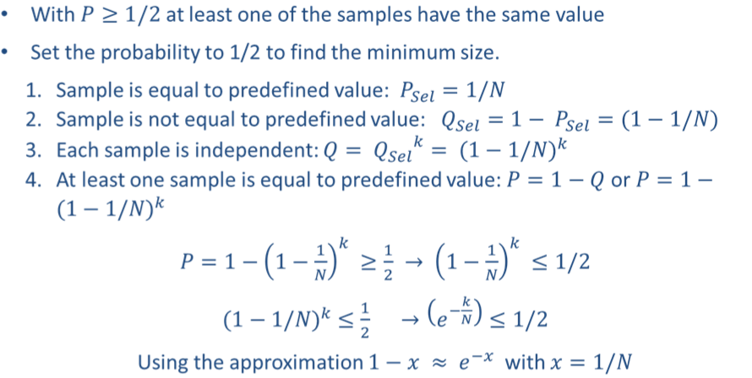
1st Problem
K>= Log 2* N
Notes:
All hash functions operate using the following general principles. The input (message, file,etc.) is viewed as a sequence of n-bit blocks, processed one block at a time in an iterative fashion to produce an n-bit hash function. Can construct a range of possible simple hash functions by just XOR’ing blocks with rotates etc. None of these are secure, since can predict how changes to message affect the resulting hash.

Slide 8
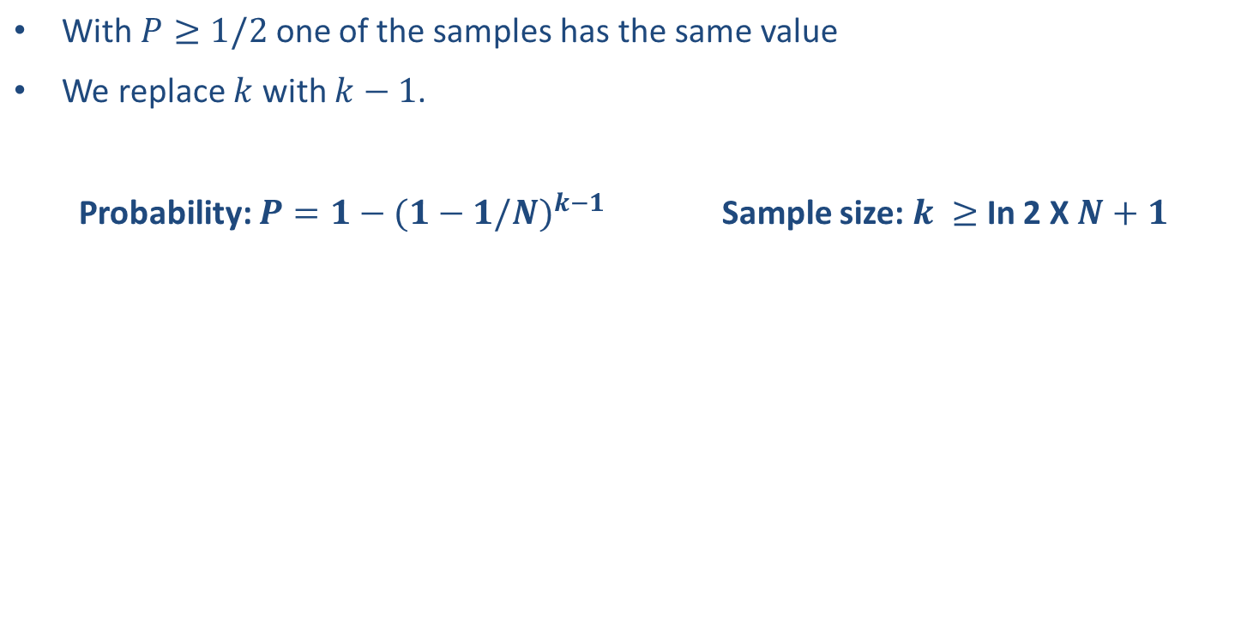
2nd Problem
Notes:
All hash functions operate using the following general principles. The input (message, file,etc.) is viewed as a sequence of n-bit blocks, processed one block at a time in an iterative fashion to produce an n-bit hash function. Can construct a range of possible simple hash functions by just XOR’ing blocks with rotates etc. None of these are secure, since can predict how changes to message affect the resulting hash.

Slide 9
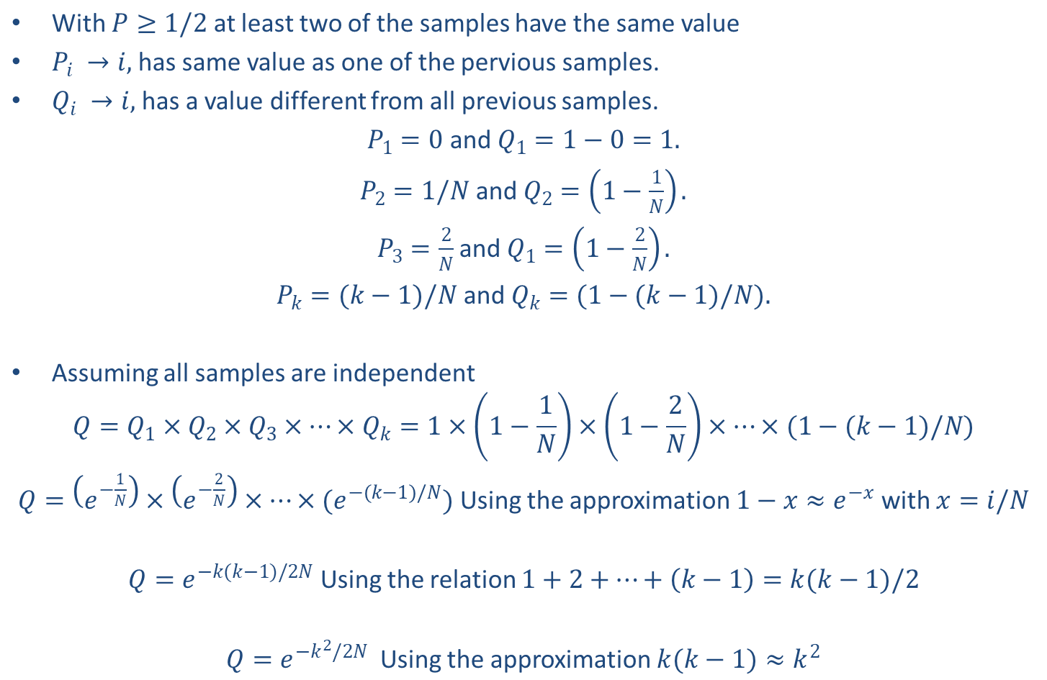
3rd Problem
Notes:
All hash functions operate using the following general principles. The input (message, file,etc.) is viewed as a sequence of n-bit blocks, processed one block at a time in an iterative fashion to produce an n-bit hash function. Can construct a range of possible simple hash functions by just XOR’ing blocks with rotates etc. None of these are secure, since can predict how changes to message affect the resulting hash.

Slide 10
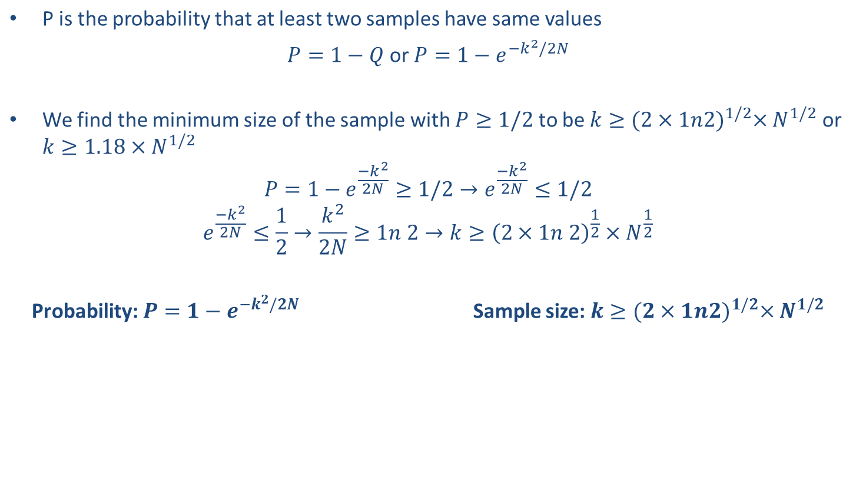
Contin…
Notes:
All hash functions operate using the following general principles. The input (message, file,etc.) is viewed as a sequence of n-bit blocks, processed one block at a time in an iterative fashion to produce an n-bit hash function. Can construct a range of possible simple hash functions by just XOR’ing blocks with rotates etc. None of these are secure, since can predict how changes to message affect the resulting hash.

Slide 11
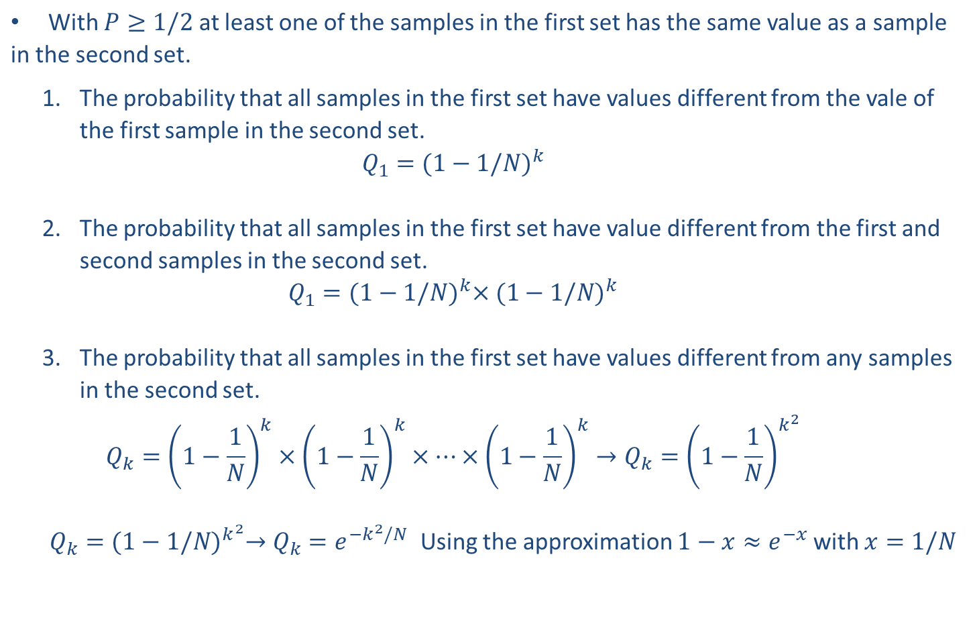
4th Problem
Notes:
All hash functions operate using the following general principles. The input (message, file,etc.) is viewed as a sequence of n-bit blocks, processed one block at a time in an iterative fashion to produce an n-bit hash function. Can construct a range of possible simple hash functions by just XOR’ing blocks with rotates etc. None of these are secure, since can predict how changes to message affect the resulting hash.

Slide 12
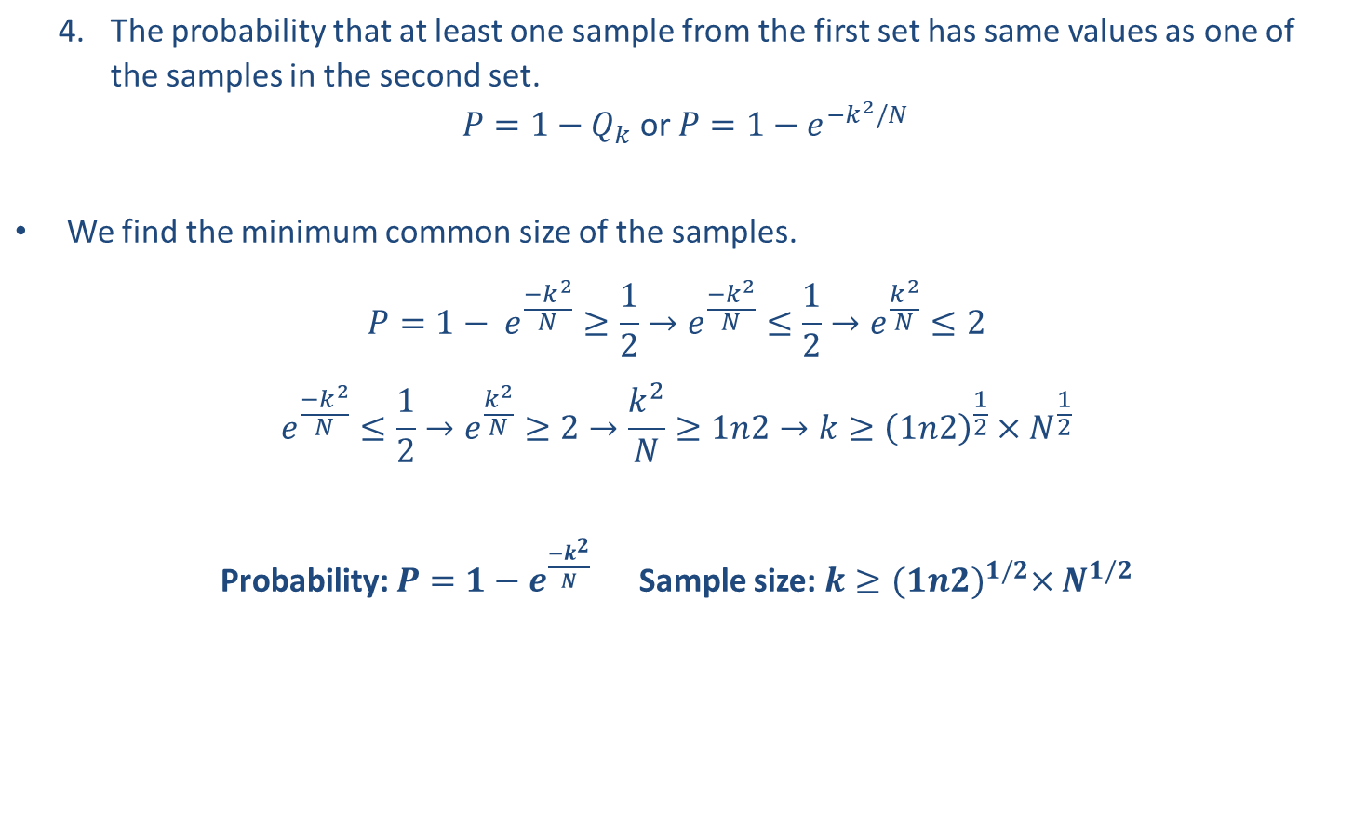
Contin…
Notes:
All hash functions operate using the following general principles. The input (message, file,etc.) is viewed as a sequence of n-bit blocks, processed one block at a time in an iterative fashion to produce an n-bit hash function. Can construct a range of possible simple hash functions by just XOR’ing blocks with rotates etc. None of these are secure, since can predict how changes to message affect the resulting hash.

Slide 13
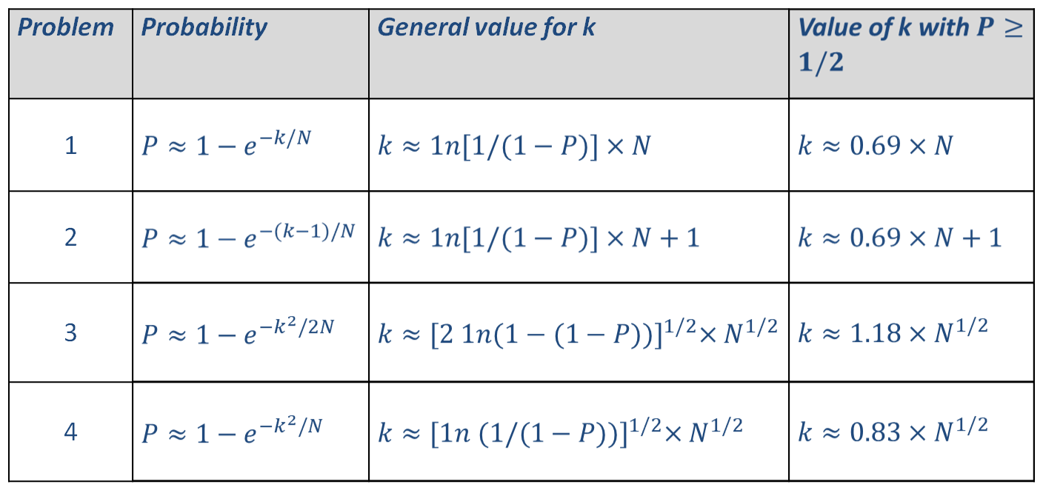
Summary
Notes:
All hash functions operate using the following general principles. The input (message, file,etc.) is viewed as a sequence of n-bit blocks, processed one block at a time in an iterative fashion to produce an n-bit hash function. Can construct a range of possible simple hash functions by just XOR’ing blocks with rotates etc. None of these are secure, since can predict how changes to message affect the resulting hash.

Slide 14
Birthday attack
Birthday attack works thus
conclusion is that need to use larger hash
Notes:
All hash functions operate using the following general principles. The input (message, file,etc.) is viewed as a sequence of n-bit blocks, processed one block at a time in an iterative fashion to produce an n-bit hash function. Can construct a range of possible simple hash functions by just XOR’ing blocks with rotates etc. None of these are secure, since can predict how changes to message affect the resulting hash.

Slide 15
Hash Algorithms Contd..
Hash Functions
  Instead of using a hash function with variable-size input, a function with fixed-size input is created
  Processing of message in blocks
Notes:
Now look at important examples of both secure hash functions and message authentication codes (MACs).
Traditionally, most hash functions that have achieved widespread use rely on a compression function specifically designed for the hash function. Another approach is to use a symmetric block cipher as the compression function.
MACs also fall into two categories: some use a hash algorithm such as SHA as the core of the MAC algorithm, others use a symmetric block cipher in a cipher block chaining mode.

Slide 16
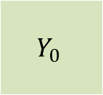
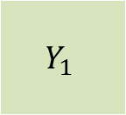
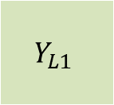




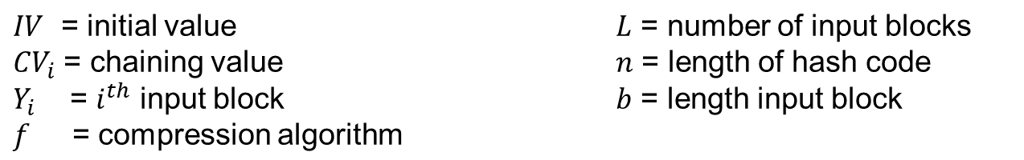
Hash Algorithm Structure
Ref: William Staling
b
b
b
f
f
f
n
n
n
n
n

Slide 17
Hash Algorithms Contd..
  The message length and padding are appended to the message to generate an expanded message that can be divided into blocks of n bits
  n is the size of the block
  The message is as m blocks, each of n bits
  Digest created at m iterations H₁, H₂,..............H_{k}
  Initial Vector : The digest H₀ is set to a fixed value, called ‘Initial Vector’ (before starting the iteration).
Notes:
Now look at important examples of both secure hash functions and message authentication codes (MACs).
Traditionally, most hash functions that have achieved widespread use rely on a compression function specifically designed for the hash function. Another approach is to use a symmetric block cipher as the compression function.
MACs also fall into two categories: some use a hash algorithm such as SHA as the core of the MAC algorithm, others use a symmetric block cipher in a cipher block chaining mode.

Slide 18
Hash Algorithms Contd..
The compression function at each iteration works on H_{i-1} and M_{i} to create a new H_{i}. In other words, we have H_{i} = f(H_{i-1}, M_{i}), where f is the compression function.
H_{k} is the hash function of the original message, i.e. H(M)
Notes:
Now look at important examples of both secure hash functions and message authentication codes (MACs).
Traditionally, most hash functions that have achieved widespread use rely on a compression function specifically designed for the hash function. Another approach is to use a symmetric block cipher as the compression function.
MACs also fall into two categories: some use a hash algorithm such as SHA as the core of the MAC algorithm, others use a symmetric block cipher in a cipher block chaining mode.

Slide 19
SHA-512
SHA-512
Generate a 512-bit message digest
Size of each message block is 1024 bits
Notes:
Now look at important examples of both secure hash functions and message authentication codes (MACs).
Traditionally, most hash functions that have achieved widespread use rely on a compression function specifically designed for the hash function. Another approach is to use a symmetric block cipher as the compression function.
MACs also fall into two categories: some use a hash algorithm such as SHA as the core of the MAC algorithm, others use a symmetric block cipher in a cipher block chaining mode.

Slide 20








SHA-512 Overview
Ref: William Stalling
N x 1024 bits
L bits
128 bits
Message
10000…00
L
1024 bits
1024 bits
…
1024 bits
F
F
F
…
+
+
+
Hash Code

Slide 21
SHA-512 Compression Function
Message is processed in 1024-bit blocks
Made up of 80 rounds
  Refresh a 512-bit buffer
  Utilize a 64-bit value, obtained from the current message block
  and a round constant, computed from cube root of first 80 prime numbers
Notes:
The SHA-512 Compression Function is the heart of the algorithm. In this Step 4, it processes the message in 1024-bit (128-word) blocks, using a module that consists of 80 rounds, labeled F in Stallings Figure 12, as shown in Figure 12.2. Each round takes as input the 512-bit buffer value, and updates the contents of the buffer. Each round t makes use of a 64-bit value Wt derived using a message schedule from the current 1024-bit block being processed. Each round also makes use of an additive constant Kt, based on the fractional parts of the cube roots of the first eighty prime numbers. The output of the eightieth round is added to the input to the first round to produce the final hash value for this message block, which forms the input to the next iteration of this compression function, as shown on the previous slide.

Slide 22
Contd..
Ref Ref: Cryptography & Network Security by Behrouz A. Forouzan
A message block and the digest as words
16 words, each of 64 bits=1024 bits
Message block
8 words, each of 64 bits=512 bits
Message digest
Notes:
Now examine the structure of SHA-512, noting that the other versions are quite similar.
SHA-512 follows the structure depicted in Stallings Figure 12.1. The processing consists of the following steps:
• Step 1: Append padding bits
• Step 2: Append length
• Step 3: Initialize hash buffer
• Step 4: Process the message in 1024-bit (128-word) blocks, which forms the heart of the algorithm
• Step 5: Output the final state value as the resulting hash
See text for details.

Slide 23
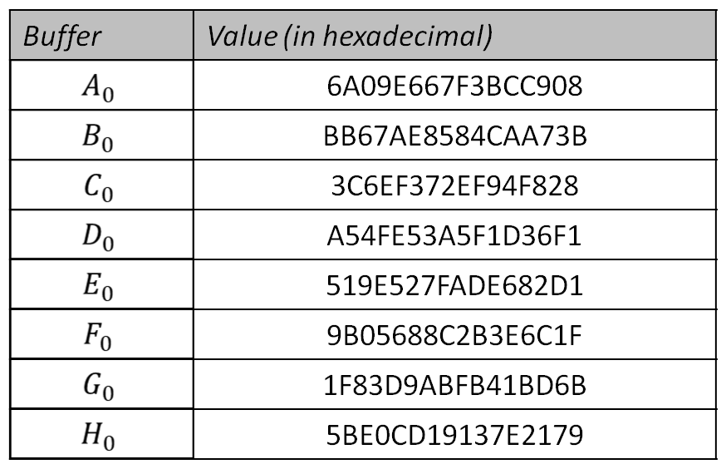
SHA-512 Overview Contd..
Message Digest Initialization
Values of constants in message digest initialization of SHA-512
Notes:
Now examine the structure of SHA-512, noting that the other versions are quite similar.
SHA-512 follows the structure depicted in Stallings Figure 12.1. The processing consists of the following steps:
• Step 1: Append padding bits
• Step 2: Append length
• Step 3: Initialize hash buffer
• Step 4: Process the message in 1024-bit (128-word) blocks, which forms the heart of the algorithm
• Step 5: Output the final state value as the resulting hash
See text for details.

Slide 24
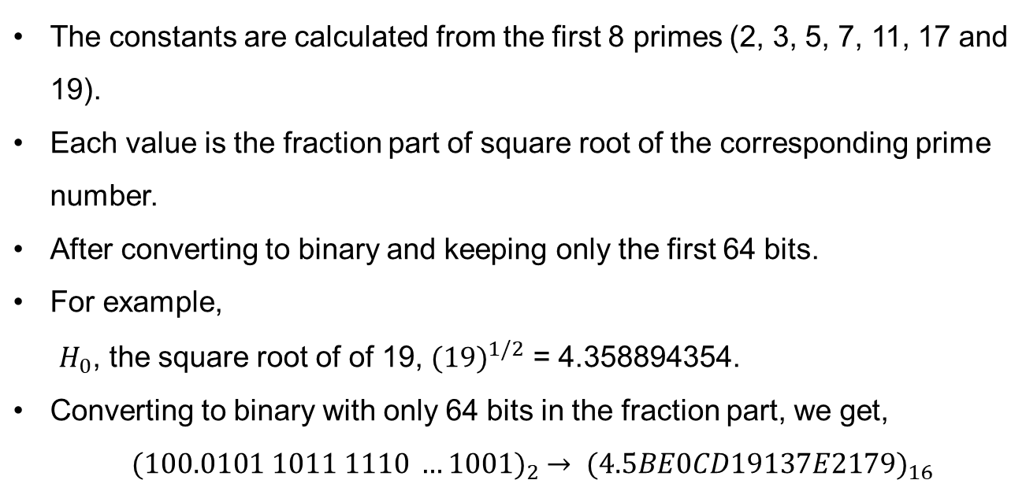
Message Digest Initialization
Notes:
Now examine the structure of SHA-512, noting that the other versions are quite similar.
SHA-512 follows the structure depicted in Stallings Figure 12.1. The processing consists of the following steps:
• Step 1: Append padding bits
• Step 2: Append length
• Step 3: Initialize hash buffer
• Step 4: Process the message in 1024-bit (128-word) blocks, which forms the heart of the algorithm
• Step 5: Output the final state value as the resulting hash
See text for details.

Slide 25












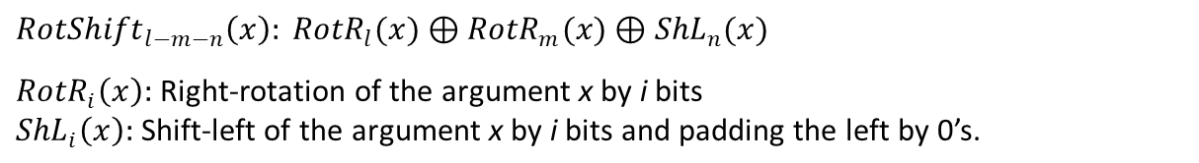
SHA-512 Overview Contd..
Ref: Cryptography & Network Security by Behrouz A. Forouzan
Word expansion in SHA-512
Block of 16 words = 1024 bits
XOR
…
…
…

Slide 26
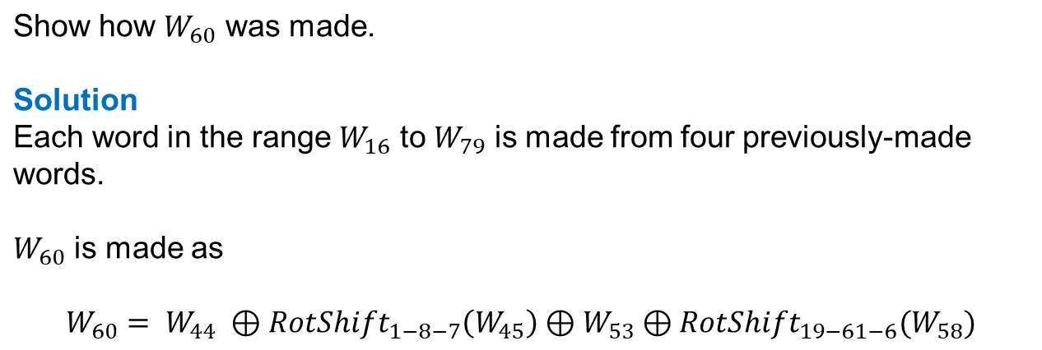
Example
Ref: Cryptography & Network Security by Behrouz A. Forouzan
Notes:
Now examine the structure of SHA-512, noting that the other versions are quite similar.
SHA-512 follows the structure depicted in Stallings Figure 12.1. The processing consists of the following steps:
• Step 1: Append padding bits
• Step 2: Append length
• Step 3: Initialize hash buffer
• Step 4: Process the message in 1024-bit (128-word) blocks, which forms the heart of the algorithm
• Step 5: Output the final state value as the resulting hash
See text for details.

Slide 27
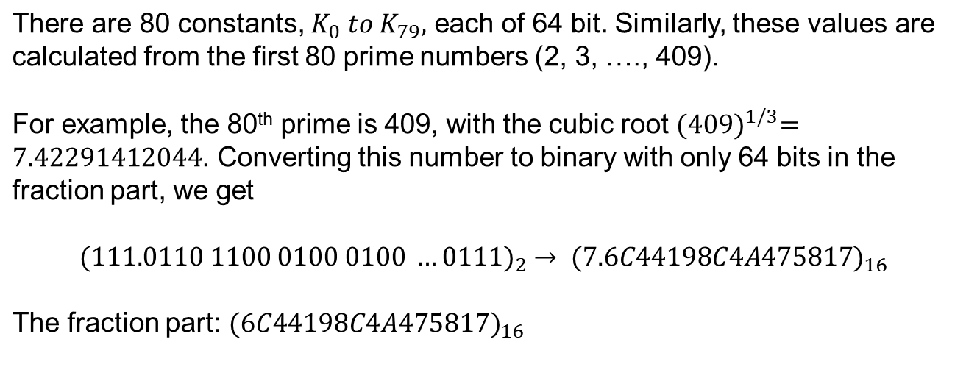
Additive Constants
Notes:
Now examine the structure of SHA-512, noting that the other versions are quite similar.
SHA-512 follows the structure depicted in Stallings Figure 12.1. The processing consists of the following steps:
• Step 1: Append padding bits
• Step 2: Append length
• Step 3: Initialize hash buffer
• Step 4: Process the message in 1024-bit (128-word) blocks, which forms the heart of the algorithm
• Step 5: Output the final state value as the resulting hash
See text for details.

Slide 28












Compression function in SHA-512
Result from the previous block or the initial digest
A B C D E F G H
Round 0
A B C D E F G H
A B C D E F G H
Round 79
Final adding
Final digest

Slide 29


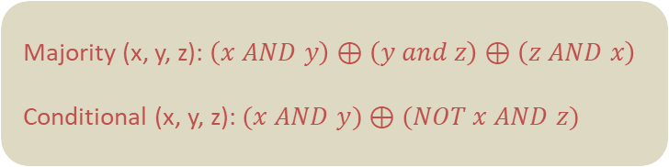
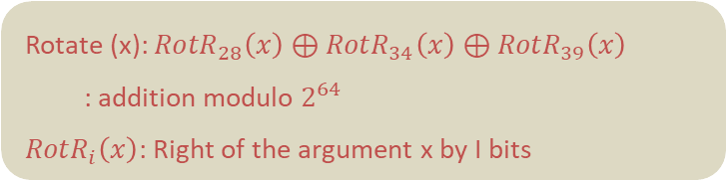
Structure of each round in SHA-512
Round
A | B | C | D | E | F | G | H
x
y
A | B | C | D | E | F | G | H
A B C
H E F G
Majority
(A, B, C)
Rotate (A)
Conditional
(E, F, G)
Rotate (E)
+
+
Mixer 1
Mixer 2
+
+
D
x
(to A)
y
(to A)
+

Slide 30
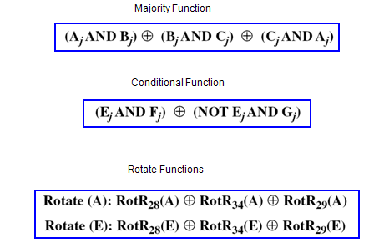
Contd..
Notes:
Now examine the structure of SHA-512, noting that the other versions are quite similar.
SHA-512 follows the structure depicted in Stallings Figure 12.1. The processing consists of the following steps:
• Step 1: Append padding bits
• Step 2: Append length
• Step 3: Initialize hash buffer
• Step 4: Process the message in 1024-bit (128-word) blocks, which forms the heart of the algorithm
• Step 5: Output the final state value as the resulting hash
See text for details.

Slide 31
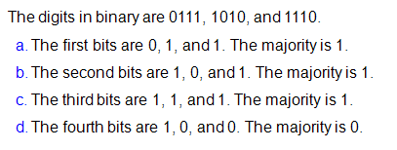
Examples
Notes:
Now examine the structure of SHA-512, noting that the other versions are quite similar.
SHA-512 follows the structure depicted in Stallings Figure 12.1. The processing consists of the following steps:
• Step 1: Append padding bits
• Step 2: Append length
• Step 3: Initialize hash buffer
• Step 4: Process the message in 1024-bit (128-word) blocks, which forms the heart of the algorithm
• Step 5: Output the final state value as the resulting hash
See text for details.

