Slide 1

Notes:
Lecture slides by Lawrie Brown for “Cryptography and Network Security”, 4/e, by William Stallings, Chapter 1 “Introduction”.

Slide 2

“Cryptography & Network Security” by William Stallings, Pearson Education Asia.
“Cryptography and Network Security” by Behrouz A. Forouzan, Mc Graw Hill.
“Introduction to Cryptography with Coding Theory” by Wade Trappe & Lawrence C Washington, Pearson.

Slide 3

To introduce prime numbers
To introduce Congruence
To introduce CRT
To introduce Fermat's & Euler’s Theorem
To introduce finite fields
To introduce discrete logarithms

Slide 4

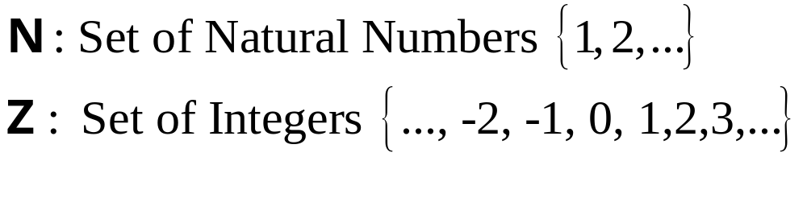
Notes:
Here are some key definitions, note boundaries between them are blurred.

Slide 5
Divisibility
Def^{n}: a, b integers, a≠0, then a divides b if there is an integer k such that b=ak. If a divides b then a is called divisor of b and relation is expressed symbolically as a|b.
^{Example : 3|48} as 48=3 ×16 .
If a|b and a|c, then a|(b+c)

Slide 6

Asymmetric-key cryptography uses primes extensively.
Def^{n}: An integer p ≥ 2 is called Prime if and only if it is divisible only by 1 and by itself (that is it has no proper factors) (its only divisors/factors are ±1 and ±p).
Example: The smallest prime is 2, which is divisible by ±2 (itself) and ±1 .
Example:
List the primes smaller than 10.
There are four primes less than 10: 2, 3, 5, and 7.
Note: By convention, the number 1 is neither Prime nor Composite.
Notes:
Here are some key definitions, note boundaries between them are blurred.

Slide 7

Every integer n >= 2 has a factorization as a product of primes:
i.e. n = p₁^{a1}p₂^{a2} _ _ _ p_{k}^{ak}
where the p_{i} are distinct primes in increasing order, and the a_{i} positive integers.
Example: 504= 2^{3 *}3^{2 *} 7

Slide 8

Greatest Common Divisor (GCD) of n numbers a₁,a₂,…,a_{n} is the largest positive divisor of a₁,a₂,…,a_{n.}
Example: GCD of 12,30,72,120 is 6, symbolically GCD of 12,30,72,120 is written as gcd(12,30,72,120).
Find gcd(28, 952) (Euclidean algorithm is used for finding the gcd of 2 large integers)

Slide 9

gcd(a,0)= a
gcd(a,b)=gcd(b,a)
gcd(a,ka)= a
…..

Slide 10

Ex: gcd (6,4) = 2
gcd ( 24,60) = 12
Def^{n}: Two integers a and b are said to be relatively Prime (co-prime) if gcd (a,b)=1
Ex: 9 & 28 are relatively prime.

Slide 11

The Euclidean Algorithm is a method developed by the Greek mathematician Euclid that finds the greatest common divisor of two positive integers. We begin with two numbers, say a and b, where a is greater than b. We divide a by b and get remainder r. We then divide b by r, to get new remainder t. We continue in this manner until the remainder is either one or zero. If the remainder is one, then the two numbers are relatively prime, so their greatest common divisor is one. However, if the remainder is zero, the greatest common divisor would be the remainder before the zero.

Slide 12

Use to compute GCD
Based on following theorem: gcd(a, b) = gcd (b, a mod b)
Example: Find gcd( 19,8)
19 = 2 * 8 + 3
8 = 2*3 + 2 (take the remainder 3 and divide it into 8)
3 = 1* 2 + 1→ gcd( 19,8)
2= 2*1+0
Answer: gcd(19,8)=1
Example GCD of 2740 and 1760 ?

Slide 13

If a and b are positive integers, then there are always integers m and n so that the gcd of a and b equals ma+nb.
ma + nb = gcd(a, b)
The extended Euclidean algorithm can calculate the gcd (a, b) and at the same time calculate the value of m and n.

Slide 14
If gcd(a,b)=1 this solves the problem of computing modular inverses.
Observation : The extended Euclidean algorithm gcd(a, b)= ma+ nb is
particularly useful when a and b are coprime, since then m is the multiplicative inverse of a modulo b, and n is the multiplicative inverse
of b modulo a.

Slide 15
Find the inverse of 8 mod 19:
19 = 2 * 8 + 3
8 = 2*3 + 2 (take the remainder 3 and divide it into 8)
3 = 1* 2 + 1→ gcd( 19,8)
2= 2*1+0
(Last non-zero remainder is gcd(19,8)). The quotients are underlined.
Steps for finding inverse : Start this with two rows:
1 0 and, underneath it, 0 1

Slide 16
0 1 (multiply the second row by our first quotient, two, and subtract it from the previous row to get next row)
Next row: 1 -2 (multiply this by our second quotient, two, and subtract it from the previous row to get next row)
Next row: -2 5 (multiply this by our third quotient, one, and subtract it from the previous row to get next row)
Next row: 3 -7, this means that
3 * 19 +(– 7) * 8 = 1
We take this mod 19, to obtain 0 – 7 * 8 = 1. Thus, the inverse of 8 is (-7) mod 19 = 12

Slide 17
Find the inverse of 20( mod 97).
Solution: 97= 20*4+17
20=17*1+3
17=3*5+2
3=2*1+1→gcd(97, 20)
2=2*1+0
Last non-zero remainder (i.e., 1) is the gcd(97,20). Quotients of each step are underlined.

Slide 18
Compute inverse as
1 0
0 1
1 -4
-1 5
6 -29
-7 34
Hence,
(-7) × 97 + 34 × 20=1
Since there are 4 steps (quotients),
3rd row = 2nd row × first quotient - 1st row.
4th row= 3rd row × second quotient – 2nd row.
Similarly…..
6th row= 5th row × fourth quotient – 4th row.

