Slide 1

Contd…
Notes:
Lecture slides by Lawrie Brown for “Cryptography and Network Security”, 4/e, by William Stallings, Chapter 1 “Introduction”.

Slide 2
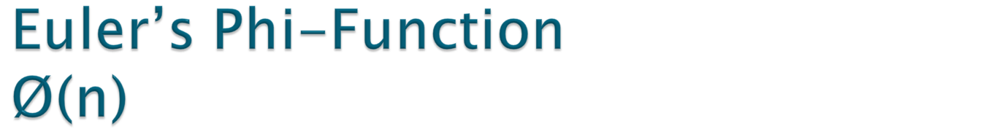
Euler’s Phi-Function of positive integer n, is denoted by Ø(n), which is equal to the number of positive integers less than n and relatively prime to n.

Slide 3

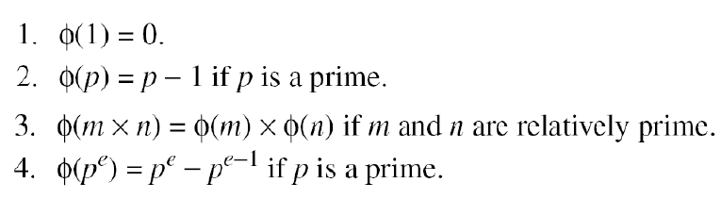

Slide 4

Note: We can also combine the rules to find Ø(n)
What is the value of Ø (13)?
We can use the third rule: Ø (10) = Ø (2) × Ø (5) = 1 × 4 = 4, because 2 and 5 are primes.
Ø(49)…..?

Slide 5

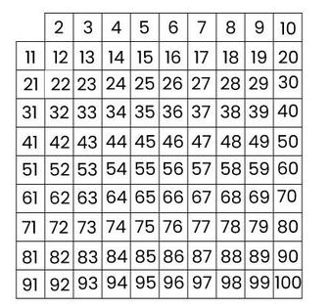
Goal: Given a number n, print all primes smaller than or equal to n.
Suppose we want to find all primes less than 100.
Compute square root of 100 = 10
We need to see if any number less than 100 is divisible by 2,3,3,5 and 7
We create a list of all numbers from 2 to 100

Slide 6
Sieve process is as follows:
Cross out all numbers divisible by 2 ( except 2 itself)
Cross out all numbers divisible by 3 ( except 3 itself)
Cross out all numbers divisible by 5 ( except 5 itself)
Cross out all numbers divisible by 7 ( except 7 itself)
The numbers left over are primes.

Slide 7

For a positive integer n, two integers ‘a’ & ‘b’ are said to be congruent modulo ‘n’, written:
a ≡ b mod n
If they leaves the same remainder when divided by n.
Notes:
The OSI security architecture focuses on security attacks,mechanisms,and services. These can be defined briefly as follows:
• Security attack: Any action that compromises the security of information owned by an organization.
• Security mechanism: A process (or a device incorporating such a process) that is designed to detect, prevent,or recover from a security attack.
• Security service: A processing or communication service that enhances the security of the data processing systems and the information transfers of an organization.The services are intended to counter security attacks, and they make use of one or more security mechanisms to provide the service.

Slide 8
Note: The set consisting of the integers congruent to ‘a’ modulo ‘n’, is called the congruence class or residue class of ‘a’ modulo n.
Denotes by Z_{n}
Congurence operator maps a member of Z to a member of Z_{n}

Slide 9

∀ a, b, a₁, b₁, c ∈ Ζ following are true
(reflexivity) a ≡ a(mod n) ;
(symmetry) if a ≡b (mod n) , then b ≡a (mod n) ;
(transitivity) if a ≡b (mod n) and b ≡c (mod n) then a ≡c (mod n) ;

Slide 10

Find 7²⁹ (mod 17)
Sol: 7¹ (mod 17) = 7
7² (mod 17) ≡ 49 (mod 17) =15
7⁴ (mod 17) ≡ 7² * 7² (mod 17) ≡ 15 * 15 (mod 17) = 4
7⁸ (mod 17) ≡ 7⁴ * 7⁴ (mod 17) ≡ 4*4 (mod 17) = 16
7¹⁶ (mod 17) ≡ 7⁸ * 7⁸ (mod 17) ≡ 16*16 (mod 17) = 1
Then, 7²⁹ (mod 17) ≡ 7¹⁶ * 7⁸ * 7⁴ * 7¹ (mod 17) ≡ 1 * 16 * 4 * 7 (mod 17) ≡ 448 (mod 17) = 6.

Slide 11

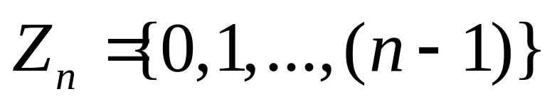
Define the set Z_{n} as the set of nonnegative integers less than n:
This set is referred to as the set of residues, or residue classes (mod n). That is, each integer in Z_{n} represents a residue class.

Slide 12

Definition : An integer b is an additive inverse to a modulo n,
if a+b ≡ 0 (mod n).
In Z_{n} every integer will have a unique additive inverse modulo n.

Slide 13

+ | 0 | 1 | 2 | 3
0 | 0 | 1 | 2 | 3
1 | 1 | 2 | 3 | 0
2 | 2 | 3 | 0 | 1
3 | 3 | 0 | 1 | 2
Additive inverse of 1 is 3
Additive inverse of 2 is 2
Additive inverse of 3 is 1
Each element has a additive inverse

Slide 14

Definition : An integer x is a (multiplicative) inverse to a modulo n,
if a.x ≡ 1(mod n)
and we denote x by a^{-1.}
Example: Find the multiplicative inverse of 14 modulo 9
Sol: Find an integer x in Z₉ such that
14.x ≡ 1(mod 9)
since 14.2 = 28 ≡ 1(mod 9), 2 is the multiplicative inverse of 14 modulo 9.

Slide 15

There is no multiplicative inverse to 2 (mod 4).
Suppose a and n are integers and n> 1. Then a has an inverse modulo n if and only if gcd(a, n) = 1. Moreover, if gcd(a, n) = 1, then a has a unique inverse, x in Z_{n}.

Slide 16

2 has no inverse in Z₄
^{( 2 has no inverse modulo 4)}
Inverse of 1 is 1
Inverse of 3 is 3
* | 0 | 1 | 2 | 3
0 | 0 | 0 | 0 | 0
1 | 0 | 1 | 2 | 3
2 | 0 | 2 | 0 | 2
3 | 0 | 3 | 2 | 1

Slide 17

Every non zero element of Z₅ has inverse in Z_{5,}
Inverse of 2 is 3, inverse of 3 is 2, inverse of 4 is 4.
* | 0 | 1 | 2 | 3 | 4
0 | 0 | 0 | 0 | 0 | 0
1 | 0 | 1 | 2 | 3 | 4
2 | 0 | 2 | 4 | 1 | 3
3 | 0 | 3 | 1 | 4 | 2
4 | 0 | 4 | 3 | 2 | 1

Slide 18

  The numbers that have inverses in Z_{n} are relatively prime to n
  That is: gcd(x, n) = 1
If n is a prime number than every non zero element of Z_{n} will have a unique inverse in Z_{n}.
Few More Sets......... Z_{P,} Z_{n}*, Z_{P}*

