Slide 1
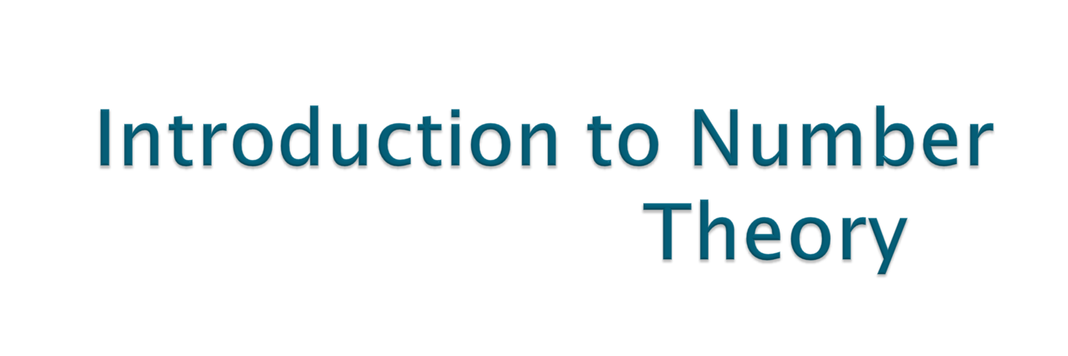
Contd..
Notes:
Lecture slides by Lawrie Brown for “Cryptography and Network Security”, 4/e, by William Stallings, Chapter 1 “Introduction”.

Slide 2

Computing inverse in modulo n arithmetic is not as straight forward as in elementary arithmetic.
Following approaches are possible to compute inverse modulo n :
1. Brute-force, or trial-and-error method
2. Fermat’s theorem, Euler's theorem, extended Euclidean algorithm may be used to compute modular inverse.

Slide 3

Example 1: Given a=3 and n=7, find the multiplicative inverse of a. By trial-and-error, we can find that the smallest integer which solves the congruence 3x≡1 (mod 7) is 5.
Find multiplicative inverse of 7, 3, 4 under modulo 6?

Slide 4

First Version : If p is prime and a is an integer such that p does not divides a then
a ^{p − 1} ≡ 1 (mod p)
Second Version : If p is prime and a is an integer then
a ^{P} ≡ a (mod p) ⇛ a ≡ a^{p} (mod p)
Application-
Exponentiation and inverse - Quickly finds a solution to some exponentiations and inverses.
Notes:
Expand on definition and use of “security attack”, as detailed above.
See Stallings Table 1.1 for definitions of threat and attack.

Slide 5

Find the result of 6¹⁰ mod 11
We have 6¹⁰ mod 11 = 1. This is the first version of Fermat’s little theorem where p = 11.
Find the result of 3¹² mod 11
Here the exponent (12) and the modulus (11) are not the same

Slide 6

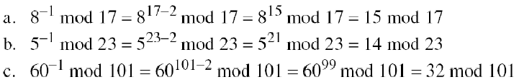
a⁻¹ (mod p) = a ^{p − 2} (mod p) ...if P is prime
The answers to multiplicative inverses modulo a prime can be found without using the extended Euclidean algorithm:

Slide 7



First Version : If a and n are co-prime, then
Second Version : if a<n, and k is any integer, then

Slide 8
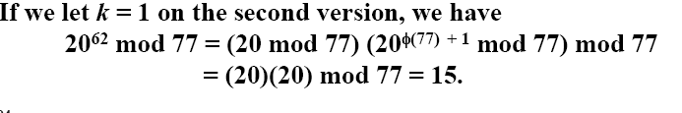
Find the result of 6²⁴ mod 35.
We have 6²⁴ mod 35 = 6 ^{Ø(35)} mod 35 = 1.
Find the result of 20⁶² mod 77

Slide 9
Euler’s theorem can be used to find multiplicative inverses modulo a composite.

Slide 10

Examples:

Slide 11

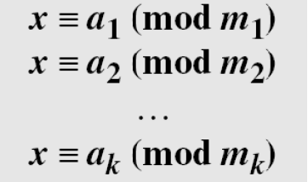
The Chinese remainder theorem (CRT) is used to solve a set of congruent equations with one variable but different moduli, which are relatively prime, as shown
below:

Slide 12

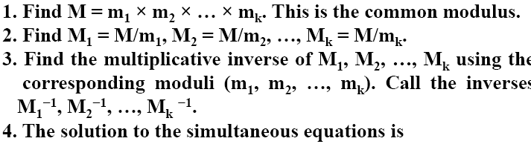

Slide 13

solution to the simultaneous equations:
We follow the steps.
1. M = 3 × 5 × 7 = 105
2. M1 = 105 / 3 = 35, M2 = 105 / 5 = 21, M3 = 105 / 7 = 15 and
3. x = (2 × 35 × 2 + 3 × 21 × 1 + 2 × 15 × 1) mod 105 = 23 mod 105

Slide 14

Solve
x≡1(mod 7), x≡6(mod 22), x≡11(mod13) by Chinese remainder theorem.
Answer: x≡50(mod 2002),

Slide 15

Definition: A non empty set G with an binary operation ‘*’ is said to form a commutative group w.r.t ‘*’ , if
1.) Closure holds in G:
i.e., a*b ∈ G, ∀ a, b ∈ G .
2.) Associativity holds in G:
(a*b)*c= a*(b*c), ∀ a, b, c ∈ G .
3.) Existence of identity element:
∃ an unique element e ∈ G, such that
a*e =e*a=a, ∀ a ∈ G .
4.) Existence of inverse:
∃ b ∈ G, such that a*b=b*a=e, ∀ a ∈ G.

Slide 16

5.) Commutativity holds in G:
a*b= b*a, ∀ a, b ∈ G.
Examples:
1.) Set of integers is a group w.r.t to addition.
2.) Z_{n} is a group w.r.t to addition modulo n. (Ex: Z₁₀
3.) Z_{n} is not a group w.r.t to multiplication modulo n, when n is composite, as all elements don’t have multiplicative inverse. Try for Z₁₀
if encryption define as c=a*b where a is plain text and b is key from Z_{10. than} decryption is…..

Slide 17

For a group G with a finite number of elements, the order of the group is defined to be the number of elements, written as O(G).

Slide 18

Definition : A non empty set F equipped with two binary operations ‘+’ and ‘.’ is called field if :-
F forms a group w.r.t to two binary operations ‘+’ and ‘.’
F has the properties: Closure, Associativity, Commutativity w.r.t binary operations ‘+’ and ‘.’ and having both additive and multiplicative identities ( 0 and 1), as well as both additive and multiplicative inverses for all the non-zero elements .
Ex Z₅

