Slide 1

Contd..
Notes:
Lecture slides by Lawrie Brown for “Cryptography and Network Security”, 4/e, by William Stallings, Chapter 1 “Introduction”.

Slide 2

A finite field is a field with a finite order (i.e., number of elements), also called a Galois field.
The order of a finite field is always a prime or a power of a prime.
Finite fields of order p can be defined using arithmetic (mod p) and denoted as Z_{p}
or GF(p).
( Note : Z_{n} is a field iff n is prime)

Slide 3
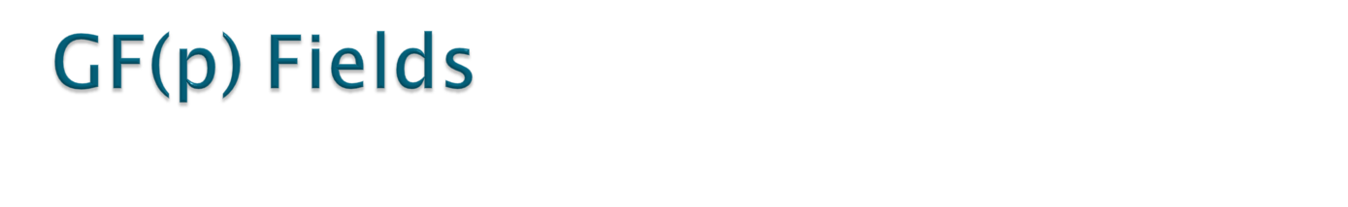
Finite fields of order p^{n,} , for n>1, can be defined using arithmetic over Polynomials.
When n = 1, we have GF(p) field. This field can be the set Z_{p=} {0, 1, …, p − 1}, with two arithmetic operations:
1.) (mod p) addition
2.) (mod p) multiplication.
Notes:
This list includes the various "classic" security services which are traditionally discussed.
Note there is a degree of ambiguity as to the meaning of these terms, and overlap in their use.
See Stallings Table 1.2 for details of the 5 Security Service categories and the 14 specific services given in X.800.

Slide 4

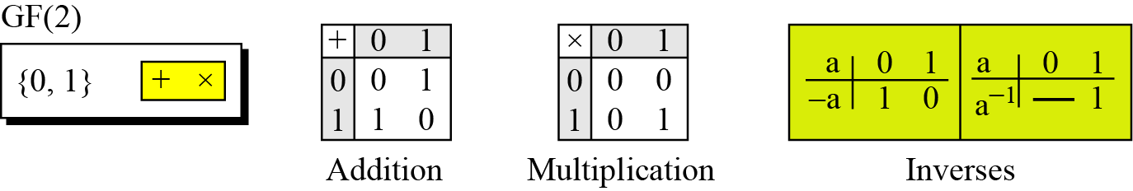
A very common field in this category is GF(2) with the set {0, 1} and two operations, addition and multiplication mod 2, as shown
Notes:
This list includes the various "classic" security services which are traditionally discussed.
Note there is a degree of ambiguity as to the meaning of these terms, and overlap in their use.
See Stallings Table 1.2 for details of the 5 Security Service categories and the 14 specific services given in X.800.

Slide 5
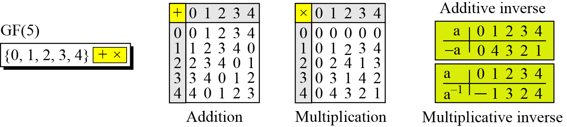
We can define GF(5) on the set Z₅ (5 is a prime) with addition and multiplication operators
Notes:
This list includes the various "classic" security services which are traditionally discussed.
Note there is a degree of ambiguity as to the meaning of these terms, and overlap in their use.
See Stallings Table 1.2 for details of the 5 Security Service categories and the 14 specific services given in X.800.

Slide 6

There exist a unique finite field of order 2^{n} for each positive integer n which is denoted by GF(2^{n}).
We can work in GF(2^{n}). The elements in this set are n-bit words. Order of GF(2^{n}) is 2^{n}
The elements of GF(2^{n}) can also be represented by polynomials of degree at most n-1, with coefficients in GF(2) .
Notes:
This list includes the various "classic" security services which are traditionally discussed.
Note there is a degree of ambiguity as to the meaning of these terms, and overlap in their use.
See Stallings Table 1.2 for details of the 5 Security Service categories and the 14 specific services given in X.800.

Slide 7

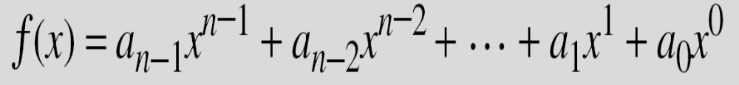
A polynomial of degree n − 1 is an expression of the form
where x^{i} is called the i^{th} term and a_{i} is called coefficient of the i^{th} term.
The degree of a polynomial is the highest degree of its terms. The degree is the value of the greatest exponent of any expression (except the constant ) in the polynomial.
Notes:
This list includes the various "classic" security services which are traditionally discussed.
Note there is a degree of ambiguity as to the meaning of these terms, and overlap in their use.
See Stallings Table 1.2 for details of the 5 Security Service categories and the 14 specific services given in X.800.

Slide 8
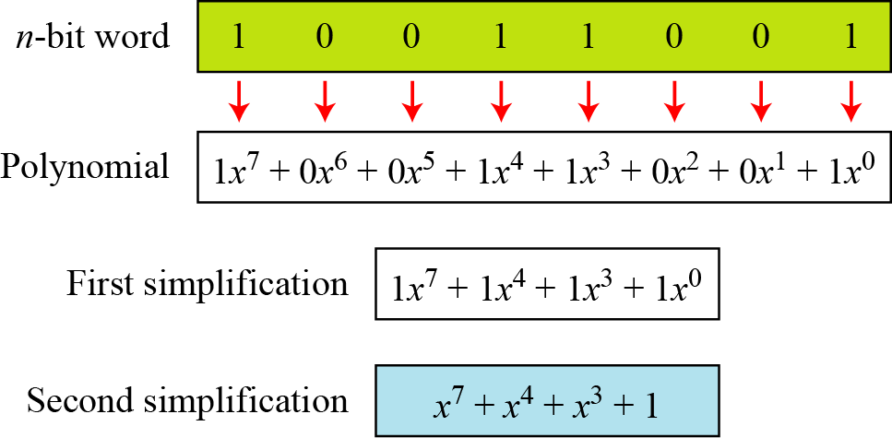
Below figure show how we can represent the 8-bit word (10011001) using a polynomials.
Notes:
This list includes the various "classic" security services which are traditionally discussed.
Note there is a degree of ambiguity as to the meaning of these terms, and overlap in their use.
See Stallings Table 1.2 for details of the 5 Security Service categories and the 14 specific services given in X.800.

Slide 9
To find the 8-bit word related to the polynomial x⁵ + x² + x, we first supply the omitted terms. Since n = 8, it means the polynomial is of degree 7. The expanded polynomial is
This is related to the 8-bit word 00100110
Notes:
This list includes the various "classic" security services which are traditionally discussed.
Note there is a degree of ambiguity as to the meaning of these terms, and overlap in their use.
See Stallings Table 1.2 for details of the 5 Security Service categories and the 14 specific services given in X.800.

Slide 10

We may add, subtract polynomials in as we do for ordinary arithmetic . Even though the coefficients are elements of GF(2) instead of actual integers, it is easy to do the calculations so long as we remember to always reduce coefficients mod 2.

Slide 11
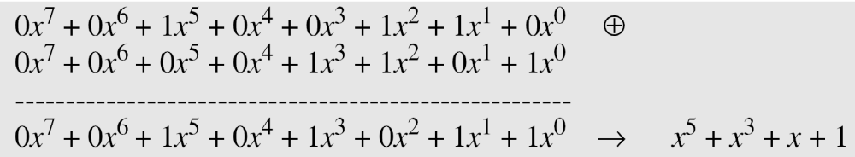
Note: Addition and subtraction operations on polynomials are the same operation in
(mod 2) arithmetic.
Let us do (x⁵ + x² + x) ⊕ (x³ + x² + 1) in GF(2⁸). We use the symbol ⊕ to show that we mean polynomial addition. The following shows the procedure:
Notes:
This list includes the various "classic" security services which are traditionally discussed.
Note there is a degree of ambiguity as to the meaning of these terms, and overlap in their use.
See Stallings Table 1.2 for details of the 5 Security Service categories and the 14 specific services given in X.800.

Slide 12

The coefficient multiplication is done in GF(2).
The multiplying x^{i} by x^{j} results in x^{i+j}.
The multiplication may create terms with degree more than n − 1, which means the result needs to be reduced using a modulus polynomial (the final answer is obtained by reducing the result of multiplication by an irreducible polynomial of degree n ).
Notes:
This list includes the various "classic" security services which are traditionally discussed.
Note there is a degree of ambiguity as to the meaning of these terms, and overlap in their use.
See Stallings Table 1.2 for details of the 5 Security Service categories and the 14 specific services given in X.800.

Slide 13

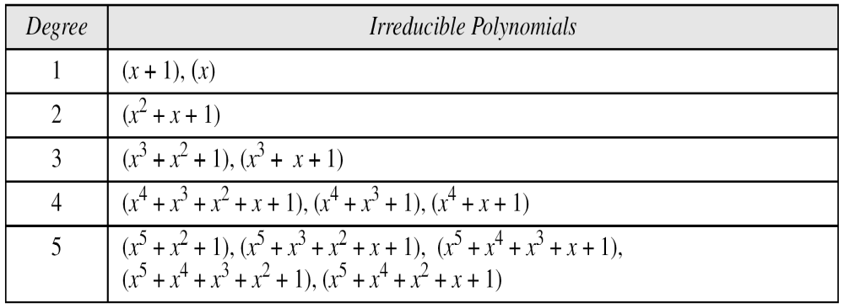
A polynomial is said to be irreducible if it cannot be factored into polynomials of lower positive degrees over the same field.
Notes:
This list includes the various "classic" security services which are traditionally discussed.
Note there is a degree of ambiguity as to the meaning of these terms, and overlap in their use.
See Stallings Table 1.2 for details of the 5 Security Service categories and the 14 specific services given in X.800.

Slide 14
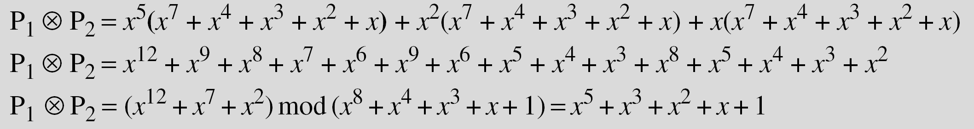
Find the result of (x⁵ + x² + x) ⊗ (x⁷ + x⁴ + x³ + x² + x) in GF(2⁸) with irreducible polynomial (x⁸ + x⁴ + x³ + x + 1). Note that we use the symbol ⊗ to show the multiplication of two polynomials.
To find the final result, divide the polynomial of degree 12 by an irreducible polynomial of degree 8 (the modulus) and keep only the remainder. Next shows the process of division.
Notes:
This list includes the various "classic" security services which are traditionally discussed.
Note there is a degree of ambiguity as to the meaning of these terms, and overlap in their use.
See Stallings Table 1.2 for details of the 5 Security Service categories and the 14 specific services given in X.800.

Slide 15
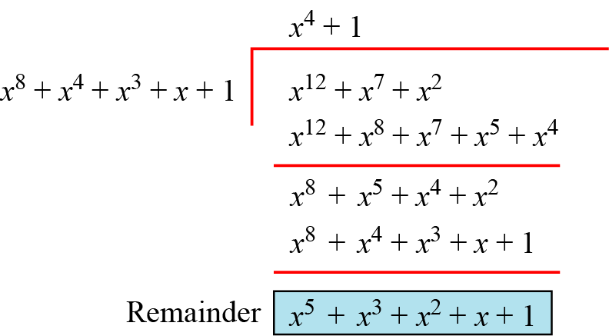
Polynomial division with coefficients in GF(2)
Notes:
This list includes the various "classic" security services which are traditionally discussed.
Note there is a degree of ambiguity as to the meaning of these terms, and overlap in their use.
See Stallings Table 1.2 for details of the 5 Security Service categories and the 14 specific services given in X.800.

Slide 16

When , GF(2^{n}) can be represented as the field of equivalence classes of polynomials whose coefficients belong to GF(2). Any irreducible polynomial of degree n yields the same field up to an isomorphism. For example, for GF(2³), the modulus can be taken as x³ + x + 1 or x³ + x² + 1 .
The GF(2³) field has 8 elements. We use the irreducible polynomial (x³ + x² + 1) and show the addition and multiplication tables for this field.
Notes:
This list includes the various "classic" security services which are traditionally discussed.
Note there is a degree of ambiguity as to the meaning of these terms, and overlap in their use.
See Stallings Table 1.2 for details of the 5 Security Service categories and the 14 specific services given in X.800.

Slide 17

Notes:
This list includes the various "classic" security services which are traditionally discussed.
Note there is a degree of ambiguity as to the meaning of these terms, and overlap in their use.
See Stallings Table 1.2 for details of the 5 Security Service categories and the 14 specific services given in X.800.

Slide 18

