Slide 1
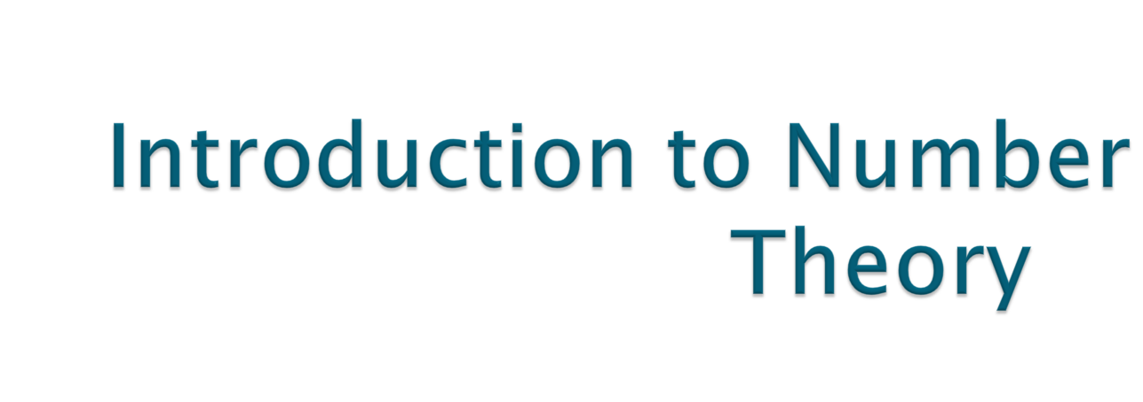
Contd..
Notes:
Lecture slides by Lawrie Brown for “Cryptography and Network Security”, 4/e, by William Stallings, Chapter 1 “Introduction”.

Slide 2

Discrete algorithm are fundamental to number of public key cryptosystem including Diffie-Hellman key exchange and digital signature algorithm.

Slide 3
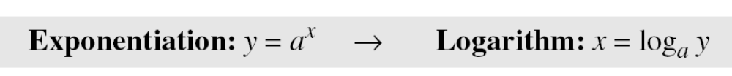

Slide 4

What is the order of group G = <Z₂₁∗, ×>? |G| = φ(21) = φ(3) × φ(7) = 2 × 6 =12. There are 12 elements in this group: 1, 2, 4, 5, 8, 10, 11, 13, 16, 17, 19, and 20. All are relatively prime with 21.

Slide 5

Find the order of all elements in G = <Z₁₀∗, ×>.
This group has only φ(10) = 4 elements: 1, 3, 7, 9. We can find the order of each element by trial and error.
a. 1¹ ≡ 1 mod (10) → ord(1) = 1.
b. 3⁴ ≡ 1 mod (10) → ord(3) = 4.
c. 7⁴ ≡ 1 mod (10) → ord(7) = 4.
d. 9² ≡ 1 mod (10) → ord(9) = 2.

Slide 6

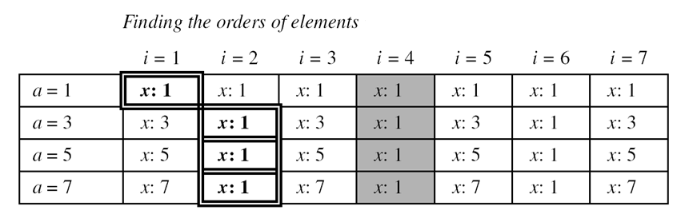
G = <Z₈∗, ×>. a^{i} =x(mod 7). Here φ(8) =4. The elements are 1,3,5,7
“If a is the member of G = <Z_{n}∗, ×> then a^{φ(n) = 1 mod n}
holds when i = φ(n)”

Slide 7

Primitive Roots In the group G = <Z_{n}∗, ×>, when the order of an element is the same as φ(n), that element is called the primitive root of the group.

Slide 8
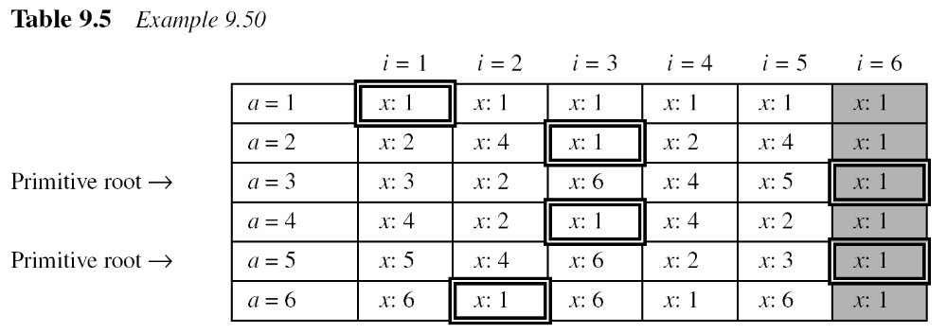
Table 9.5 shows the result of a^{i} ≡ x (mod 7) for the group G = <Z₇∗, ×>. In this group, φ(7) = 6.

Slide 9
Note:
The group G = <Z_{n}*, ×> has primitive roots only if n is 2, 4, p^{t}, or 2p^{t}. (p is prime but not 2).
Examples
a. G = <Z₁₇∗, ×> has primitive roots, 17 is a prime.
b. G = <Z₂₀∗, ×> has no primitive roots.
c. G = <Z₃₈∗, ×> has primitive roots, 38 = 2 × 19 prime.
d. G = <Z₅₀∗, ×> has primitive roots, 50 = 2 × 5² and 5 is a prime.

Slide 10
Note:
If the group G = <Z_{n}*, ×> has any primitive root, the number of primitive roots is φ(φ(n)).
The group G = <Z₁₀*, ×> has two primitive roots because φ(10) = 4 and φ(φ(10)) = 2. It can be found that the primitive roots are 3 and 7. The following shows how we can create the whole set Z₁₀* using each primitive root.

Slide 11
idea of Discrete Logarithm
Properties of G = <Z_{p}*, ×> :
Its elements include all integers from 1 to p − 1.
It always has primitive roots.
The elements can be created using g^{x}
The primitive roots can be thought as the base of logarithm.

Slide 12

Def: The problem of finding i satisfying the equation
b ≡ a^{i} (mod p)
given b, p, and a^{i} (mod p) is called the discrete logarithm problem. The exponent i is referred to as the discrete logarithm of the number b to the base a(mod p).

Slide 13
The discrete logarithm problem has the same complexity as the factorization problem.

