Slide 1
Spandan Project - AI Enabled smart watches for police personnel
AI TEAM UPDATE

Slide 2
AI Model Workflow Architecture
Layer 1: Activity & Stress Model
Extract 13 base features (per row)
Standard Scaler (500k samples)
Model 1 ONNX Inference
STRESS / PHYS-ICAL ACTIVITY
/ NORMAL
Argmax
Raw Sensor CSV HR, Accel, Gyro, GPS, Timestamps
Final CSV
predictions
appended
Extract 10 base features
Sliding window: size 60, step 10
Compute 7 stat features
Standard Scaler (window-based)
Model 2 ONNX Inference
Threshold 0.5
DISTRACTED
/ FOCUSED
Layer 2: Distraction Model
Model 1 inputs (13 features, per row): raw Heart Rate, Accelerometer (X, Y, Z), Gyroscope (X, Y, Z), GPS-derived lat delta / lon delta, time delta, and related instantaneous motion values — scaled and passed directly to ONNX for a 3-class argmax decision.
Model 2 inputs (7 features, per 60-row window): acceleration magnitude variance, gyroscope magnitude variance, movement entropy, micro-motion frequency, heart rate variance, heart rate trend/slope, and average speed (from positional delta / time delta) — aggregated per window, scaled, then passed to ONNX for a probability score.

Slide 3
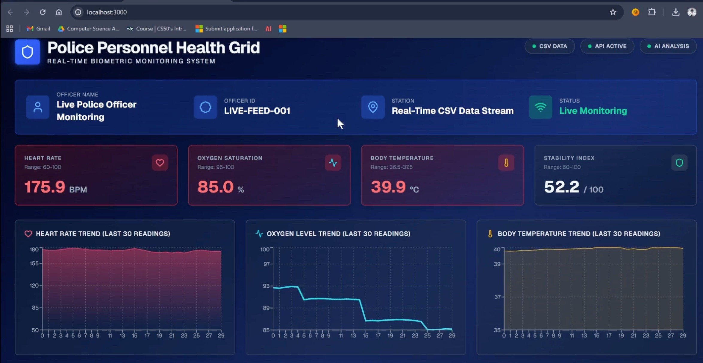
Live Dashboard — Real-Time Biometric Monitoring

Slide 4
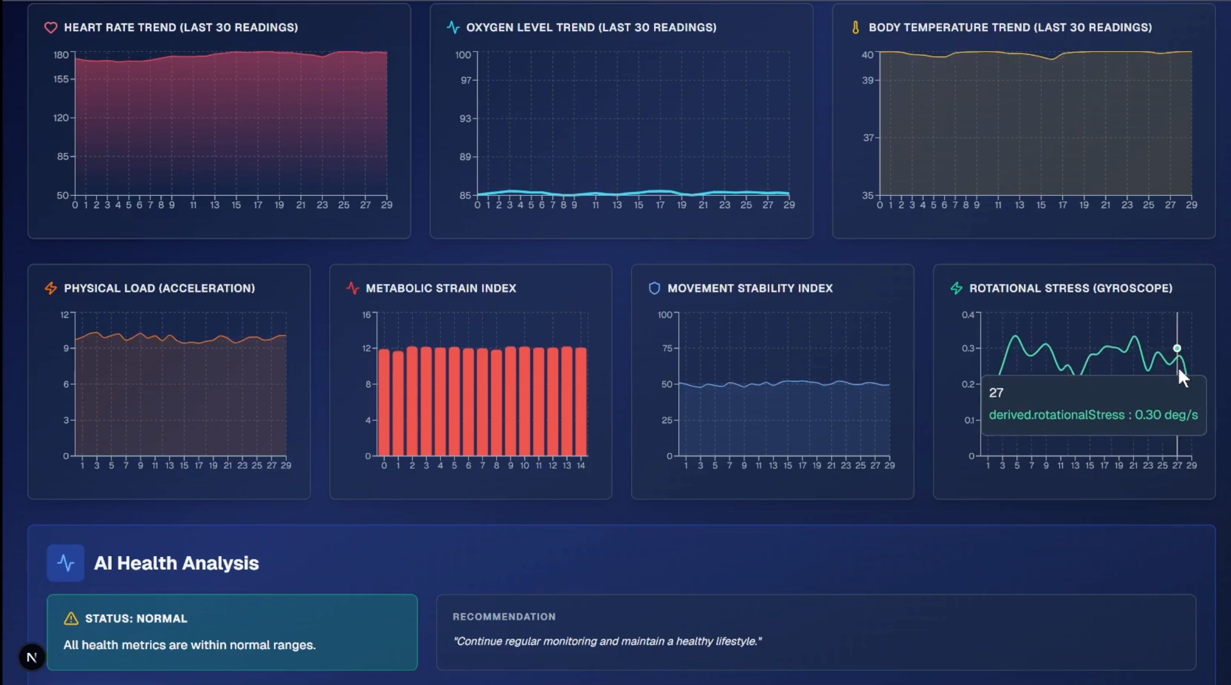
Live Dashboard — Extended Metrics & AI Health Analysis

Slide 5
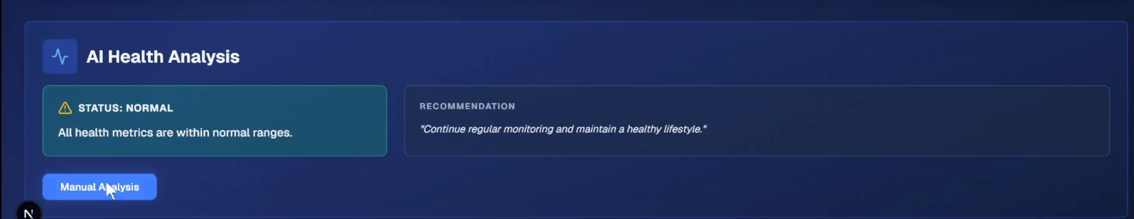
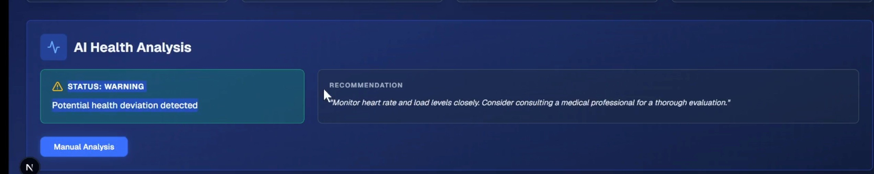
AI-Generated Recommendations — Sample Outputs
Status: Normal
Status: Warning

Slide 6
AI Team Deliverables
AI-side development substantially complete
01 Dashboard & LLM
02 State Classification
03 Cognitive Engagement
Visualisation module complete
LLM recommendation engine ready
Components ready for integration
Env & deployment files shared
READY TO MERGE
Predicts: Stress / Activity / Focus
ONNX format for web deployment
Sensor input →
per-personnel output
Per-user display designed
MODEL READY
Same smartwatch sensor inputs
Classifies Cognitive Engagement
Dashboard flags distracted personnel
MODEL READY

Slide 7
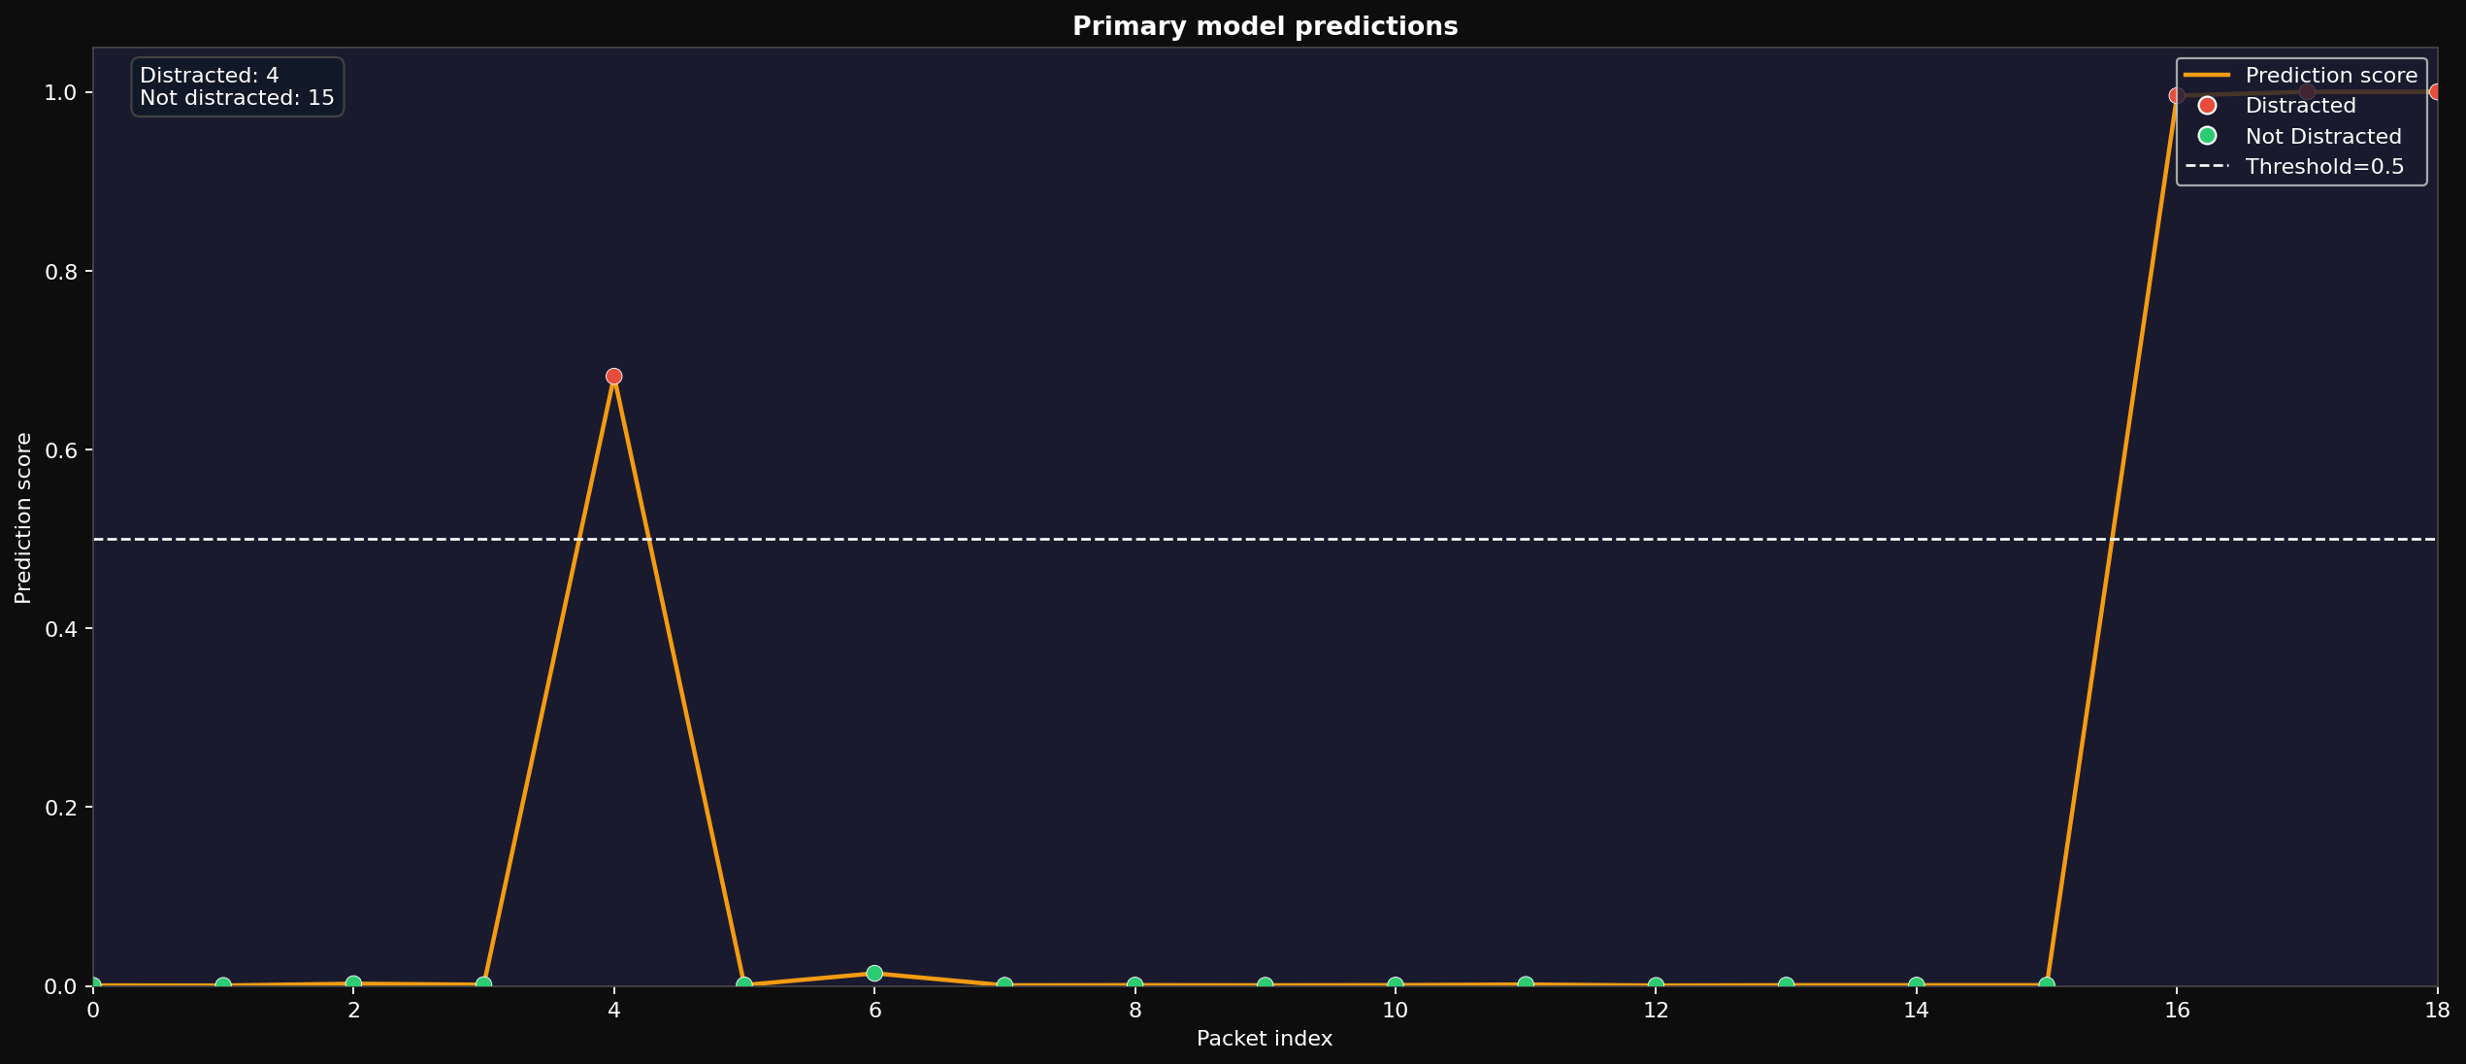
Cognitive Alertness Model - Initial Live Validation
Live Test Summary
During a 20-second session, the subject intentionally made vigorous movements for about
4 seconds, which the AI correctly classified this period as Distracted.
These initial results indicate that the model can detect sudden changes in attention using smartwatch sensor data.

Slide 8
Data Robustness
▲ The Problem
Watch HR readings were unstable and inconsistent during smartwatch sensor stream testing.
Efforts by AI Team + ECE Team
Motion Debounce & Post-Motion Recovery
Sensor Warmup & Pause Vitals During Motion
Delayed Motion Flush & Beat Timestamp Reset
Lower HR Amplitude Threshold
HR Stability Requirement & HR Smoothing
Hold Last Valid HR reading
Longer SpO₂ Window & Lower Signal Gate
SpO₂ R-Ratio Jump Check & Stability Check
SpO₂ Status: ✓ Readings reasonably stable
HR Status: × Readings fluctuate significantly
Impact on AI Models:
Incorrect model predictions
Unreliable live testing outcomes
Difficulty validating model performance
⇒ Live validation will now be done.

Slide 9
Next Phase - Making the AI More Reliable
What happens next?
Once the complete smartwatch system is deployed, sensor data will be collected continuously for approximately one month. This real-world data from police personnel will help us understand normal duty patterns across different situations. We will perform detailed analysis to identify false alarms, missed detections, and behaviour trends. Using these insights, the AI models will be retrained and fine-tuned to improve accuracy and reliability.
Expected Impact for Police
More reliable detection of stress, fatigue, and cognitive distraction.
Fewer false alerts, allowing officers to trust the system during field operations.
Better long-term monitoring helps supervisors identify personnel who may need support.

