Slide 1
GUJARAT POLICE | FINAL PRESENTATION
♥
SPANDAN
Real-time health and focus monitoring for every officer on duty
Smartwatch • AI Models • Live Dashboard
Notes:
Welcome. Spandan means pulse. We built a system that watches over officers' wellbeing and alertness in real time, using the smartwatch they already wear.

Slide 2
THE NEED
Duty is demanding. The warning signs are invisible.
STRESS
EXERTION
LOST FOCUS
Rising strain on the body during long, high-pressure duty.
Heavy physical activity that needs to be told apart from real stress.
Distraction at the moments when alertness matters most.
Spandan sees it as it happens, officer by officer, in real time.
PROJECT SPANDAN | Gujarat Police
Notes:
Long shifts, high pressure, physical exertion. Stress and lost focus build quietly. Spandan makes them visible while they are happening.

Slide 3
WHAT WE BUILT
One system, three parts
1
2
3
SMARTWATCH
TWO AI MODELS
LIVE DASHBOARD
Heart rate, oxygen, movement and location from the officer's wrist.
Physical-state detection and focus monitoring.
Real-time vitals, AI health analysis and plain-language advice.
PROJECT SPANDAN | Gujarat Police
Notes:
Three parts working together: the watch collects, two AI models understand, the dashboard shows and advises.

Slide 4
BUILT ON THE REAL THING
Trained and tested on real police duty data
29
100,658
15,113
Police officers
Duty records collected
Unseen records used for testing
WHAT THE WATCH MEASURES
Heart rate
Oxygen (SpO2)
Movement
Location
Altitude
Timing
PROJECT SPANDAN | Gujarat Police
Notes:
Not a lab simulation. Real officers, real shifts. Models were checked on data they had never seen.

Slide 5
THE KEY LESSON
Real data changes everything
30.75%
Overall accuracy: simulated data only
78.59%
Overall accuracy: trained on real data
PROJECT SPANDAN | Gujarat Police
Notes:
A model trained only on simulated data barely worked on real officers. Training on real duty data turned it into a reliable detector.

Slide 6
MODEL 1
Physical-state detection
STRESS
PHYSICAL ACTIVITY
NORMAL
88.51%
78.59%
64.28%
Stress detection score
Overall accuracy
Balanced score across all 3 states
Best model for final deployment: trained on real officer duty data
PROJECT SPANDAN | Gujarat Police
Notes:
Model 1 tells apart stress, physical activity and normal state. Stress, the most important state to catch, is detected at 88.51%.

Slide 7
MODEL 2
Focus and distraction monitoring
98.12%
100%
Overall accuracy
of distraction events caught
97.28%
95.77%
FOCUSED vs DISTRACTED
Balanced score
Distraction detection score
PROJECT SPANDAN | Gujarat Police
Notes:
Model 2 catches every distraction event in testing, with 98.12% accuracy.

Slide 8
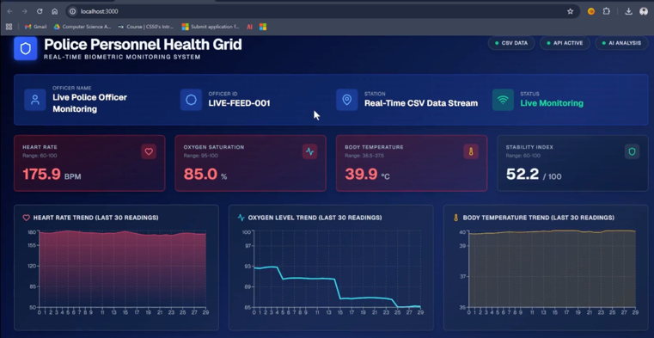
LIVE DASHBOARD
Every officer's vitals, in real time
Live vitals
Heart rate, oxygen, body temperature and a stability index.
Trend charts
The last 30 readings at a glance.
Instant status
Colour-coded alerts when readings go out of range.
PROJECT SPANDAN | Gujarat Police
Notes:
The dashboard is complete, working, and showing live data from the smartwatch stream.

Slide 9
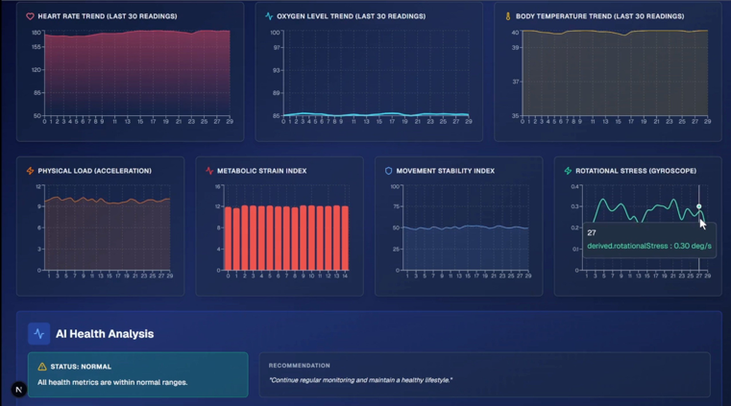
BEYOND THE BASICS
Deeper insight and plain-language advice
Extended metrics
Physical load, metabolic strain, movement stability, rotational stress.
AI health analysis
Turns the signals into a clear Normal or Warning status.
Recommendations
Human-readable advice, no technical skill needed.
PROJECT SPANDAN | Gujarat Police
Notes:
Extended health metrics plus an AI health analysis that gives a clear Normal or Warning message with a recommendation.

Slide 10
PROVEN AND WHAT IS NEXT
Live-tested. Ready for a field pilot.
THE ROAD AHEAD
LIVE TEST RESULTS
Deliberate vigorous movement was correctly flagged
Oxygen readings stayed steady
Heart-rate readings fluctuated, so we are adding smoothing and signal checks
1
Sensor reliability upgrades
Warm-up, smoothing, bad-signal filtering
2
One month of live field use
Continuous real-world duty data
3
Review and retrain
Check false alarms and misses, then improve
PROJECT SPANDAN | Gujarat Police
Notes:
Early live test worked: vigorous movement was caught. Heart rate can fluctuate, so next we add signal smoothing and run a one-month pilot.

