Slide 1
Multi and Hybrid Cloud Computing

Slide 2
Index
Introduction
Multi and Hybrid Cloud Computing
Literature Review
Related Concern and Solution
Methodology
Conclusion

Slide 3
Introduction
Cloud computing is the way of accessing shared, configurable computer resources over the internet without on-premises infrastructure.
This enables organizations to optimize resource utilization, scale operations seamlessly, and foster new innovations by providing a platform for new developments.
The evolving landscape of cloud computing now demands a robust infrastructure that is possible to encompass compute power, storage capacity, network bandwidth, and security measures.
This necessities require a strategic planning to ensure optimal performance and resilience.
In this era, cloud computing has now been shaped to support diverse industries by enabling scalability, and adaptability to market demands. One such current application includes Multi and Hybrid Cloud computing which enables simultaneous use of services from various cloud providers.

Slide 4
Multi and Hybrid Cloud Computing
Multi and Hybrid Cloud Computing refers to a strategic IT architecture that combines the benefits of multiple cloud deployment models to optimize performance, scalability, and flexibility.
Multi-Cloud Computing involves the use of services from two or more cloud providers, allowing organizations to select the most suitable services for specific workloads or applications.
It enables cost optimization by leveraging competitive pricing and diverse service offerings.
Hybrid Cloud Computing integrates on-premises infrastructure with one or more cloud providers to create a unified, flexible computing environment.
It provides the benefits of both public and private clouds, catering to varying security, compliance, and performance requirements.

Slide 5
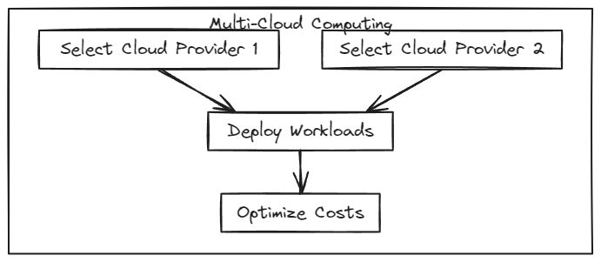
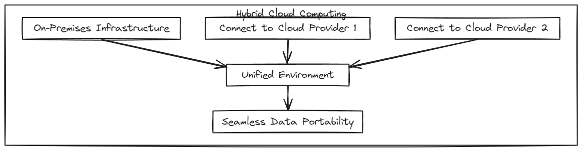
[5]
[6]

Slide 6
Literature Review
Author | Year | Description | Remarks
Celesti et. al. [1] | 2019 | The paper suggests using a multi-cloud storage (MCS) system as a potential solution for data availability and reliability when using third-party cloud storage providers. | The paper can consider additional factors beyond data transfer performance which can provide holistic perspective for MCS.
Islam et. al. [2] | 2021 | The paper aims at enhancing the cost-efficiency and performance in big data analytics by optimizing Virtual Machine (VM) usage costs. | Achieving a 20 percent decrease in VM usage cost demonstrates a significant potential for cost savings.
Vaish et. al. [3] | 2022 | The paper aims at distributing workload across multiple clouds for IoT to enhance resource utilisation and stability | The paper emphasizes on consideration of business requirements in cloud resource which is indeed a practical approach.
Garigipati et. al. [4] | 2023 | The Multi-Layer Hybrid Security Algorithm aims at overcoming potential vulnerabilities in the existing encryption schemes. | Evaluation using Amazon’s cloud platforms strengthens practicality of proposed algorithm

Slide 7
Related Concern and Solution
While multi and hybrid cloud computing have garnered considerable attention from researchers, notable gaps persist that require identification and resolution.
Limited studies on effective strategies for workload distribution and migration in dynamic Multi-Cloud environments. The possible solution can be development of adaptive algorithms that consider real-time workload characteristics for optimal workload distribution and migration.
Insufficient exploration of security implications and privacy concerns in Hybrid Cloud architectures involving sensitive data. Can utilize encryption techniques and blockchain mechanism to overcome security concerns.
Lack of standardized methodologies for assessing and comparing the performance of various Multi-Cloud and Hybrid Cloud configurations. It needs to establish industry-wide benchmarks and performance metrics to enable consistent evaluation and comparison of diverse cloud deployment models.
Limited focus on energy-efficient resource management and sustainable practices in Hybrid-Multi-Cloud infrastructures. Can investigate green computing strategies, leveraging energy-aware algorithms and renewable energy sources for Hybrid-Multi-Cloud environments.

Slide 8
Methodology for Secure Green Multi-Hybrid Cloud Computing
Green cloud computing requires energy-aware resource allocation, renewable energy integration, green cooling solutions and idle resource consolidation.
Can include development of an intuitive dashboard that provides administrators with real-time visibility into energy consumption, server utilization, and the overall environmental impact of the Hybrid-Multi-Cloud infrastructure.
Rather than going for manual approach, implementation of a decentralized resource allocation mechanism using smart contracts on the blockchain can resolve security concern along with reducing environmental negative impact.
Smart contracts will autonomously govern resource distribution within the multi-hybrid cloud infrastructure, considering factors such as energy consumption, server utilization, and environmental impact.
It ensure that cloud operations are powered by a predetermined percentage of renewable energy.

Slide 9
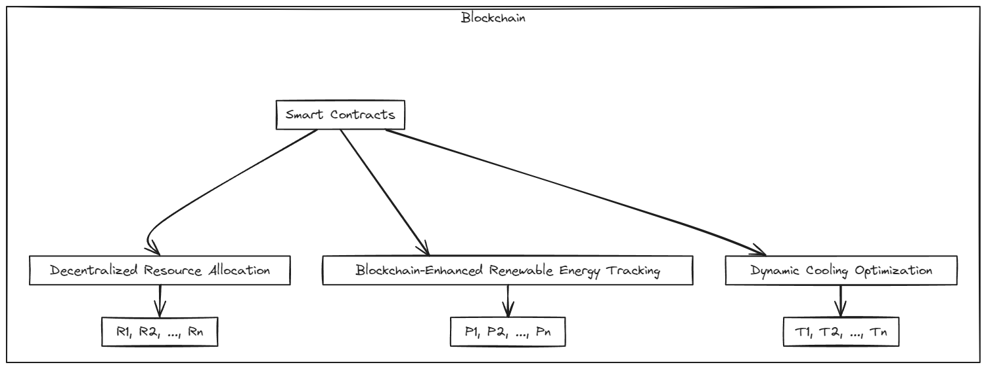
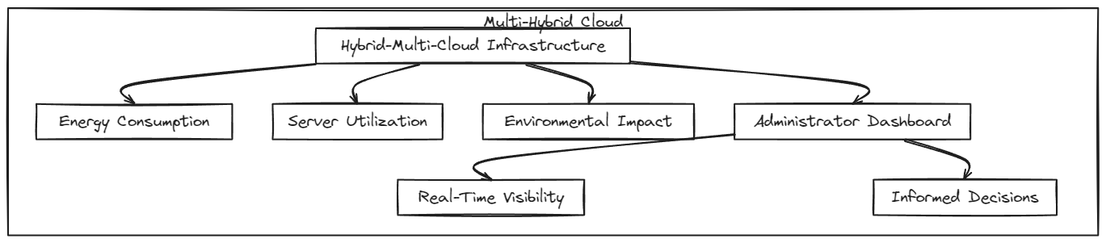
[7]

Slide 10
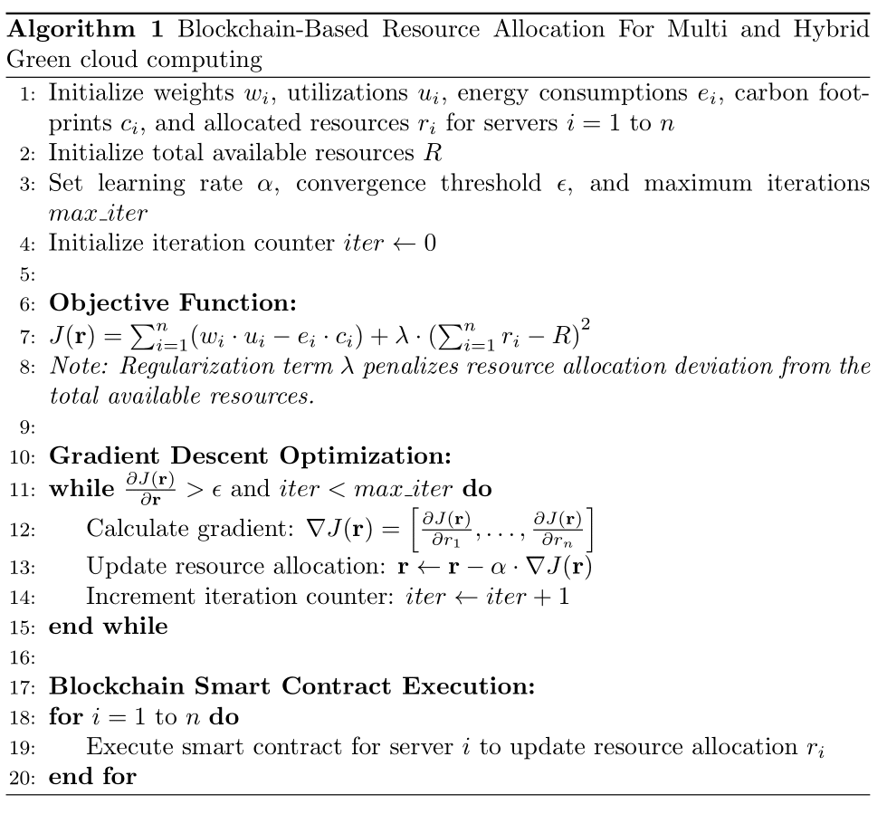

Slide 11
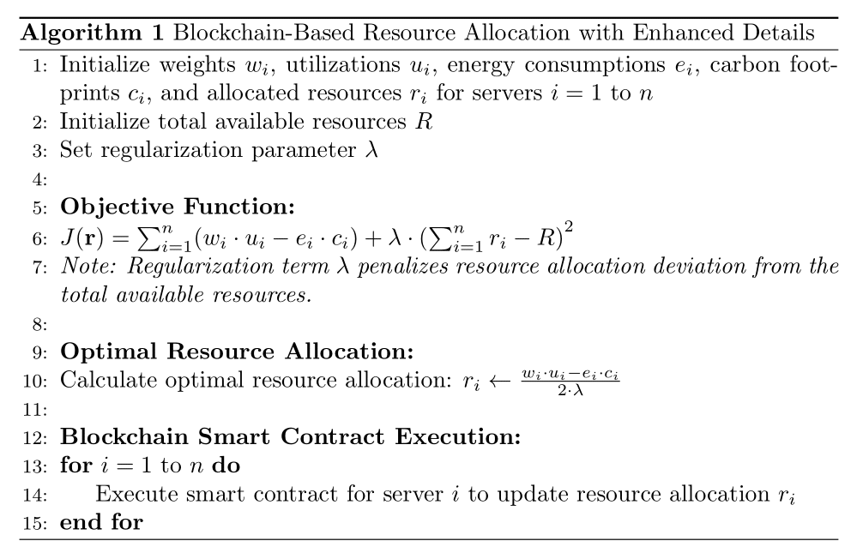

Slide 12
Conclusion
This is how Multi and Hybrid Cloud Computing serve as versatile paradigms, allowing organizations to optimize performance and flexibility through the strategic integration of diverse cloud deployment models.
While these approaches offer significant benefits, our exploration has unveiled research gaps, particularly in the realms of energy-efficient resource management and security.
To address these challenges, a pioneering solution involves leveraging blockchain technology to enhance the green and secure aspects of Multi and Hybrid Cloud Computing.
By implementing blockchain for secure data transactions and adopting decentralized consensus mechanisms, organizations can not only fortify the security posture of their cloud infrastructures but also establish a transparent and efficient ecosystem for sustainable resource management.

Slide 13
References
[1] A. Celesti, A. Galletta, M. Fazio, and M. Villari, “Towards hybrid multicloud storage systems: Understanding how to perform data transfer,” Big Data Research, vol. 16, pp. 1–17, 2019.
[2] M. T. Islam, H. Wu, S. Karunasekera, and R. Buyya, “Sla-based scheduling of spark jobs in hybrid cloud computing environments,” IEEE Transactions on Computers, vol. 71, no. 5, pp. 1117–1132, 2022.
[3] P. Vaish, N. Anand, and G. Sharma, “Dealing heavy iot systems with hybrid cloud platform,” in 2022 IEEE Conference on Interdisciplinary Approaches in Tech
[4] N. Garigipati, S. Srithar, and V. Reddy, “A multi-layered hybrid security algorithm based on integrity for the cloud computing environment,” in 2023 2nd International Conference on Edge Computing and Applications (ICECAA), pp. 50–57, 2023.
[5] J. Hong, T. Dreibholz, J. Schenkel, and J. Hu, An Overview of Multi-cloud Computing, pp. 1055–1068. 03 2019.
[6] R. Nedzelský, “Hybrid cloud computing: Security aspects and challenges,” 05 2019.
[7] Geetanjali and S. J. Quraishi, “Energy savings using green cloud computing,” in 2022 Third International Conference on Intelligent Computing Instrumentation and Control Technologies (ICICICT), pp. 1496–1500, 2022.

