Slide 1

Indian Crop Data Analysis To Grow Suitable Crops
Submitted By:
Vineet Rathor (171500382)
Aman Sharma(171500033)
Ashutosh Anand (171500064)

Slide 2
Contents
Introduction
What is Big Data
Dataset
Implementation of Dataset
Methodology
User Interface
Future Prospective

Slide 3
Introduction
Farming is the backbone of the country.
Government is taking many initiatives for farming.
We will tell the farmers which crops are beneficial for them and in which season which crop should they grow.

Slide 4

Big Data
Big data is a field that treats ways to analyze, systematically extract information from, or otherwise deal with data sets that are too large or complex to be dealt with by traditional data-processing application software.

Slide 5
Dataset
Main Data source : https://data.gov.in/
Main Columns are : State, District, Season, Crop, Area & Production.
We added a new column of production per area.
Imported the data into MongoDB from CSV file.

Slide 6
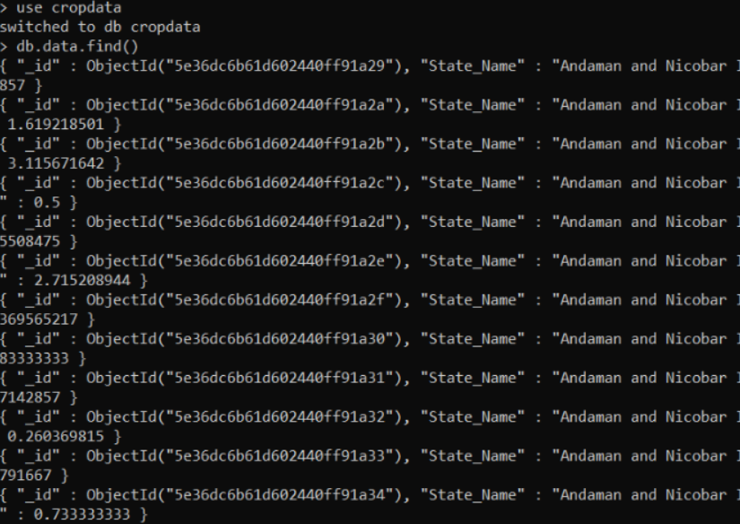
Implentation of Dataset
Used the command Mongo Import to import the dataset into MongoDB:-
mongoimport -d cropdata -c data --type csv --file finalcrops.csv --headerline

Slide 7
Methodology
We took the data from data.gov.in and cleaned it.
Transferred the data into MongoDB.
Connection of database with node.js used Express to create local server.
Embedded queries of mongoDB into node.js.
Displaying results on the basis of queries of farmers.

Slide 8
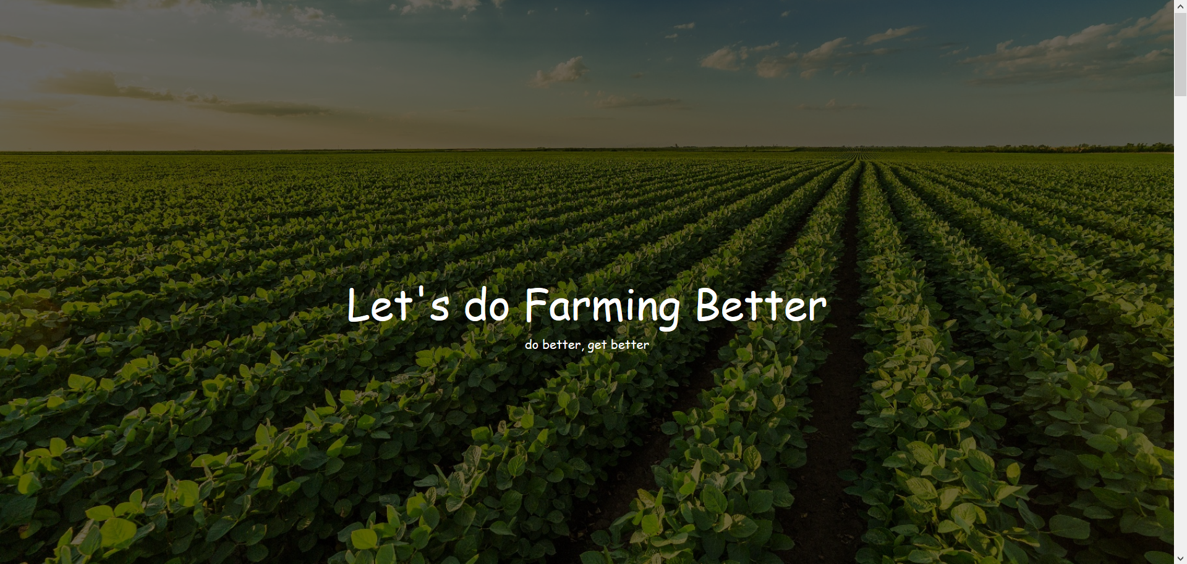
User Interface

Slide 9
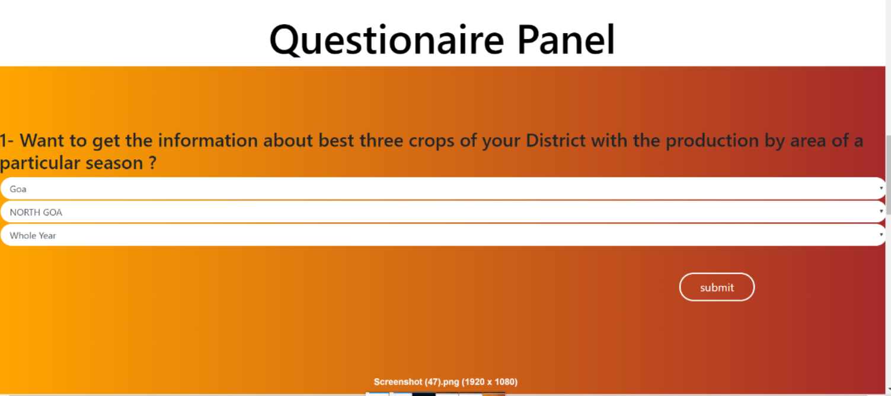

Slide 10
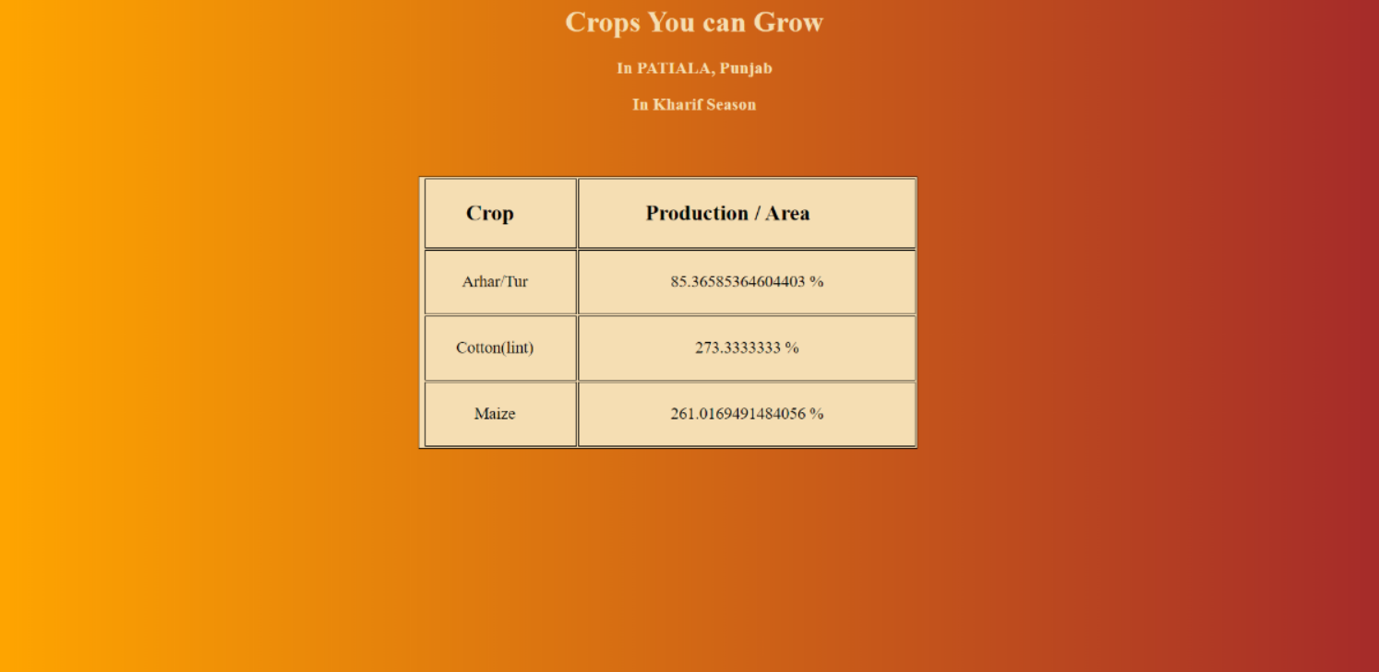

Slide 11
Future Prospective
Currently, we are able to display the top top three crops of farmer’s district, by which he will be able to decide which crop he should grow.
We are planning to show the daily prices of the market for that crop which he wants to grow by using the real time data provided by government.
We will also try to show the map of the farmers place so that he can look for the transportation needed and thus can calculate total transportation cost.

Slide 12
Thank You

