Slide 1
Git and GitHub
Atul Kahate

Slide 2
Version Control
System that tracks changes in files over time
Allows developers to restore previous versions
Maintains a complete history of changes
Enables multiple people to work on the same project
Essential for software development and data projects

Slide 3
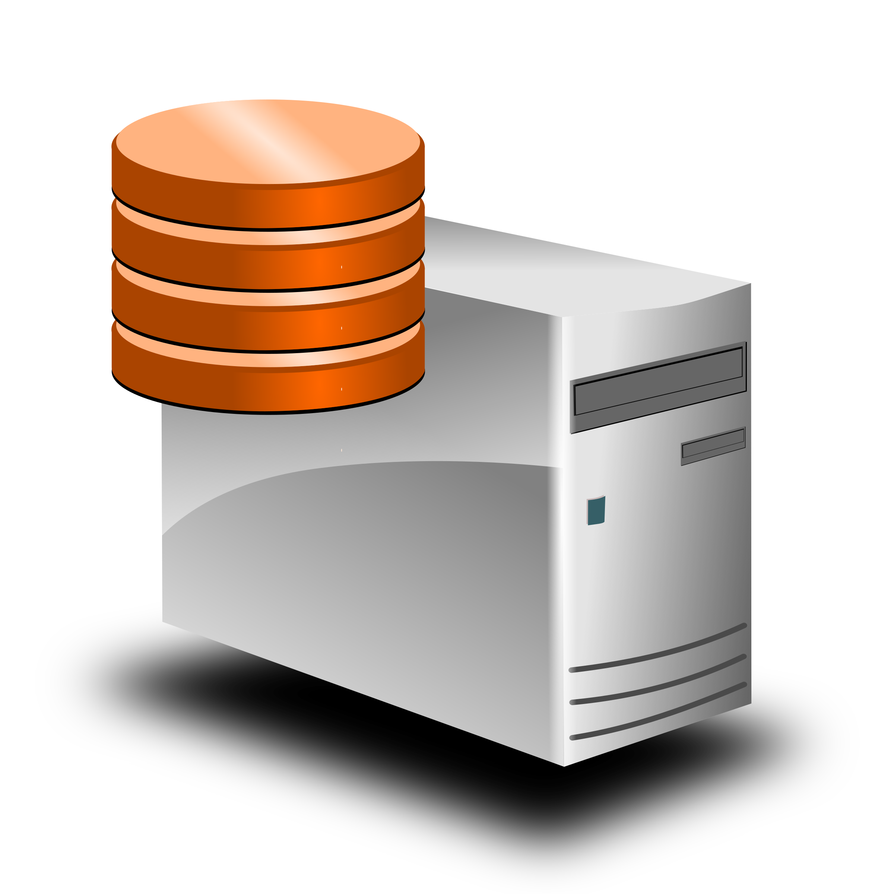


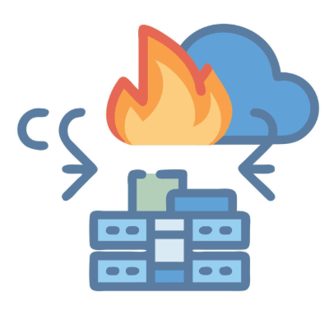
Without Version Control
Application Version 1.0
Application Version 1.0
Production (“Live”) server
Developer 1
Developer 2
Application Version 2.0
Production (“Live”) server
Developer 2

Slide 4
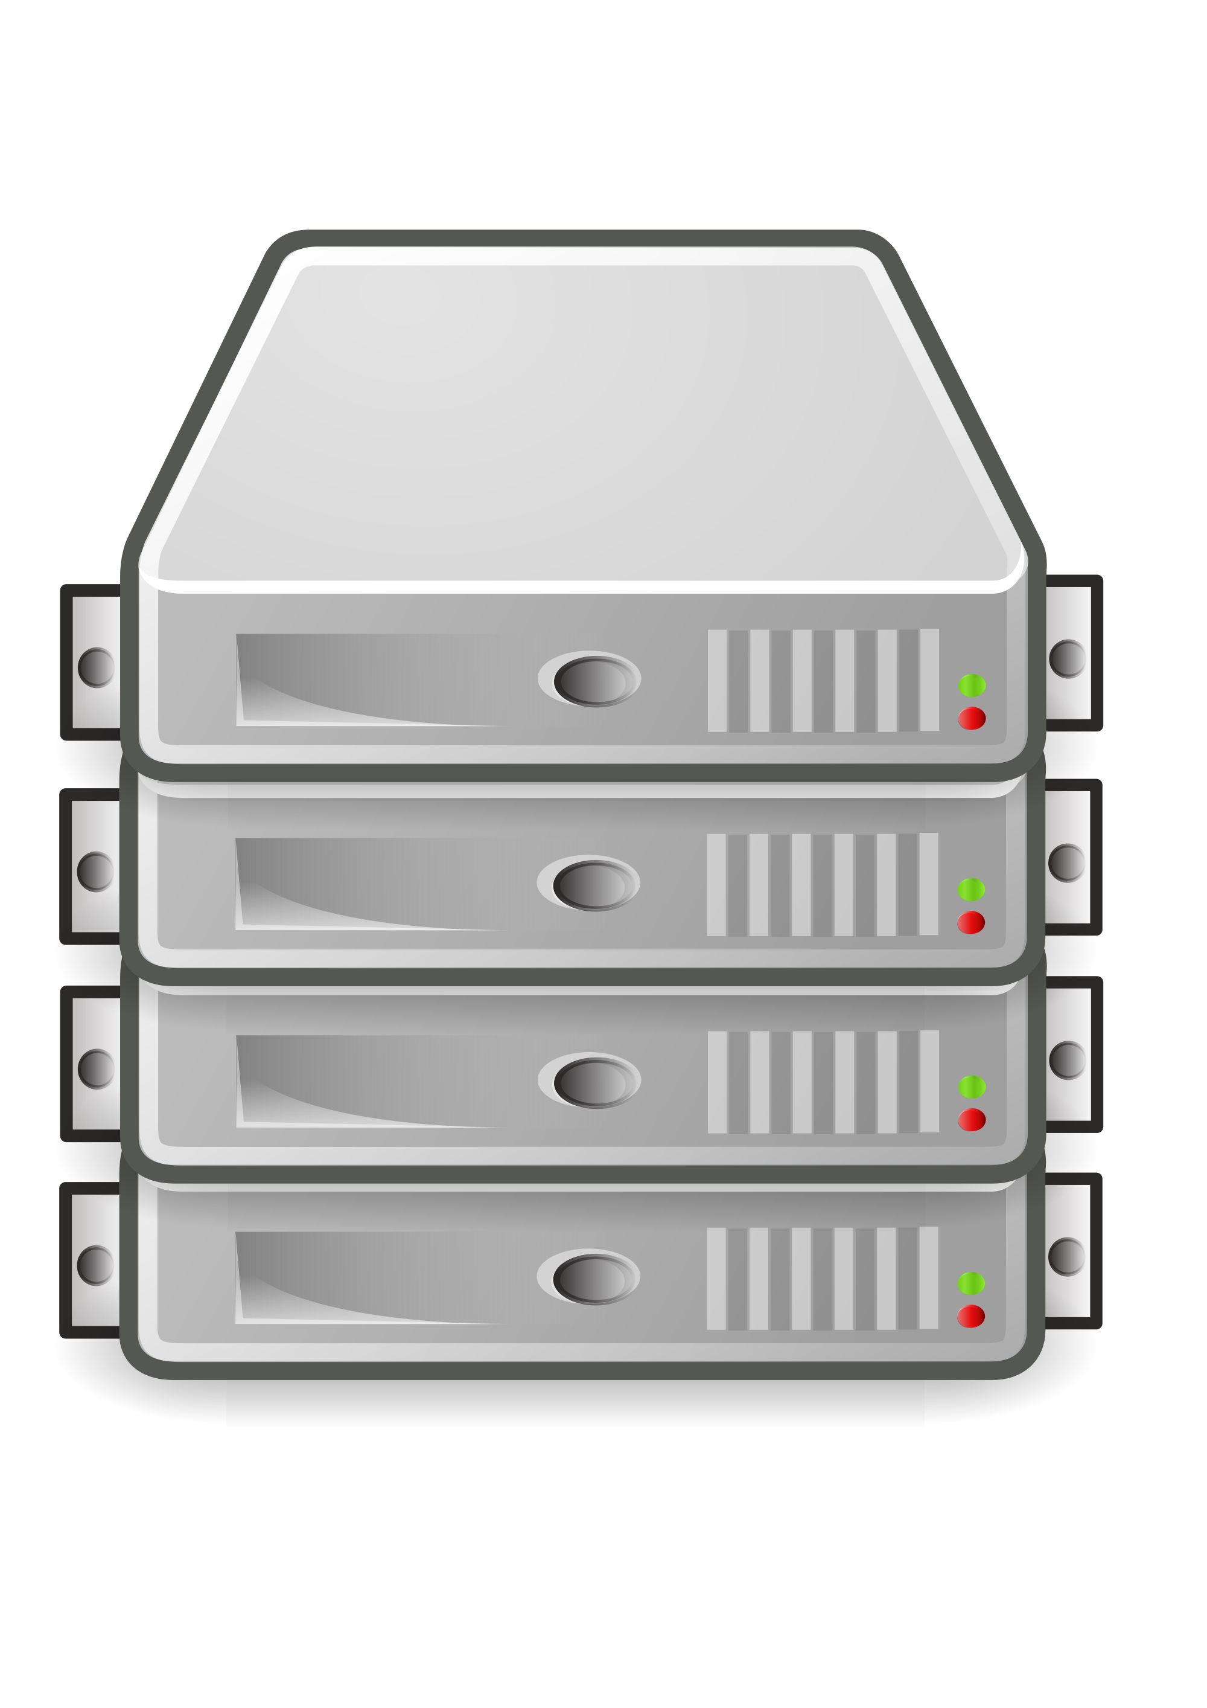
With Version Control
Application Version 1.0
Production (“Live”) server
Developer 1
Repository
Application Version 1.0
Application Version 2.0
Repository
Production (“Live”) server
Developer 2
Application Version 2.0
This Photo by Unknown Author is licensed under CC BY-NC

Slide 5
Centralized Vs Distributed Version Control
Feature | Centralized Version Control (CVCS) | Distributed Version Control (DVCS)
Repository Location | Single central server | Every developer has full repository
Internet Requirement | Usually required to commit changes | Not required for most operations
History | Stored on central server | Stored on every developer machine
Speed | Slower due to server communication | Faster since operations are local
Backup | Risk if central server fails | Multiple copies act as backup
Collaboration | Developers depend on central server | Developers can work independently
Offline Work | Limited or not possible | Fully possible
Scalability | Less scalable for large teams | Highly scalable
Examples | SVN, CVS, Perforce, Visual Source Safe (VSS), Endeavor | Git, Mercurial, Bazaar

Slide 6
Git
A Distributed Version Control System (DVCS) used to track changes in files and source code
Created by Linus Torvalds in 2005 for Linux kernel development
Allows multiple developers to work on the same project simultaneously
Maintains a complete history of all changes made to files
Supports branching and merging for parallel development
Works locally on a developer’s machine, so many operations are very fast
Enables easy collaboration through platforms like GitHub, GitLab, and Bitbucket
Widely used in software development, DevOps, AI/ML projects, and data science workflows

Slide 7
GitHub
A cloud-based platform for hosting Git repositories
Allows developers to store, share, and collaborate on code online
Built on top of Git version control system
Enables teams to work together on the same project from different locations
Provides features like Pull Requests, Issues, and Code Reviews
Keeps track of project history and contributions by different developers
Integrates with CI/CD tools for automated testing and deployment
Widely used for open-source projects, software development, and collaborative coding

Slide 8
Creating a GitHub Repository
Go to https://github.com and log in to our account
Click the “+” icon at the top-right corner
Select New repository.
Enter the Repository name (example: demo)
Optionally add a description for the repository
Choose repository visibility
Public (anyone can see)
Private (only invited users can see)
Optionally select:
Add a README file
Add .gitignore
Choose a license
Click Create repository
GitHub will create the repository and show commands to connect our local Git project
We can now clone, add files, commit, and push code to this repository

Slide 9
Git Commands
Command | Purpose | What Happens
git add | Add files to staging area | Selects changes that will be included in the next commit
git commit | Save changes to local repository | Creates a snapshot of the staged changes with a message
git push | Upload changes to remote (GitHub) repository | Sends committed changes from local machine to remote repository

Slide 10
Git On the Local Machine
nano hello.py
Workspace
(Directory where we write code)
git add hello.py
Staging Area
(git now tracks our files)
git commit –m “first commit”
Local Repo
(Replica of remote repo)
git push origin main
Remote Repo
(cloud-based github repo)

Slide 11
Set Up Git to Work With GitHub
git config --global user.name “Atul Kahate“
git config --global user.email “newdelthis@gmail.com"

Slide 12
Generating a Personal Access Token (PAT)
Log in to GitHub
Click on your profile icon (top-right corner)
Select Settings
In the left sidebar, click Developer settings
Click Personal access tokens
Select Tokens (classic) or Fine-grained tokens
Click Generate new token
Enter a token name (description)
Set the expiration period
Select required permissions (scopes) such as repo
Click Generate token
Copy and store the token immediately (it will not be shown again)
Use this PAT instead of your GitHub password when performing operations like git push

Slide 13
On the Local Machine (Git) Terminal
cd ~
git clone https://github.com/newdelthis/demo.git
cd demo
nano Hello.java
git status
git add Hello.java
git commit -m "Added Hello.java“
git push origin main

Slide 14
Miscellaneous Git Commands
Command | Purpose | Example
git status | Show current state of repository | git status
git log | Show commit history | git log
git diff | Show differences between files | git diff
git pull | Fetch and merge updates from remote | git pull origin main
git fetch | Download changes without merging | git fetch origin
git remote -v | Show remote repositories | git remote -v
git reset | Undo staging or commits | git reset file1.txt
git rm | Remove a file from repository | git rm file1.txt
git stash | Temporarily save changes | git stash
git stash pop | Restore stashed changes | git stash pop

Slide 15
Branch and Merge
Original “main” Repository on GitHub
Branch D-1
Branch D-2
Merge
Merge into “main” branch

Slide 16
Branch and Merge Example – Basic Setup
Step | Action | Command
1 | Create a new repo | In GitHub, create a new repo named branch-test
2 | Clone it on the Linux machine | cd ~ git clone https://github.com/newdelthis/branch-test.git
3 | Create hello.py | cd branch-test Nano hello.py
4 | Push it to GitHub | git add . git commit -m “Branch test – First commit” git push origin main

Slide 17
Branch and Merge Example
Step | Action | Command
1 | Create branches (-b means create) | git checkout -b d-1 git checkout -b d-2
2 | Switch to d-1 branch and complete developer 1’s work | git checkout d-1 nano hello.py Edit the line and add a line git add hello.py git commit -m "Developer-1 hello.py"
3 | Repeat for Developer 2 | git checkout d-2 nano hello.py Edit the line and add a line git add hello.py git commit -m "Developer-2 hello.py"

Slide 18
Branch and Merge Example
Step | Action | Commands
1 | Try merging d-1 branch into d-2 branch | git merge d-1 ERROR!
2 | Edit hello.py and resolve conflicts | nano hello.py and resolve conflicts
3 | Again add and commit | git add hello.py git commit -m “Conflict handled”
4 | Try merging again | git merge d-1 OK!
5 | Switch to main and merge branch 2 | git checkout main git merge d-2 git push origin main
6 | Remove other branches | git branch -d d-1 git branch -d d-2

Slide 19
Branch and Merge Commands
Command | Purpose | Example
git branch | List all branches in the repository | git branch
git branch branch_name | Create a new branch | git branch feature1
git checkout branch_name | Switch to an existing branch | git checkout feature1
git checkout -b branch_name | Create and switch to a new branch | git checkout -b feature2
git merge branch_name | Merge another branch into the current branch | git merge feature1
git branch -d branch_name | Delete a local branch | git branch -d feature1
git push origin branch_name | Push a branch to remote repository | git push origin feature1
git push origin --delete branch_name | Delete a remote branch | git push origin --delete feature1

Slide 20
Alternative: switch Command
Command | Purpose | Example
git switch branch_name | Switch to an existing branch (modern alternative to checkout) | git switch feature1
git switch -c branch_name | Create a new branch and switch to it | git switch -c feature2
git switch main | Switch back to the main branch | git switch main
git switch - | Switch to the previously used branch | git switch -
git switch --detach commit_id | Switch to a specific commit (detached HEAD state) | git switch --detach a1b2c3d

