Slide 1
Prometheus
Atul Kahate

Slide 2
Prometheus
Prometheus: An open source system monitoring and alerting tool
Allows analysis of applications and infrastructure from the metrics discovered by it
Written in Go
Uses multi-dimensional data time-series using time series data
Uses metric name and key-value pair
Example: http_requests_total{method=“get”}
Here, metric name is http_requests_total, method is key, and value is get
Uses the PromQL read-only language (only allows reading) for quering
Works on single nodes
Has an alert manager
Alternatives: graphite, influxdb, OPENTSDB, Nagios, Sensu

Slide 3
Prometheus Installation
cd ~/Downloads
Visit https://prometheus.io/download/
Download the latest Linux AMD tar.gz file
tar -xzf <downloaded file>
This installs Prometheus
Rename the long Prometheus directory name to Prometheus:
mv prometheus-3.11.3…… prometheus
cd prometheus and ls -l
To run prometheus: ./prometheus
Open browser: localhost:9090

Slide 4
Prometheus
Type up in the Enable query history and click on the Execute button
Output up{instance="localhost:9090",job="prometheus"} is Element and its Sample value
Here, up is a special metric that outputs a list of targets (including itself) scraped by Prometheus; so here it is showing information about itself
Below we can change the calendar values to filter for certain time period
Instead of Console, we can select Graph to see a graphical view

Slide 5
Changing Metric
Now change the metric to promhttp_requests_total in the Execute query history menu and click on the Execute button
See the graph
Then click on stacked

Slide 6
Prometheus Configuration File
nano ~/Downloads/prometheus/prometheus.yml
The global block specifies general properties for all the targets
Example: Scrapping will be done every 15 seconds, and the rules will be evaluated every 15 seconds

Slide 7
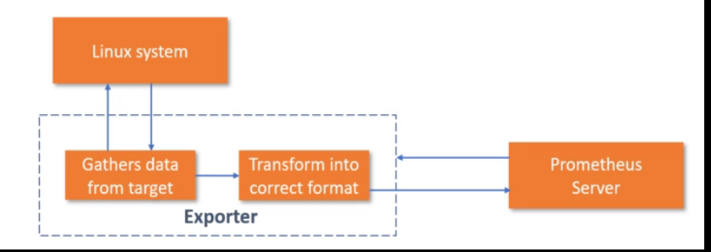
Exporters
An exporter is software that helps in exporting existing metrics from third-party systems (e.g. Linux/Windows) in the same format as Prometheus metrics
Linux exporter is called Node and Windows exporter is called WMI
Example:

Slide 8
Node Exporter
Open browser, open link https://github.com/prometheus/node_exporter/releases
Download latest file: e.g. https://github.com/prometheus/node_exporter/releases/download/v1.11.1/node_exporter-1.11.1.linux-amd64.tar.gz
In the terminal, in the Downloads directory, run this command: tar -xzf node_exporter-…...
Rename the resulting long directory to node_exporter
Go to node_exporter directory and run the command ./node_exporter
To access the node exporter in the browser, type localhost:9100
Click on Metrics – It will show the metrics for the current machine

Slide 9
Adding Node Exporter Scraping to Prometheus
To allow Prometheus to scrape information from node exporter, edit the prometheus.yml file
# The job name is added as a label `job=<job_name>` to any timeseries scraped from this config.
- job_name: 'prometheus'
# metrics_path defaults to '/metrics'
# scheme defaults to 'http'.
static_configs:
- targets: ['localhost:9090']
- job_name: 'node_exporter'
# metrics_path defaults to '/metrics'
# scheme defaults to 'http'.
static_configs:
- targets: ['localhost:9100']

Slide 10
Restart
Restart Node Exporter and Prometheus
Node Exporter terminal: Ctrl+C and ./node_exporter
Prometheus terminal: Ctrl+C and ./prometheus
In the Prometheus Server browser window (localhost:9100), select Status->Target health
Now we should see two targets: node exporter and localhost

Slide 11
Node Exporter
In the Prometheus Server browser window (localhost:9100), select Status->Targets
Now we should see two targets: node exporter and localhost
Go to the home page of Prometheus and again give up command in Enable query history
It should show two results
Let us now see how much memory was available on the Linux machine
In the Enable query history, type node_memory_MemAvailable_bytes
Execute – about 4.7 GB in my case – Now click on Graph
Reduce the time from 1 hour to 5 minutes to see detailed usage

Slide 12
WMI Exporter
Used for Windows machine scraping
WMI – Windows Management Instrumentation
Assuming that the host machine is Windows, open browser
Open and download https://github.com/prometheus-community/windows_exporter/releases/download/v0.31.6/windows_exporter-0.31.6-amd64.msi
Run the file
Open localhost:9182/metrics
It will show the metrics for the Windows machine

Slide 13
WMI Exporter
We need to create a host only network for VM Prometheus server to collect data from the Windows machine
First stop VM Prometheus server machine in VirtualBox
In VirtualBox, Tools->Create
It will create a Host-only network and show its IP address (e.g. 192.168.201.1) – This will be the IP address that we will use in the Ubuntu VM Prometheus server
Right click on Prometheus Ubuntu VM
Under Network, add a Host-only adapter and select the just-created adapter
Start the Prometheus Server Ubuntu VM

Slide 14
WMI Exporter
From the Prometheus Server VM, ping the host network address, e.g. ping 192.168.201.1
If it does not work, assign static IP address to this interface and retry
Type network to search for Network settings option
For the second network interface (Host only), click on the settings icon
Under IPv4, change Automatic to Manual and give IP address that is in the same subnet as the host network, e.g. 192.168.201.3 and mask as 255.255.255.0
Click Apply
Make this interface off once and again on
Retry ping

Slide 15
WMI Exporter
On the Prometheus Server VM, open browser and try accessing the WMI running on Windows by typing URL http://192.168.201.1:9182/metrics (where 192.168.201.1 should be replaced with the actual host-only network IP address)
It should bring up Windows metrics
Exercise: Change Prometheus configuration to scrape this data now

Slide 16
WMI Exporter
Solution: Open prometheus.yml file and add the following to the end of the file:
- job_name: ‘wmi_exporter'
# metrics_path defaults to '/metrics'
# scheme defaults to 'http'.
static_configs:
- targets: ['192.168.201.1:9182’]
Then start the Prometheus server and open localhost:9080 … Now it should also show wmi

Slide 17
WMI Exporter
Instead of up, now scroll down till you see wmi list
Example: Select wmi_logical_disk_free_bytes and change it to wmi_logical_disk_free_bytes/1024/1024/1024
This will show the free disk space per volume in GB

