Slide 1
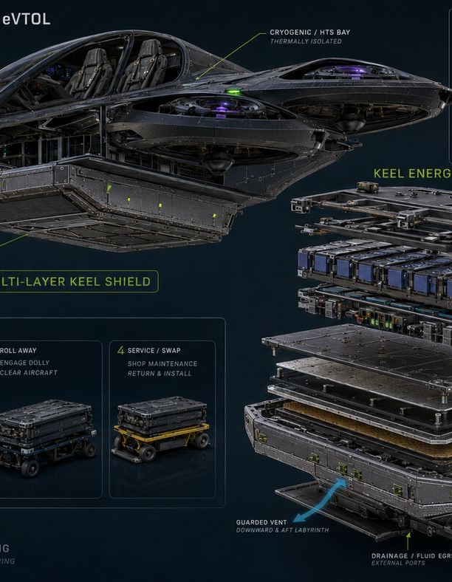
CRTFE
Test the smallest question first
A simple funding and partnership presentation
Dorian Martin-Smith | Lawton, Oklahoma
PHASE 1 REQUEST: $25,000
Notes:
Thank you for meeting with me. CRTFE is a big idea, but I am not asking anyone to believe a flying machine already works. I am asking for help running one small, honest experiment that can tell us whether to continue or stop.
[Sources]
- CRTFE repository: README.md
- User-provided CRTFE V5 concept image
[/Sources]

Slide 2
CRTFE is the project name
02
Controlled project name
CRTFE Experimental Aerospace Research Project
Plain English: Can electricity and magnets push moving air?
The old files use both CRFTE and CRTFE. The full letter-by-letter meaning has not been approved, so we do not make one up.
CRTFE P2 | CONCEPT ONLY - NOT FLIGHT READY
Dorian Martin-Smith | Lawton, Oklahoma
Notes:
This is the CRTFE Experimental Aerospace Research Project. In plain words, we are asking whether electricity and magnets can push moving air. The files use two spellings, CRFTE and CRTFE. We will use CRTFE today and will not invent a full name for the letters.
[Sources]
- Dorian Project Meeting Control Register
- CRTFE_OKFB_Phase_1_Funding_Presentation.pptx
- CRFTE repository README.md
[/Sources]

Slide 3
Big dream. Small next step.
03
ONE DAY
TODAY
Study a two-seat vehicle that may move air without normal propellers.
→
Build one small wind-tunnel test. Measure the facts. Stop if the facts say no.
No crew. No flight. No complete aircraft.
CRTFE P2 | CONCEPT ONLY - NOT FLIGHT READY
Dorian Martin-Smith | Lawton, Oklahoma
Notes:
The long-term dream is a two-seat research vehicle. But we are not building that now. The next step is a small table-top test. No people fly in it. If the result is bad, we stop or change direction.
[Sources]
- CRFTE repository: docs/TARGET-VEHICLE-V5.md
- CRFTE repository: docs/V0.3-PROTOTYPE-BUILD-GUIDE.md
[/Sources]

Slide 4
Four simple steps
04
1
2
3
4
Air moves
Air gets a charge
A field moves
We measure
→
→
→
A blower sends air through a small tunnel.
A closed lab tool adds electrical energy.
Coils make a magnetic pattern move.
Sensors tell us if the air was pushed.
The reaction force might create thrust later. The first test only checks the ingredients.
CRTFE P2 | CONCEPT ONLY - NOT FLIGHT READY
Dorian Martin-Smith | Lawton, Oklahoma
Notes:
Here is the idea in four steps. Air moves through a tunnel. A closed laboratory tool puts energy into the air. Coils make a magnetic pattern move. Then sensors measure what happened. We are not calling this thrust yet. We are only checking the ingredients.
[Sources]
- CRFTE repository: docs/V2-HYBRID-MHD-BASELINE.md
- CRFTE repository: docs/V0.3-PROTOTYPE-BUILD-GUIDE.md
[/Sources]

Slide 5
One question decides the project
05
Can moving air carry enough electricity...
without using too much power, making too much heat, or turning into a dangerous arc?
YES → design the next test
NO → stop or redesign
CRTFE P2 | CONCEPT ONLY - NOT FLIGHT READY
Dorian Martin-Smith | Lawton, Oklahoma
Notes:
This is the one question we need answered. Can moving air carry enough electricity without wasting too much power, getting too hot, or becoming an arc? A yes only earns the next test. A no saves us from wasting money on a vehicle.
[Sources]
- CRFTE repository: docs/V0.3-CONDUCTIVITY-GATE.md
- CRFTE repository: docs/V4-V5-REVISED.md
[/Sources]

Slide 6
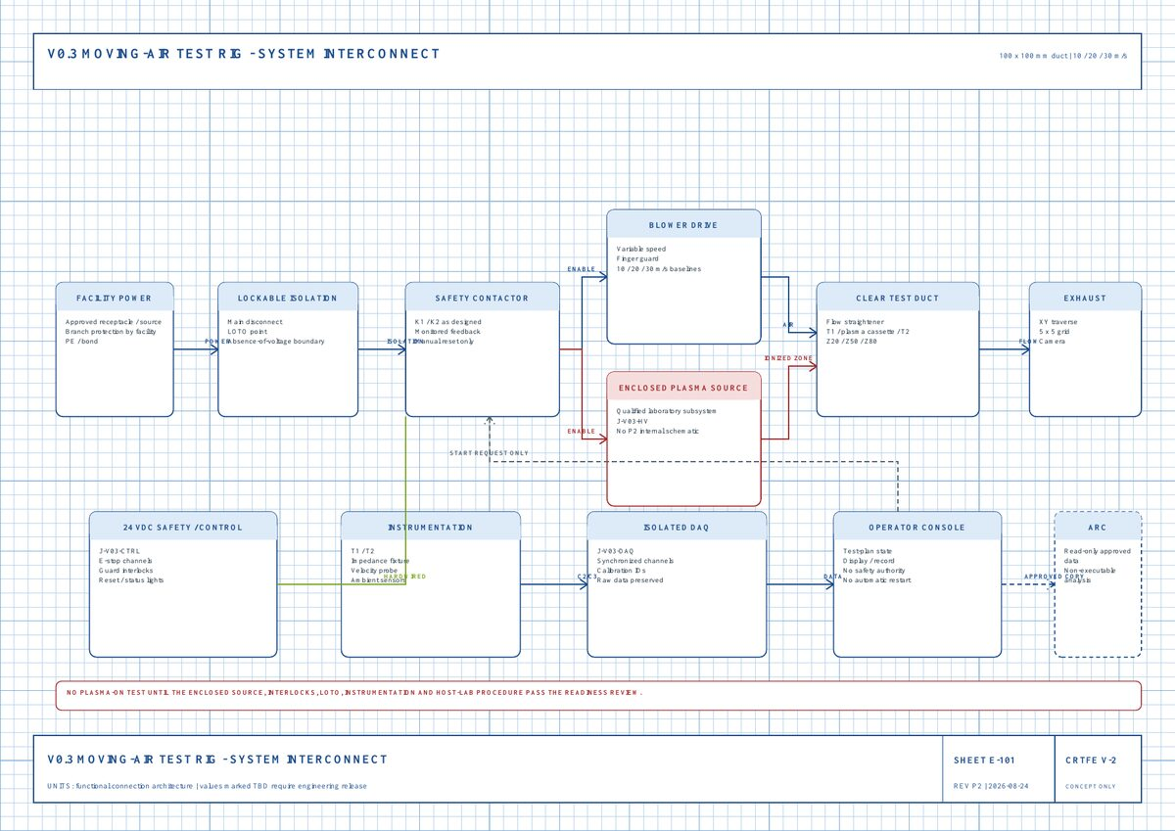
V0.3 is our first experiment
06
What we measure
Air speed: 10, 20, 30 m/s
Conductivity
Power and heat
How long the charge lasts
Whether the air really moves
Small duct: 100 mm × 100 mm
CRTFE P2 | CONCEPT ONLY - NOT FLIGHT READY
Dorian Martin-Smith | Lawton, Oklahoma
Notes:
This is the updated wiring picture for the first experiment. A blower moves air through a small tunnel. The plasma tool stays closed inside a qualified lab. Sensors measure air speed, conductivity, power, heat, and how long the charge lasts. We first test at 10, 20, and 30 meters per second.
[Sources]
- CRFTE repository: docs/V0.3-PROTOTYPE-BUILD-GUIDE.md
- CRTFE V-2 Electrical Wiring Schematic Set P2, sheet E-101
[/Sources]

Slide 7
The result says stop or go
07
Below 20 S/m
STOP or make a major change
20-60 S/m
Borderline - learn and redesign
60+ S/m
Re-run the model with real data
80-150+ S/m
Best research target only if power and heat stay reasonable
A bright spark is not a win. Streams or arcs fail the current path.
CRTFE P2 | CONCEPT ONLY - NOT FLIGHT READY
Dorian Martin-Smith | Lawton, Oklahoma
Notes:
We set the rules before seeing the answer. Below 20 means stop or make a major change. Between 20 and 60 means learn and redesign. At 60 or more, we run the model again using real data. A bright spark is not success if it is only a streamer or arc.
[Sources]
- CRFTE repository: docs/V0.3-CONDUCTIVITY-GATE.md
- CRFTE repository: docs/V0.3-PROTOTYPE-BUILD-GUIDE.md
[/Sources]

Slide 8
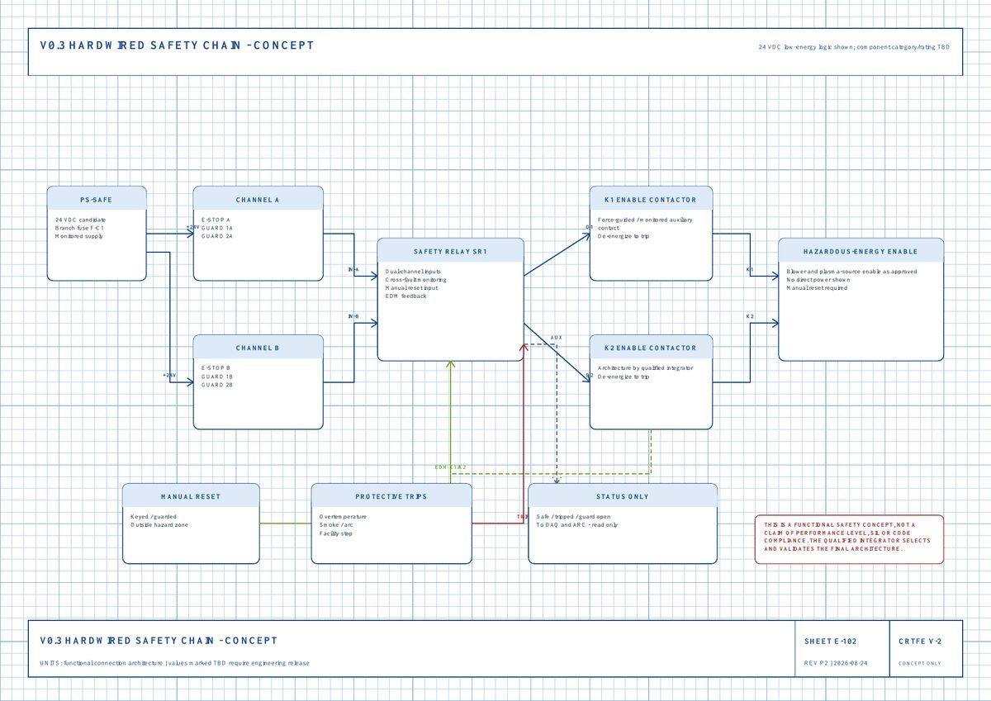
Safety stays outside ARC
08
Qualified laboratory
Closed high-voltage tool
Emergency stop and door guards
Manual reset - no surprise restart
ARC reads status but cannot bypass safety
No unqualified person operates the equipment.
CRTFE P2 | CONCEPT ONLY - NOT FLIGHT READY
Dorian Martin-Smith | Lawton, Oklahoma
Notes:
Safety is not left to a laptop or AI. The emergency stop and door guards use a hardwired safety chain. The high-voltage tool stays closed. The machine must need a manual reset after a trip. ARC may read the safe or stopped status, but it cannot bypass the safety system.
[Sources]
- CRTFE V-2 Electrical Wiring Schematic Set P2, sheet E-102
- OSHA 29 CFR 1910.147
- OSHA 29 CFR 1910.333
- OSHA 29 CFR 1910.306
[/Sources]

Slide 9
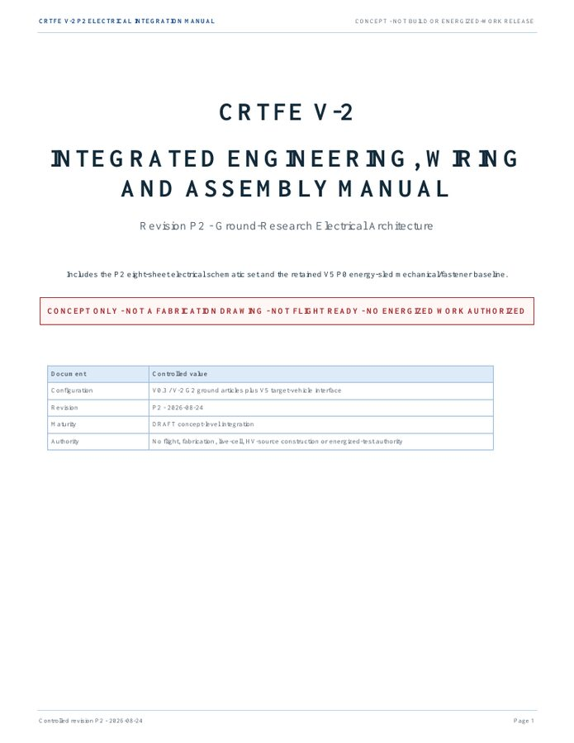
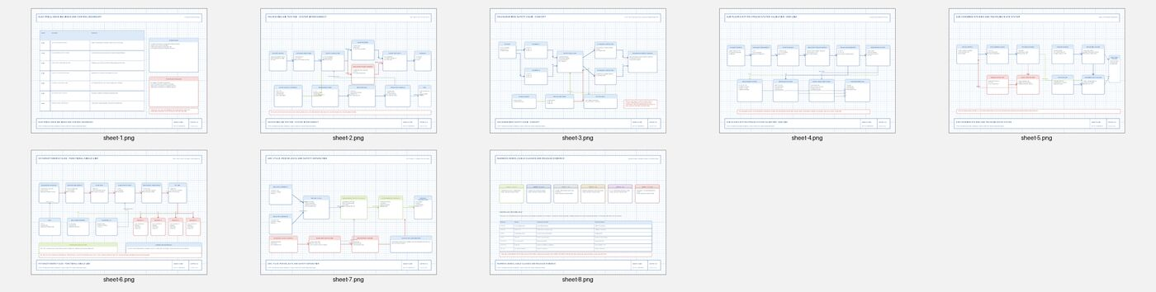
We already built the research base
09
Public GitHub record
Math and failure models
Stop/go test rules
ARC evidence tracking
8 wiring sheets
Build and inspection steps
47-page manual
CRTFE P2 | CONCEPT ONLY - NOT FLIGHT READY
Dorian Martin-Smith | Lawton, Oklahoma
Notes:
I did not stop at a sketch. The project now has a public repository, math, failure models, stop-and-go rules, an updated 47-page manual, and eight electrical wiring sheets. ARC helps track evidence and disagreements, but every plan stays non-executable.
[Sources]
- CRFTE GitHub repository
- CRTFE V-2 Integrated Engineering, Wiring and Assembly Manual P2
- CRTFE V-2 Electrical Wiring Schematic Set P2
- The Akashic-record repository ARC Revision 1.4
[/Sources]

Slide 10
Possible Oklahoma uses
10
These are future use ideas - not proven benefits.
FARMS
UTILITIES
Look at crops and livestock from the air
Check power lines and pipelines
WILDFIRE
RESCUE
Watch fire, smoke, and hard-to-reach land
Help search teams see large rural areas
First prove the physics. Then study the use.
CRTFE P2 | CONCEPT ONLY - NOT FLIGHT READY
Dorian Martin-Smith | Lawton, Oklahoma
Notes:
If the science works later, Oklahoma could study uses for farms, power lines, pipelines, wildfire watching, and search-and-rescue. These are possible use ideas, not promises. We must prove the physics first.
[Sources]
- Dorian Project Meeting Control Register
- CRTFE_OKFB_Phase_1_Funding_Presentation.pptx
[/Sources]

Slide 11
First test: $25,000
11
$25,000
Lab, setup, and safety
$9,000
Plasma and diagnostics expert
$6,000
A planning request for one controlled test
Tools, calibration, and data
$4,000
Analyze data and re-run model
$3,000
Independent technical review
$2,000
A useful negative result still saves future money.
Open report and reproducibility
$1,000
CRTFE P2 | CONCEPT ONLY - NOT FLIGHT READY
Dorian Martin-Smith | Lawton, Oklahoma
Notes:
The documented first-step budget is twenty-five thousand dollars. Nine thousand is for the lab and safety. Six thousand is for the plasma and diagnostics expert. Four thousand is for tools, calibration, and data. The rest pays for analysis, independent review, and an open report. A negative result is still useful because it can stop a much more expensive mistake.
[Sources]
- Emergent_Ventures_CRFTE_V03_Concept.pdf
- CRFTE V0.3 Experimental Supporting Documentation
[/Sources]

Slide 12
Our ask for OKFB
12
1
Tell us which rural problems are worth studying.
2
Introduce us to a qualified Oklahoma lab, UAS group, or engineer.
3
Help us find the right accelerator, sponsor, or grant path for the $25,000 test.
We are not asking OKFB to certify the physics.
CRTFE P2 | CONCEPT ONLY - NOT FLIGHT READY
Dorian Martin-Smith | Lawton, Oklahoma
Notes:
Our ask is simple. First, tell us which rural problems are worth studying. Second, introduce us to a qualified Oklahoma lab, university, drone group, or engineer. Third, help us find the right accelerator, sponsor, or grant path for the twenty-five-thousand-dollar test. We are not asking Farm Bureau to certify the physics.
[Sources]
- Dorian Project Meeting Control Register
- CRTFE_OKFB_Phase_1_Funding_Presentation.pptx
- Emergent_Ventures_CRFTE_V03_Concept.pdf
[/Sources]

Slide 13
Why take a chance on me?
13
I turned an idea into a documented research project.
I kept the failed math instead of hiding it.
I changed direction when the numbers said no.
I chose one smaller experiment that can prove me wrong.
I know qualified experts and a real laboratory must control the test.
I am asking you to believe in the process - not a promise.
CRTFE P2 | CONCEPT ONLY - NOT FLIGHT READY
Dorian Martin-Smith | Lawton, Oklahoma
Notes:
Why should anyone take a chance on me? Because I kept the bad result instead of hiding it. I changed the project when the math said no. I designed a smaller test that can prove me wrong. I also know that qualified experts and a real laboratory must control the dangerous parts. I am asking you to believe in the process, not a promise.
[Sources]
- CRFTE repository: docs/V4-V5-REVISED.md
- CRFTE repository: docs/V0.3-CONDUCTIVITY-GATE.md
- CRFTE repository revision history
[/Sources]

Slide 14
Our next win is one honest answer.
Help CRTFE test before it builds.
1
Choose the right Oklahoma path
2
Help secure the $25,000 first experiment
3
Introduce the lab, mentors, and partners
Dorian Martin-Smith | dorianmartinsmith@gmail.com
The evidence decides what happens next.
Notes:
The next win is not a flight claim. It is one honest answer. I would like your help choosing the right Oklahoma path, securing or assembling the twenty-five-thousand-dollar first experiment, and meeting the right lab, mentors, and partners. Then we let the evidence decide what happens next.
[Sources]
- Dorian Project Meeting Control Register
- Emergent_Ventures_CRFTE_V03_Concept.pdf
- CRFTE repository: docs/V0.3-PROTOTYPE-BUILD-GUIDE.md
[/Sources]

