Slide 1
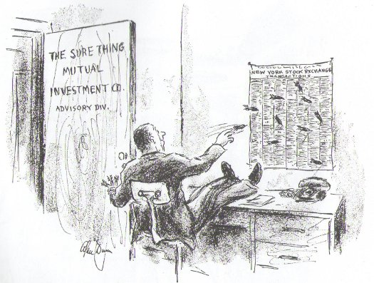
Stock Portfolio
Team TLT
Taehee Jung
Lev Golod
Temi N Lal

Slide 2
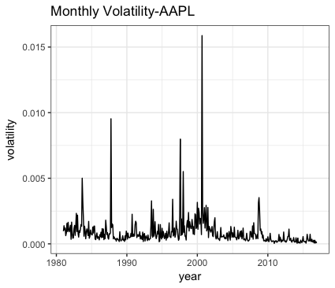
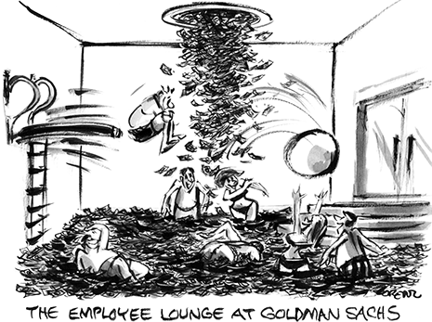
Introduction
We were previously trying to predict returns, but after further consideration we decided to predict volatility instead because it is autocorrelated.
Volatility = variance of daily returns
The average of the squared, mean-centered returns.
Our goal is to use volatility in our optimization problem to achieve a portfolio that has:
Fewer than 40 stocks (sparse initialization and updates)
Higher returns on average than the S&P 500
Lower variance than the S&P 500

Slide 3
Volatility Prediction: Experiment
We used data from Jan 1980 – Dec 2013 to test our model.
We want to predict monthly volatility.
We need to find the “best” prediction model among the different combinations of methods, training windows, and step sizes:
Methods: AR, VAR (feature: volume), MA, Simple Moving Average (SMA)
Training windows (training period for one step) : 6 / 12 / 18 / 24 months
Step sizes (months to predict with one training window): 1 / 3 / 5 months
Evaluation Metric : Average RMSE (root mean squared error)
Test Period
Train1
Step1
Predicted
volatility in given period
Average
RMSE
Train2
Step2
Train3
Step3
....

Slide 4
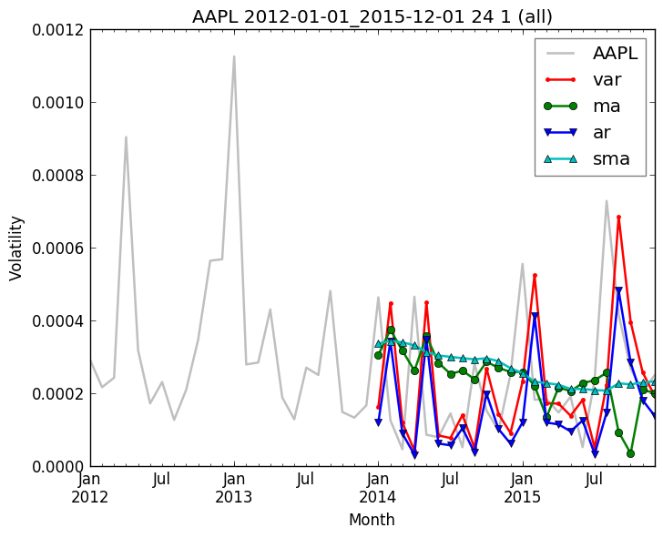
Volatility Prediction: Results
Based on our evaluation metric, what is the best prediction model?
: VAR(+Volume) + 24 Months(Training Window) + 1 Month(Step Size)
VAR means we are predicting volatility based on 1) past volatility and 2) volume
Training window (=t) | Steps | RMSE
 |  | AR (t-1) | MA (2) | VAR_volume (t-1) | SMA (t)
6 | 1 | 0.000447 | 0.000492 | 0.000410 | 0.000372
6 | 3 | 0.001927 | 0.000537 | 0.005971 | 0.000435
6 | 5 | 0.051782 | 0.000578 | 1.159149 | 0.000473
12 | 1 | 0.000399 | 0.000441 | 0.000375 | 0.000393
12 | 3 | 0.001159 | 0.000505 | 0.000929 | 0.000461
12 | 5 | 0.018620 | 0.000552 | 0.018547 | 0.000501
18 | 1 | 0.000383 | 0.000406 | 0.000360 | 0.000415
18 | 3 | 0.001029 | 0.000488 | 0.000504 | 0.000482
18 | 5 | 0.016111 | 0.000543 | 0.000948 | 0.000523
24 | 1 | 0.000378 | 0.000396 | 0.000358 | 0.000436
24 | 3 | 0.000989 | 0.000490 | 0.000479 | 0.000503
24 | 5 | 0.015571 | 0.000549 | 0.000664 | 0.000545
Actual vs. Predicted Volatility
AAPL, 2012 - 2016

Slide 5
Volatility Prediction with Sentiment Features
We chose 5 sample companies to use to test the effect of adding sentiment features as a predictor to our volatility model.
We compared the RMSE of a VAR with sentiment features (freq, pos, neg) with the RMSE of the best prediction model without sentiment features for each company.
Overall, we cannot conclude that a VAR with sentiment features will consistently beat the best model without sentiment features for all or most companies.
Company | Training window | Steps | RMSE
 |  |  | + volume (No Twitter) | + tweet freq (Twitter) | + positive tweets (Twitter) | + negative tweets (Twitter)
AAPL | 24 | 1 | 0.000195 | 0.000242 | 0.000235 | 0.000295
AMZN | 24 | 1 | 0.000074 | 0.000198 | 0.000194 | 0.000239
MSFT | 24 | 1 | 0.000149 | 0.000181 | 0.000179 | 0.000199
FB | 18 | 1 | 0.000084 | 0.000109 | 0.000108 | 0.000495
GOOGL | 24 | 1 | 0.000285 | 0.000270 | 0.000266 | 0.000289
Total Test Period: 2009.01.01 - 2013.12.31
Evaluation Metric : Average RMSE

Slide 6
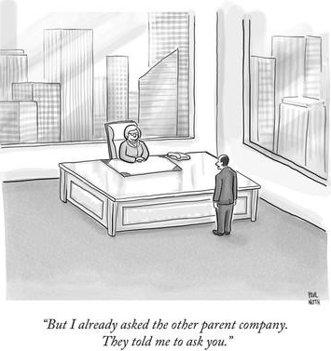
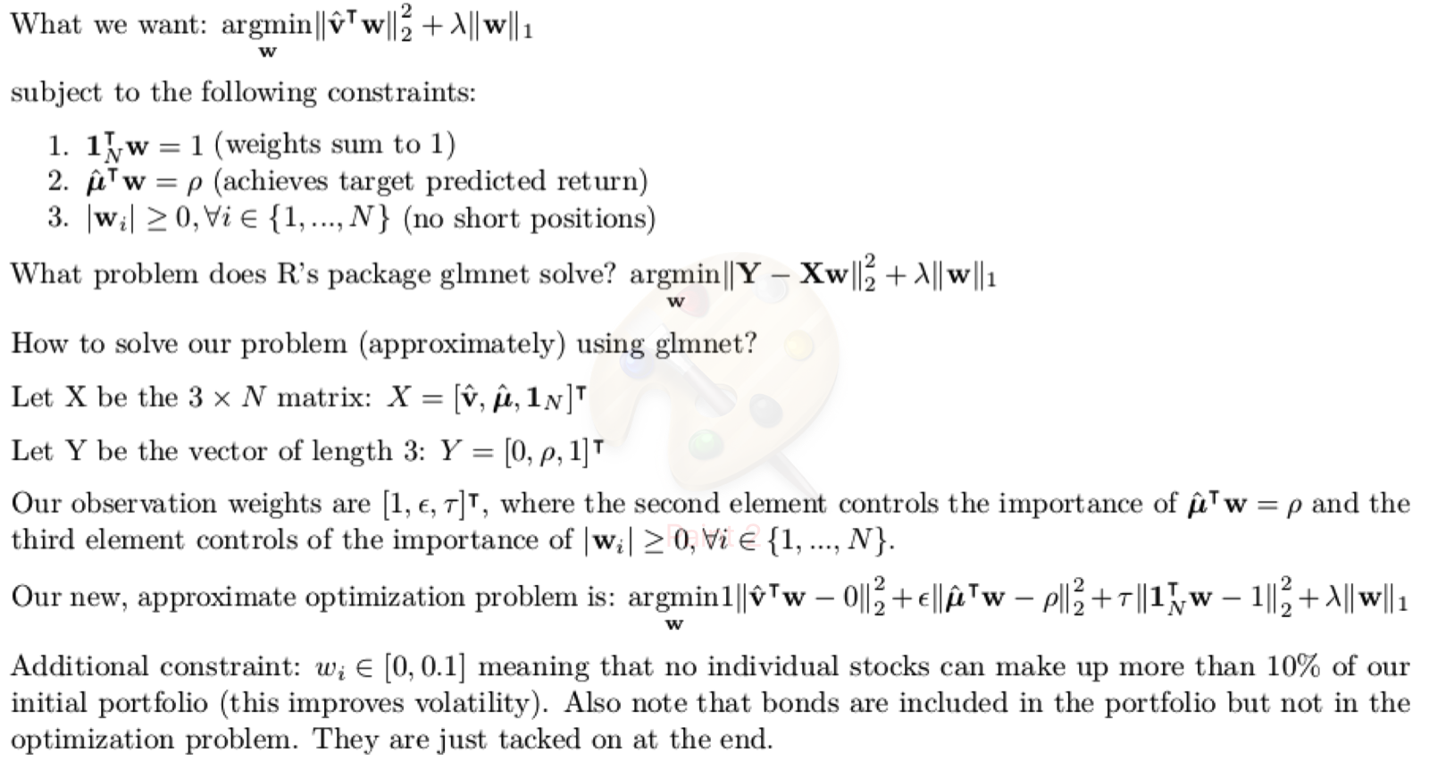
Portfolio Optimization

Slide 7
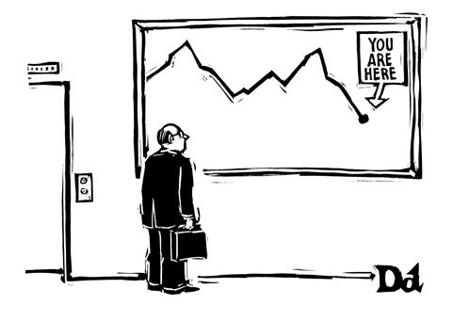
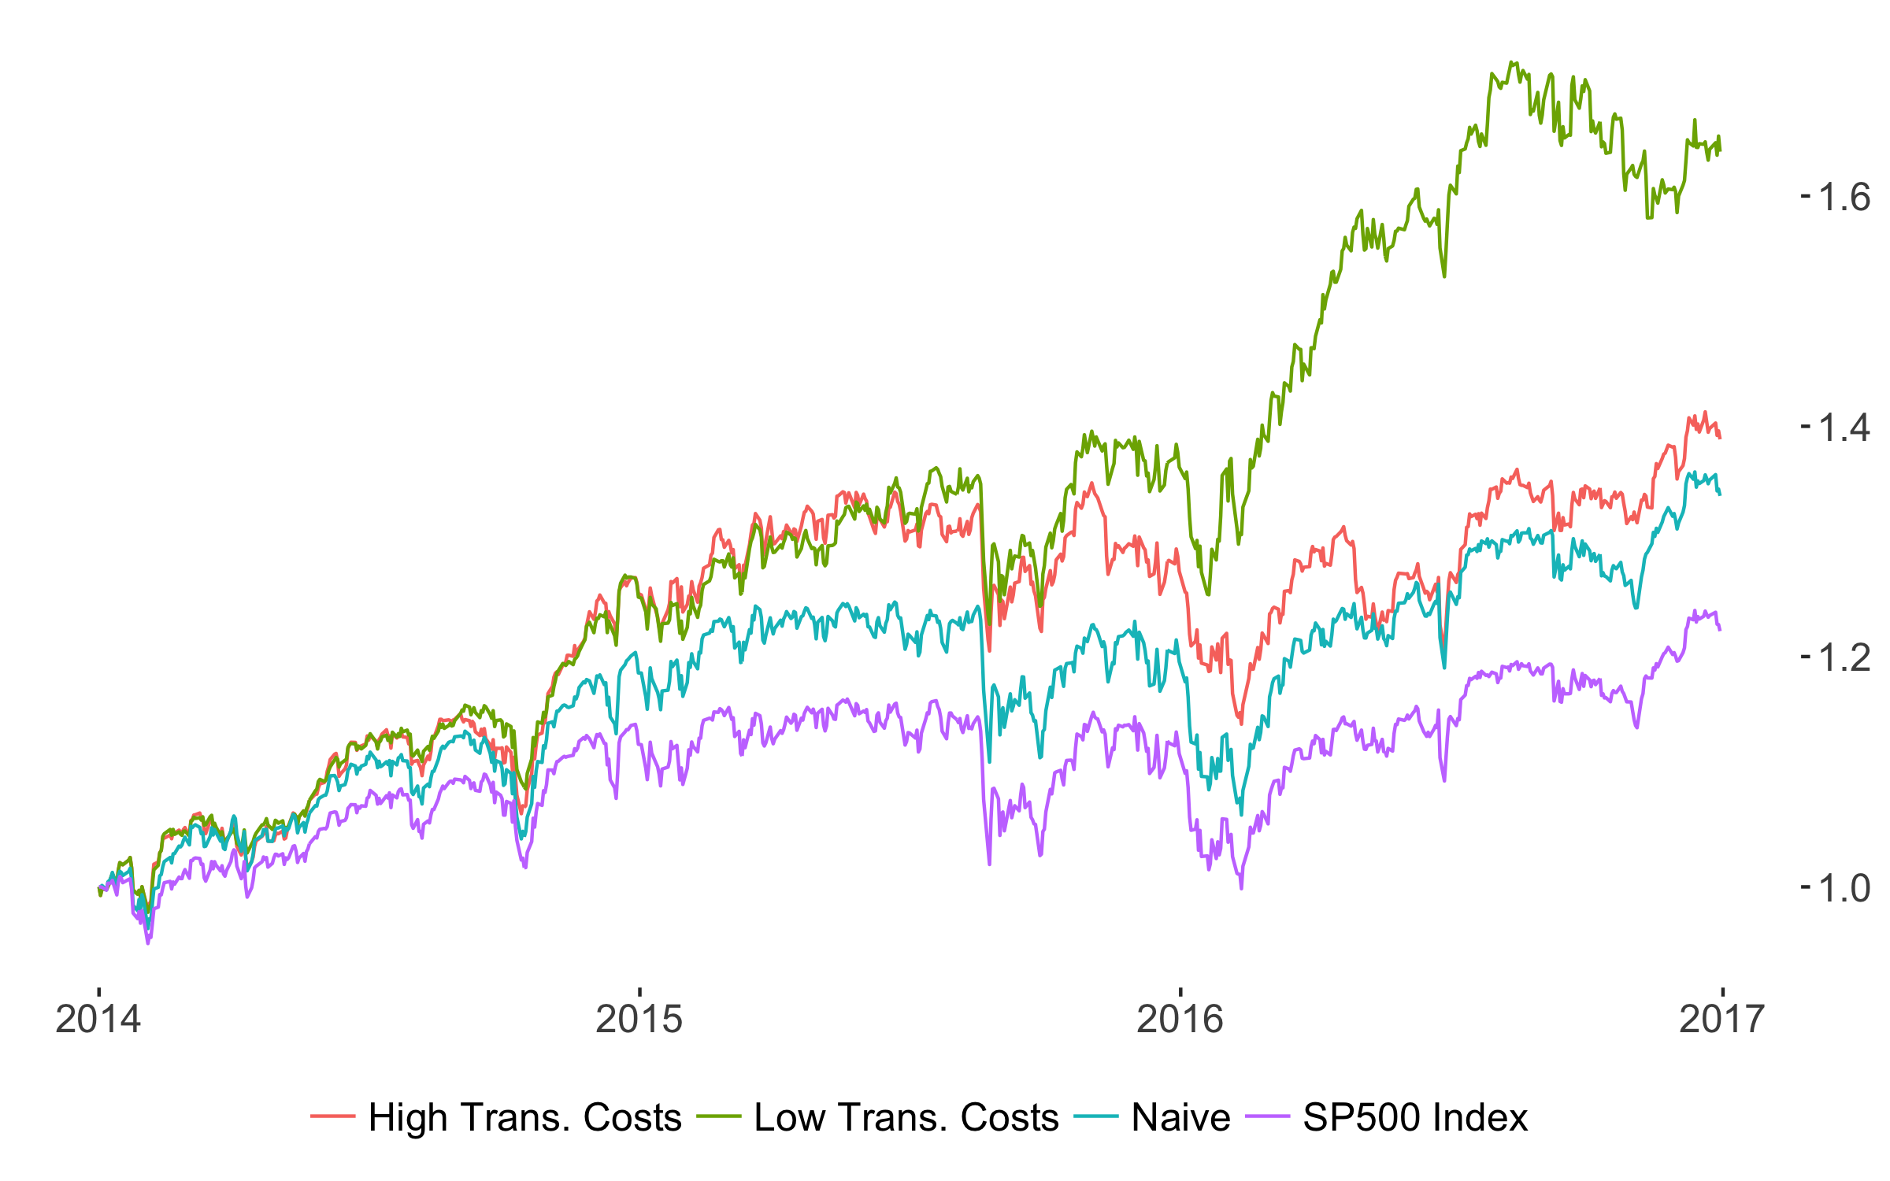
Results: 2014-2016
20% of initial capital was allocated to 10-year US Treasury bonds
Our goal was to beat the S&P 500 Index: Higher returns, lower variance, and sparsity
Portfolio | Annual Returns | Volatility | Relative Volatility | # Active Positions
 |  |  |  | Start | End
High Transaction Costs | 11.6% | 5.9E-05 | 82% | 19 | 19
Low Transaction Costs | 17.9% | 6.4E-05 | 89% | 19 | 29
SP 500 Index | 6.9% | 7.1E-05 | 100%
Naive Portfolio | 10.2% | 7.5E-05 | 105%

Slide 8
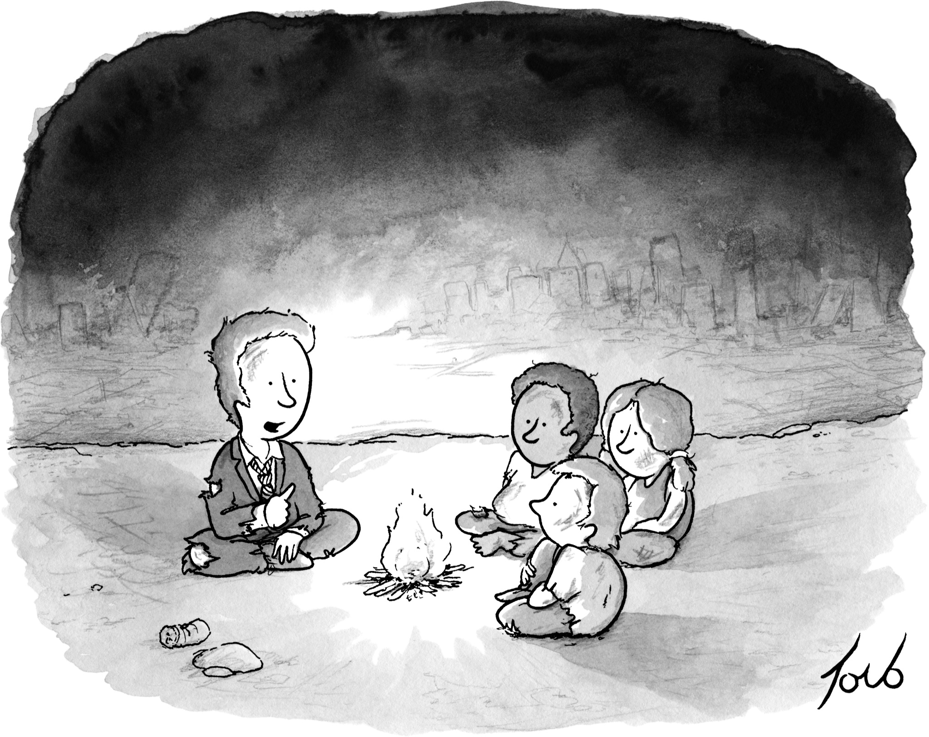
Limitations & Directions for Further Research
Things we didn’t do (yet) due to time constraints:
Incorporate annual re-balancing to maintain initial 80/20 stock/bond split
Predict ‘good’ or ‘bad’ years in the market; adjust bond holdings accordingly
Factor in the destabilizing influence of certain high-profile Twitter users
Future ideas:
New features to predict volatility:
Can past information about Stock X help predict volatility of Stock Y?
General market conditions: interest rates, GDP, commodity prices
Trade-off between transaction costs and sparsity:
Low transaction costs promote profitability but lead to a ballooning number of active positions over time.
Can this be controlled algorithmically?
“Yes the planet got destroyed. But for a beautiful moment in time, we created a lot of value for shareholders.”

