Slide 1

Plant Disease Detection Application
Name: Sumit Parashar
Enrollment Number: E23CSEU1080
Batch-36

Slide 2

Overview
It is a web application designed to help farmers and agricultural professionals identify plant diseases through image analysis using artificial intelligence. Users can upload images of their plants, and the application provides instant predictions along with treatment recommendations.

Slide 3
Key Features
Image Upload: Users can easily upload images of plants.
Disease Prediction: The application analyzes the image using a trained AI model to identify potential diseases.
User Dashboard: A dashboard for users to track previous uploads and predictions.

Slide 4
Technology Stack
Frontend:
Streamlit for building the user interface.
Backend:
TensorFlow for AI model integration.
Flask for additional backend functionalities.

Slide 5
User Interface Design
Home Page
Title: Plant Disease Detection
Description: Brief introduction and instructions on how to use the application.
Upload Button: An easy-to-find button for uploading images.
Disease Detection Page
Header: "Disease Detection"
Image Upload: A file uploader for users to select and upload their plant images.
Predict Button: Triggers the prediction process.
Result Display: Shows the predicted disease, confidence level, and treatment recommendations.
User Dashboard
Previous Uploads: List of previously analyzed images with results.
Feedback Section: Form for users to provide feedback on predictions.

Slide 6
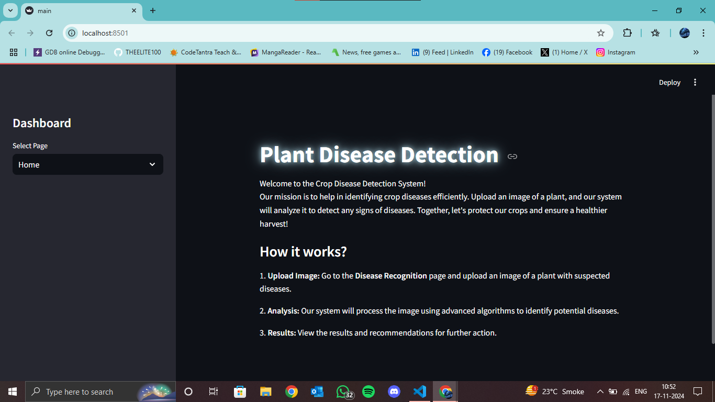
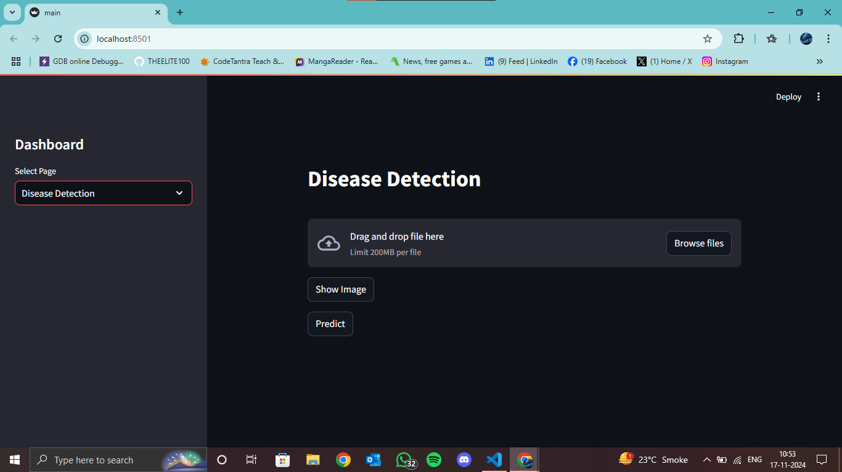
HOmEPAGE AND DASHBOARD

Slide 7
Results
The application effectively detects a variety of plant diseases. Users can upload images, and the system provides instant feedback on the health of the plant along with the predicted disease name.
Accuracy: 97%

Slide 8
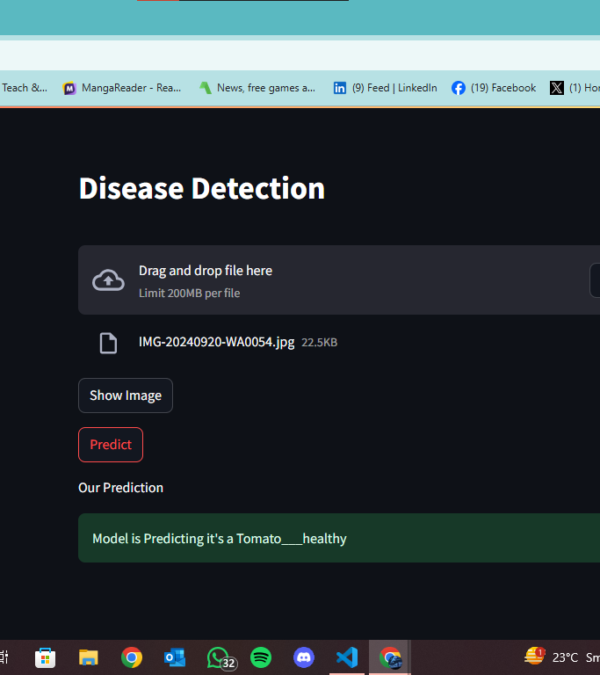
OUTPUT

Slide 9
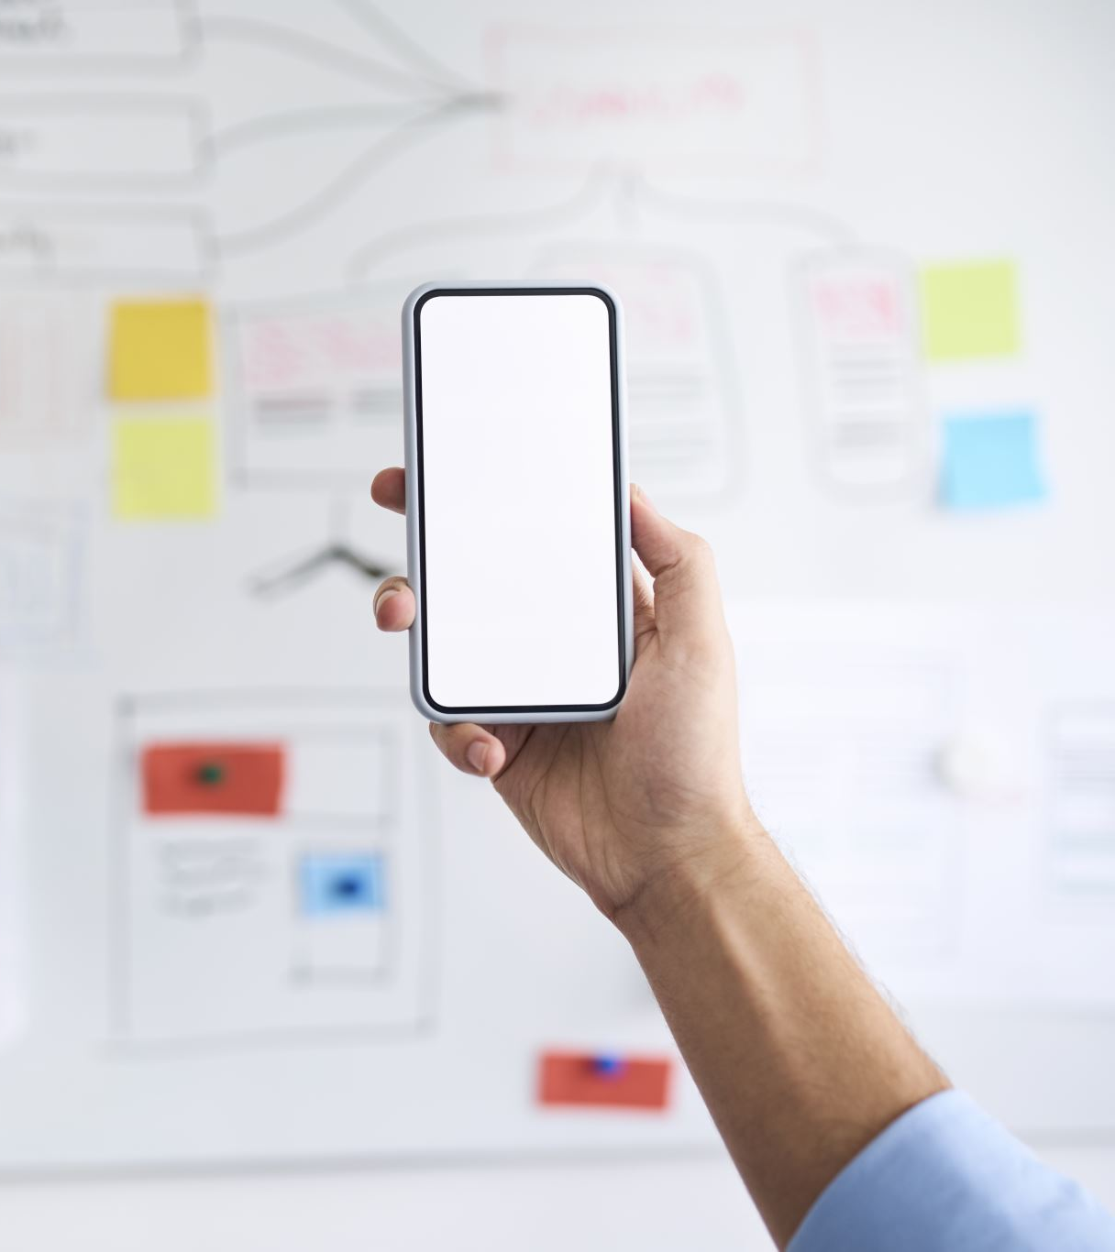
Future Enhancements
Mobile Compatibility: Develop a mobile-responsive version or a dedicated mobile app.
Expanded Disease Database: Regularly update the model with new data and diseases.
User Authentication: Implement a login system for personalized dashboards and data tracking.

Slide 10
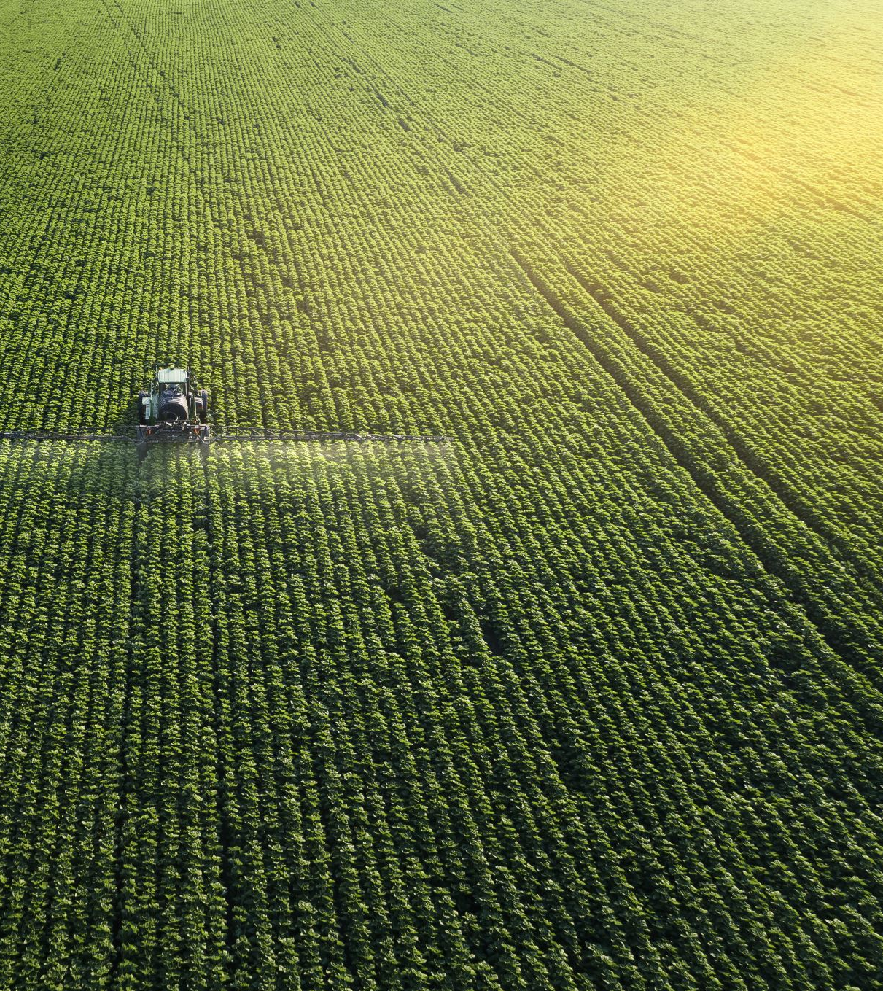
Conclusion
We aims to empower farmers and agriculturalists by providing them with a powerful tool for disease detection, ultimately leading to healthier crops and increased productivity.

Slide 11
Thank you

