Slide 1

SMART IRRIGATION
Submitted by : THEERTHA T.
MCA S4
TVE20MCA-2055
Project Guide : Sreerekha V. K.

Slide 2
INTRODUCTION
Water irrigation system based on Internet of Things (IoT).
Delivers a smart and cost effective irrigation system.
Irrigate the farmland in an efficient manner with automated irrigation
System based on soil moisture.
Operates by monitoring the value on soil moisture sensor and based
on the reading, motor is kept ON or OFF.
User-friendly experience with the help of mobile application.

Slide 3
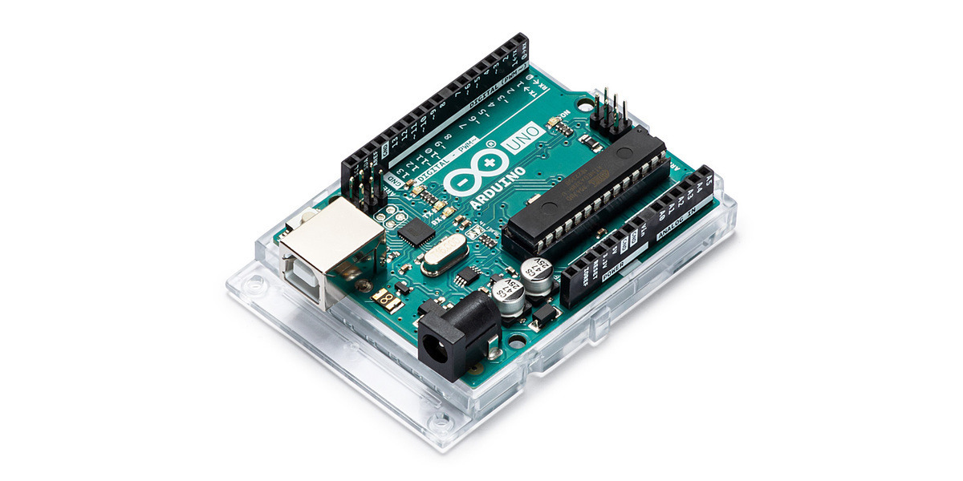
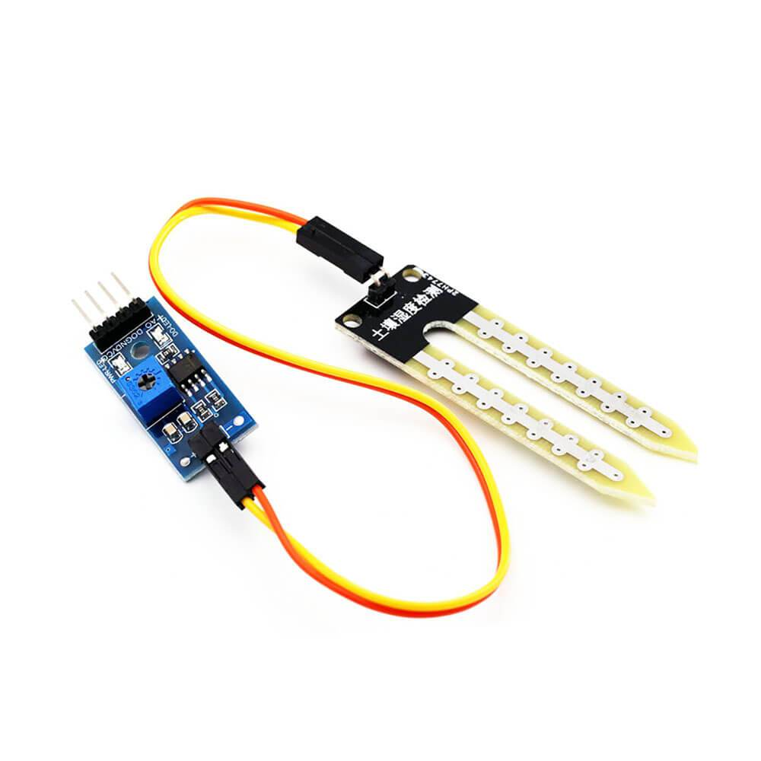
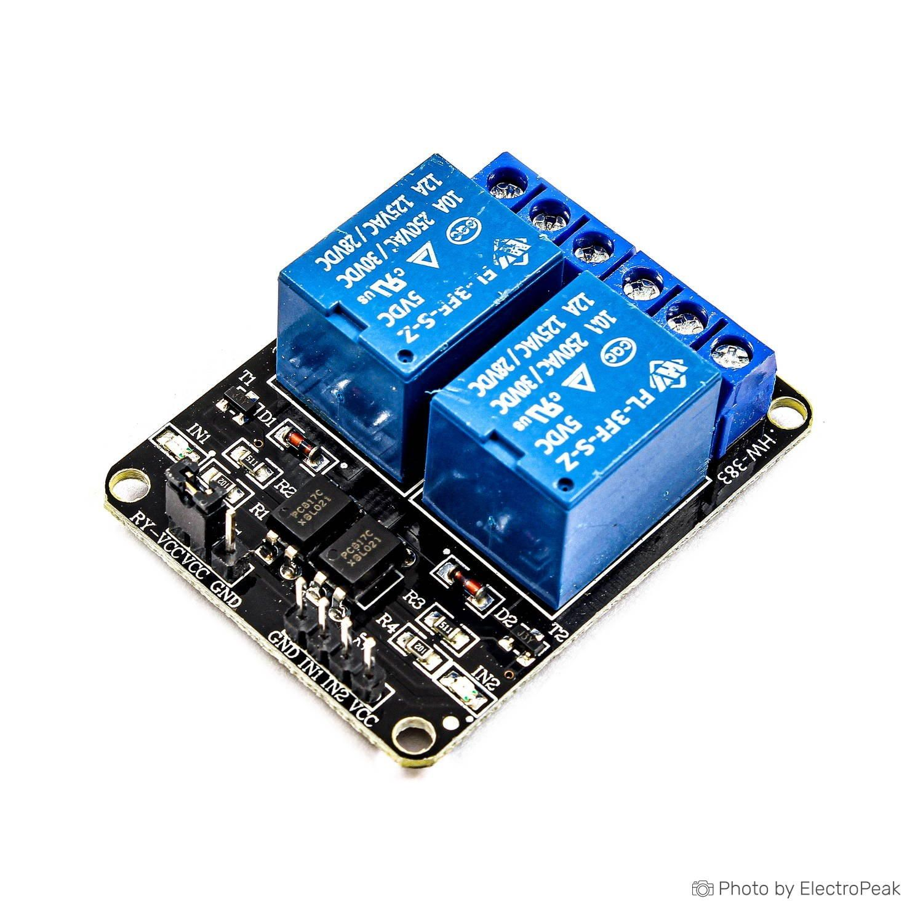
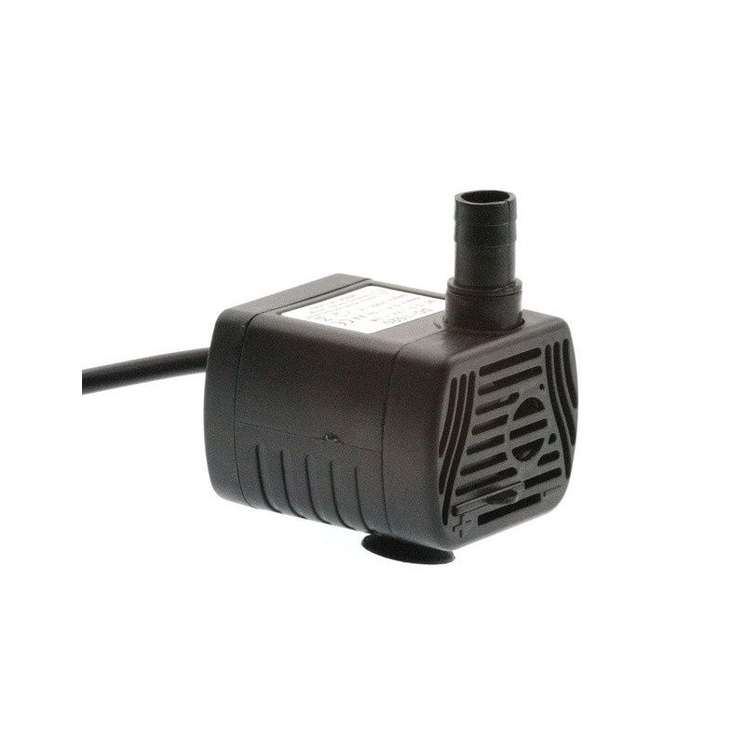
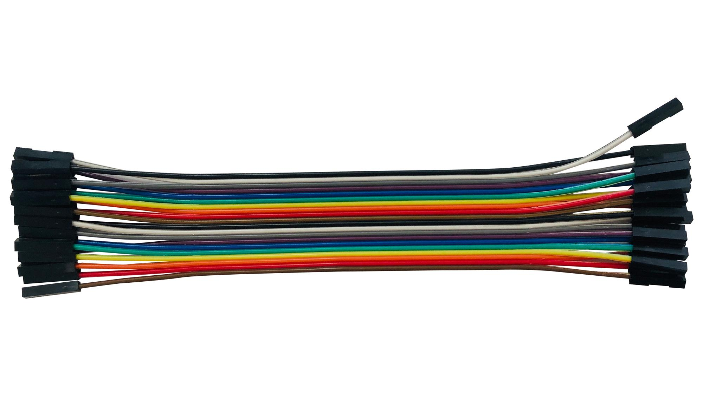
COMPONENTS
Arduino
Soil moisture sensor
5V Relay
Water pump with tubes
Jumper wires

Slide 4
EXISTING SYSTEM
In existing system, we require manual supervision and labour for proper irrigation.
It needs additional labour and is costlier. We cannot guarantee its efficiency.
As per the paper "An IoT Based Smart Irrigation System," 2021 , existing system
consist of a motor that pumps water automatically based on the value of sensor.

Slide 5
PROPOSED SYSTEM
In the proposed system, the watering process is automated which reduces manual work.
Various parameters of the plant and soil such as temperature, humidity and moisture
are sensed with the help of sensors and is displayed in the mobile application.
When there is a decrease in any of these sensed values, it sends a signal to the user and
the user can turn ON the motor by a simple click on mobile phone.

Slide 6
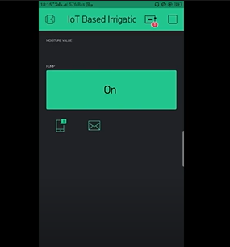

Slide 7
REFERENCE
M. R. H. Naeem, S. Gawhar, M. B. H. Adib, S. A. Sakib, A. Ahmed and N. A. Chisty,
"An IoT Based Smart Irrigation System," 2021 2nd International Conference on Robotics, Electrical and Signal
Processing Techniques (ICREST), 2021, pp. 243-247, doi: 10.1109/ICREST51555.2021.9331092.
C. Stolojescu-Crisan, B. -P. Butunoi and C. Crisan, "An IoT Based Smart Irrigation System,“
in IEEE Consumer Electronics Magazine, doi: 10.1109/MCE.2021.3084123.
V. R. Balaji, V. Kalvinathan, A. Dheepanchakkravarthy and P. Muthuvel, "IoT Enabled Smart Irrigation System,"
2021 International Conference on Advancements in Electrical, Electronics, Communication, Computing and
Automation (ICAECA), 2021, pp. 1-6, doi: 10.1109/ICAECA52838.2021.9675690.

