Slide 1

SMART IRRIGATION
Submitted by : THEERTHA T.
MCA S4
TVE20MCA-2055
Project Guide : Sreerekha V. K.

Slide 2
CONTENTS
Introduction
Literature Review
Existing System
Proposed System
Components
Architecture
Circuit Diagram
Working
References

Slide 3
INTRODUCTION
Water irrigation system based on Internet of Things (IoT).
Irrigate the farmland in an efficient manner with automated irrigation System based on soil moisture.
Operates by monitoring the value on soil moisture sensor and based on the reading, motor is kept ON or OFF.
Node MCU transports the data to the digital platform of the server for processing of the data. Then those data are sent to the mobile application of the user.
User-friendly experience with the help of mobile application.

Slide 4
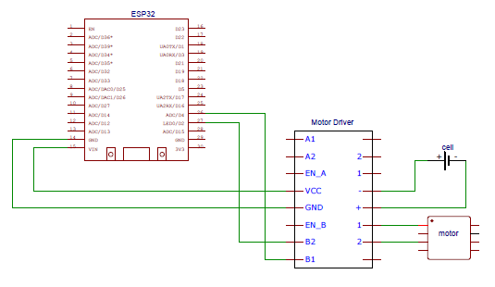
LITERATURE REVIEW
YEAR
NAME OF THE PAPER
AUTHOR
DESCRIPTION
LIMITATIONS
M. Mayuree
P. Aishwarya
A. Bagubali
User should be alert
every time to OFF the
motor.
2019
Automatic Plant Watering
System
User will be notified to switch
ON/OFF the motor
J. Karpagam
I. I. Merlin
P. Bavithra
J. Kousalya
2020
Water irrigation using IoT
Pump get ON and OFF
automatically
no customized settings,
expensive
IoT Enabled Smart Farming
and
Irrigation System
M. Rohith
R. Sainivedhana
N. Sabiyath Fatima
user cannot interfere
with the process
2021
switch on the motor to
water the plants automatically
College of Engineering Trivandrum, MCA Department
College of Engineering Trivandrum, MCA Department
College of Engineering Trivandrum, MCA Department
4
4
4

Slide 5
EXISTING SYSTEM
In existing system, we require manual supervision and labour for proper irrigation.
As per the paper "An IoT Based Smart Irrigation System," 2021 , existing system consist of a motor that pumps water automatically based on the value of sensor.
No user intervention
Expensive
No customized settings

Slide 6
PROPOSED SYSTEM
In the proposed system, the watering process is automated which reduces manual work.
Various parameters of the plant and soil such as temperature, humidity and moisture are sensed with the help of sensors and is displayed in the mobile application.
When there is a decrease in any of these sensed values, it sends a signal to the user and the user can turn ON the motor by a simple click on mobile phone.

Slide 7
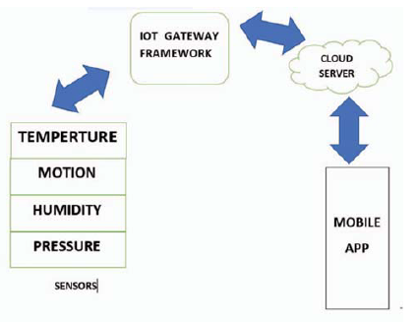
ARCHITECTURE

Slide 8
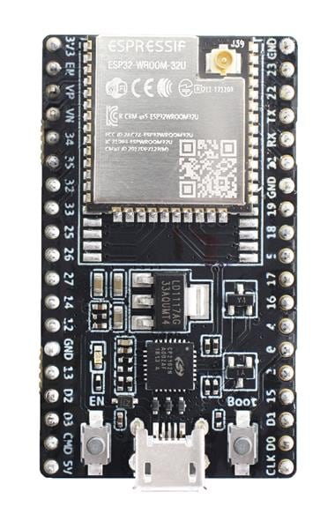
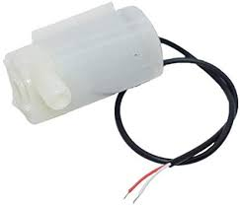
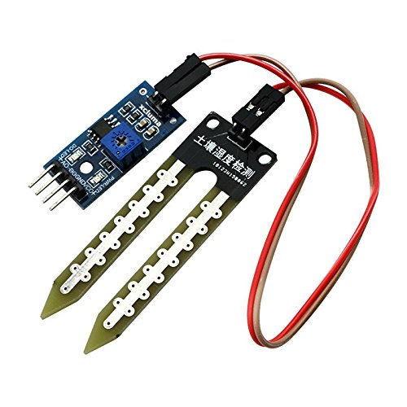
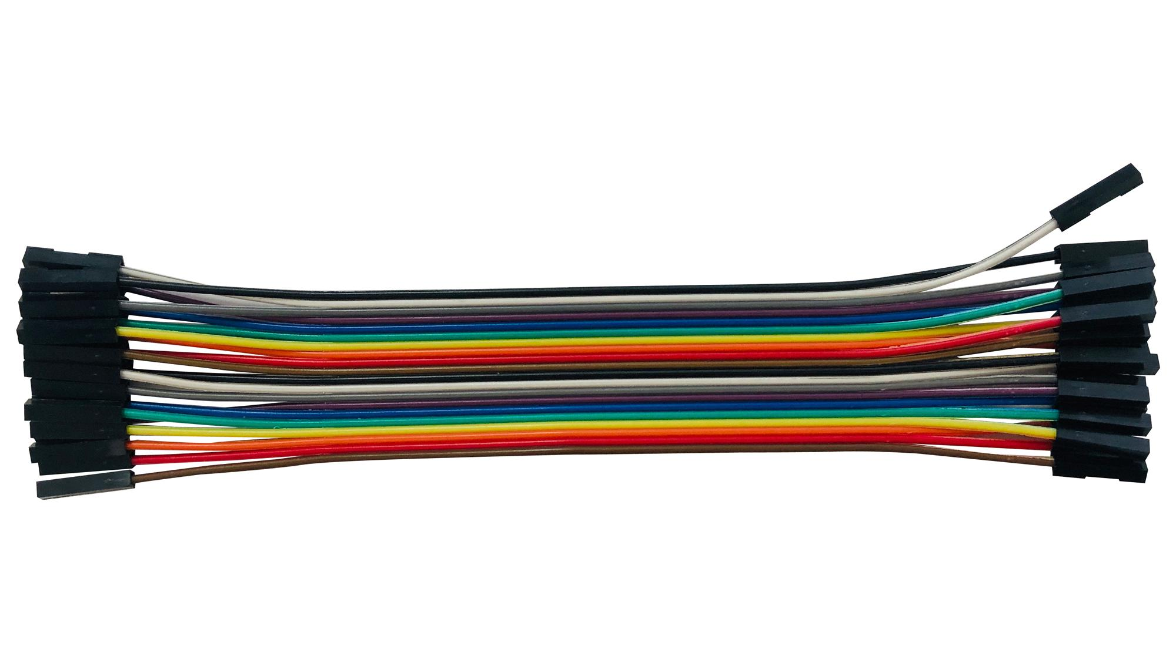
COMPONENTS
ESP32
2. Soil moisture sensor
3. Water pump
4. Jumper wire

Slide 9
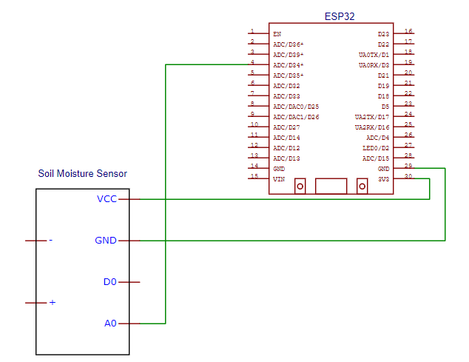
CIRCUIT DIAGRAM

Slide 10
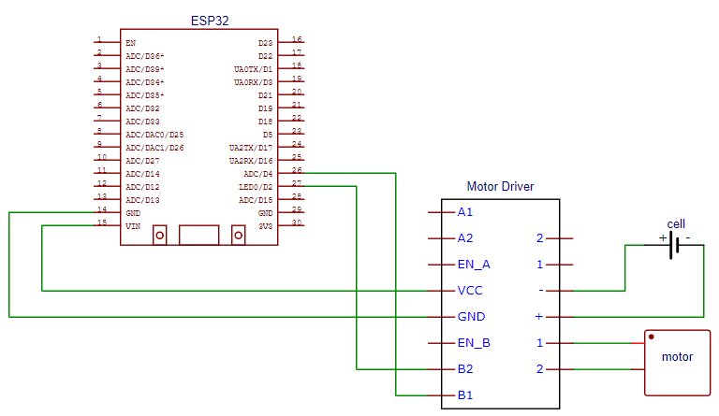

Slide 11
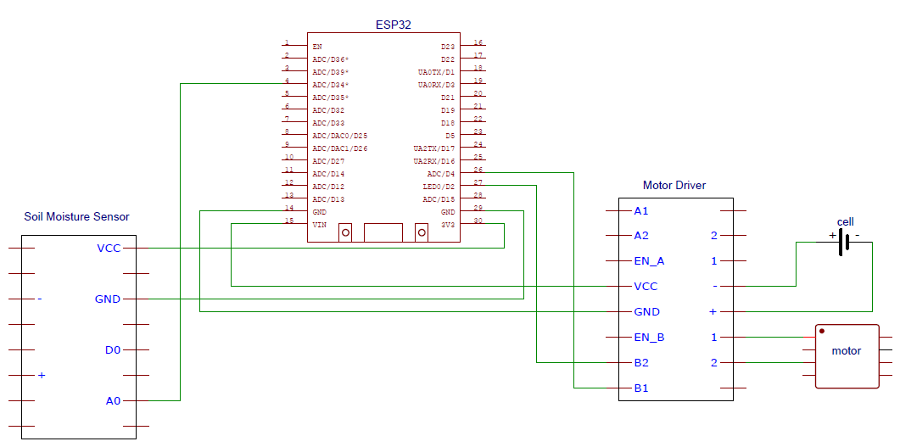

Slide 12
FLOW CHART
START
ALERT THE USER
NO
MOISTURE
>=
THRESHOLD
CHECK MOISTURE CONTENT
NO
YES
MOISTURE<THRESHOLD
YES
STOP WATER PUMP
College of Engineering Trivandrum, MCA Department
12

Slide 13
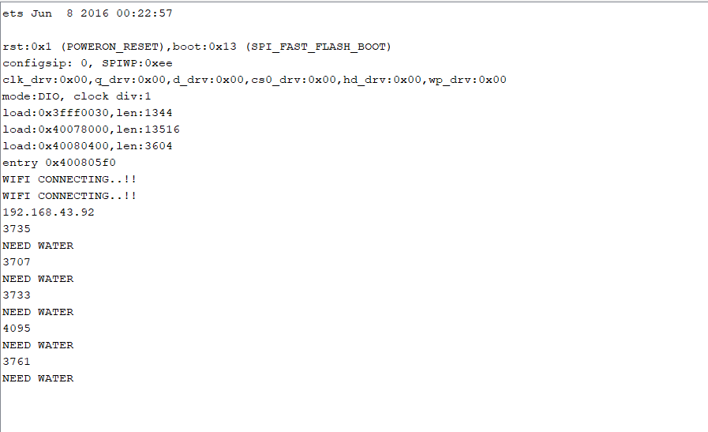
SCREENSHOT
WHEN SOIL IS DRY
Alert Message
Sensing
value
College of Engineering Trivandrum, MCA Department
College of Engineering Trivandrum, MCA Department
College of Engineering Trivandrum, MCA Department
13
13
13

Slide 14
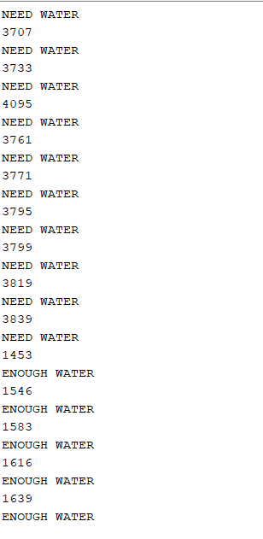
WHEN SOIL IS WET
Alert Message
Sensing value
College of Engineering Trivandrum, MCA Department
College of Engineering Trivandrum, MCA Department
College of Engineering Trivandrum, MCA Department
14
14
14

Slide 15
TIMELINE
Till 12/05/2022, completed soil moisture sensing.
Till 1/06/2022 , completed working of motor.
Till 7/06/2022 , completed working of motor based on the value of sensor.
Till 14/07/2022, completed WiFi connection.
By 20/07/2022 , water plants based on the sensing value.
By 25/07/2022, create android application for customizing settings.
By 30/07/2022, working of motor based on android app.
By 8/08/2022, completion of project.
College of Engineering Trivandrum, MCA Department
College of Engineering Trivandrum, MCA Department
15
15

Slide 16
CONCLUSION
Smart irrigation is a water irrigation system using IoT.
Here a sensor is placed on the soil to sense the moisture.
If the sensed value is lesser than the threshold value, alert is sent to the user.
And there by, User turns ON the motor.
When the sensed value is greater than the threshold value, motor gets OFF automatically.
College of Engineering Trivandrum, MCA Department
College of Engineering Trivandrum, MCA Department
16
16

Slide 17
REFERENCES
M. Rohith, R. Sainivedhana and N. Sabiyath Fatima, "IoT Enabled Smart Farming and Irrigation System," 2021
5th International Conference on Intelligent Computing and Control Systems (ICICCS), 2021, pp. 434-439, doi:
10.1109/ICICCS51141.2021.9432085.
M. Mayuree, P. Aishwarya and A. Bagubali, "Automatic Plant Watering System," 2019 International Conference
on Vision Towards Emerging Trends in Communication and Networking (ViTECoN), 2019, pp. 1-3, doi:
10.1109/ViTECoN.2019.8899452.
J. Karpagam, I. I. Merlin, P. Bavithra and J. Kousalya, "Smart Irrigation System Using IoT," 2020 6th International
Conference on Advanced Computing and Communication Systems (ICACCS), 2020, pp. 1292-1295, doi:
10.1109/ICACCS48705.2020.9074201.
College of Engineering Trivandrum, MCA Department
College of Engineering Trivandrum, MCA Department
17
17

Slide 18
THANK YOU
College of Engineering Trivandrum, MCA Department
College of Engineering Trivandrum, MCA Department
18
18

