Slide 1
Alexandria University
Institute of graduate Studies and Research
NLP Project
Submitted by
DR - Tamer Amr Zohdy
ID#: 1404-3-086
ENG - Khaled Muhamed Fathallah
ID#: 1404-3-101
ENG - Eslam Talaat Abdel-Qawy
ID#: 1404-3-135
Under Supervision of
Dr. Christine Basta

Slide 2
Abstract
In this project, we will classify the condition of patients using the reviews of the drugs given by patients using drug reviews dataset available in UCI Machine Learning Repository.
We will use the NLP algorithm to make a project in which the medical person will insert the patient Review in the form of a text as an input and the algorithm will give a diagnosis for the patient condition with recommendation of the best drug for therapy

Slide 3
Introduction
NLP Algorithms has been developed to be used in many fields
Their applications are used in machine translations, Sentiment analysis, chatbots, social media monitoring, etc…
The NLP Algorithms are able to understand the semantics and logics of texts and this will help us using them in the medical field for diagnosis and drug recommendation for treatmnet .

Slide 4
Project Problem
The main aim of this project is to use the patient own word and to understand their opinion about the drugs they use concerning efficacy, advantages, disadvantages , side effects and the duration they use the drugs in order to predict the diagnosis of the patient disease and to recommend the best drug for therapy.
The patient own words are not a scientific words and the challenge is to make the machine understand them to get a proper diagnosis

Slide 5
Dataset
drug reviews dataset available in UCI Machine Learning Repository in the form of csv file.
The Dataset has 161297 rows with 7 columns
The most important columns are DrugName, condition, review and rating
The rest of the columns will be dropped

Slide 6
Project general steps
(Implementation)
Reading the csv file
Data preprocessing (Text Cleaning - Text Tokenization - Text Normalization - Removing Rare Words - Text Vectorization
splitting the dataset into train set and test set
Making a model to be trained on the train set
The model is made by a vectoriser & classifier
We used many combination of different vectoriser like CountVectorizer-TFIDF- TFIDF: Bigrams-TFIDF: Triigrams
We used many classifiers like Naïve Bayes-Passive Aggressive Classifier

Slide 7
The best combination was with the TFIDF-Trigrams as vectorizer and the Passive Aggressive Classifier as classifier
After testing the model the accuracy was 0.986
Saving the model (classifier & vectorizer
making a GUI in which it takes the patient review in the form of the text
Using the saved model to predict the diagnosis of the patient condition and recommend the best drug for therapy.

Slide 8
Software
In this project, we are using the following:
Python 3.10 as programming language.
Many Libraries such as:
OpenCv2
Numpy
Matplotlib
Sklearn
Scipy
Pandas
NLTK
Spacy

Slide 9
Screenshots
of
the application

Slide 10
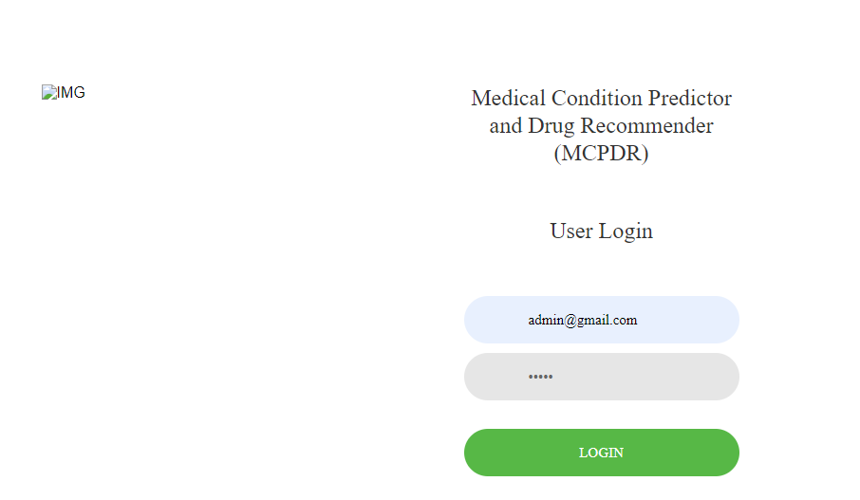

Slide 11
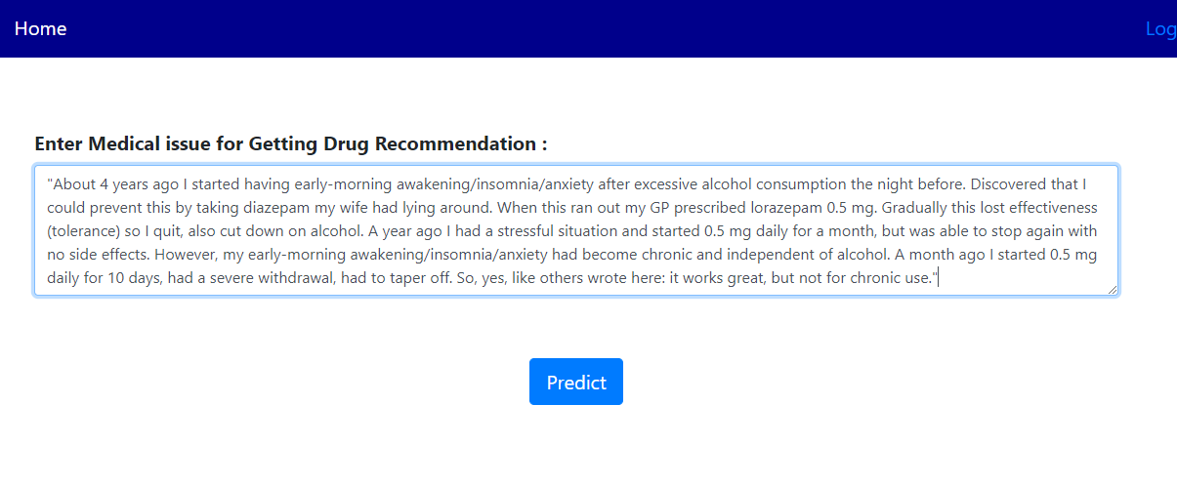

Slide 12
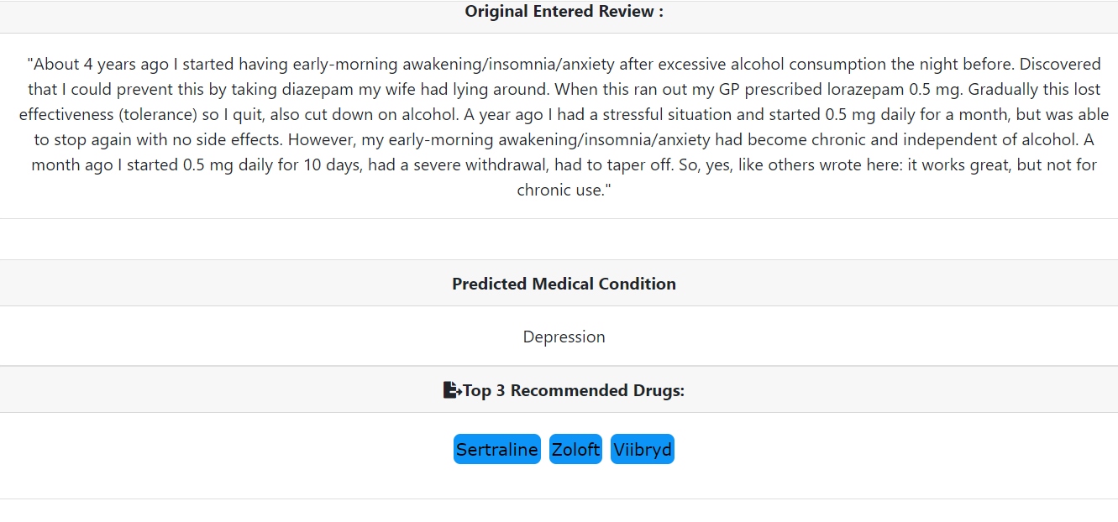

Slide 13
Project Benefits
This project can help the physician in diagnosis by taking the patient own word as a complain and insert it as text to predict the diagnosis of the patient condition then recommending the best three useful drugs for treatment of the patient.

Slide 14
Conclusion:
This project will be very useful for medical persons to help them in the diagnosis of the patient condition and choosing the best drug for treatment.
The Dataset we use do not cover every type of patient diseases so after we implement our code we will estimate its accuracy and we will try to find a larger Dataset covering more diseases and drugs.

