Slide 1
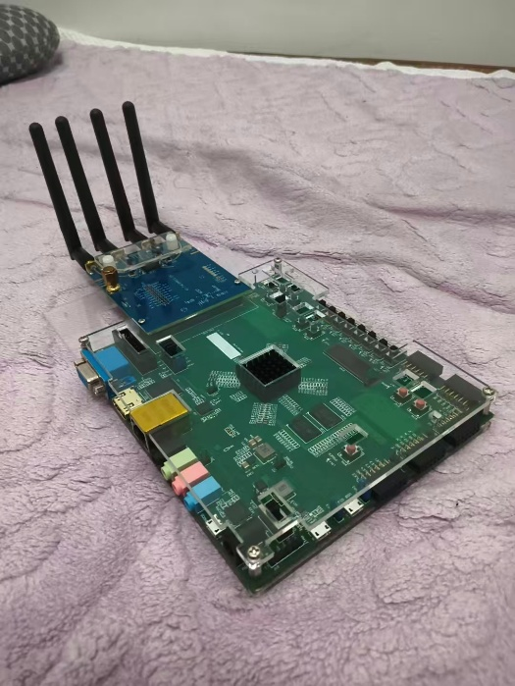


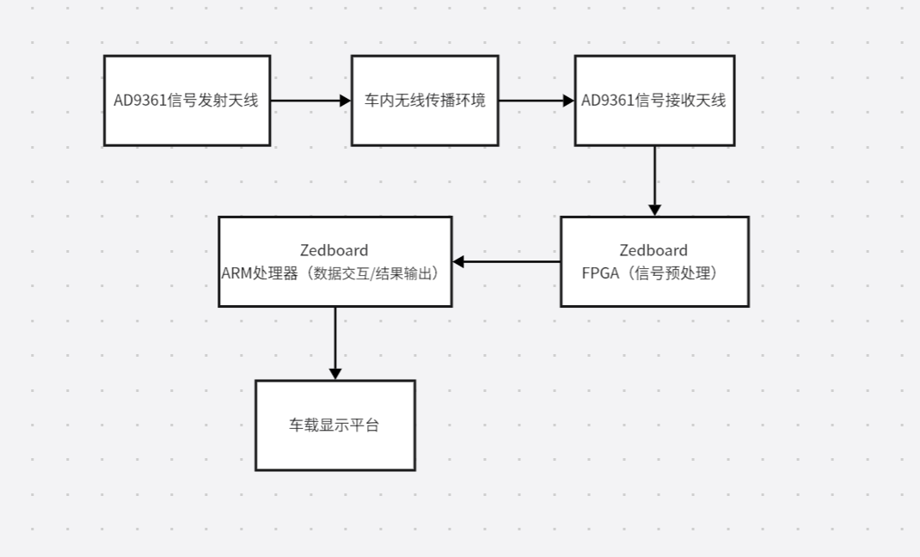
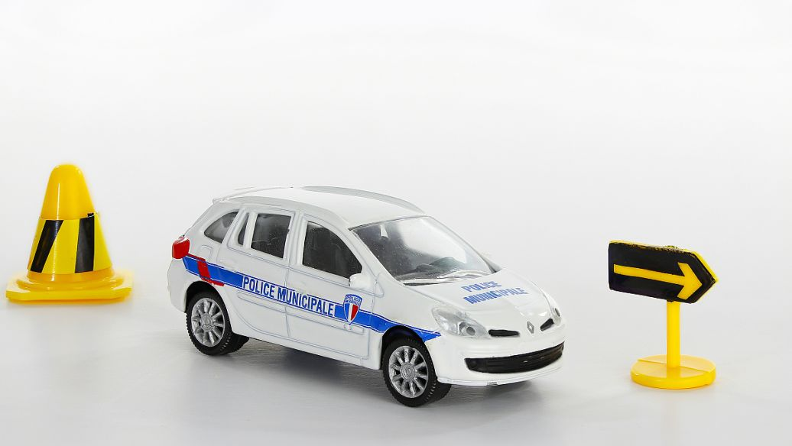

INTRODUCTION
Intelligent Detection System for In-Vehicle Personnel Status
OpenHW2025
On board test by AMD ZYNQ7010
This Zedboard-AD9361 system detects in-vehicle personnel and seatbelt status: AD9361 transmits signals to simulate the in-vehicle wireless environment, Zedboard processes returned signal changes, and integration with a large model enhances detection accuracy, outperforming traditional light-dependent solutions.
It is widely applicable to scenarios such as safety configuration for passenger car roll-off, autonomous vehicles, and child left-behind detection in school buses. In specific use cases, it can quickly identify if children are left in the vehicle to prevent safety accidents and monitor passengers in real time.
Key technical issues addressed:
[1] Zhu W R, Yu Y Z, Xia Z Y, et al. Design of a Software-Defined Radio Platform Based on ZYNQ-7000 and AD9361[J]. VIP Journal, 2025, 7201252040.[2] Hu W R, Wang Z G, Hu J J, et al. Design of a Universal Modulation Platform Based on Zynq-7000 + AD9361[J]. Telecommunication Engineering, 2020, 60 (12): 1432-1438.[3] Cai W J, Wang G F, Ye J C. Design and Implementation of Wireless Transmission System Based on Zedboard and AD9361[C]//IOP Conference Series: Earth and Environmental Science. IOP Publishing, 2020, 440(2): 022093.
C
R
R
E
E
S
1. Test Results
The Zedboard (Zynq7010)-AD9361 test platform verifies core functions: AD9361 stably transmits 2.4GHz signals, with in-vehicle propagation changes captured accurately; Zedboard’s FPGA handles signal preprocessing, ARM interacts with upper computer, and results output smoothly—no communication interruptions.
2. Performance
Personnel detection time: ≤10s, misjudgment rate ≤5%.
Signal coverage: 0.5-5m (mainstream vehicles), light-independent, stable in complex lighting.
3. Outlook
Upgrade hardware (Zynq7020, enhanced AD9361) for better speed/accuracy.
Optimize software (lightweight large models, preprocessing algorithms).
Expand to smart home/office via parameter adjustment.
A
T
U
I
L
V
T
System Architecture
E
Typical application case
1.AD9361 emits 2.4GHz sine waves. 2.In-vehicle signals alter (strength/phase) via human obstruction. 3.AD9361 receives altered signals, sends raw data to Zedboard’s FPGA. 4.FPGA preprocesses (filtering, amplification, ADC, feature extraction) to remove noise, extract features. 5.Preprocessed data to Zedboard’s ARM, which communicates with upper computer via Ethernet. 6.ARM outputs results to vehicle display or alarm.
D
E
S
I
N
G
High-speed Acquisition Card:
1.Innovative detection methods
2. hardware-software collaboration
3. strong privacy protection

