Slide 1
WELCOME
.

Slide 2
CONTENTS :
Introduction
History of Chatbot
Problem with current scenario
Educational requirement
System requirement
How does it work?
Types of Chatbot

Slide 3
Introduction :
Chat bot is typically perceived as engaging software entity which humans can talk to. It can be interesting, inspiring and intriguing. It appears everywhere, from old ancient HTML pages to modern advanced social networking websites, and from standard computers to fashionable smart mobile devices.

Slide 4
History
The first Chatbot ever was developed by MIT professor Joseph Weizenbaum in the 1960s. It was called ELIZA. You’ll read more about ELIZA and other popular Chatbots that were developed in the second half of the 20th century later on.

Slide 5
Problem with current Scenario :
This process consumes lot of time as well as money as the customer needed to visit college if its miles away from home.
Also, this process may lead to communication gap between student and college.

Slide 6
Educational requirement :
This project is developed using Php as a language. We used Notepad++ for Design and coding of project. Created and maintained all databases into My SQL 5.6, in that we create tables, write query for store data or record of project.

Slide 7
System requirement :
Hardware requirement :
Processor-Intel Pentium or higher  RAM-minimum->4GB maximum->6GB
Software requirement :
1. Front End- OS-Windows 7,8,10 2. Back End- Python must be installed 3. Python IDE (jetBrains Pychram)

Slide 8
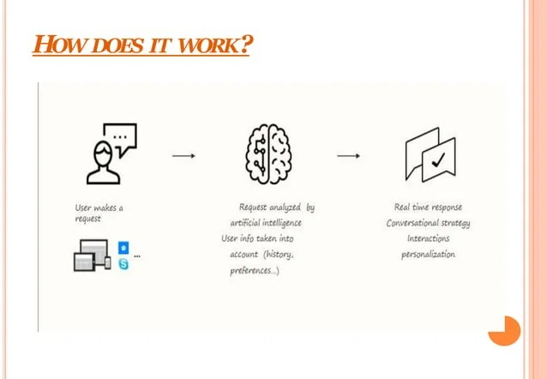
How does it work :

Slide 9
Types of Chatbot :
1. Flow-oriented Chatbot
2.Artificially intelligent Chatbot
3. Hybrid Chatbot
4. Human supportedbots

Slide 10
THANK YOU !
.

