Slide 1

ElderShield
AI-Powered Scam Detection & Awareness Platform
IS 6465 | Final Project Presentation
Sunny Nguyen | Joe Milner | Cameron Hubbard
March 2026

Slide 2
Business Objectives
The Problem
Our Solution
$10B+ lost annually
to elder fraud in the U.S. alone (FBI IC3)
1 in 5 seniors targeted
by scams each year
Seniors often lack tools
to identify sophisticated scam tactics like phishing, impersonation, and social engineering
AI-powered scam analysis
Elders submit suspicious messages and get instant risk scores with plain-language explanations
Caregiver early intervention
High-risk reports auto-notify linked caregivers and admins
Dual-interface system
Simplified elder UI + management console for caregivers/admins
ElderShield | IS 6465 | Group 1

Slide 3
Code Organization & Workflow
Folder Structure
Navigation Flow
src/
├─ config/ db.php, config.php
├─ includes/ auth, helpers, billing
├─ pages/ all UI pages (16 files)
├─ api/ delete, reanalyze
├─ database/ schema + seed.php
├─ assets/ CSS + images
├─ cli/ billing runner
└─ uploads/ user screenshots
docs/
├─ ERD, wireframes, use cases
Login → Dashboard → Submit → Detail → Back
Shared header.php / footer.php
Role-based nav menus
Mobile hamburger menu
Technology Stack
PHP 8.3 | MySQL | HTML5 + CSS | Ollama (AI) | MAMP
Landing Page
about.php — public page with pricing, how-it-works, and sign-up CTAs
ElderShield | IS 6465 | Group 1

Slide 4




Ethics & Critical Thinking
Privacy by Design
Protecting Vulnerable Populations
No monetization of user data. Minimal data collection. Passwords hashed with bcrypt (cost 12).
Accessibility-first interface for seniors. Plain-language explanations. Caregiver oversight.
Transparent AI
Security First
AI is a tool supporting human decisions, not an autonomous system. Admin can override AI judgments.
CSRF protection, session management, input sanitization, PDO prepared statements, security headers.
ElderShield | IS 6465 | Group 1

Slide 5

Security
Authentication, Sessions & Data Protection

Slide 6

Security Implementation
+ Security Headers: CSP, X-Frame-Options, X-Content-Type-Options, Referrer-Policy (config.php)
Password Hashing
Session Management
CSRF Protection
password_hash() with BCRYPT
password_verify() on login
session_regenerate_id() on login
requireLogin() on all protected pages
csrfToken() + csrfField() on every form
verifyCsrf() validates on POST
auth.php
auth.php
auth.php
Input Sanitization
PDO Prepared Statements
Logout & Session Destroy
htmlspecialchars(), trim(), filter_var()
strip_tags() on user input
All DB queries use parameterized queries
No string concatenation in SQL
$_SESSION = [], cookie destroy
session_destroy() on logout
helpers.php
db.php
logout.php
ElderShield | IS 6465 | Group 1

Slide 7


Authorization & Role Management
Elder
Caregiver
Admin
Submit scam reports
View own incidents & analysis
Edit/resolve own reports
Manage profile
View linked elders' incidents
Submit reports on behalf of elders
Receive high-risk notifications
Manage billing & subscription
Manage all users (CRUD)
Override AI analysis
Manage subscriptions
Broadcast notifications
Implementation:
requireRole() on every restricted page → unauthorized.php (403 page) if role mismatch | Role-based nav menus in header.php | Access control on incident detail views
ElderShield | IS 6465 | Group 1

Slide 8

SQL & Database
6 Tables | Foreign Keys | Multi-table JOINs

Slide 9
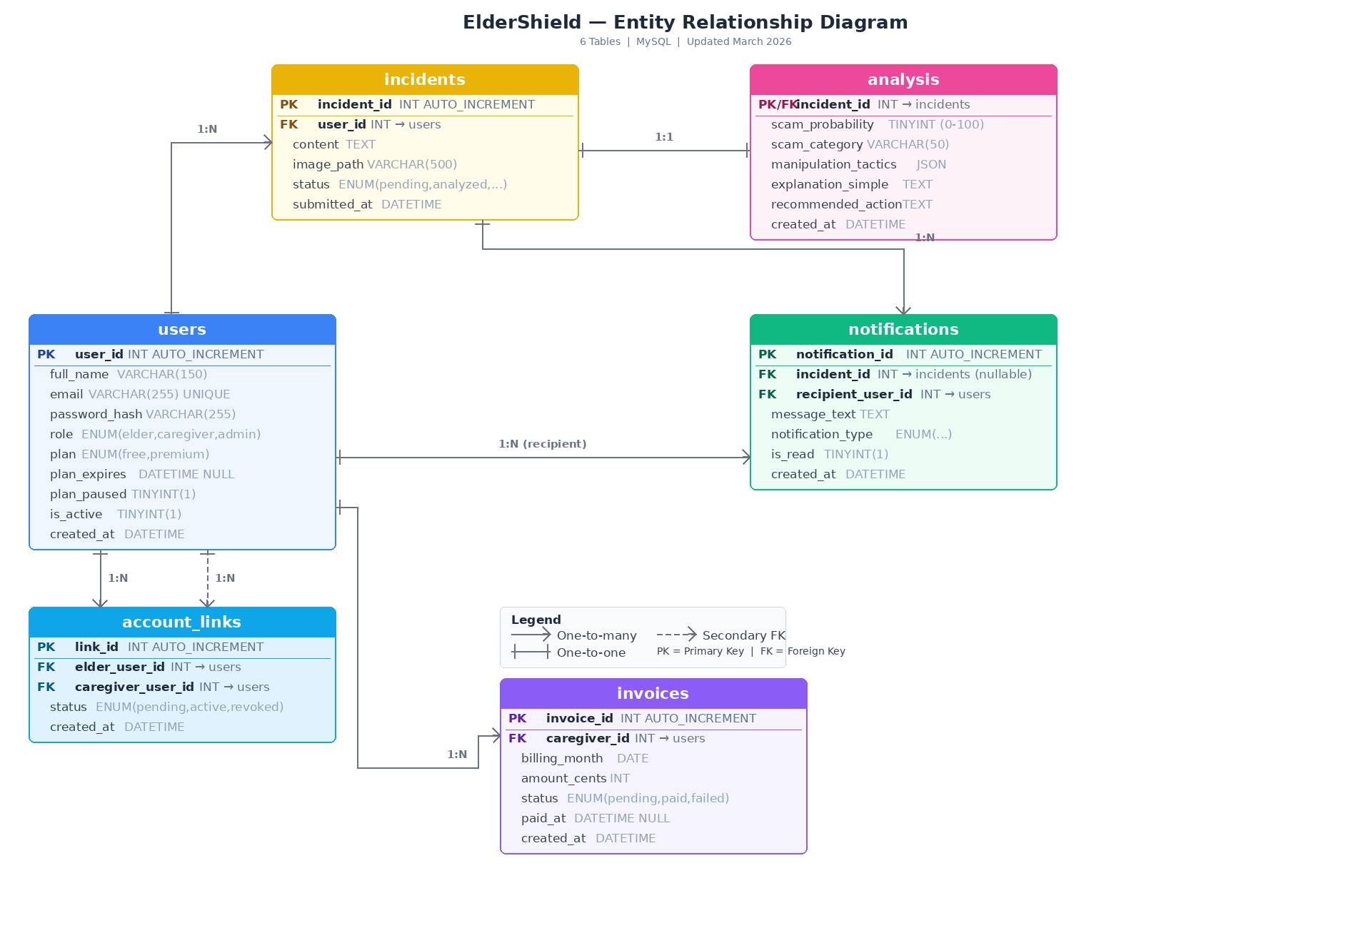
Entity Relationship Diagram
ElderShield | IS 6465 | Group 1

Slide 10

CRUD Use Cases
5 Entity Sets × 4 Operations = 20 Use Cases

Slide 11




CRUD: Users
CREATE
READ
Admin creates user via admin_users.php form
Self-registration via register.php
password_hash with BCRYPT
Admin views all users in admin_users.php
User reads own profile in profile.php
JOIN queries for user data
UPDATE
DELETE
User updates name, email, password
Admin changes role and active status
Email uniqueness validation
Admin hard-deletes user record
CASCADE removes related data
Self-delete prevented
ElderShield | IS 6465 | Group 1

Slide 12
CRUD: Incidents
CREATE
READ
Elder submits via submit.php
Caregiver submits on behalf of linked elder
Image upload support
Elder: my_incidents.php (own reports)
Admin/Caregiver: incidents.php (all)
incident_detail.php with JOIN to analysis
UPDATE
DELETE
Elder edits content text
Elder resolves (reviewed/dismissed)
Admin/Caregiver updates status
Elder deletes own incident
Admin deletes any incident
CASCADE removes analysis + notifications
ElderShield | IS 6465 | Group 1

Slide 13
CRUD: Analysis
CREATE
READ
AI (Ollama) generates analysis after submission
Scam probability, category, tactics, explanation
Background async processing
incident_detail.php shows full analysis
JOIN between incidents and analysis
Risk gauge, tactics list, recommendations
UPDATE
DELETE
Admin overrides scam category
updateScamCategory() in helpers.php
Admin override flag tracked
Admin deletes analysis
Resets incident status to pending
Allows re-analysis if needed
ElderShield | IS 6465 | Group 1

Slide 14
CRUD: Notifications
CREATE
READ
Auto-generated on high-risk incidents
Admin broadcast to all users
Billing notifications for caregivers
notifications.php lists all per user
Filtered by type (high risk, admin, info)
LEFT JOIN to incidents and users
UPDATE
DELETE
Toggle read/unread via AJAX
mark_notification.php API endpoint
Bulk mark-all-as-read feature
Delete single notification
Clear all notifications
Admin can delete any notification
ElderShield | IS 6465 | Group 1

Slide 15
CRUD: Account Links
CREATE
READ
Caregiver/Admin sends link request
linkCaregiverToElder() function
Duplicate detection built in
admin_users.php shows all relationships
profile.php shows elder's caregivers
JOIN users to account_links
UPDATE
DELETE
Approve: pending → active
Revoke: active → revoked
Admin/Elder can manage link status
Admin hard-deletes link record
deleteLink() in helpers.php
Removes relationship permanently
ElderShield | IS 6465 | Group 1

Slide 16
CRUD: Subscriptions
CREATE
READ
Caregiver self-upgrades to Premium
Admin upgrades via admin_subscriptions.php
Custom expiry date support
subscription.php shows current plan
Admin sees all caregiver subscriptions
Tabs: All, Premium, Paused, Free
UPDATE
DELETE
Admin: pause/unpause subscription
Edit expiry date
Upgrade/downgrade plan
Admin removes subscription entirely
Downgrades to Free + notifies user
Clears plan_expires and plan_paused
ElderShield | IS 6465 | Group 1

Slide 17

Interactive Use Cases
2 Multi-Entity Use Cases

Slide 18
Interactive: Scam Report Pipeline
1
2
3
4
▶
▶
▶
Elder Submits
Incident Created
AI Analyzes
Caregivers Notified
submit.php
incidents table
Ollama → analysis table
notifications table
Tables Involved (5-table JOIN chain)
users
→
incidents
→
analysis
→
account_links
→
notifications
Elder submits suspicious content → AI returns scam probability, category, and tactics → high-risk reports auto-notify linked caregivers and admins for early intervention
ElderShield | IS 6465 | Group 1

Slide 19
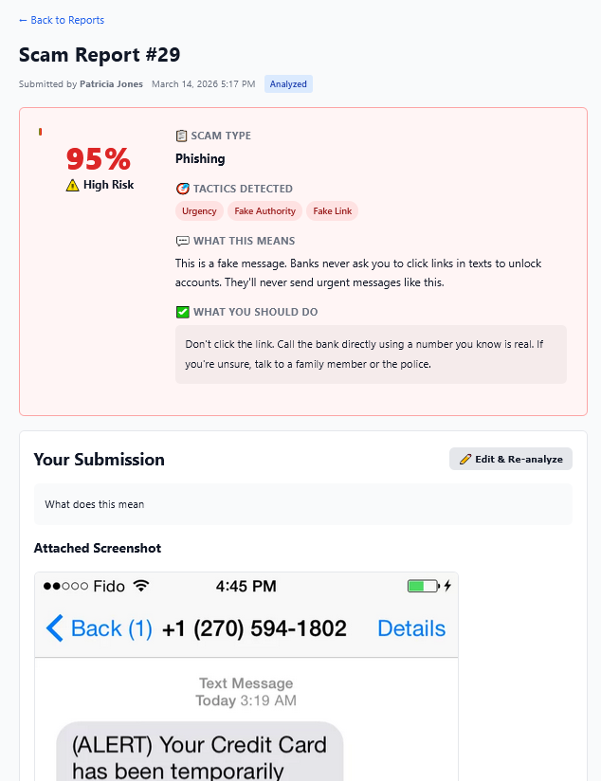

Analysis
Incident Submission

Slide 20
Interactive: Dashboard Analytics
Admin Dashboard
Caregiver Dashboard
30-day incident volume chart
Risk distribution donut (high/medium/low)
Top scam categories (horizontal bars)
Month-over-month comparison
Total users, incidents, high-risk count
7-day activity chart for linked elders
Scam category breakdown
High-risk count this week
Linked elder count + total incidents
Recent incident list with risk badges
JOINs: users + incidents + analysis
JOINs: users + incidents + analysis + account_links
ElderShield | IS 6465 | Group 1

Slide 21
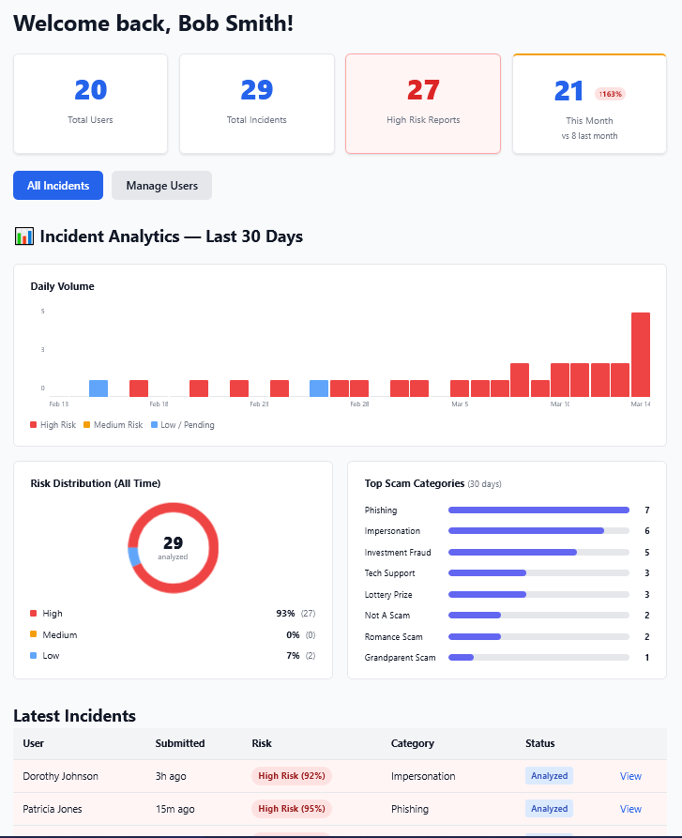
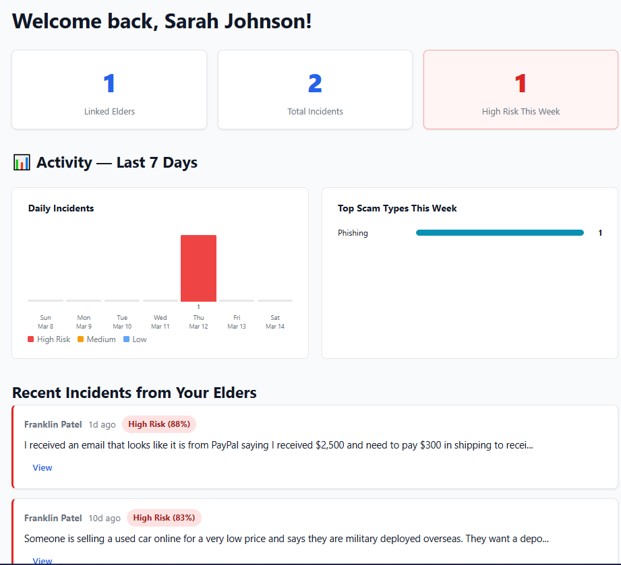
Admin Dashboard
Caregiver Dashboard

Slide 22

Questions?
Thank you for your time!
Sunny Nguyen | Joe Milner | Cameron Hubbard
ElderShield | IS 6465 | March 2026
github.com/THESunnyNguyen/eldershield

Slide 23

Live Demo
Test users: bsmith@eldershield.com / mysecret | pjones@eldershield.com / acrobat

