Slide 1
SERVERLESS
Doug Lampe
Orlando Code Camp 2018

Slide 2
AGENDA
Evolution of Application Architecture
Traditional Architectures
Containerized Architectures
Serverless Architectures
AWS “Serverless” Services
Sample Application
Takeaways

Slide 3
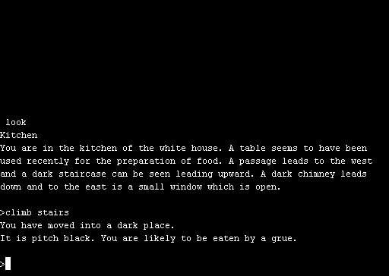

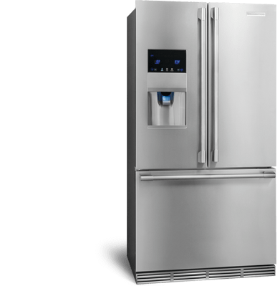
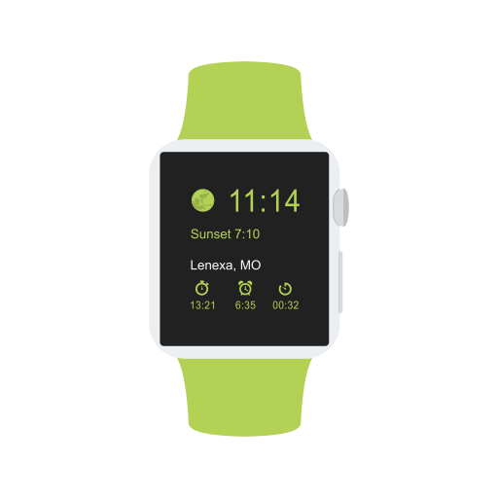



Evolution of Application Architecture
Single Procedural Program
Device with Software and Cloud API
Just Someone Else’s Computer
Notes:
Over the years, application architectures have moved from single procedural programs to complex, distributed, loosely-coupled applications typically consisting of a user interface on anything from a watch to a refrigerator with some code running locally with data storage and other processes running in “the cloud” (which, as we know is just someone else’s computer). Whether you are building a web application, mobile application, or scheduler for your espresso machine, the “cloud” side of your application is pretty much the same – some form of storage and processing that happens periodically upon request from software in some remote device. We aren’t talking about applications like YouTube or Netflix where you have a constant stream of data to millions of users at the same time. However, we could be talking about Candy Crush where you need to keep track of which level someone is on, track how many special candies and gold bars they have, allow them to buy gold bars, etc. At first this might just be you and your friends, but ideally it will eventually be millions of users.

Slide 4
Traditional Architectures
Single Dedicated Server
Load Balanced
Distributed
Web
DB
Workers
Notes:
When most people learn to build web applications and by extension web APIs, they think in term of communicating with a single dedicated server. In fact during development, this is the most common scenario where the “server” is actually the same machine as the client which happens to be the developer’s laptop. Most developers, especially early in their careers, think in terms of this architecture. One of the first complexities people usually encounter is the idea of a load balancer where you can no longer depend on users hitting a specific server. For static content, this isn’t a big concern since you can just replicate the data across multiple servers but the more complicated the application the more complicated the architecture. Eventually you end up with more complex, distributed architectures with various operations being performed by multiple servers behind the scenes so you can handle issues like performance, capacity, resiliency, etc. The one thing that is consistent across all of these architectures is the concept of the servers. Whether they are virtual or physical servers doesn’t matter. They exist and have to be managed.

Slide 5
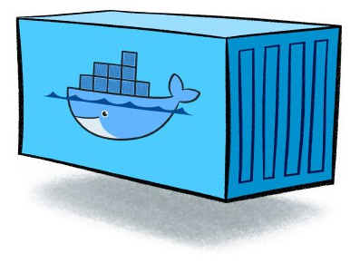
Containerized Architectures
Web
DB
Worker
Managers
Workers
Notes:
Container technologies like Docker and Kubernetes have allowed us to at least move into architectures where we don’t care about how servers are configured and we can make sure all of the dependencies we need to run our code can be placed in a container. This means we don’t worry about server configurations any more (other than making sure that they are running our preferred container management software). Once you start building containerized applications, you quickly realize that concepts like distributed storage, centralized messaging, distributed worker processes, and even distributed databases are much simpler to implement so while they are necessary for large, distributed architectures, you can implement them early in the development process to make sure your application is ready to scale. When you add the ability to add nodes and containers to meet demand, you can see why containerization is so popular. However, one thing containerization has not addressed is physical storage. Containers are transient by design so storage is always handled at a server level. Even if the physical device is network storage and not local storage on the server, you still have to mount that volume to your container so the container can store its data. So even if you use a central data store like Redis or MongoDB or even SQL Server, you are still writing to a file system that has to be configured and managed. Also, what about when your total combined workload doesn’t even require a single server? How much does it cost to keep a server up and running for the few times a day/week/month that you and your friends are testing your new awesome app?

Slide 6
Serverless Architecture
Notes:
Serverless architectures are, well, serverless. Your client code interacts with APIs which are only used when required. These APIs can provide content and data storage, authentication and authorization, and even execute your own custom code. Unlike server architectures, you do not run a server waiting for one of these API calls to happen. A provider such as Amazon provides managed services which leverage economies of scale across thousands or even millions of customers so your processes are only executed when needed and you are only charged for what you need.

Slide 7


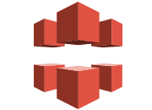
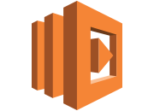
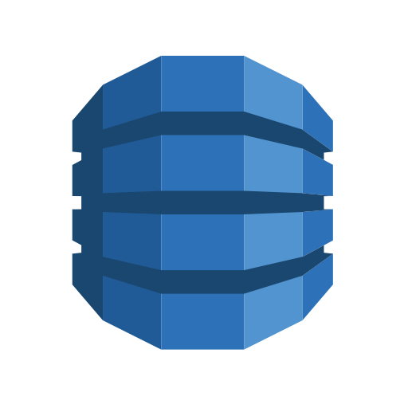





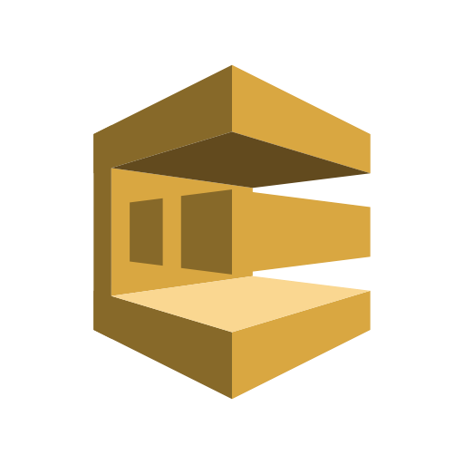
AWS “Serverless” Services
Simple Storage Service (S3) – Cloud storage
CoudFront – Content delivery (CDN)
DynamoDB and RDS Aurora – NoSQL and Relational DB
Identity & Access Management (IAM) – Manage user access
Cognito – Identity Management and authentication
Simple Queue Service (SQS) – Message queueing
Simple Notification Service (SNS) – Push notifications and SMS
Lambda – Run code only when you need it
API Gateway – Manage APIs (including integration with Lambda)
Route 53 – Domain name management
Simple Email Service (SES) – Send and receive e-mail
Notes:
Amazon AWS offers an extensive variety of services but I would like to focus on a few that are key to serverless architectures. S3 allows you to store data in “buckets”. Think of S3 as a web-based file system with worldwide availability and low latency. DynamoDB provides NoSQL support. Amazon RDS supports popular platforms such as MSSQL, Oracle, MySQL, Postgres, etc. but these are more traditional server based solution and the pricing reflects this. Aurora is Amazon’s relational DB engine and both Aurora and DynamoDB are priced based on throughput and storage making them a truly pay-as-you-use service. IAM and Cognito work side by side to allow you to authenticate users and control access. IAM gives you a single identity for your application or its users that you can use across your application. Cognito adds third-party login support and user directory. Lambda allows you to define functions that can be invoked only when triggered (say from an HTTP request). This means that if you have intermittent tasks (which will be particularly prevalent during development and ramp up), you only pay for the processing you use and you aren’t paying for a server to run 24/7 waiting for requests. Finally, the API gateway allows you to manage and secure APIs

Slide 8
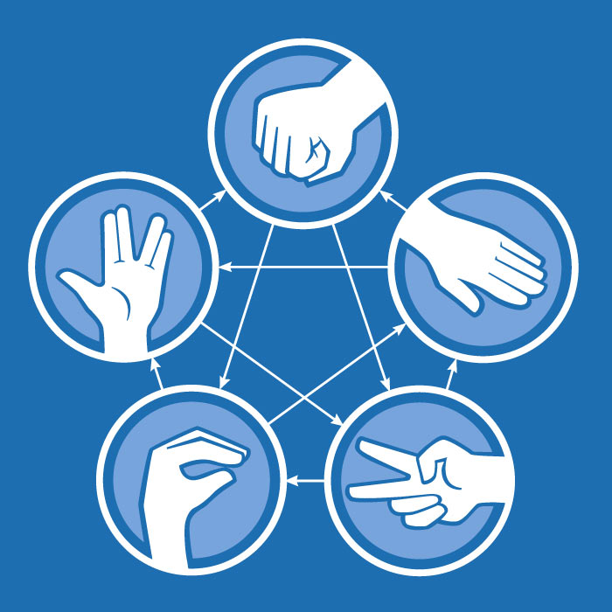
Sample Application: Rock Paper Scissors Lizard Spock
User registration and login with 3rd party login support
Find friends by phone or e-mail
Challenge AI, friends, or strangers
Record guesses
Determine results
Record results
Track leader board
Notes:
Taking a look at these requirements, the server-side code would be mostly concerned with

Slide 9
Sample Application Bowser App Load
Route 53
CloudFront
API Gateway
S3
Images
Images
HTML
Images
JS

Slide 10
Sample Application Register User
Mobile App
Cognito
Route 53
CloudFront
API Gateway
Lambda
IAM
Browser App
DynamoDB

Slide 11
Sample Application Query Data
Mobile App
Route 53
CloudFront
API Gateway
Lambda
DynamoDB
Browser App
JSON

Slide 12
Sample Application Play Game
IAM
Mobile App
DynamoDB
Route 53
CloudFront
API Gateway
Lambda
SQS
Browser App
SQS
Lambda
Notes:
During each step of game play, we can use lambda to authenticate the user based on a token provided in the API call, validate the game state from DynamoDB or Aurora, then queue the requested result in SQS. This allows us have multiple listeners to the result of each step in the game. For example, we will always store the result and update the leaderboard in the database, but depending on user preferences we may push a notification to their mobile device using SNS or send them an e-mail from SES.

Slide 13
Takeaways
Serverless architectures:
Allow you to pay only for the computing resources you use
Encourage “good” design patterns that support resiliency, performance, and scale
But they also:
Create opportunities for bad design patterns by locking into specific implementations
Can actually end up costing more than “serverfull” architectures

Slide 14
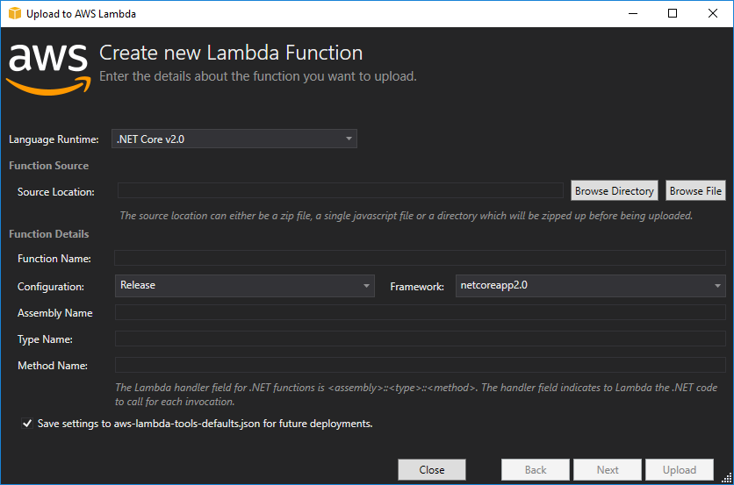
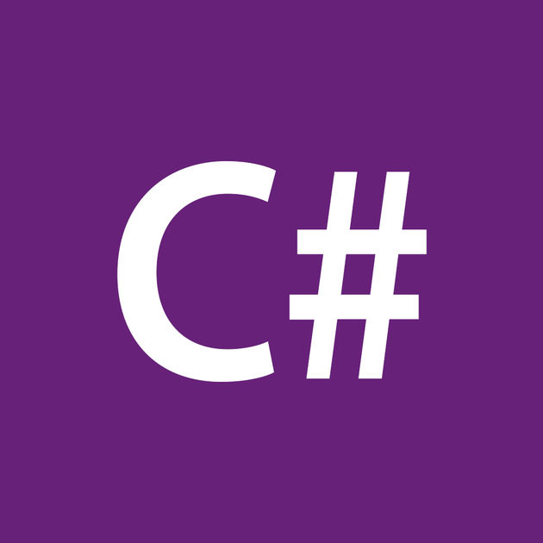
AWS Lambda Supports C#
AWS SDK Extension for VS 2017

Slide 15
Appendix: AWS “Less-Server” Services
AWS Batch – Spin up server, run job, dispose of server
Elastic Beanstalk – Spin servers up and down as demand changes
Elastic Container Service (ECS/EKS) – AWS spins servers up and down as demand changes

