Slide 1

SMART INDIA HACKATHON 2026
TITLE PAGE
•Problem Statement ID – SIH26005 ​
​
•Problem Statement Title – Solar-Powered Smart Mini Cold Storage System for Fresh Vegetables in North Eastern Region (NER) ​
​
•Theme – Agriculture, FoodTech & Rural Development​
​
•PS Category – Hardware ​
​
•Team ID – SIH26-A04-394 ​
​
•Team Name – LUMORA ​
​

Slide 2

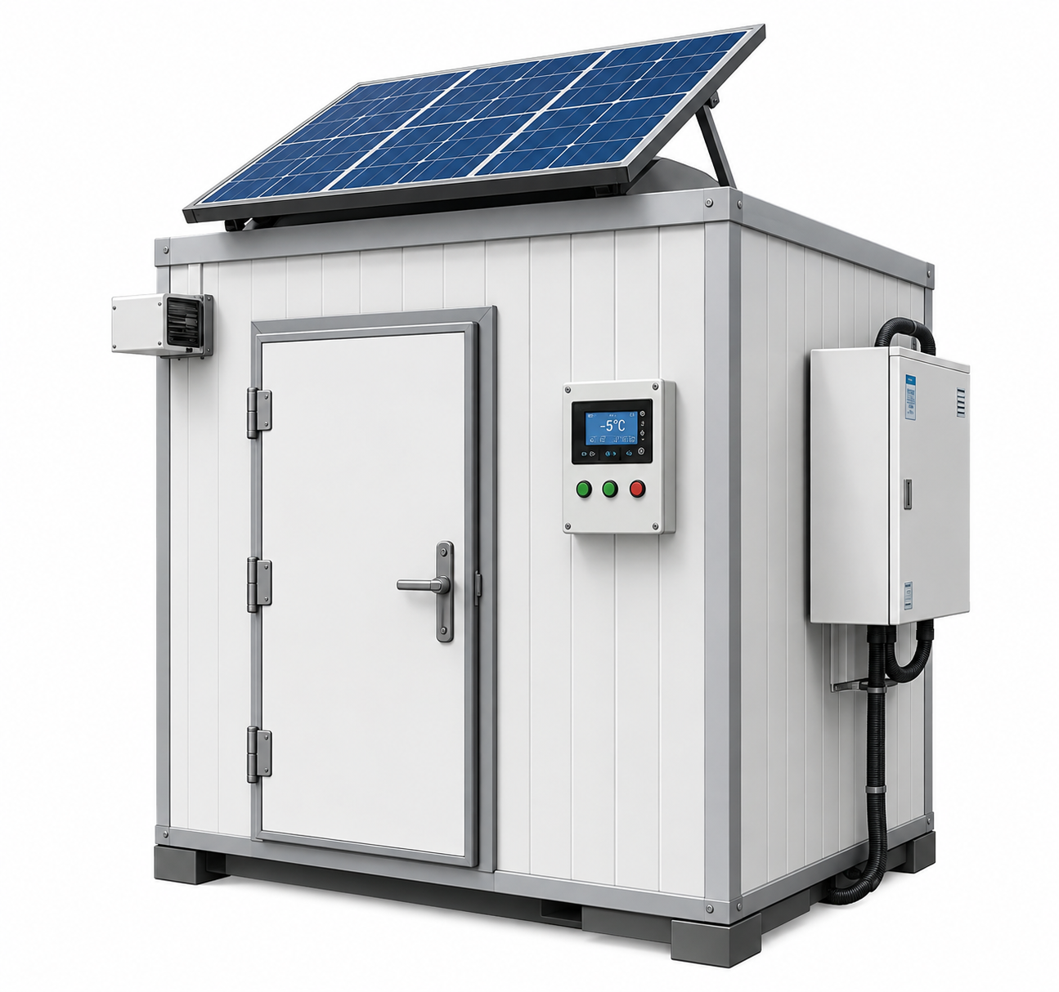
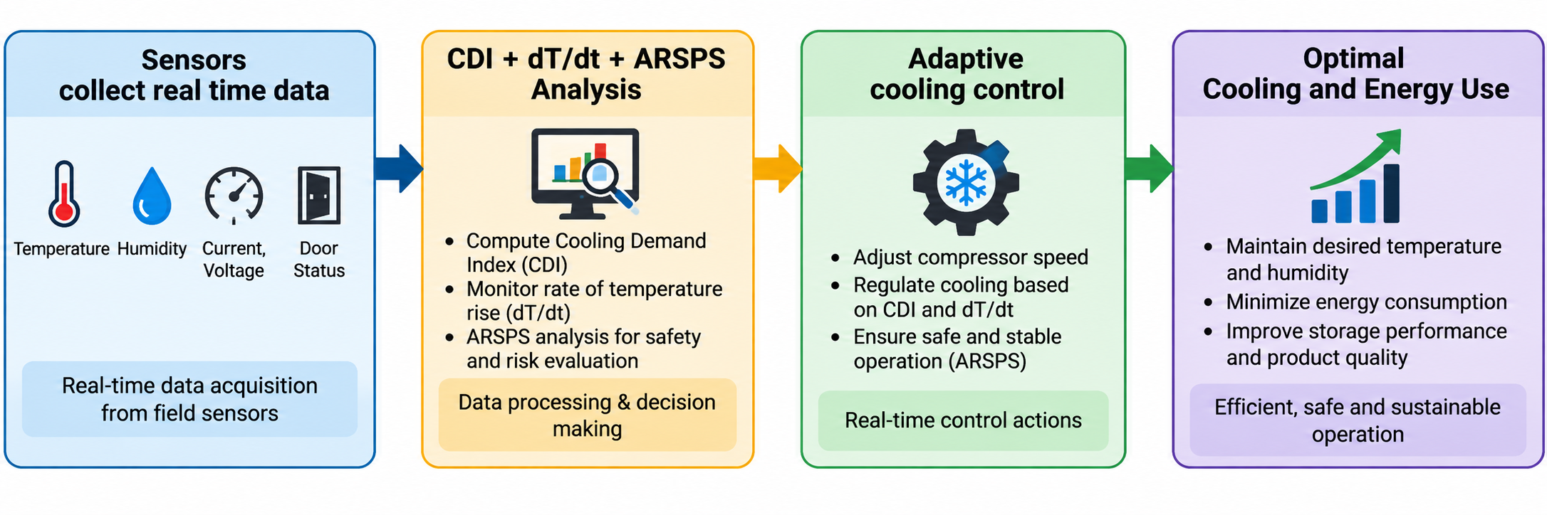
IDEA TITLE
PROBLEM AT HAND
OUR SOLUTION
WHERE WE STAND OUT
High Post-Harvest Loss: 30–40% of vegetables & fruits spoil due to lack of affordable, reliable cold storage near farms.
Unreliable Power Supply: Frequent power cuts in rural & remote NER locations make electric cold storage impractical.
High Operating Cost: Diesel-based or grid-based cold storages have high running cost and are not feasible for small farmers.
No Real-time Monitoring: Farmers lack visibility on temperature, humidity and storage conditions; silent spoilage occurs.
Battery & Energy Risks: Improper battery use leads to low backup time, high maintenance and safety risks.
Solar-Powered Adaptive Smart Mini Cold Storage
Decentralized • Energy-Efficient • Farmer-Friendly
Produce-Aware Shelf-Life Prediction Uses produce type, temperature & humidity history to estimate storage life for better planning and reduced waste.
Predictive Thermal Control (dT/dt) dT/dt-based early detection enables proactive cooling before unsafe conditions, reducing losses.
Adaptive Cooling (CDI) Uses Cooling Demand Index (CDI) with dT/dt, temperature, humidity, ambient & door status for adaptive cooling.
ARSPS Protection Adaptive battery protection monitors voltage, current, temperature & SOC for safety and longer battery life.
Temperature & Humidity Control Maintains produce-specific temperature & humidity to improve quality and extend shelf life.
Smart Alerts Instant alerts for temperature deviation, low energy, door open & battery faults on local display/app.
Compact & Modular Design Easy to install, scale & maintain in remote locations with minimal infrastructure.
Solar PV + MPPT
Alerts & Display
LiFePO₄ Battery
+ ARSPS
Intelligent Controller
Smart Sensing
Variable-Speed Cooling
HOW IT WORKS?
IDEAL FOR
Farm & Village Collection Centres
Hilly & Remote NER Regions
Small & Marginal Farmers
Highly Perishable Produce

Slide 3
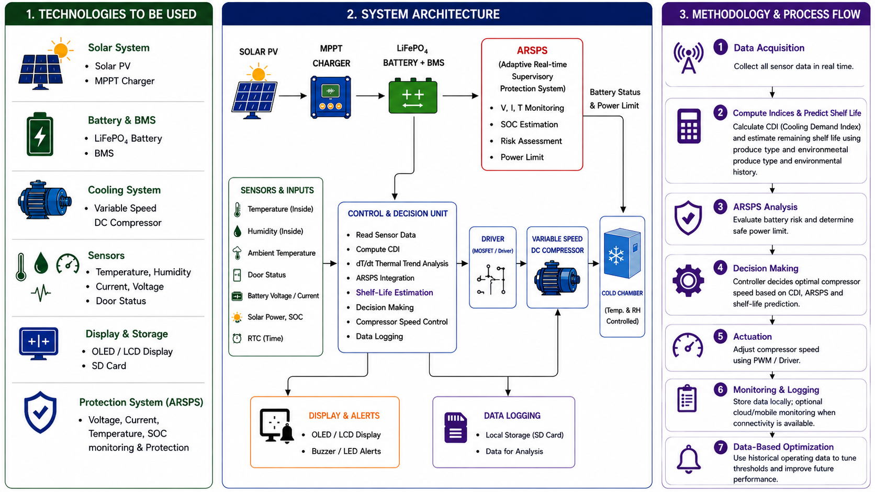
TECHNICAL APPROACH

Slide 4
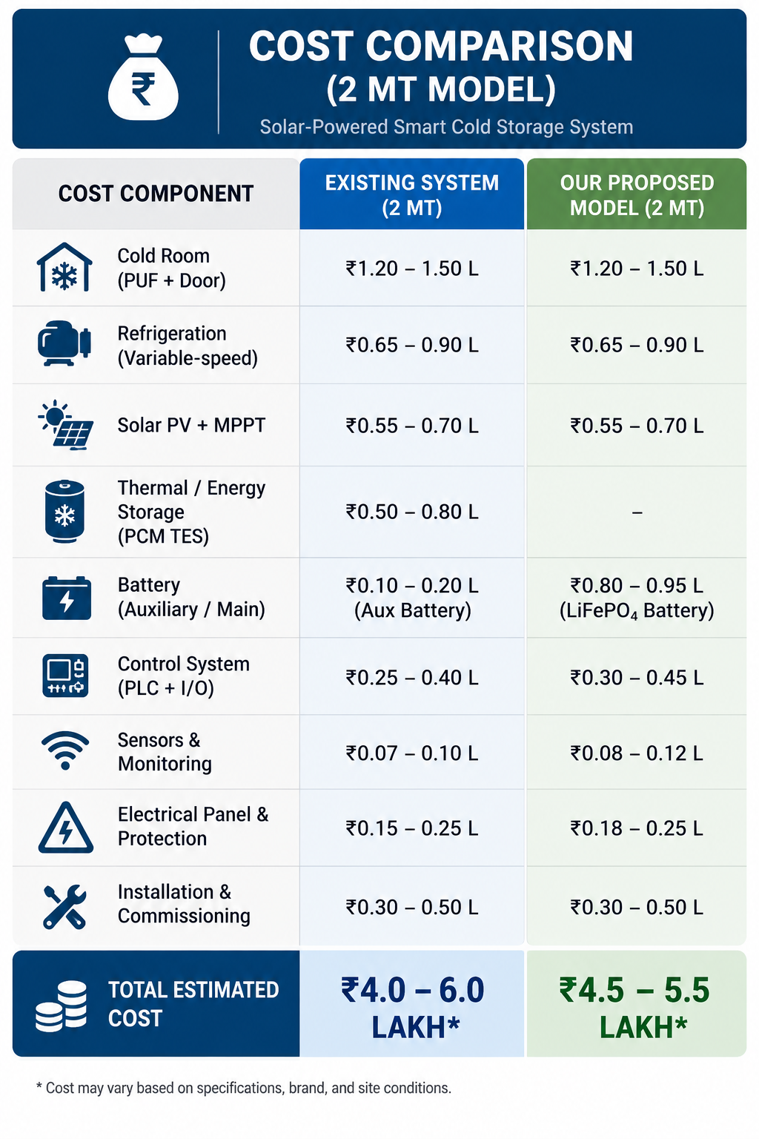
FEASIBILITY AND VIABILITY
Technically Feasible: Proven technologies: solar PV, LiFePO₄ battery, variable-speed compressor and PLC control.
Economically Feasible: Estimated cost (2 MT): ₹4.5 – 5.5 lakh, comparable to the market range.
Low Manpower: Only one operator required due to automation and smart control.
High Efficiency: Estimated efficiency of 75 – 85% (20 – 30% better energy utilization).
Backup Autonomy: 36 – 48 hours of autonomy with the optimized system..
Long Life and Reliability: LiFePO₄ battery with ARSPS protection gives 12 – 15 years of life
Low Solar Availability: Reduced energy during monsoon or cloudy days.
Battery Degradation: High temperature or improper charging reduces battery life.
Sensor Errors: Inaccurate data can affect cooling decisions and efficiency.
Maintenance and Skill Gap: Lack of technical knowledge may lead to improper maintenance.
Component Failure: Compressor, PLC or sensor failure may cause downtime.
Initial Cost Sensitivity: Slightly higher initial cost may affect adoption.
Smart Energy Management: Use CDI, dT/dt and EAI logic to optimize cooling based on demand and available energy. Store excess energy in battery/PCM.
Battery Protection (ARSPS): Continuous monitoring of V, I, T and SOC to prevent over-stress and extend battery life.
Quality Sensors: Use reliable sensors with periodic calibration for accurate data.
Preventive Maintenance: Regular inspection, cleaning and scheduled maintenance to reduce unexpected failures.
Cost Optimization: Local sourcing, standard design and bulk procurement to reduce cost.

Slide 5
IMPACT AND BENEFITS
1.POTENTIAL IMPACT ON THE TARGET AUDIENCE
FARMERS Reliable, affordable and smart cold storage ensures reduced post – harvest losses and better income.
LOCAL COMMUNITIES Better access to fresh produce, improved food security and reduced seasonal price fluctuation.
SMALL BUSINESSES / TRADERS Consistent quality storage enables longer storage and wider market reach.
GOVERNMENT & DEVELOPMENT AGENCIES Supports rural development goals, agri-value addition and self-reliance in cold chain infrastructure.
ENVIRONMENT & SOCIETY Promotes clean energy use and sustainable technology adoption in rural areas.
2.BENEFITS OF THE SOLUTION (SOCIAL,ECONOMIC,ENVIRONMENTAL,ETC)
SOCIAL BENEFITS Reduces food wastage and improves food availability. Strengthens rural livelihoods and farmer welfare. Encourages local employment for operation & maintenance.
ECONOMIC BENEFITS Reduces post-harvest losses by 20-30%. Lowers operating cost through smart energy management. Increases farmer income with better produce quality and longer storage.
ENVIRONMENTAL BENEFITS Uses solar energy – clean and renewable. Lower carbon footprint compared to diesel – based systems. Energy efficiency reduces overall resource consumption.
TECHINCAL & OPERATIONAL BENEFITS Smart adaptive cooling ensures optimal temperature control. Battery safety (ARSPS) extends battery life (12-15 years). 36-48 hours backup without sun ensures reliable operation.
LONG –TERM IMPACT Builds resilient and self-sustained cold chain in rural areas. Scalable model for 1 MT – 10 MT and future IoT integration. Promotes sustainable agriculture and economic growth.

Slide 6
RESEARCH AND REFERENCES
1] G. Hussain, M. Sultan, M. Aleem, M. W. Shahzad, M. S. Ahamed, M. Farooq, U. Sajjad, Z. Zhang, and S. Ahmad, “Development and performance evaluation of solar-powered cold storage system for perishable agricultural products,” International Communications in Heat and Mass Transfer, vol. 168, p. 109408, 2025, doi: 10.1016/j.icheatmasstransfer.2025.109408.
[2] B. Natarajan, A. C. Kathiresan, and S. K. Subramanium, “Development and performance evaluation of a hybrid portable solar cold storage system for the preservation of vegetables and fruits in remote areas,” Journal of Energy Storage, vol. 72, p. 108292, 2023, doi: 10.1016/j.est.2023.108292.
[3] W. Amjad, A. Munir, F. Akram, A. Parmar, M. Precoppe, F. Asghar, and F. Mahmood, “Decentralized solar-powered cooling systems for fresh fruit and vegetables to reduce post-harvest losses in developing regions: A review,” Clean Energy, vol. 7, no. 3, pp. 635–653, 2023, doi: 10.1093/ce/zkad015.
[4] H. J. El-Khozondar, M. Elnaggar, A. Al-Mabouh, L. Abu Zanouna, M. I. Al-Atawne, and O. Safi, “Solar-powered cold storage system,” in Proc. 2021 International Conference on Promising Electronic Technologies (ICPET), 2021, pp. 28–33, doi: 10.1109/ICPET53277.2021.00012.

