Slide 1


SMART INDIA HACKATHON 2026
TITLE PAGE
Problem Statement ID –26172
Problem Statement Title-Low Latency and Efficient Voice Activator for Edge Devices
Theme-Smart Automation
PS Category- Hardware
Team ID- SIH26-A04-394
Team Name- LUMORA

Slide 2
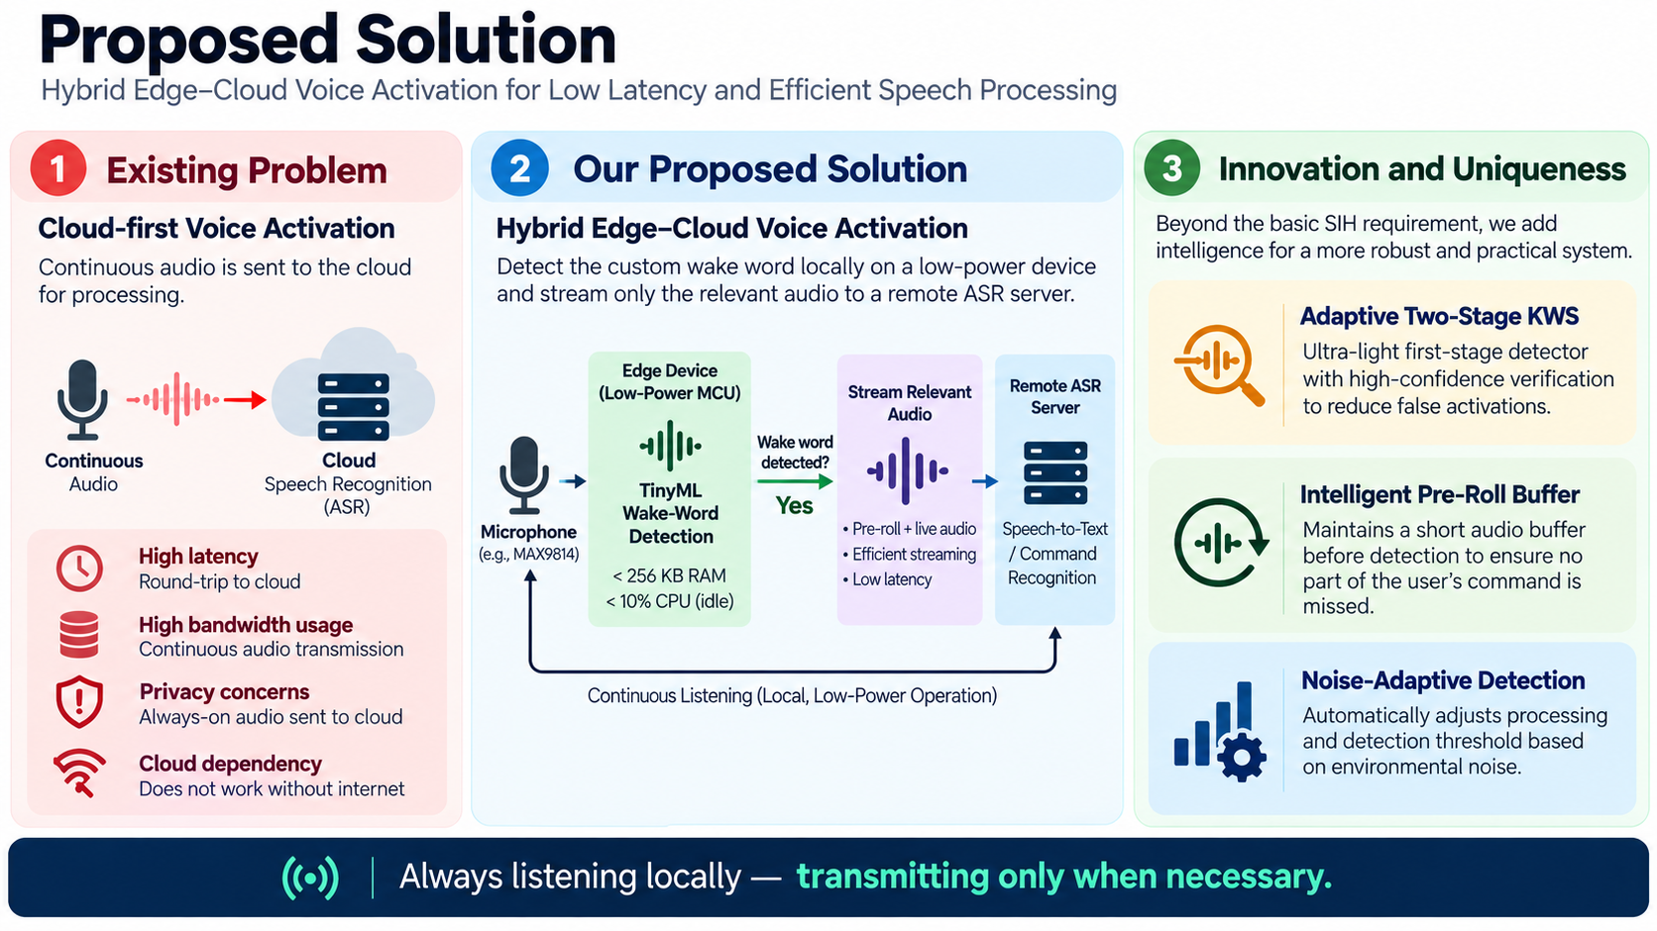
IDEA TITLE

Slide 3
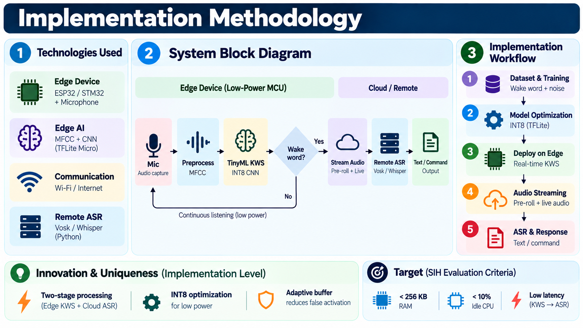
TECHNICAL APPROACH

Slide 4
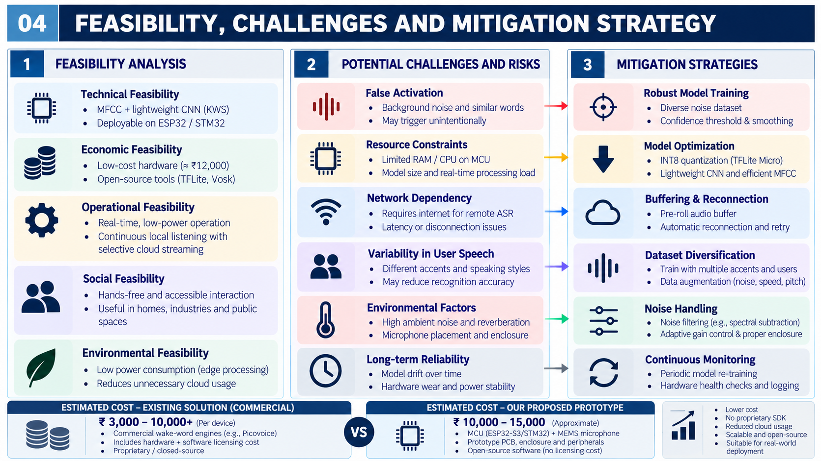
FEASIBILITY AND VIABILITY

Slide 5
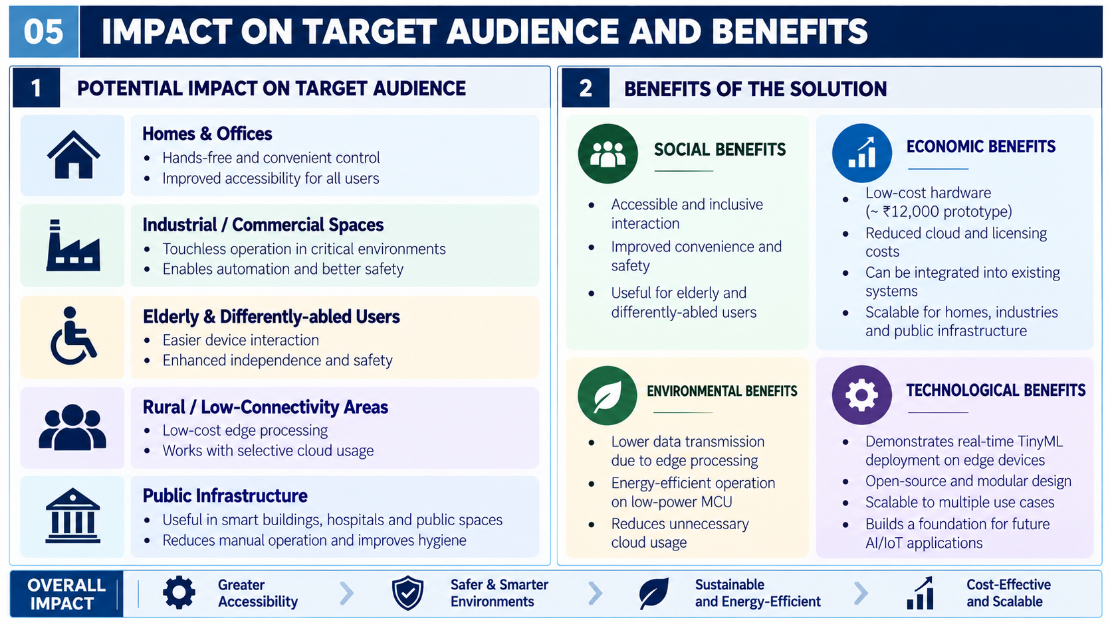
IMPACT AND BENEFITS

Slide 6
RESEARCH AND REFERENCES
TensorFlow Lite for Microcontrollers
Lightweight machine-learning framework for deploying neural-network models on resource-constrained microcontrollers.
Reference:
https://www.tensorflow.org/lite/microcontrollers
openWakeWord
Open-source framework for wake-word detection and custom model development. Useful as a reference for lightweight keyword spotting and custom wake-word training.
Reference:
https://github.com/dscripka/openWakeWord
Espressif ESP-SR / WakeNet
Open-source speech-recognition framework for ESP32 platforms, including local wake-word detection and voice-processing components.
Reference:
https://github.com/espressif/esp-sr

