Slide 1

SMART INDIA HACKATHON 2026
TITLE PAGE
•Problem Statement ID – SIH26005 ​
​
•Problem Statement Title – Solar-Powered Smart Mini Cold Storage System for Fresh Vegetables in North Eastern Region (NER) ​
​
•Theme – Agriculture, FoodTech & Rural Development​
​
•PS Category – Hardware ​
​
•Team ID – SIH26-A04-394 ​
​
•Team Name – LUMORA ​
​

Slide 2

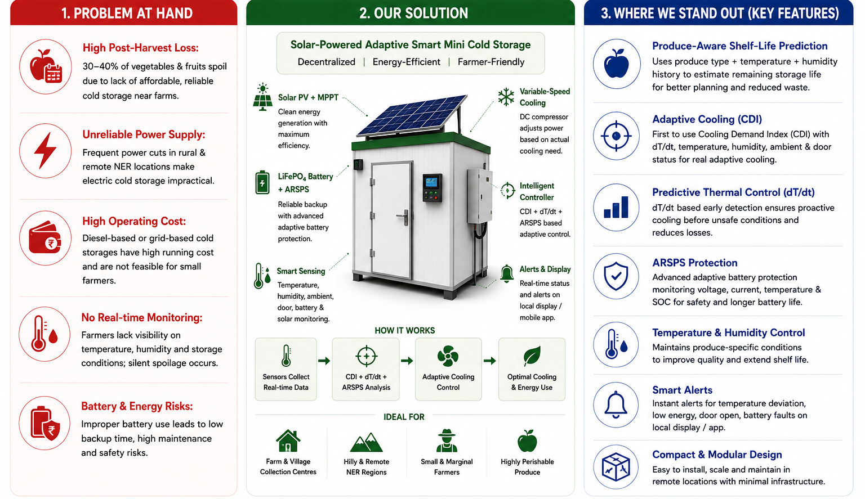
IDEA TITLE

Slide 3
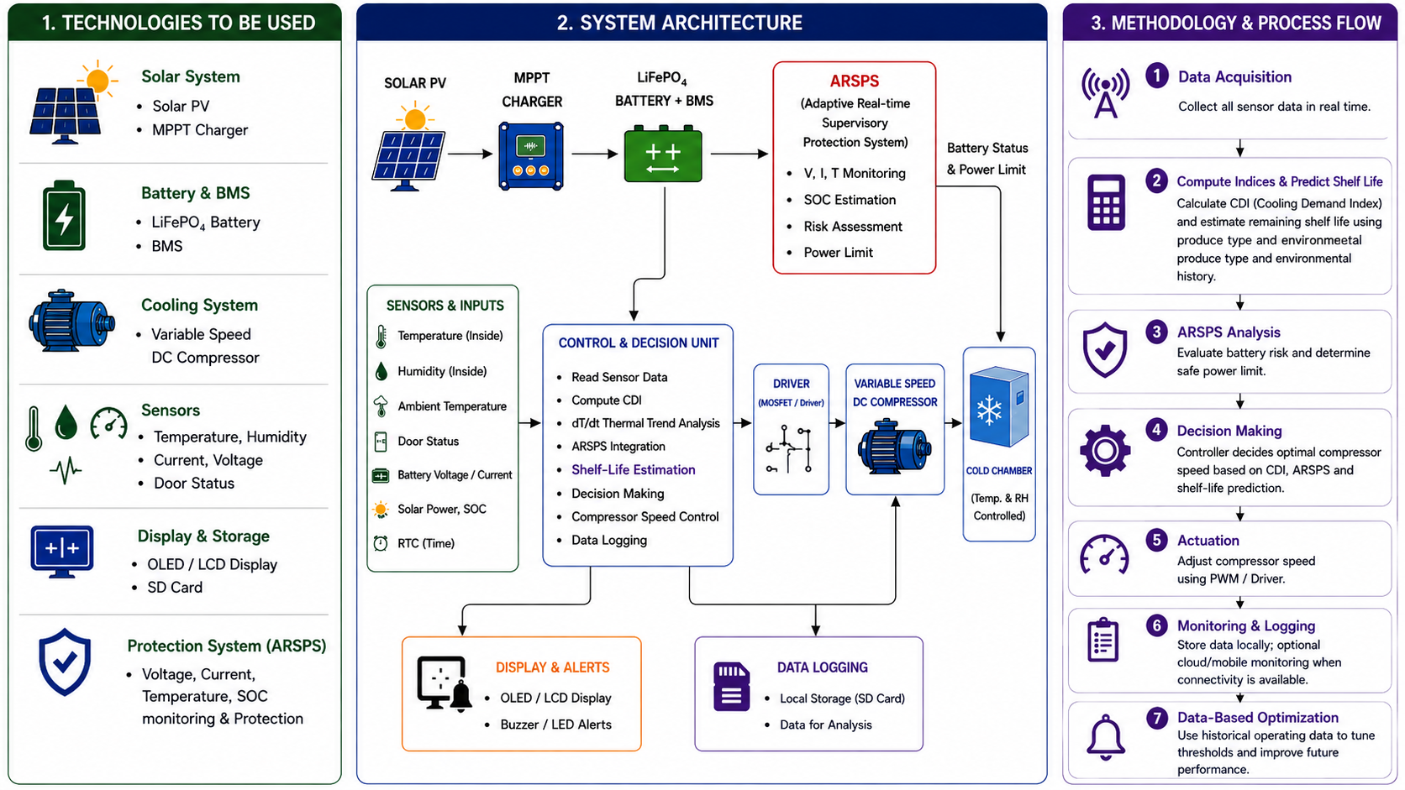
TECHNICAL APPROACH

Slide 4
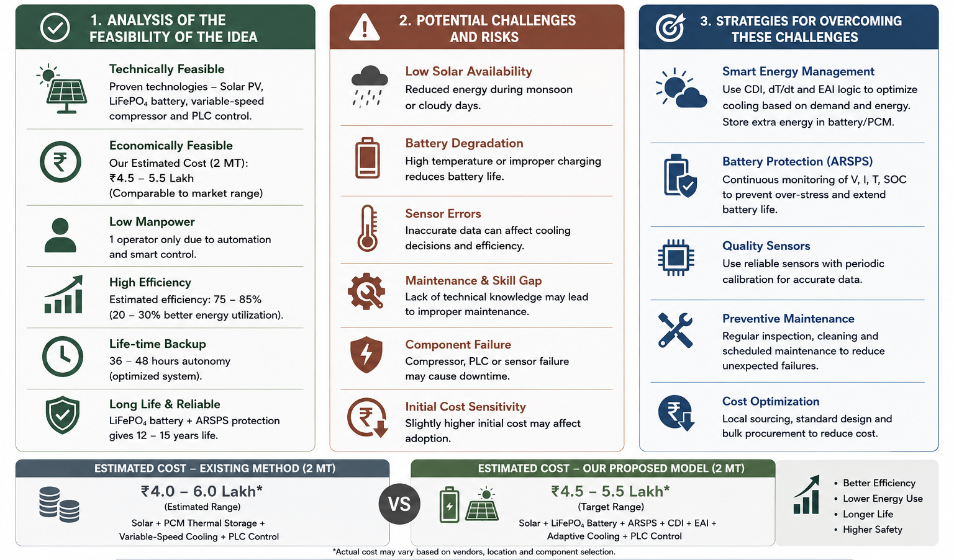
FEASIBILITY AND VIABILITY

Slide 5
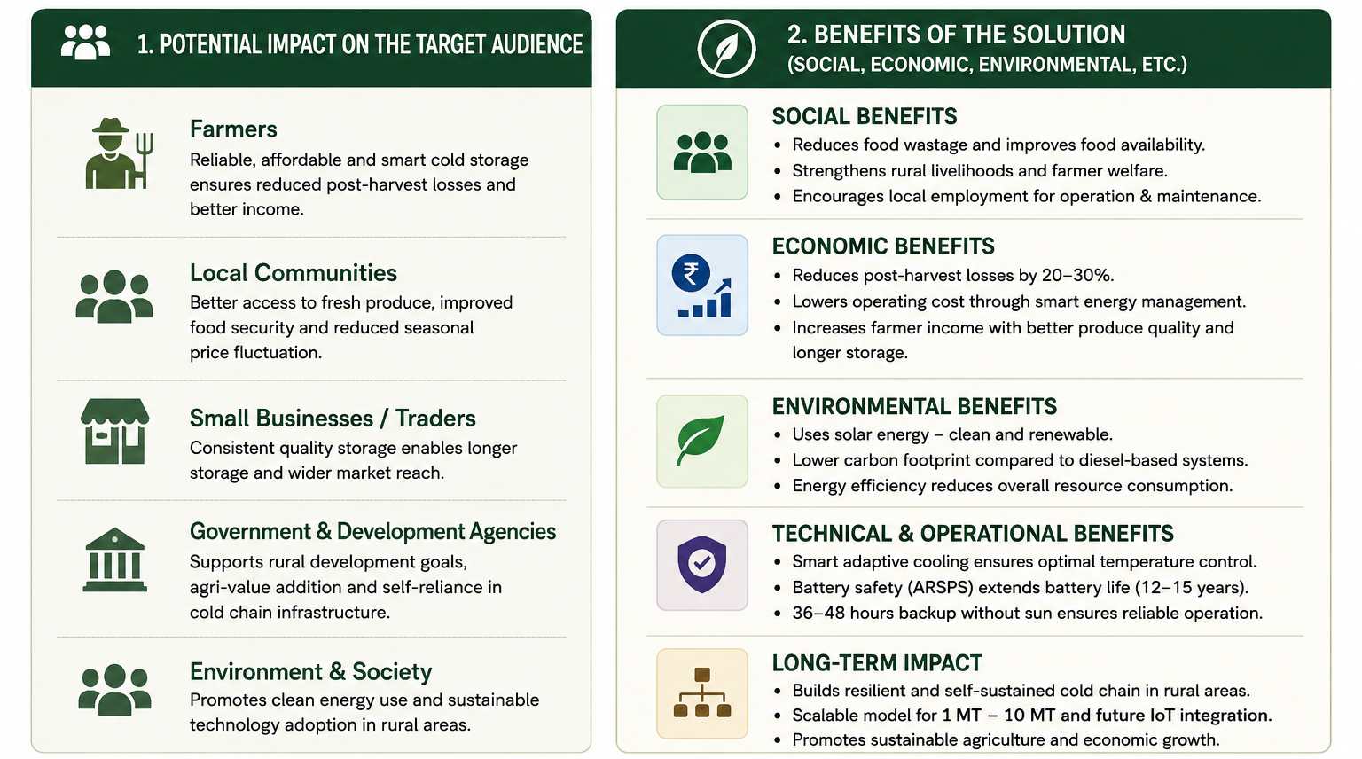
IMPACT AND BENEFITS

Slide 6
RESEARCH AND REFERENCES
1] G. Hussain, M. Sultan, M. Aleem, M. W. Shahzad, M. S. Ahamed, M. Farooq, U. Sajjad, Z. Zhang, and S. Ahmad, “Development and performance evaluation of solar-powered cold storage system for perishable agricultural products,” International Communications in Heat and Mass Transfer, vol. 168, p. 109408, 2025, doi: 10.1016/j.icheatmasstransfer.2025.109408.
[2] B. Natarajan, A. C. Kathiresan, and S. K. Subramanium, “Development and performance evaluation of a hybrid portable solar cold storage system for the preservation of vegetables and fruits in remote areas,” Journal of Energy Storage, vol. 72, p. 108292, 2023, doi: 10.1016/j.est.2023.108292.
[3] W. Amjad, A. Munir, F. Akram, A. Parmar, M. Precoppe, F. Asghar, and F. Mahmood, “Decentralized solar-powered cooling systems for fresh fruit and vegetables to reduce post-harvest losses in developing regions: A review,” Clean Energy, vol. 7, no. 3, pp. 635–653, 2023, doi: 10.1093/ce/zkad015.
[4] H. J. El-Khozondar, M. Elnaggar, A. Al-Mabouh, L. Abu Zanouna, M. I. Al-Atawne, and O. Safi, “Solar-powered cold storage system,” in Proc. 2021 International Conference on Promising Electronic Technologies (ICPET), 2021, pp. 28–33, doi: 10.1109/ICPET53277.2021.00012.

