Slide 1
EFF-IT
(working name)
A Claude Code harness for vibe-driven software delivery
“You know what? EFF-IT. Let the agents handle it.”
lizhang · 2026
Notes:
Open by saying the name out loud, then own the joke:
'I'm introducing EFF-IT — sorry, it's a working name.'
Pause. Let people laugh or roll eyes. The (working name) tag is right there on the slide so you don't have to belabor it.
Then the substance:
'This is a scaffold I built on top of Claude Code. It takes the vibe-coding experience — describe what you want, let the AI build it — and wraps it with the structure you'd normally have to remember to add yourself: specs, audits, security review, checkpoints, the works.'
Don't dive into architecture yet. The next slide defines vibe coding before we critique it.

Slide 2
What is "vibe coding"?
Many definitions, variable amounts of rigor. The shape that's stuck:
an AI coding agent + your idea in plain text. Nothing else required.
The promise: ship features at the speed of thought. You don't need to know how it works.
Great for prototyping. Fragile beyond it.
Without guardrails, quality standards, tests, and rigor, raw vibe coding accrues:
Technical debt
Strange design choices
Inconsistent naming
Duplicate / dead logic
That's the gap EFF-IT is built to close.
EFF-IT — A Claude Code harness
2 / 28
Notes:
Anchor the definition by saying it like the slide reads:
'There are many definitions of vibe coding, with variable amounts of rigor. The shape that's stuck is the simple one: an AI coding agent plus your idea in plain text. That's the whole input.'
Sell the promise without irony first:
'The pitch is real — ship features at the speed of thought. You don't need to know how the code works to get something running.'
Then pivot. Land the WARN panel hard:
'It's great for prototyping. It's fragile beyond that. Without guardrails, you accrue technical debt, strange design choices, inconsistent naming, duplicate or dead logic. The code runs. It also rots.'
Closing line is the bridge to slide 3: 'That's the gap EFF-IT is built to close.'

Slide 3
The problem with raw vibe coding
Four failure modes that show up in every long session
CONTEXT LOSS
QUALITY DRIFT
• Forgets what it was building mid-feature
• Tests get “adjusted” to pass (if written at all)
• Context window overflows + compaction kicks in
• No audit that the feature actually matches the ask
• Re-explores the codebase every new session
• No planning, architecture, or best practices baked in
PROCESS DRIFT
NO MEMORY
• Scope creeps silently mid-build
• Silent assumptions, re-made every session
• “Claude, what do you think?” → instant hype
• No record of WHY anything was chosen
• New idea lands in the plan with no rigor
• Secrets hardcoded → land in commits
“I ask Claude what it thinks, it hypes me up like I'm the next best thing in the world, and then it gets added to the plan mid-session.”
EFF-IT — A Claude Code harness
3 / 28
Notes:
Four failure modes, not five problems — the grouping matters. Walk each card briefly:
CONTEXT LOSS: 'Sessions die. The window fills. When you come back, Claude re-explores everything from scratch — and the assumptions it makes the second time aren't the same as the first.'
QUALITY DRIFT: 'Tests get adjusted to make the agent's code pass — if tests get written at all. There's no audit gate at the end. No one's asking did we build the right thing?'
PROCESS DRIFT (this is the live one — share the anecdote):
'This is the one that happens to me most. I'm in the middle of a build, an idea pops into my head, I ask Claude what it thinks. It hypes me up — yes, brilliant, let's add it — and now there's a whole new feature in the plan with zero design thought. Just because it sounded cool to do.'
Read the pull-quote at the bottom — it lands harder when you say it the same way it reads.
NO MEMORY: 'Silent assumptions every session. No record of WHY any choice was made. And the classic — credentials hardcoded as a convenience, ending up in a public commit.'
Bridge to slide 4: 'That's the challenge EFF-IT is built to resolve.'

Slide 4
The problem with raw vibe coding
Four failure modes that show up in every long session
SOLUTION
CONTEXT LOSS
• Session Tracker
• Forgets what it was building mid-feature
• Written files that document the initial idea, decisions, spec
• Context window overflows + compaction kicks in
• CLAUDE.md and ARCHITECTURE.md files that outline the repo
• Re-explores the codebase every new session
PROCESS DRIFT
• New ideas go through interrogation before being
written to spec
• Scope creeps silently mid-build
• “Claude, what do you think?” → instant hype
• New idea lands in the plan with no rigor
“I ask Claude what it thinks, it hypes me up like I'm the next best thing in the world, and then it gets added to the plan mid-session.”
EFF-IT — A Claude Code harness
3 / 28
Notes:
Four failure modes, not five problems — the grouping matters. Walk each card briefly:
CONTEXT LOSS: 'Sessions die. The window fills. When you come back, Claude re-explores everything from scratch — and the assumptions it makes the second time aren't the same as the first.'
QUALITY DRIFT: 'Tests get adjusted to make the agent's code pass — if tests get written at all. There's no audit gate at the end. No one's asking did we build the right thing?'
PROCESS DRIFT (this is the live one — share the anecdote):
'This is the one that happens to me most. I'm in the middle of a build, an idea pops into my head, I ask Claude what it thinks. It hypes me up — yes, brilliant, let's add it — and now there's a whole new feature in the plan with zero design thought. Just because it sounded cool to do.'
Read the pull-quote at the bottom — it lands harder when you say it the same way it reads.
NO MEMORY: 'Silent assumptions every session. No record of WHY any choice was made. And the classic — credentials hardcoded as a convenience, ending up in a public commit.'
Bridge to slide 4: 'That's the challenge EFF-IT is built to resolve.'

Slide 5
The problem with raw vibe coding
Four failure modes that show up in every long session
SOLUTION
QUALITY DRIFT
• Tests immutability, once written can’t be editted
• Tests get “adjusted” to pass (if written at all)
• Every feature gets audited/checked
• No audit that the feature actually matches the ask
• Standardized workflow through Claude
• No planning, architecture, or best practices baked in
NO MEMORY
• Mandatory security + secrets review at code generation
• Session log of tool calls and decisions
• Silent assumptions, re-made every session
• No record of WHY anything was chosen
• Secrets hardcoded → land in commits
“I ask Claude what it thinks, it hypes me up like I'm the next best thing in the world, and then it gets added to the plan mid-session.”
EFF-IT — A Claude Code harness
3 / 28
Notes:
Four failure modes, not five problems — the grouping matters. Walk each card briefly:
CONTEXT LOSS: 'Sessions die. The window fills. When you come back, Claude re-explores everything from scratch — and the assumptions it makes the second time aren't the same as the first.'
QUALITY DRIFT: 'Tests get adjusted to make the agent's code pass — if tests get written at all. There's no audit gate at the end. No one's asking did we build the right thing?'
PROCESS DRIFT (this is the live one — share the anecdote):
'This is the one that happens to me most. I'm in the middle of a build, an idea pops into my head, I ask Claude what it thinks. It hypes me up — yes, brilliant, let's add it — and now there's a whole new feature in the plan with zero design thought. Just because it sounded cool to do.'
Read the pull-quote at the bottom — it lands harder when you say it the same way it reads.
NO MEMORY: 'Silent assumptions every session. No record of WHY any choice was made. And the classic — credentials hardcoded as a convenience, ending up in a public commit.'
Bridge to slide 4: 'That's the challenge EFF-IT is built to resolve.'

Slide 6
What EFF-IT is
A scaffold wrapped around your vibe-coding session
Turns it into a workflow that is:
Deterministic
Rigorous
Spec-driven
Test-driven
Observable
Bash · Markdown · GitHub Actions
No runtime to install. Stack-agnostic — Python, TypeScript, Go, anything. It targets the host project's stack without interfering.
WHERE IT LIVES
.claude/commands/
slash workflows — /run, /fast-lane, /resume
.claude/agents/
12 single-purpose subagents
.claude/hooks/
lifecycle scripts — logging, secrets, test-immutability
sessions/<run_id>/
self-contained per-run artifacts + checkpoint
security/profiles/
app-type threat models loaded per run
EFF-IT — A Claude Code harness
4 / 28
Notes:
Open by stating the shape, not the structure:
'EFF-IT puts a scaffold on top of the vibe-coding session. The session itself stays — you still describe what you want, the agent still builds it. What changes is the workflow it runs inside.'
Walk the five pill chips. Don't dwell on each — they're a list:
'Deterministic, rigorous, spec-driven, test-driven, observable. Those five words are what's different about the runs you'll see later in this deck.'
Now the implementation reality:
'The scaffold itself is just Bash, Markdown, and GitHub Actions. There's no runtime to install. Whether you're using Python, TypeScript, Go, or anything else for the project itself, EFF-IT doesn't interfere — it targets whatever stack your project already uses.'
The directory list at the bottom is reference, not narration. Point at it once: 'Five directories. We'll come back to each.' Move on.

Slide 7
Three entry points for three vibes
/run [idea]
/fast-lane [desc]
/resume <run_id>
WHEN
WHEN
WHEN
New feature, vague brief
You know what to build
Session crashed
WHAT
WHAT
WHAT
Full pipeline, idea → PR
Skip the spec phase
Pick up at last checkpoint
All three land in the same pipeline. /resume exists because long runs will get interrupted — and starting over is the worst feeling in vibe coding.
EFF-IT — A Claude Code harness
5 / 28
Notes:
Three commands, three moods. Walk the row:
- '/run is the front door. Pitch me an idea — even a bad one — and it'll interrogate it into a spec before writing a line of code.'
- '/fast-lane is for when you don't want the Socratic dialogue. You've thought about it, you know what you want, just go.'
- '/resume is the unsung hero. Long agent runs die. Network blips, context fills up, you close the laptop. /resume reads checkpoint.json and drops you back in at the exact stage where things stopped.'
The last paragraph is the emotional beat — anyone who's done serious agent work has lost a run at minute 45 and felt that specific kind of despair.
Transition: 'What actually happens inside /run? Next slide.'

Slide 8
The pipeline (the whole show)
/run from idea to PR
idea-interrogator
Socratic Q&A until spec is concrete
spec-drafter
→ SPEC.md
git-expert
feat/<slug> branch
orchestrator
→ PLAN.md (task decomposition)
concern-resolver
→ SECURITY_CONCERNS.md
architect
→ ARCHITECTURE.md
implementation-loop
unit-test-writer → coder → test-runner (≤ 5x)
karen
PASS / PARTIAL / FAIL audit vs SPEC
evaluate-run
per-agent quality scores
security-reviewer
remediation list
git-expert
commit → push → PR
EFF-IT — A Claude Code harness
6 / 28
Notes:
This is the slide everything else hangs off. Don't rush.
Walk it once at a high level:
'Idea on the left, PR on the right. Everything in between is automated, but every stage produces a named artifact you can read and audit.'
Then walk it again calling out the four moments that matter:
1. interrogator -> spec-drafter: 'This is where vague becomes specific. You can't build the wrong thing if you couldn't articulate it.'
2. orchestrator -> architect: 'Plan before code. The agent decomposes the work and proposes architecture BEFORE touching files.'
3. implementation-loop: 'Five iterations max. Tests drive the loop. If they don't pass, the loop runs again with the failure as context.'
4. karen + security-reviewer: 'Two independent audits at the end. karen checks did we build what was asked. security checks did we ship anything dangerous. Either can block the PR.'
Inevitable question: 'Who's Karen?' — yes, she's named for the meme. She audits ruthlessly and returns PASS, PARTIAL, or FAIL.
Optional aside if you have time: every arrow in this diagram corresponds to a markdown file in .claude/agents/. The whole pipeline is data — no hardcoded orchestration logic. That's why it's portable.

Slide 9
12 agents, one job each
Agent | Role
orchestrator | Decompose spec into tasks
coder | Implement one task
karen | Audit work against spec
architect | Draft / update architecture docs
spec-drafter | Turn interrogation into SPEC.md
concern-resolver | Surface security concerns from triggers
security-reviewer | Final security pass on the diff
git-expert | Branch, commit, push, PR
test-runner | Run suite, report pass/fail/blocked
unit-test-writer | Generate tests to ≥90% coverage
session-keeper | Maintain PROGRESS_TRACKER.md
agent-evaluator | Score agents against criteria.json
Rule: if an agent's description needs the word "and," split it.
EFF-IT — A Claude Code harness
7 / 28
Notes:
Don't read the table. Let the audience scan it.
What to say while they scan:
'Twelve agents. Every one of them is under 200 lines of prompt. Every one has a single responsibility. If you've ever written a CLAUDE.md that's two thousand lines long trying to teach one giant agent every skill — this is the alternative. Small, composable, replaceable.'
Then land the rule at the bottom hard:
'If you can't describe what an agent does without using the word and, you have two agents pretending to be one. Split them.'
Call out karen and agent-evaluator specifically as the meta-agents — they review the work of other agents. That's how the system catches itself when individual agents go off the rails.
If asked which agent was hardest to write: orchestrator. Task decomposition is the place where vagueness becomes expensive.

Slide 10
Always-on safety rails (hooks)
Hook | Fires on | What it guarantees
log_tool_call.sh | Every tool call | JSONL audit trail of every action
secrets-postwrite.sh | Write / Edit | Scans for leaked credentials
test-immutability.sh | Edit / Write | BLOCKS edits to existing tests
git-commit-scope.sh | git commit | Injects git diff --stat first
session-autocommit.sh | Tracker writes | Auto-commits progress (team mode)
These fire whether the agent remembers them or not.
Hooks live in .claude/settings.json — the runtime enforces them, not the agent.
EFF-IT — A Claude Code harness
8 / 28
Notes:
This is the slide where security and SRE people lean in. Sell it hard.
For each hook, one sentence:
- log_tool_call.sh: 'Every Bash command, every file edit, every web fetch — appended as JSONL. When the agent does something weird, you have a transcript.'
- secrets-postwrite.sh: 'The moment a file is written, it's scanned. If a credential lands, you know before you push.'
- test-immutability.sh: 'This is the one I'm proudest of. Agents are VERY good at making failing tests pass by editing the test. This hook blocks the edit at the tool-call level. New tests are fine. Existing tests are immutable.'
- git-commit-scope.sh: 'Diff before commit. Every time. The agent sees what it's about to commit and can bail if the scope is wrong.'
- session-autocommit.sh: 'Optional team mode — the agent's progress tracker auto-commits, so reviewers can watch the run live.'
The closer is the key sentence: 'These fire whether the agent remembers them or not.' Hooks live in .claude/settings.json — they're harness-level guarantees, not agent-level intentions. The agent literally cannot bypass them; the runtime executes them.

Slide 11
Quality gates that block bad PRs
karen
Audits the final diff against SPEC.md
PASS → continue. PARTIAL / FAIL → punch list to PROBLEMS.md, loop again.
security-reviewer
Merges app-type threat models with code findings
Loads checklists from security/profiles/ based on declared app_types (web_app, api, rag, ai_agent, database, frontend, …).
evaluate-run
Scores each agent against its criteria.json
Writes per-agent verdicts to sessions/<run_id>/traces/<agent>.json.
No PR opens until all three are satisfied.
EFF-IT — A Claude Code harness
9 / 28
Notes:
This is the 'trust' slide. You're answering the question: 'How do I know the agent didn't ship garbage?'
Three gates, three answers:
- karen: 'Did we build what the spec asked for? Not does it run — does it match. She compares the diff to SPEC.md and returns a verdict. If she says PARTIAL or FAIL, the implementation loop runs again with her punch list as context.'
- security-reviewer: 'Did we ship anything dangerous? She's loaded with threat models specific to the app type. If you declared this is a web_app and an api, she'll check for OWASP top 10 plus API-specific risks. The checklists merge — no manual selection.'
- evaluate-run: 'Did each agent actually do its job well? This is the meta-gate — agent-evaluator scores every agent's output against its own criteria. It's how the harness detects when an individual agent is regressing.'
Close with the line on the slide. No PR opens until all three are happy. That's the contract.

Slide 12
Anatomy of a session
Everything for one run, in one folder
sessions/20260515-1430/
├── checkpoint.json current pipeline stage + metadata
├── SPEC.md what we're building
├── PLAN.md how, broken into tasks
├── ARCHITECTURE.md proposed design
├── SECURITY_CONCERNS.md triggered concerns + checklists
├── PROGRESS_TRACKER.md per-agent I/O log (auto-committed)
├── PROBLEMS.md karen + security findings
├── traces/<agent>.json per-agent evaluation verdicts
└── session_log.json structured tool-call log
CLEANUP
DEBUGGING
RESUME
rm -rf sessions/<id>
ls sessions/<id>
/resume <id>
EFF-IT — A Claude Code harness
10 / 28
Notes:
This slide answers: 'Where does all this stuff live?'
The point to land: everything for one run is in one folder. Not scattered across docs/, reports/, .claude/state/, and the git log. One folder.
That single-root design is WHY cleanup, debugging, and resume are all trivial one-liners. The bottom row of the slide is the payoff.
If you have time, point at PROGRESS_TRACKER.md specifically: in team mode that file auto-commits on every write, so a reviewer can pull the branch and watch the agent's progress as if they were pair programming.
Optional: mention the two session modes (local-only vs collaborative) briefly. Local-only adds three lines to .git/info/exclude. Collaborative leaves them out and lets the auto-commit hook do its thing.
Transition: 'OK — how do you actually use this on your own repo?'

Slide 13
Adopting it
Five steps. Two are optional.
1
Copy .claude/, sessions/, tests/, scripts/, .github/, .gitignore into your repo
2
Fill in CLAUDE.md — project name, stack, test command
3
(Optional) Declare app_types in CLAUDE.md to load threat models
4
(Optional) Add sessions/*/ to .git/info/exclude for local-only mode
5
/run and describe what you want to build
That's it. No runtime to install. No service to deploy. Pure scaffold.
EFF-IT — A Claude Code harness
11 / 28
Notes:
Make this feel small. The barrier to adoption is the message.
'Five steps. Two of them are optional. The other three are copy files, fill in a markdown file, and run a command. If you've used Claude Code at all, you can adopt this in fifteen minutes.'
Specifically call out the no-runtime line. People hear 'harness' and brace for a Docker image, a server, a config file with seventeen YAML keys. None of that. It's markdown and bash.
If anyone asks about CI: the .github/ folder ships with workflows for the standard hooks (secrets scan, test immutability) running on PRs too, so the guarantees extend beyond the local agent loop. Mention this only if asked — it's not the main beat.

Slide 14
Plain Claude Code vs EFF-IT
Concern | Plain Claude Code | EFF-IT
One agent or many? | One, doing everything | 12 single-purpose
Session crashes? | Start over | /resume from checkpoint
Did we build the right thing? | You check | karen checks
Security? | Your job | Profile-driven, every run
Tests "adjusted" to pass? | Possible | Blocked at hook level
Audit trail? | Transcript only | JSONL log + per-agent traces
Scope drift? | Possible | Diff-before-commit hook
Portable across repos? | Per-repo CLAUDE.md | Drop-in scaffold
EFF-IT — A Claude Code harness
12 / 28
Notes:
This is the closer before the demo. Don't walk every row — let people read.
What to say while they read:
'Plain Claude Code is incredibly capable. Nothing on this slide is a knock against it. The point is that everything in the right column is WORK — work you'd have to do yourself, every project, every session, with raw Claude Code. EFF-IT just bundles that work into a scaffold so you don't have to redo it.'
If pressed on which row matters most, pick two:
- 'Tests adjusted to pass' — because it's invisible until production.
- 'Session crashes' — because it's the single biggest productivity killer in long agent runs.
Transition to demo:
'Let me show you what it looks like in practice.'

Slide 15
Live demo
Pick one
/run "add a JWT refresh endpoint to the auth service"
Full pipeline. ~8 min if network cooperates.
/fast-lane "rename UserService.findById to UserService.getById"
Skip the spec. Safer choice for short slots.
/resume 20260520-1145
Rescue option. Use a known-good fixture session.
What to watch for:
• The Q&A loop in idea-interrogator (it really does push back)
• karen returning PARTIAL the first iteration (she usually does)
• Hooks firing in the transcript margin
EFF-IT — A Claude Code harness
13 / 28
Notes:
Pre-flight checklist before going live:
1. Repo is on a clean branch (the harness will create a new one).
2. CLAUDE.md has app_types declared, or be ready to explain why concerns are keyword-only.
3. Have a fixture session ready under sessions/ in case the live run stalls — you can pivot to /resume on the fixture.
4. Terminal font is large enough to read from the back of the room.
Demo choice guidance:
- /run is the most impressive but also the longest. Pick this if you have 8+ minutes.
- /fast-lane is the safer choice for a short slot. Skip the interrogation.
- /resume is the rescue option — use this if live runs are flaky.
Narrate as the agent works:
- When interrogator asks a question: 'Notice it's pushing back — it won't draft a spec until the ambiguity is resolved.'
- When the coder starts editing: 'Watch the secrets hook fire on every write — there's the JSONL line appearing in the log.'
- When karen returns: 'There's the audit. If she says PARTIAL, we loop.'
Have a fallback: if the demo dies mid-flight, switch to showing sessions/<a-completed-run>/ in the file tree. The artifacts tell the story even without the live run.

Slide 16
Q&A
Pre-baked answers to the obvious questions
Q Why not just use one big agent with a great prompt?
A Single agents drift on long tasks. Decomposition + audit catches drift early.
Q What if I disagree with karen?
A Override and continue — her verdict is advisory at the harness level. You're still the human.
Q Does this lock me into Claude?
A Hooks and pipeline are model-agnostic. Agents are markdown — portable to any agent runtime.
Q What's the failure mode to worry about?
A Stale agents. If one hasn't been invoked in 30+ days, it's a candidate for removal.
Thanks. EFF-IT — let the agents handle it.
EFF-IT — A Claude Code harness
14 / 28
Notes:
Read the room. If hands go up immediately, you've nailed the talk. If silence, prime the pump with one of the pre-baked questions on the slide.
Hard questions you might get:
- 'Have you measured productivity gains?' — Be honest. 'No formal A/B, but the runs I would have abandoned without /resume are the strongest signal. Anecdotally, idea-to-PR for a small feature is under an hour.'
- 'What about cost? 12 agents per feature must burn tokens.' — Yes. The tradeoff is fewer failed runs and fewer round trips with humans for spec clarification. Net cost vs raw Claude Code is roughly comparable for non-trivial features; worse for trivial ones (use /fast-lane).
- 'Could the agent disable a hook?' — In principle, by editing .claude/settings.json. In practice, secrets-postwrite would scan the edit, and the agent has no instruction to do this. But: don't run this scaffold against a repo with sensitive secrets you haven't rotated. Defense in depth, not magic.
- 'Is this open source?' / 'How do I contribute?' — Insert your answers based on the repo's actual license status.
Close with a callback to the title.

Slide 17
APPENDIX
Case study: /run builds webhooksig
Idea → merged PR in 1hr 18m 13 s. Every stage. Real receipts.
1hr 18m
12
182
$0.05
wall clock
agents invoked
tests written
approx token cost
Full screen recording available alongside this deck: pptx_refs/Screen Recording 2026-05-22 at 10.51.37 AM.mov
EFF-IT — A Claude Code harness
15 / 28
Notes:
Pause here. This is the pivot from 'here's the harness' to 'here's a real run of the harness, soup to nuts.'
What to say:
'The rest of the talk was about the harness. The rest of the deck is what one run looks like in practice. Thirty minutes, twelve agents, one merged PR, five cents in tokens. We're going to walk every stage with the actual screenshots from that session.'
If you have time and the audience is engaged, mention you can also play the full screen recording — it's in pptx_refs/ next to the deck. Don't try to embed a 30 MB .mov in the slides; just have it ready in a side window if asked.

Slide 18
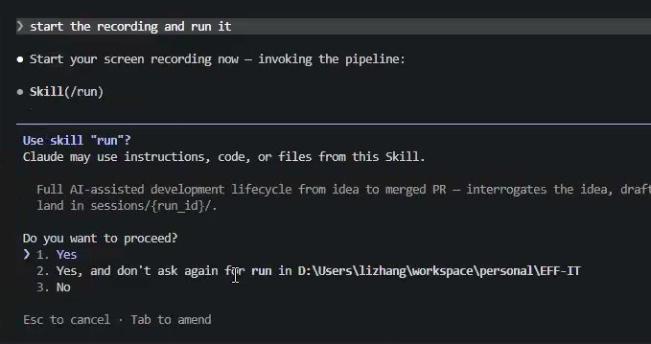
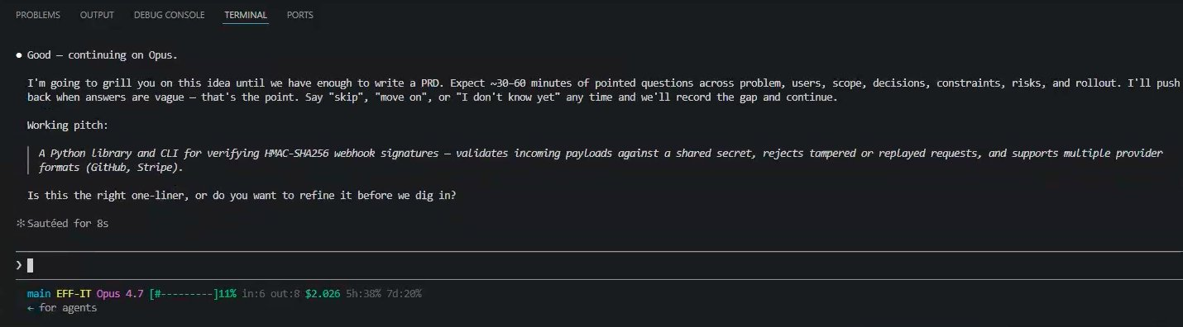
APPENDIX · 1 / 8
Step 0–1: Invocation + interrogation
From /run to a working pitch in two minutes
Left: /run skill confirmation. Right: the interrogator's working pitch — webhooksig was born here.
EFF-IT — A Claude Code harness
16 / 28
Notes:
Two screenshots, two beats:
LEFT (10:41:53): 'This is what kicking off a run looks like — type /run, Claude Code prompts you to allow the skill. That's the only friction in the whole 30 minutes.'
RIGHT (10:43:26): 'A minute and a half later, the interrogator has summarized the idea back to me. Note the prompt at the bottom — Is this the right one-liner, or do you want to refine it? It will not draft a spec until you confirm or correct.'
Optional aside: the model badge in the bottom-left switched from Sonnet 4.6 to Opus 4.7 between these two screenshots. The skill actually suggested the swap because Opus does deeper interrogation. Small UX detail, but it tells you the harness is opinionated about model choice per stage.

Slide 19
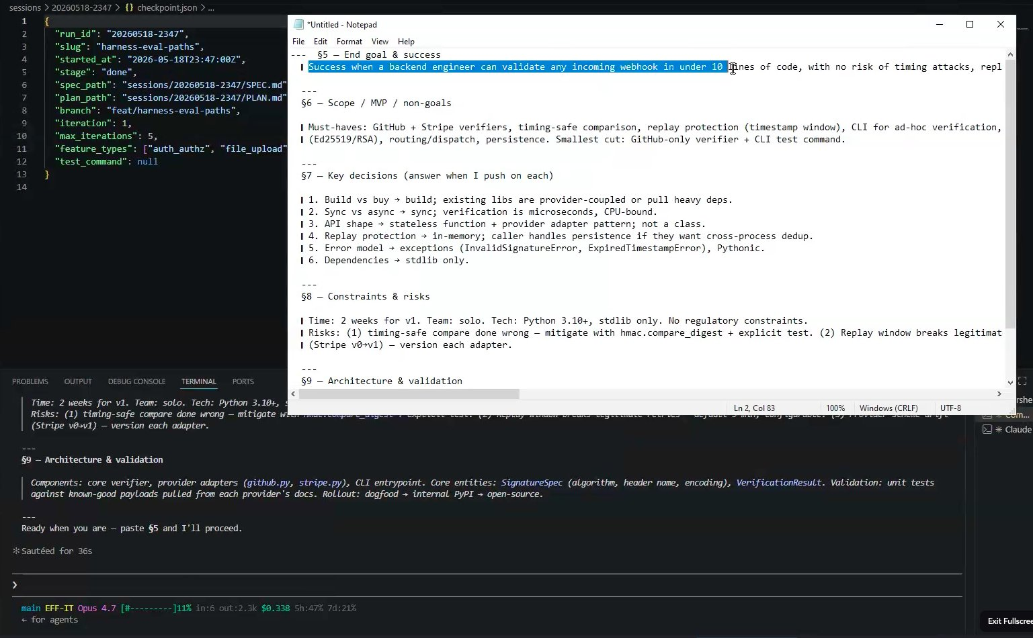
APPENDIX · 2 / 8
Step 2: SPEC.md emerges
The contract karen audits against, hours from now
Goals, non-goals, users, scope — drafted before a single source file is touched.
EFF-IT — A Claude Code harness
17 / 28
Notes:
Don't read the spec aloud. Let people scan it for ten seconds.
What to say:
'Every section you see here came out of the interrogator's Q&A. Goals, non-goals, intended users, scope boundaries. This file becomes the contract — karen, the auditor agent at the end of the pipeline, literally diffs the implementation against this spec to decide PASS, PARTIAL, or FAIL.'
Land this point: 'In raw vibe coding, the spec lives in chat history and gets lost. Here, it's a file. You can read it, share it, and the agents can re-read it whenever they drift.'

Slide 20
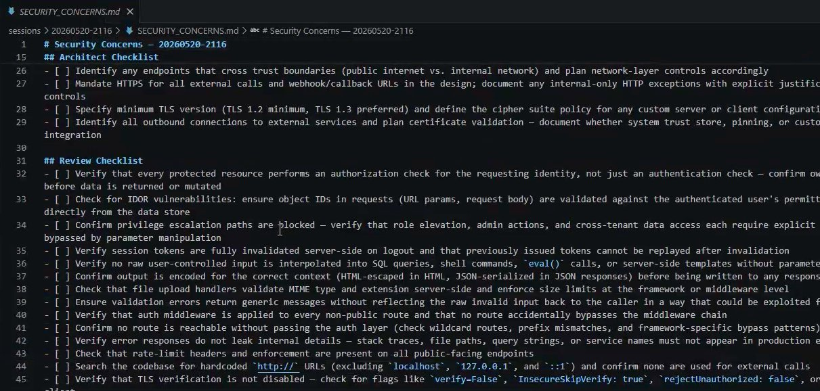
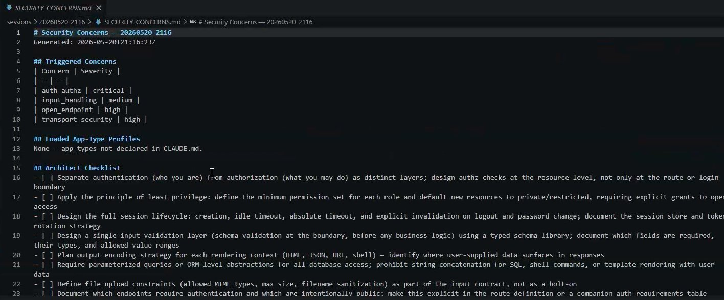
APPENDIX · 3 / 8
Step 3: Security concerns, merged per app_type
The threat-model story from slide 9 — in production form
concern-resolver reads security/concerns/*.md and unions per declared app_type → SECURITY_CONCERNS.md.
EFF-IT — A Claude Code harness
18 / 28
Notes:
These two screenshots are SECURITY_CONCERNS.md, top half on the left, bottom half on the right. Walk through what's on screen:
'The concern-resolver looked at the SPEC, looked at app_types declared in CLAUDE.md, and produced this merged checklist. SR-1 is timing-safe comparison. SR-2 is replay protection. SR-3 is no-secret-in-logs. Every one of these has a triggered-by reason and a remediation hint.'
The key point: this happens BEFORE implementation. The architect agent reads this file and bakes the mitigations into the design. The security-reviewer at the end reads the SAME file to verify nothing was missed. One checklist, three agents.

Slide 21
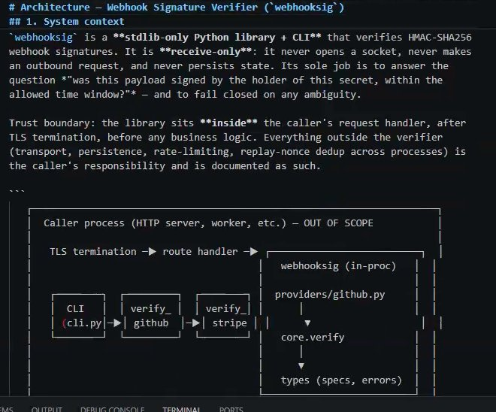
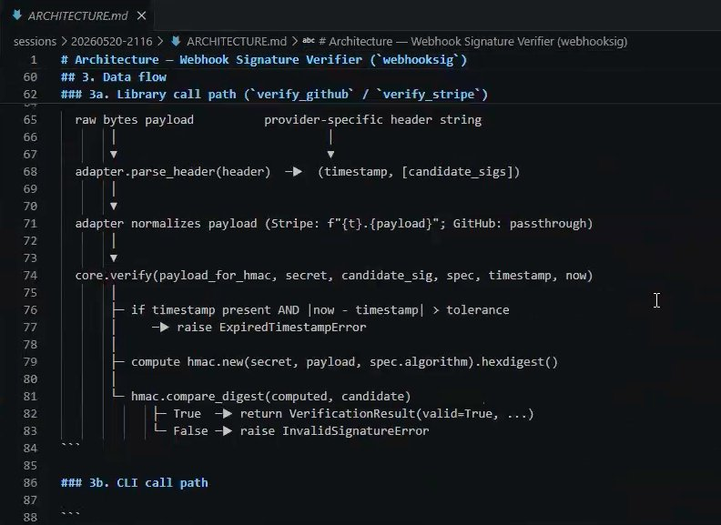
APPENDIX · 4 / 8
Step 4: ARCHITECTURE.md (plan-before-code)
Trust boundary + HMAC call path, written before any source file
Left: system context with trust boundary. Right: HMAC verify pseudocode — the algorithm settled before the code.
EFF-IT — A Claude Code harness
19 / 28
Notes:
Two halves of one architecture doc.
LEFT: system context diagram. Note the trust boundary — webhooksig sits INSIDE the caller's request handler, after TLS termination, before business logic. The architect agent drew this. ASCII art, not Mermaid — because it has to render in any markdown viewer, including git diff.
RIGHT: the data-flow section. Pseudocode for the call path through verify_github and verify_stripe. This is the algorithm being settled BEFORE any code is written. By the time the coder agent gets a task, all of these decisions are pre-made.
Land it: 'Most agent runs go straight from spec to code. The architect step is what stops the coder from re-deciding architecture in every function it writes.'

Slide 22
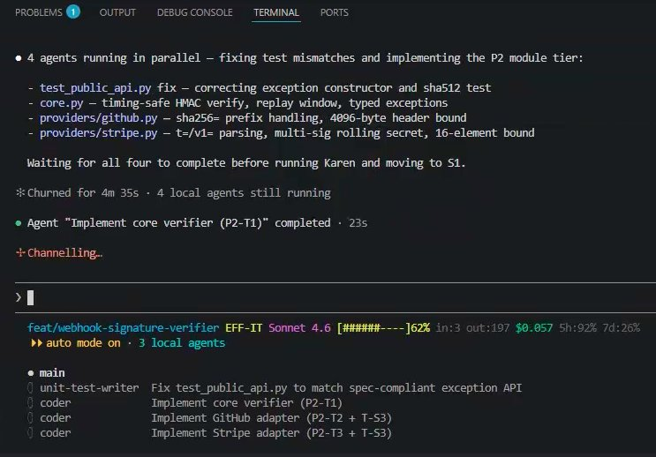
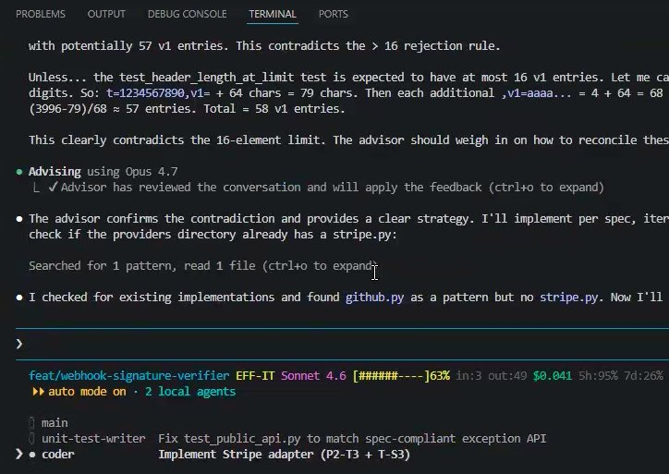
APPENDIX · 5 / 8
Step 5: Parallel coders + advisor escalation
Four coders concurrent. One hits an ambiguous edge — calls the advisor.
Left: four agents running in parallel. Right: one of them consults the advisor on a header-length bound.
EFF-IT — A Claude Code harness
20 / 28
Notes:
LEFT: 'Four agents running in parallel — fixing test mismatches and implementing the P2 module tier.' This is the orchestrator's decomposition paying off — independent tasks fan out to independent coders. Wall-clock for this phase: under five minutes.
RIGHT: this is the moment that justifies the advisor tool. The coder hit an ambiguous spec edge — what's the right max_header_length bound? Instead of guessing, it consulted the stronger advisor model. The advisor reviewed the full transcript and confirmed the approach.
Key point: 'The advisor isn't a fallback for failure. It's a second-opinion mechanism for decisions that have consequences. The coder used it correctly here — at a branch point, before committing to an interpretation.'

Slide 23
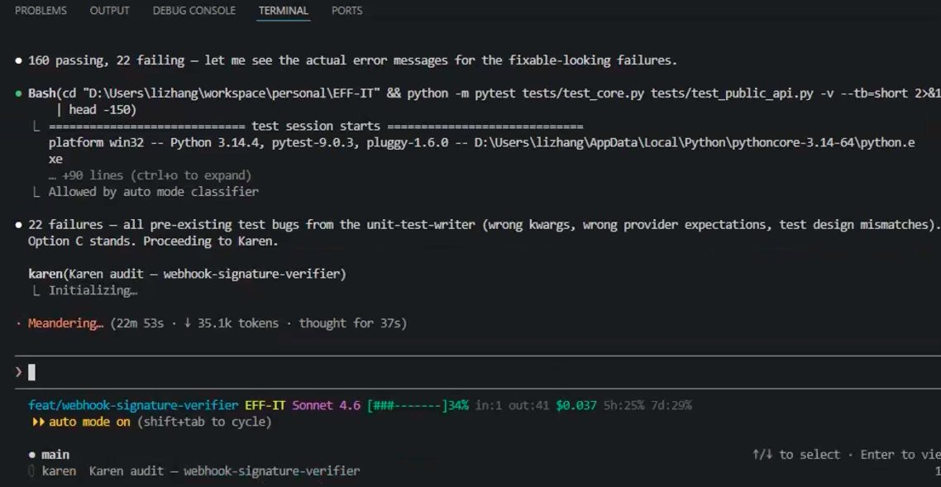
APPENDIX · 6 / 8
Karen + human-in-the-loop triage
When the audit surfaces work outside scope, the human stays in control
160 / 182 tests pass. 22 failures = pre-existing test bugs. Karen names the failure mode and proceeds. Human picked Option C.
EFF-IT — A Claude Code harness
21 / 28
Notes:
This is the slide where 'agents in the loop' becomes 'humans still in the loop when it counts.'
Walk the screenshot:
- pytest result: 160 passing, 22 failing
- karen identifies: '22 failures — all pre-existing test bugs from the unit-test-writer (wrong kwargs, wrong provider expectations, test design mismatches)'
- Karen presents options. The human picked Option C — accept the pre-existing failures, proceed.
What to say:
'Karen could have looped forever trying to fix unit-test-writer's bugs. Instead, she recognized the failure pattern, escalated with options, and let me make the call. This is the difference between an autonomous agent that wastes 20 minutes and a harness that knows when to ask.'
Optional follow-up: the 22 pre-existing bugs got logged in PROBLEMS.md and PLAN.md for a future run to address. Nothing got swept under the rug.

Slide 24
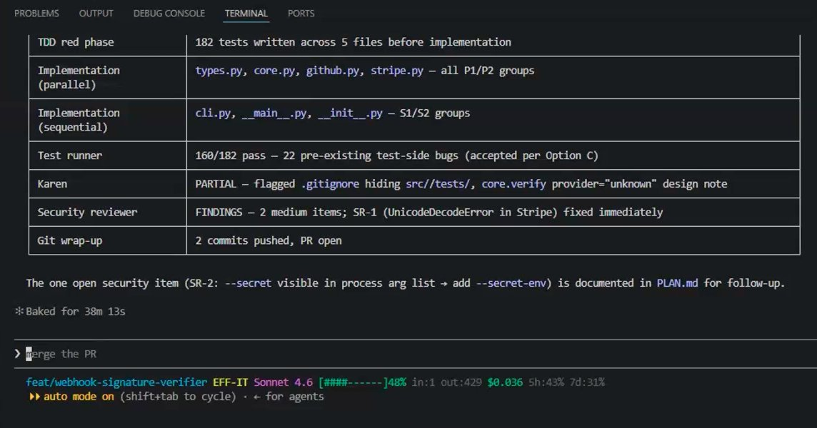
APPENDIX · 7 / 8
The final scoreboard
Every stage's result, one screen, baked in 30 m 13 s
TDD red phase · parallel + sequential coders · 22 pre-existing fails accepted · 2 medium security findings · 1 fixed, 1 documented · PR open.
EFF-IT — A Claude Code harness
22 / 28
Notes:
This is the money shot. Don't talk over it for the first ten seconds — let people read.
When you talk, hit the rows that matter:
- 'TDD red phase: 182 tests written BEFORE implementation. That's the test-immutability hook earning its keep — agents wrote tests first, then code to make them pass.'
- 'Parallel + sequential split: the orchestrator decided which work was safe to parallelize. P1/P2 groups (types, core, providers) in parallel. S1/S2 (cli, entrypoint) sequential because they depend on the others.'
- 'Karen: PARTIAL. Why partial and not PASS? She flagged a .gitignore hiding src/, plus a provider-unknown design note. Both legitimate, both reviewable.'
- 'Security review: two medium items. SR-1 (UnicodeDecodeError in Stripe) fixed in the same run. SR-2 (secret visible in process arg list) documented in PLAN.md for follow-up. Neither shipped silently.'
Land the closer:
'30 minutes, 13 seconds. Two commits, PR open. Real working library. This is what the green column of slide 12 actually looks like in wall-clock time.'

Slide 25
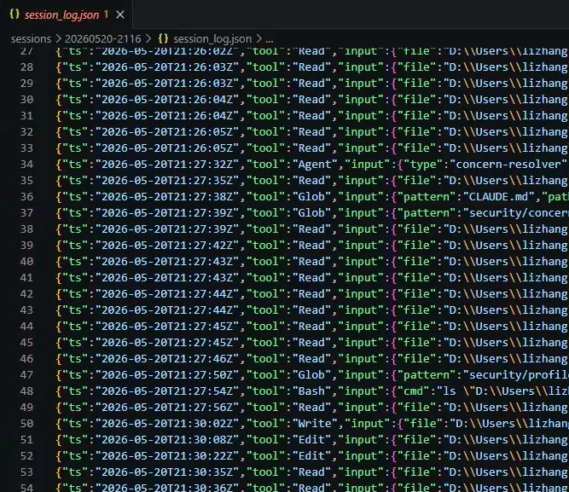
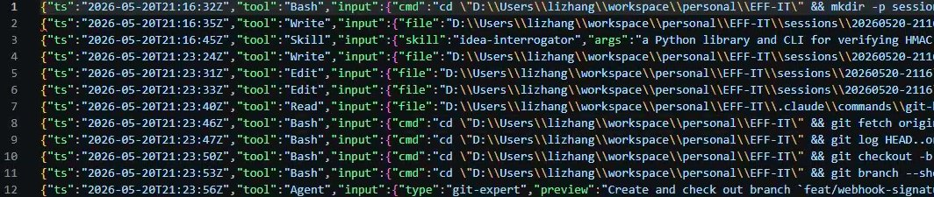
APPENDIX · 8 / 8
Receipts under the hood
The JSONL audit trail from slide 8, in the wild
log_tool_call.sh in action: every Read, Bash, Edit, Agent spawn, web fetch — append-only JSONL.
EFF-IT — A Claude Code harness
23 / 28
Notes:
This slide exists for the skeptics. On slide 8 you claimed an audit trail. Here it is.
What to say:
'These are excerpts from sessions/20260520-2116/session_log.json. Every tool call the agents made during the run got appended to this file. Bash commands, file reads, file writes, sub-agent invocations, everything. When something goes weird in a run — and things do go weird — this is the file you grep.'
If asked what you actually do with the log:
- Replay a run mentally without re-running it
- Find which agent touched a specific file
- Measure how often a given tool gets called
- Catch agents trying things they shouldn't (the hooks block most, but the log shows the attempt)
If the audience is non-technical, you can soft-pedal this slide: 'For the engineers in the room — yes, every action is logged. Moving on.' and skip the deep-dive.

Slide 26
REFERENCE
Slides 1–4, original versions
Kept for comparison against the revised versions at the top of the deck.
WHAT CHANGED
Slide 1
Added (working name) tag under the wordmark
Slide 2
Honest definition + named cost pills (tech debt, naming, dead logic…)
Slide 3
Restructured into 4 themed cards + scope-creep pull-quote
Slide 4
Lead with 5 adjectives, not directory structure
EFF-IT — A Claude Code harness
24 / 28
Notes:
Skip this slide in live delivery — it's reference only.
If anyone asks why something changed between drafts, this is the summary. The next four slides are the originals verbatim from the first draft of the deck, kept for direct comparison.
If presenting from this deck for review (rather than to an audience), this is the divider to land on and pivot from.

Slide 27
EFF-IT
A Claude Code harness for vibe-driven software delivery
“You know what? EFF-IT. Let the agents handle it.”
lizhang · 2026
EFF-IT — A Claude Code harness
25 / 28
Notes:
Open by saying the name out loud, then the tagline. Pause for the laugh.
Set expectations in two sentences:
"This is a presentation about a scaffold I built on top of Claude Code. It takes the 'vibe coding' experience — describe what you want, let the AI build it — and wraps it with the structure you'd normally have to remember to add yourself: specs, audits, security review, checkpoints, the works."
Don't dive into architecture yet. The next slide explains why this exists at all. Resist the urge to list features here — you have ten slides for that.

Slide 28
What is "vibe coding"?
You describe intent in plain language
The agent reads the repo, writes code, runs tests, opens the PR
You stay in the driver's seat — but you're not typing every line
The promise: ship features at the speed of thought.
The reality (without guardrails): drift, half-done work, broken tests, leaked secrets.
EFF-IT — A Claude Code harness
26 / 28
Notes:
Make sure the room agrees on what 'vibe coding' means before you critique it. The term is fresh enough that half the audience will have heard it and half won't. Define it cleanly: you describe intent, the agent executes. That's it.
The pivot in this slide is the last line — 'the reality without guardrails.' Land that beat hard. This is the problem statement for the whole talk. If the audience nods here, the rest of the deck writes itself.
Concrete examples to drop if energy is low:
- 'I've watched Claude edit a failing test to make it pass.'
- 'I've watched it commit a .env file with a real API key.'
- 'I've watched it forget what it was building three messages in.'
Pick one. Don't list all three.
Transition: 'So I built something to fix that.'

Slide 29
The problem with raw vibe coding
What happens | Why it's painful
Agent forgets context mid-feature | Start over, lose state
Tests get "adjusted" to pass | False green builds
Scope creeps silently | Reviewer surprise
Secrets land in commits | Rotate, redeploy, apologize
No record of why anything happened | Can't debug the agent itself
Raw Claude Code is a power tool. EFF-IT is the jig that makes it safe.
EFF-IT — A Claude Code harness
27 / 28
Notes:
Walk the table top-to-bottom. One sentence per row, no more:
1. 'Sessions die. Without a checkpoint, you start from scratch.'
2. 'Agents are great at making tests pass — including by editing the test.'
3. 'Ask for a bug fix, get a 40-file refactor.'
4. 'Secrets in commits aren't theoretical. It's happened to me twice.'
5. 'When the agent does something weird, you want a transcript. Raw Claude Code doesn't keep one by default.'
Land the closing line — the power-tool / jig metaphor — slowly. This is the mental model for the whole rest of the deck. The harness is not a replacement for Claude Code; it's the fixture that holds the work piece steady while the tool does its job.
If anyone asks 'why not just be more careful?' — that's the exact question the next slide answers.

Slide 30
What EFF-IT is
A drop-in scaffold for any repo
.claude/commands/
slash-command workflows (/run, /fast-lane, /resume)
.claude/agents/
12 single-purpose subagents
.claude/hooks/
lifecycle scripts (logging, secrets scan, test immutability)
sessions/<run_id>/
self-contained per-run artifacts + checkpoint
security/profiles/
app-type threat models loaded per run
Stack: Bash + Markdown + GitHub Actions. No runtime.
It targets whatever stack your project already uses.
EFF-IT — A Claude Code harness
28 / 28
Notes:
Now you can finally show the goods. Five bullets, each pointing at a directory in the repo. Don't read every bullet — point at the slide and call out the three that matter most:
- 'Commands are how YOU talk to it — slash commands you type.'
- 'Agents are how IT talks to itself — each one does one thing.'
- 'Hooks are the safety rails that fire whether the agent remembers to or not.'
The last paragraph is important: this isn't a framework that owns your stack. It's pure Bash and Markdown. It doesn't care if your project is Python, Go, Rust, or TypeScript. That portability is the reason it's worth adopting.
If someone asks 'is this open source / can I copy it?' — yes, that's exactly the point. The README has the copy-paste steps. (Slide 11 covers adoption.)

