Slide 1

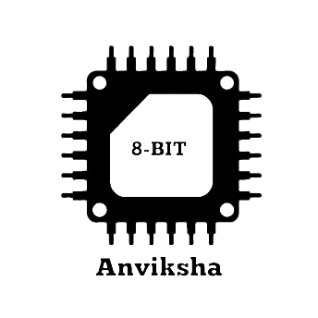
ANVIKSHA 8 – Bit CPU
Vivekananda College of Engineering & Technology
[A Unit of Vivekananda Vidyavardhaka Sangha Puttur®]
Affiliated to Visvesvaraya Technological University
Approved by AICTE New Delhi & Recognised by Govt of Karnataka
“A hardware-level implementation of an 8-bit microprocessor architecture with complete fetch–decode–execute cycle.”
Name | USN
THIYANAND M (Team Lead) | 4VP23EC050
CHAITHANYA | 4VP23EC005
FATHIMATH ANEESHA | 4VP23EC010
PREETHA S M | 4VP23EC029

Slide 2

Introduction:
A CPU (Central Processing Unit) is the brain of a Computer.
It performs arithmetic, logic, and control operations.
Modern processors are complex, this project demonstrates the basic working principle.
Motivation:
To understand internal architecture of a processor.
To implement theoretical digital concepts practically.
To learn hardware-level instruction execution.
To strengthen knowledge in:
Digital Electronics
Computer Organization
Microprocessors

Slide 3
Aim:
To build a working 8-bit CPU using digital ICs on breadboard.
As per Complex Logics, We can’t directly implement on breadboard, So we will follow Software Implementation (Logisim Evolution & KiCad Schematic) and Hardware Implementation (IC’s on Breadboard)
Design & Logic Implementation
Using Logisim Evolution Software for Design and Logics Implementation.
HDL Simulation
Using Verilog (HDL) for RTL Design and Functional Simulation (Virtuoso)
Schematics
Using KiCad Software for Electrical Rules Check (ERC)
Breadboarding
Stage where you verify the “Proof of Concept"

Slide 4
Perquisites
RISC vs CISC Comparison
Feature | Our 8-bit CPU | RISC | CISC
Instruction Size | Fixed (8-bit) | ✅ Yes | ❌ Variable
Instruction Complexity | Simple | ✅ Simple | ❌ Complex
Control Unit | Hardwired | ✅ Yes | ❌ Mostly Micro-coded
Execution Cycles | Few cycles | ✅ Few | ❌ Multiple

Slide 5
Project Objective:
Program Counter
Memory Address Register
Instruction Register
Control Unit
Register (A & B)
ALU
Design 8 – Bit Datapath.
Implementation:
Executing Basic Instructions:
ADD
SUB
LOAD
STORE
JMP

Slide 6
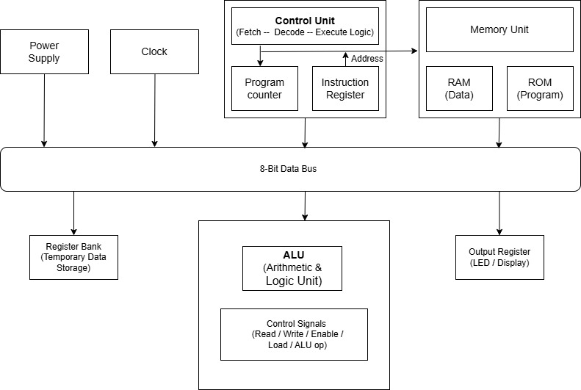
Block Diagram: Same as CPU Architecture

Slide 7
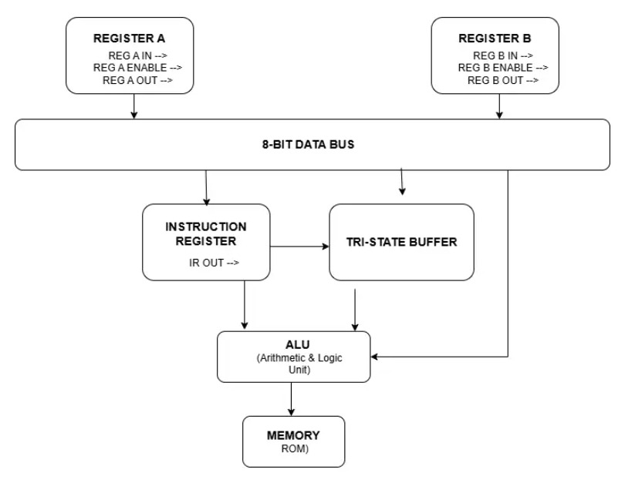
Data Bus Architecture:

Slide 8
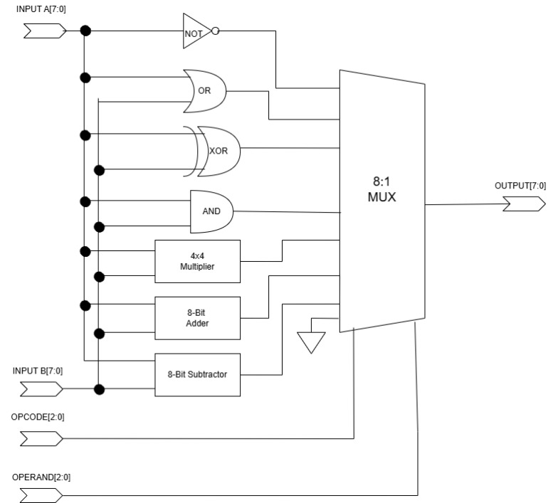
Arithmetic Logic Unit:

Slide 9
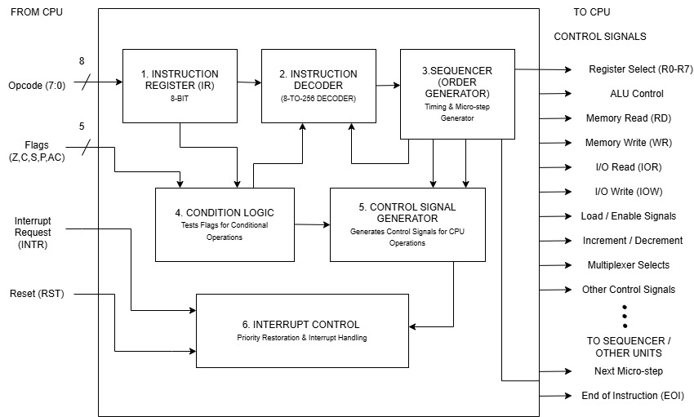
Control Unit:

Slide 10
Instruction Cycle:
T0
PC
MAR
T1
Memory
IR, PC++
T2
Instruction Decode
T3
Operand Fetch
T4
Executre Operation
T5
Store Results/Update Flags
We have designed 6 T – States accordingly,
Fetch
Decode
Execute
Opcode | Instruction | Meaning
0000 | NOP | Do nothing
0001 | LDA addr | Load RAM → A
0010 | ADD addr | A ← A + RAM
0011 | SUB addr | A ← A − RAM
0100 | STA addr | Store A → RAM
0101 | OUT | Output A
1111 | HLT | Halt CPU

Slide 11
Applications:
Educational Purposes.
Understanding Processor Architecture.
Foundation For:
Microprocessor Design.
FPGA Design.
ASIC Design.

Slide 12
Any Questions!!!
Please give us Feedback, We hope maintained professional Dignitaries… Thank you Everyone!! Soon we will come with our own CPU Design…

