Slide 1


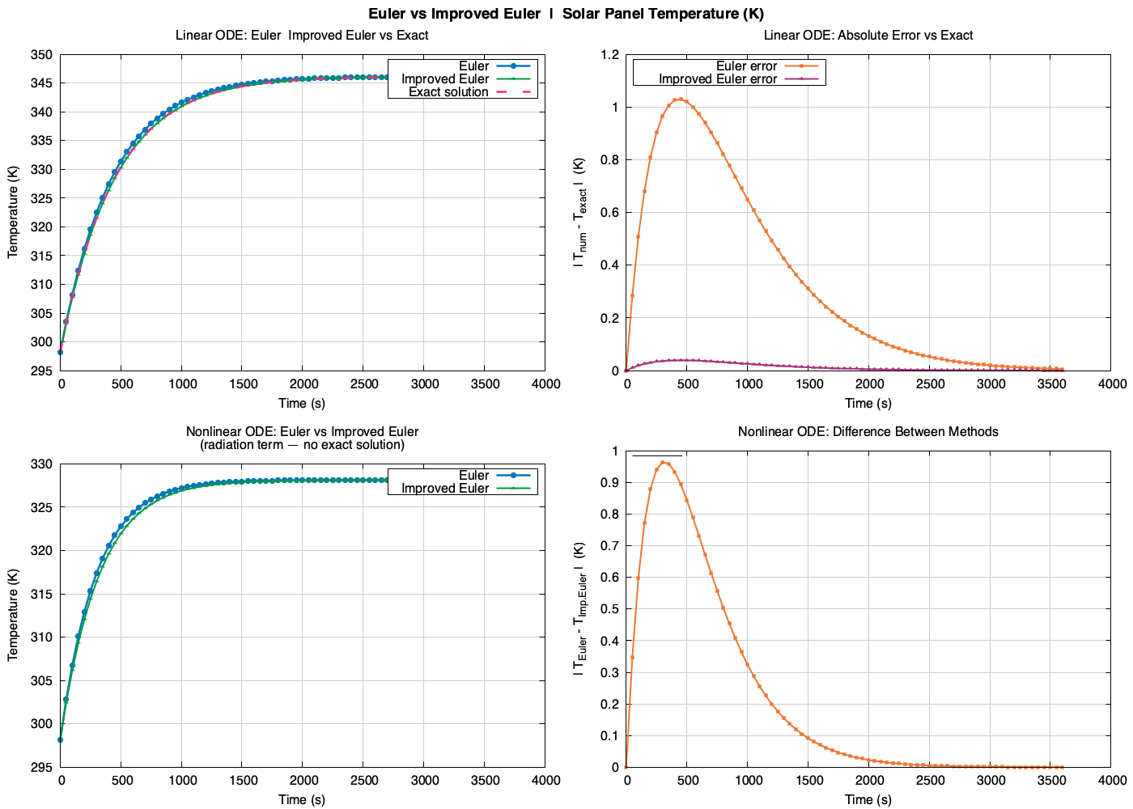
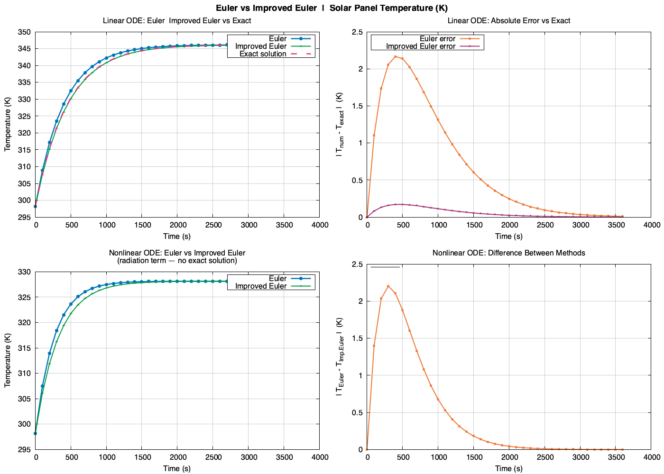
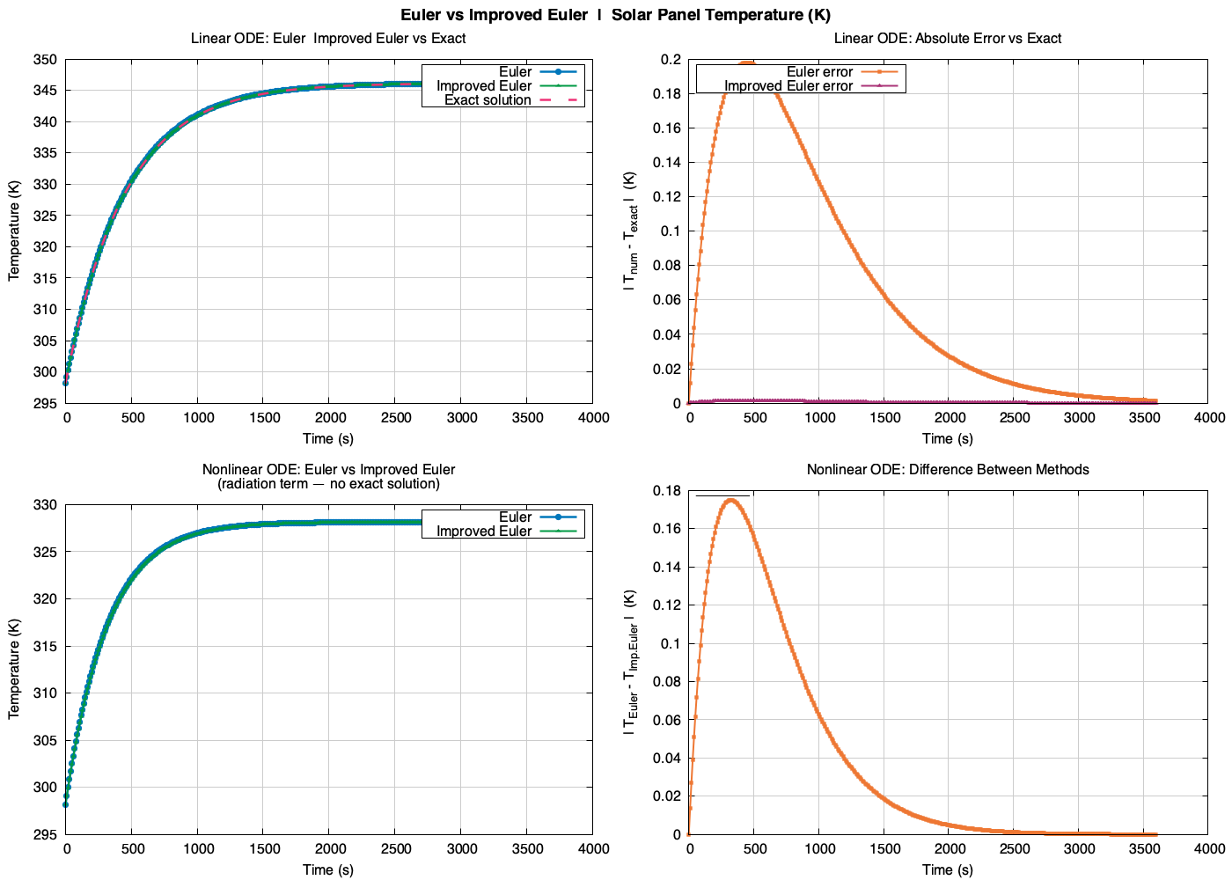
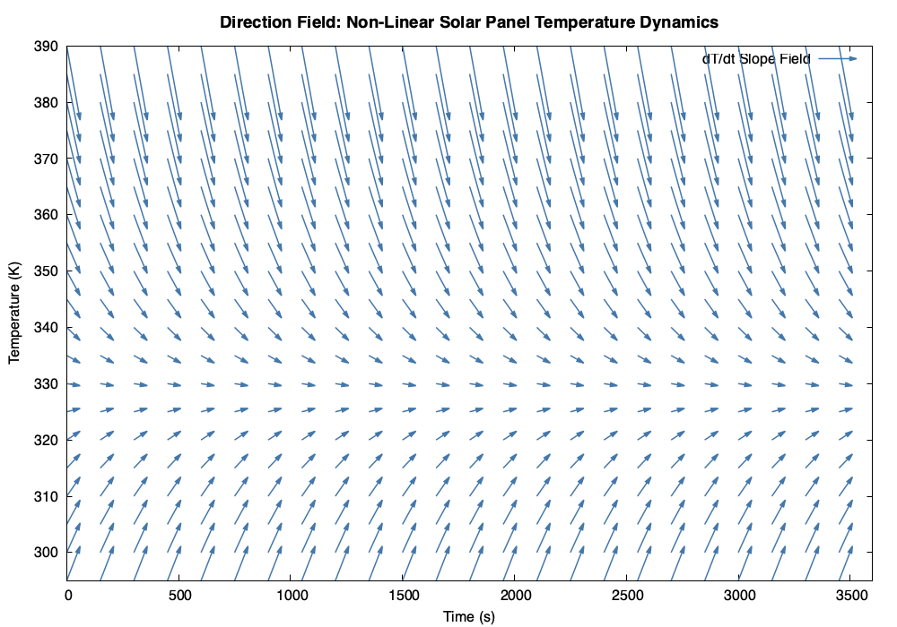
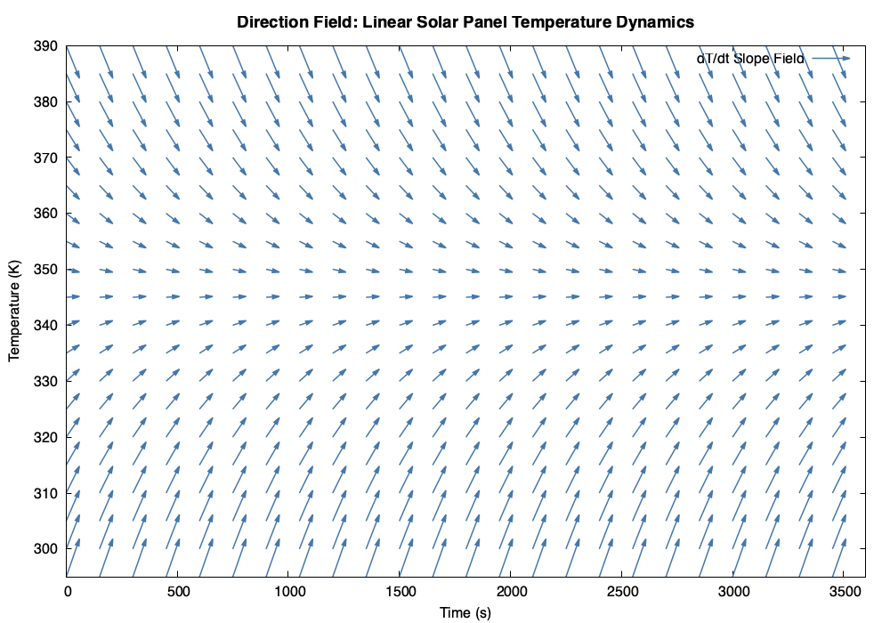
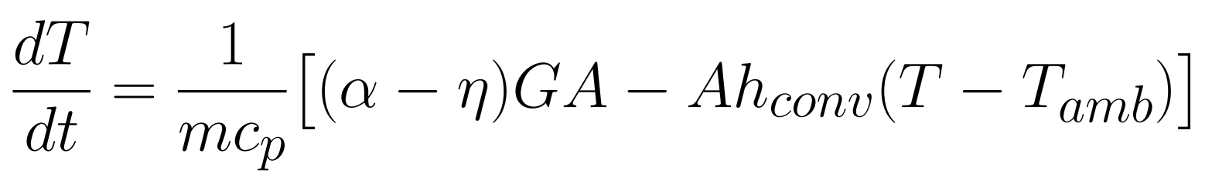
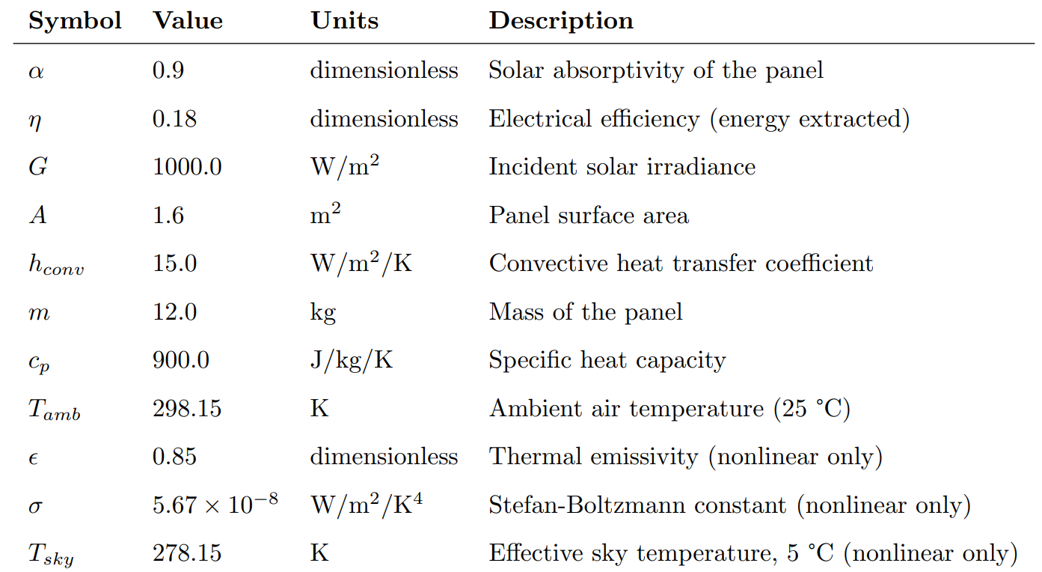

Comparing Six Methods for Determining the Refractive Index of a Glass Prism Using a Multi-Wavelength Laser and a Versatile Optical Setup
,
Investigating Approximations for the Linear and Non-Linear First Order Differential Equation Describing the Operating Temperature of a Photovoltaic Cell.
Thomas Campagna, Wyatt Crosby, Joey Spaeth
Department of Physics, Engineering, and Astronomy, Austin Peay State University, Clarksville, TN 37044, USA
wcampagna@students.apsu.edu
Abstract
We present three methods for analyzing the first order differential equation for the change in temperature of a solar panel over time. The methods include: Eulers method, Improved Euler’s method, and plotting the vector field. This research stems from wanting a deeper understanding of first order differential equations as well as an interest in how solar panels temperature change relative to the energy efficiency of the model. We found that solving using the Improved Euler’s method yielded better results, but the difference between the models is reduced significantly as the number of points created increased. The vector fields were produced using the exact function in GNU Plot. In the future, we intend to investigate various computational methods such as Monte Carlo simulations as well as a coupling of physics equations to yield ideal results.
Theory and Code
Energy Balance Derivation
A solar panel absorbs solar irradiance G (W/m²) over its face area A. A fraction α (absorptivity) of this energy is converted to heat while a fraction η (panel efficiency) exits as electrical work. The remainder drives the panel’s temperature rise. Heat is simultaneously lost to the environment by convection and, in the nonlinear model, by thermal radiation. Applying the first law of thermodynamics to a lumped-capacitance panel of mass m and specific heat cₙ yields the governing ODE:
Model 1 — Linear ODE (Convection Only)
The solar gain term (α−η)GA is constant, making this a first-order linear ODE with constant coefficients. The convective loss hᴀA(T−Tₐₙₙ) is proportional to the temperature difference between the panel and the ambient air, introducing a linear restoring force. This structure allows separation of variables and exact analytical solution.
Model 2 — Nonlinear ODE (Convection + Radiation)
Adding the Stefan-Boltzmann radiation term εσA(T⁴− $T_{sky}^{4}$) introduces strong nonlinearity because panel emission scales as T⁴ while sky absorption scales as $T_{sky}^{4}$. The sky temperature (278.15 K) is lower than ambient air temperature (298.15 K), reflecting the effective radiative temperature of the atmosphere. No closed-form solution exists; numerical methods are required.
Analytical Solution (Linear Model Only)
$$T\left(t\right)=T_{ss}+(T_{0}−T_{ss})e^{−t/τ}$$
Steady-state temperature: $T_{ss}=T_{ann}+\left(α−n\right)\frac{G}{hA}=346.15$K
Thermal time constant: τ = mcₙ / (hᴀA) = (12×900) / (15×1.6) = 450 s
The panel reaches ~63% of its final temperature rise after one time constant (t = 450 s) and is within 2% of steady state by t ≈ 4τ = 1800 s. This exact solution serves as the benchmark against which numerical method errors are measured.
Method 1 — Euler’s Method (First-Order)
Tₙ₊₁ = Tₙ + h ⋅ f(tₙ, Tₙ)
Euler’s method approximates the solution by advancing along the tangent line at the current point using step size h. It is derived from the first two terms of the Taylor series: T(t+h) ≈ T(t) + hT’(t). The local truncation error is O(h²) per step, and the global error accumulates to O(h) over the interval. Because only the slope at the left endpoint is used, the method consistently overshoots on concave-down portions of the solution curve.
Method 2 — Improved Euler / Heun’s Method (Second-Order)
k₁ = f(tₙ, Tₙ) (slope at current point)
k₂ = f(tₙ+h, Tₙ+h⋅k₁) (slope at predicted endpoint)
Tₙ₊₁ = Tₙ + (h/2)(k₁ + k₂) (corrected step)
Heun’s method is a predictor-corrector scheme: it first takes a full Euler step (the predictor) to estimate T at t+h, then evaluates the slope there, and finally advances using the average of the two slopes (the corrector). This averages out the overshoot of a single Euler step. The local truncation error is O(h³) and global error is O(h²), one order better than forward Euler. Because it requires two function evaluations per step, the computational cost is roughly double, but accuracy improves far more proportionally.
Method 3 — Direction Field (Vector Field)
A direction field (slope field) visualizes the ODE without solving it. At each grid point (t, T), the slope dT/dt is evaluated directly from the right-hand side of the ODE and plotted as a short arrow. GNU Plot’s parametric plotting mode was used to draw arrows of uniform visual length scaled to the magnitude of dT/dt. The resulting field reveals the qualitative behavior of all solution curves simultaneously: arrows point upward (dT/dt > 0) below the equilibrium and downward (dT/dt < 0) above it, showing that the equilibrium temperature is a stable attractor.
Physical Parameters
(a). 37 Points
(b). 73 Points
(c). 361 Points
(d)
(e)
Accuracy, Step Size, Error Profile & Physical Interpretation
Three step sizes were tested; figure a: h = 100 s (37 points), figure b: h = 50 s (73 points), and figure c: h = 10 s (361 points). For the linear ODE, Euler’s peak absolute error vs. the exact solution was 2.15 K, 1.05 K, and 0.19 K respectively. Halving h from 100 s to 50 s reduced Euler error by a factor of ~2.05, and further reduction to 10 s reduced it by ~5.5×. This is consistent with O(h) (first-order) convergence. Improved Euler’s peak errors were 0.15 K, 0.04 K, and 0.002 K, that’s a reduction of ~3.8× and ~20× respectively clearly demonstrating O(h²) (second-order) convergence. These results confirm the theoretical prediction that doubling the number of integration points should reduce Improved Euler error by approximately 4×.
The absolute error does not grow indefinitely but instead rises to a maximum near t ≈ 400–500 s and then decays back toward zero as the panel approaches steady state. This bell-shaped error profile is a direct consequence of the ODE’s decaying transient: during the steep initial rise, each step accumulates the largest per-step error; as the solution flattens near Tₛₛ, the slope f(t,T) → 0, so subsequent steps add negligible error and the trajectory asymptotes to the same steady state regardless of method. The peak error location (t ≈ τ = 450 s) coincides with the inflection region of the solution, where curvature is greatest.
The linear model predicts a steady-state panel temperature of Tₛₛ = 346.15 K (73°C). Adding the radiation term in the nonlinear model lowers this to approximately 327 K (54°C). This is physically significant: silicon PV cell efficiency decreases by approximately 0.4–0.5% per degree Celsius above 25°C. A 19 K overestimate of the panel temperature by the linear model would translate to a ~7.6–9.5% overprediction of efficiency loss. The nonlinear model is therefore the more realistic representation of true panel operating temperatures.
Direction Field Analysis
Both direction fields (figure d, figure e) show that the equilibrium is a global stable attractor: all arrows below Tₛₛ point upward and to the right, while those above point downward and to the right. No solution can diverge. The linear field shows nearly uniform arrow angles at a given height confirming the system is autonomous. In the nonlinear field, the arrows at the same T are identical across time for the same reason, but the transition from strongly upward (near T₀) to horizontal (near 327 K) is sharper than in the linear case, reflecting the accelerated energy dissipation from the T⁴ term at elevated temperatures. Arrows above ~360 K angle steeply downward in the nonlinear field but only moderately in the linear field, illustrating how radiation creates a stronger restoring force at high temperatures.
Practical Implications for Solar Panel Design
Panel temperature at steady state has direct consequences for energy output. The nominal power coefficient for crystalline silicon is −0.45%/°C. At the linear-model steady state of 73°C vs. the 25°C STC reference, the panel would operate at 100% − 0.45%×(73−25) = 78.4% of rated power. Using the nonlinear model’s 54°C yields 100% − 0.45%×(54−25) = 87.0%. This results in nearly a 9 percentage-point difference in predicted output. This underscores the value of physically complete models: omitting radiation leads to a systematic underestimate of real-world energy yield. Future experimental validation would allow calibration of the convection coefficient hᴀ and emissivity ε, which are the primary sources of model uncertainty.
Discussion
Higher-Order Numerical Methods (RK4)
The logical next step is to implement the classical 4th-order Runge-Kutta method (RK4), which uses four slope evaluations per step and achieves O(h⁴) global error. RK4 would provide a near-exact benchmark for the nonlinear ODE, where no analytical solution is available, and allow a complete three-way comparison of accuracy vs. computational cost across all step sizes tested here. The expected result is that a single RK4 pass at 37 points will surpass the accuracy of Improved Euler at 361 points, demonstrating the power of higher-order methods for stiff or computationally expensive problems.
Monte Carlo Uncertainty Quantification
The physical parameters used in this study (hᴀ, ε, G, α, η) each carry real-world uncertainty. Convection coefficients can vary by ±20–50% depending on wind speed; solar irradiance fluctuates with cloud cover; emissivity degrades over panel lifetime. A Monte Carlo approach would draw random samples from probability distributions for each parameter, run the nonlinear ODE thousands of times using Improved Euler, and construct probability distributions for the predicted temperature trajectory. This would yield confidence intervals at each time point and identify which parameters contribute most to prediction uncertainty, guiding future experimental measurement priorities.
Coupled Thermal–Electrical Model
Currently, the electrical efficiency η is treated as a constant 18%. In practice, η decreases linearly with temperature: η(T) = ηₛᵗᶜ [1 − β(T − Tₛᵗᶜ)], where β ≈ 0.0045/K for silicon. Substituting this into the ODE creates a feedback loop: higher T reduces η, which increases net heat absorption, which further raises T. Solving this coupled system would require iterative root-finding at each time step (since the RHS now implicitly depends on η(T)), and would produce more accurate steady-state temperatures and direct predictions of real power output as a function of time.
Time-Varying Irradiance and Diurnal Modeling
The current model assumes constant peak irradiance G = 1000 W/m², which is only achieved at solar noon. A more realistic model would replace G with a time-dependent function such as G(t) = G₀ sin²(πt/Tᴀᴀᵧ), where Tᴀᴀᵧ is the day length. This would make the ODE non-autonomous (f now depends explicitly on t), eliminating the exact analytical solution but creating a far more realistic temperature trajectory over a full day. Night cooling and morning warm-up cycles could be simulated, and integration over the daily temperature profile would allow direct prediction of daily energy harvest.
Future Work
Acknowledgements
We would like to acknowledge our professor Dr. Ntatin for his help in guiding us through this project.
Citations
[1] Boyce, W. E., DiPrima, R. C., & Meade, D. B. (2017). Elementary Differential Equations and Boundary Value Problems (11th ed.). Wiley.
[2] Williams, T. & Kelley, C. (2023). Gnuplot 5.4: An Interactive Plotting Program. http://www.gnuplot.info
[3] Chapman, S. J. (2018). Fortran for Scientists and Engineers (4th ed.). McGraw-Hill.
[4] Skoplaki, E. & Palyvos, J. A. (2009). On the temperature dependence of photovoltaic module electrical performance. Solar Energy, 83(5), 614–624.

