Slide 1


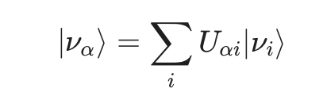
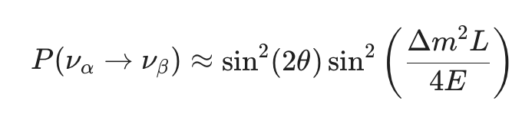
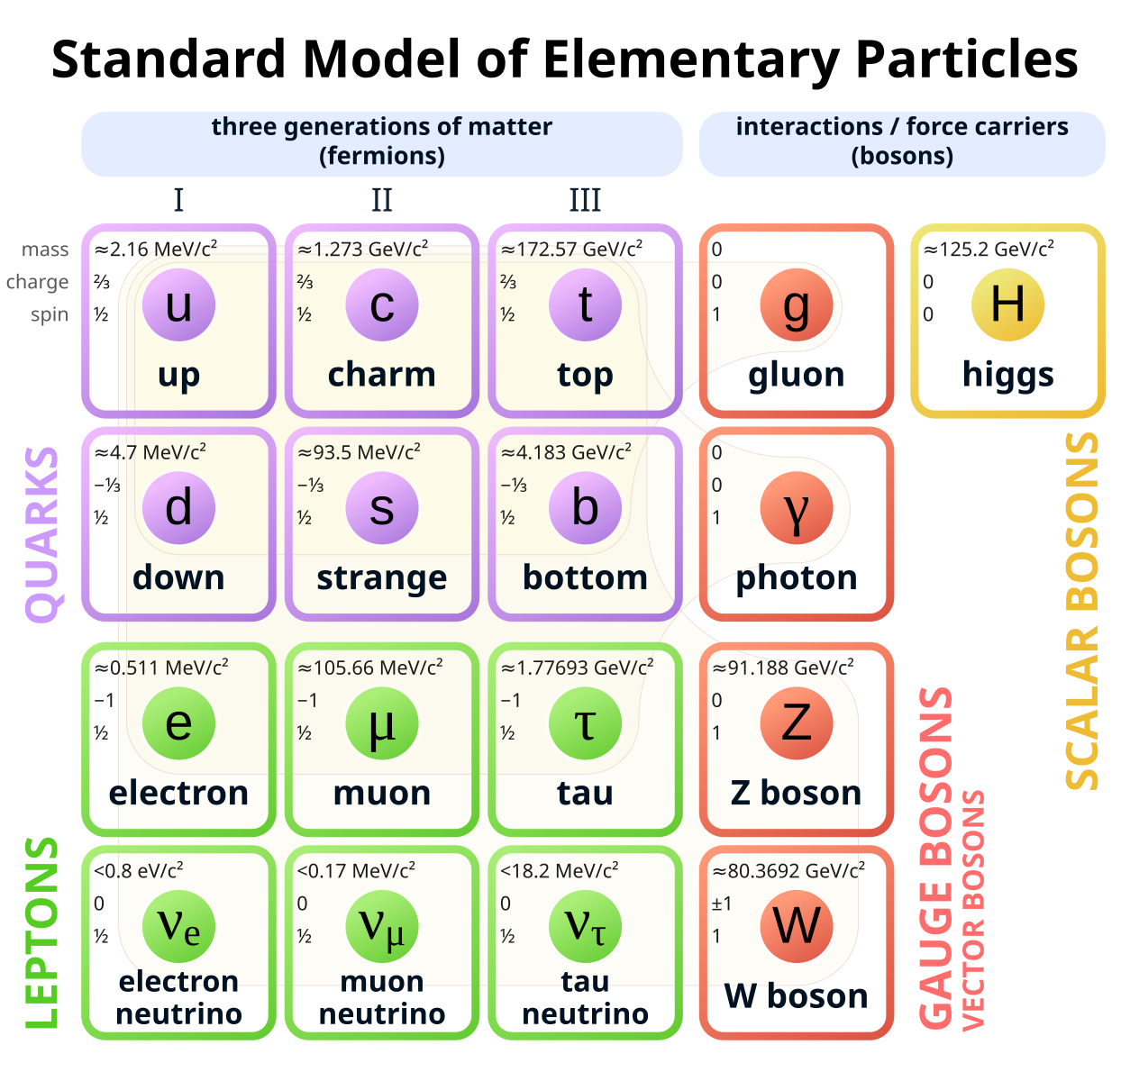

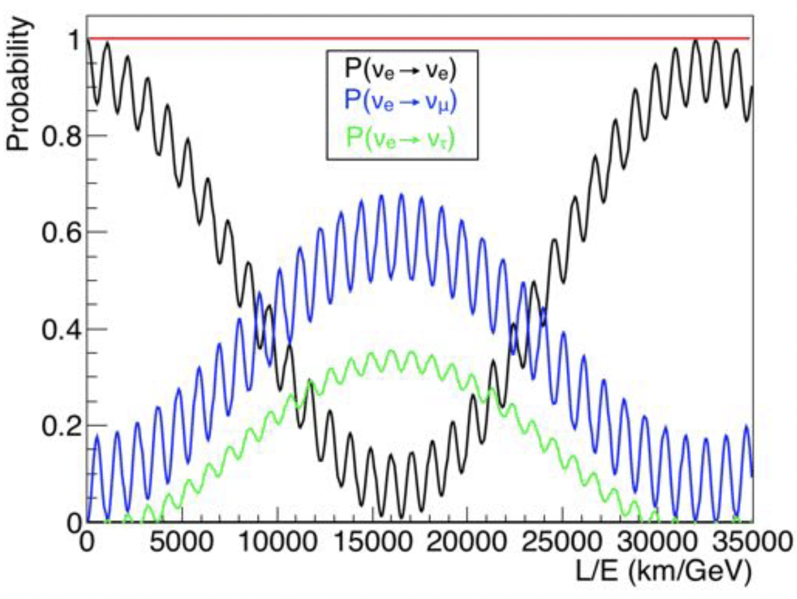
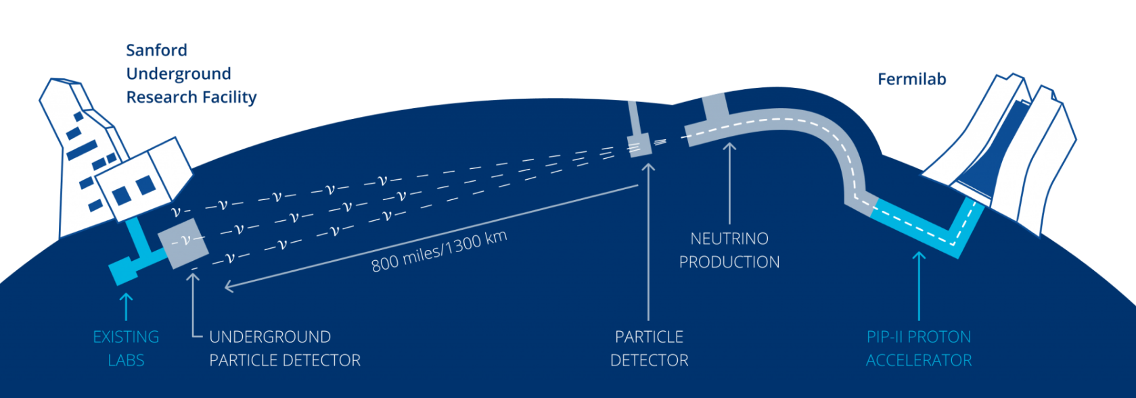
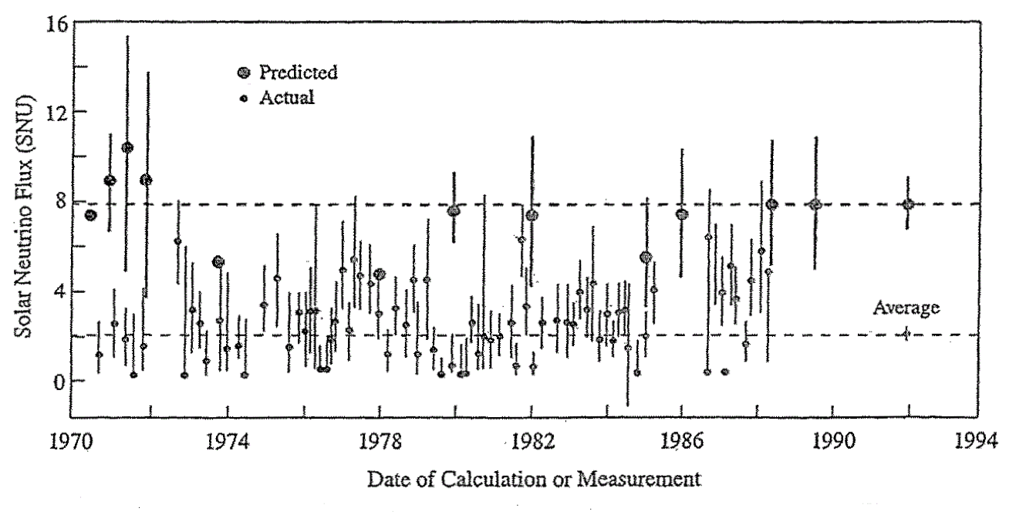
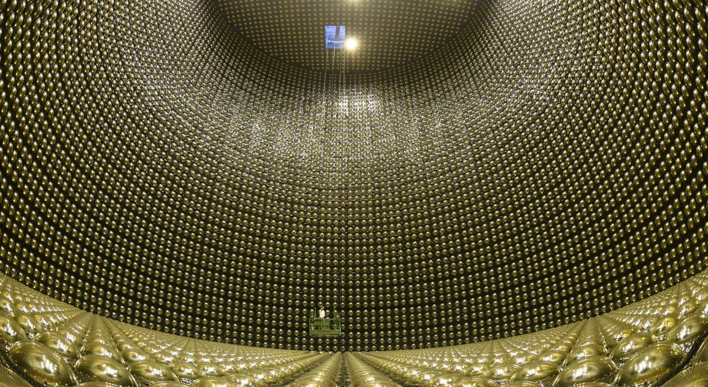
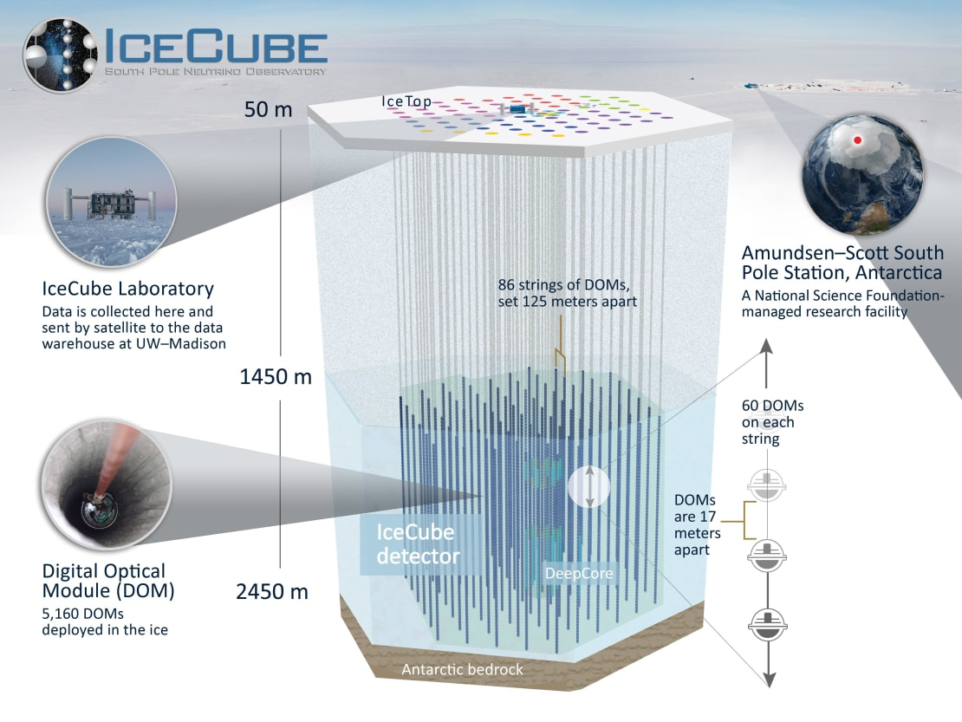
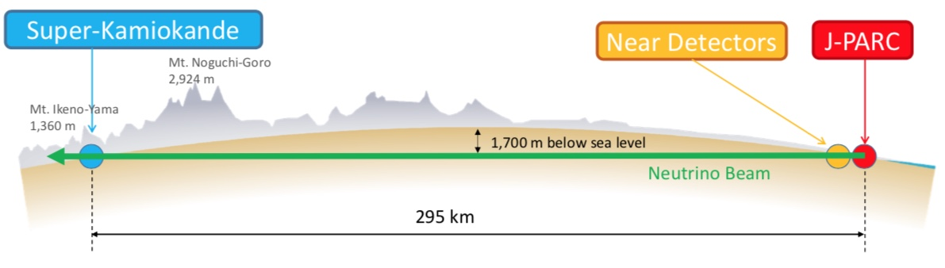
Neutrino Oscillations: What Does It Mean
Eden Kope, Thomas Campagna
Dept. of Physics, Engineering & Astronomy, Austin Peay State University
ekope@students.apsu.edu, wcampagna@students.apsu.edu
What is a Neutrino?
Neutrinos are one of the elementary particles. They have no electric charge, rarely interact with other matter, and are the most abundant particles in the Universe that have mass (although, very little mass) [4], [8]. There are three flavors of neutrinos: the electron neutrino, the muon neutrino, and the tau neutrino [3].
The Standard Model (SM) organizes all known particles and forces (except gravity) (Fig. 1) [6], originally assuming neutrinos were massless [8]. Neutrino oscillations suggests they do have mass, requiring new physics beyond the SM. Oscillations are described in terms of probabilities as their mass states propagate (Fig. 2). There are several other open problems that neutrinos affect - matter/antimatter asymmetry, supernova physics, and proton decay being some [8].
The Physics of Oscillation
When detected, neutrinos show up as one of three flavors: electron, muon, or tau. However, when they travel through space, they exist as three distinct mass states. Nature propagates the mass states, but detectors only measure the flavor states. The Pontecorvo-Maki-Nakagawa-Sakata (PMNS) Matrix is the key that links these two viewpoints. It specifies exactly how much of each mass state contributes to creating each flavor state [8]. Because each mass state has a slightly different mass, they travel at slightly different "speeds" or, more precisely, their quantum phases evolve differently with time and distance. As the neutrino travels, this difference causes the original flavor mixture to change. This change is what we call neutrino oscillation [3].
The Neutrino Oscillation Probability Equation yields the probability that a neutrino created as one flavor is later measured as a different flavor after traveling a distance. Oscillations happen because the flavor states are mixtures of mass states, and the mass states move with slightly different phases as they travel [9]. The mixing angle controls how strongly the flavors mix. The mass squared difference (MSD) controls oscillation frequency, if the MSD was 0 then there would be no oscillations, that is why oscillations imply a difference in mass. The first sin² term sets the oscillation amplitude (maximum conversion), while the second sin² term governs the periodic frequency (2).
Future
There are many ongoing projects looking into the questions that neutrinos propose, such as:
Mass hierarchy: unsure if they receive their mass the same, might answer if neutrinos are their own antiparticles
CP violation: if neutrinos and antineutrinos behave differently, then their symmetry is broken, thus causing a CP violation - by studying neutrino and antineutrino oscillations and their possible differences, it will show CP violation in action
Sterile neutrinos: proposed fourth flavor of neutrinos - it would only interact with matter through gravity and could potentially also have its own varieties . It would be incredibly difficult to observe, but if it is part of neutrino oscillations, it would alter the rate of tau and muon neutrinos becoming electron neutrinos, and thus could be observable. [13]
Upcoming detectors:
Hyper-Kamiokande detector: the grandchild of the Kamiokande detector; set to start experimentation in 2028 (so soon!) Their main scientific goals are exploring the history of the Universe (cosmology) and the Grand Unified theory through CP violation, neutrinos and antineutrinos, and proton decay . The detector will be 8.4 times larger fiducial mass than its predecessor, Super-Kamiokande, and will have newly developed photosensors and a high-intensity neutrino beam. [18]
The Deep Underground Neutrino Experiment (DUNE) is another long-baseline neutrino detector (Fig. 7), asking similar questions as above. This detector will be using ultra-pure argon - when a neutrino collides with the nucleus of an argon atom, it knocks loose electrons, that can be drawn into a distinctive signal [23].
PINGU: The Precision IceCube Next Generation Upgrade is the proposed low-energy in-fill extension to IceCube that would improve oscillation detection [12].
JUNO: The Jiangmen Underground Neutrino Observatory will also be delving into neutrino mass heirarchy by measuring the energy of electron neutrinos detected using liquid scintillator and photomultiplier tubes [16]. It just started getting data not even a month ago! [17]
(1)
(2)
Figure 1: The Standard Model of Elementary Particles. [Image obtained from WikiMedia Commons, Cush]
Current Neutrino Experiments
Current large-scale experiments - Super-K, IceCube, NOvA - extend oscillation physics, probe the neutrino mass hierarchy, and search for Charge-Parity (CP) violation.
The Super-Kamiokande Detector observes neutrinos via a huge tank filled with 50,000 tons of ultra-pure water and 13,000 photomultipliers [21] (Fig. 4) detect the faint Cherenkov radiation that neutrinos emit when they interact with the water molecules. Through the Super-K’s data, it was discovered that neutrinos change their flavor and the three modes of neutrino oscillation. They were also the first to use an artificial neutrino beam in the KEK to Kamioka (K2K) and Tokai to Kamioka (T2K) (Fig. 5) experiments [19]. In 2020, they started the SK-Gd Project - introducing gadolinium into the ultra-pure water, to observe neutrinos from supernovae and the Diffuse Supernova Neutrino Background (DSNB) (currently still undetected [11]).
The IceCube neutrino observatory (Fig. 6) at the South Pole detects high-energy cosmic neutrinos using a cubic kilometer of Antarctic ice - it is the first gigaton neutrino detector [15]. The DeepCore subdetector has the possibility to study neutrino oscillations. The sensors within the detector model the trajectory of the neutrino from its interactions with the ice (the neutrinos are not oberseved directly) [15].
The NuMi Off-Axis νₑ​ Appearance (NOvA) experiment is also researching neutrino oscillations, specifically muon neutrinos to electron neutrinos, because it has not yet been observed. The NuMI (Neutrinos at the Main Injector) neutrino beam sends neutrinos to the NOvA detectors made extruded, highly reflective plastic PVC filled with liquid scintillator. [22]
Figure 2: Probabilities of neutrino oscillations assuming the initial state is an electron neutrino. [10]
History
The Homestake experiment, led by Ray Davis, first revealed a problem with the Standard Model’s view of neutrinos. The detector, using 615 tons of perchloroethylene [4], was only sensitive to electron neutrinos (νₑ​) and detected only 1/3 of the predicted solar νₑ​ flux (Fig. 3) [4]. This deficit demonstrated that electron neutrinos were disappearing, leading to the conclusion that neutrinos must change flavor during their journey from the Sun to Earth.
The Kamioka Nucleon Decay Experiment (Kamiokande) laid the groundwork for several experiments and the discovery of neutrino oscillations, notably by observing neutrinos from a supernova [5]. Its successor, the Super-Kamiokande (Super-K) detector, provided evidence for oscillation in 1998. Super-K observed a clear zenith-angle dependent deficit of atmospheric muon neutrinos​ [3]. This dependence allowed for precise extraction of Δm2 and the mixing angle [3]. Together, these results delivered the first evidence that neutrinos may possess mass [7].
Figure 7: A diagram showing the Long-Baseline Neutrino Facility neutrino beam to DUNE detector. [Fermilab]
Citations
[1] Diwan et al., “A Novel Method for Event Reconstruction in Liquid Argon Time Projection Chamber”
[2] Abi et al., “Deep Underground Neutrino Experiment (DUNE), Far Detector Technical Design Report, Volume II”
[3] Fukuda et al., “Evidence for Oscillation of Atmospheric Neutrinos”
[4] Davis et al., “Search for Neutrinos from the Sun”; Scott, “The Cosmic Neutrino Background”
[5] Collaboration et al., “The Long-Baseline Neutrino Experiment”
[6] Gaillard et al., “The Standard Model of Particle Physics.”
[7] Sakurai et al., “The Variation of the Solar Neutrino Fluxes over Time in the Homestake, GALLEX(GNO) and Super-Kamiokande Experiments.”
[8] Hernández and Valencia, NEUTRINOS: OPEN QUESTIONS.
[9] Mondal, “Physics of Neutrino Oscillation.”
[10] Fernandez, Neutrino Physics in Present and Future Kamioka Water-Cherenkov Detectors with Neutron Tagging.
[11] Santos, “Diffuse Supernova Neutrino Background.”
[12] Collaboration, “PINGU: A Vision for Neutrino and Particle Physics at the South Pole.”
[13] All Things Neutrino. (n.d.). neutrinos. Retrieved December 7, 2025, from https://neutrinos.fnal.gov/
[14] Evidence for oscillation of atmospheric neutrinos. (n.d.). Kamioka Observatory. Retrieved December 7, 2025, from https://www-sk.icrr.u-tokyo.ac.jp/sk/_pdf/articles/nuosc98.submitted.pdf
[15] IceCube Neutrino Observatory - University of Wisconsin–Madison. (n.d.). IceCube Neutrino Observatory. Retrieved December 7, 2025, from https://icecube.wisc.edu/science/icecube/
[16] JUNO. (n.d.). Jiangmen Underground Neutrino Observatory. Retrieved December 9, 2025, from https://juno.ihep.cas.cn/
[17] JUNO Experiment Delivers First Physics Results Two Months After Completion. (n.d.). Retrieved December 7, 2025, from https://english.cas.cn/newsroom/research_news/phys/202511/t20251119_1132383.shtml
[18] Kamiokande Observatory. (n.d.). Overview | Hyper-Kamiokande. Retrieved December 7, 2025, from https://www-sk.icrr.u-tokyo.ac.jp/en//hk/about/outline/
[19] Kamiokande Observatory. (n.d.). Research History | Super-Kamiokande Official Webiste. Retrieved December 7, 2025, from https://www-sk.icrr.u-tokyo.ac.jp/en/sk/about/history/
[20] Long Baseline neutrino oscillation experiment, from KEK to Kamioka (K2K). (n.d.). neutrino. Retrieved December 7, 2025, from https://neutrino.kek.jp/intro/k2k.html
[21] Neutrino Oscillations. (n.d.). Neutrino Oscillations | Super-Kamiokande Official Webiste. Retrieved December 7, 2025, from https://www-sk.icrr.u-tokyo.ac.jp/en/sk/neutrino/kajita/vibration/
[22] NOvA. (n.d.). NOvA experiment. Retrieved December 7, 2025, from https://novaexperiment.fnal.gov/
[23] Overview – DUNE at LBNF. (n.d.). DUNE at LBNF. Retrieved December 7, 2025, from https://lbnf-dune.fnal.gov/about/overview/
[24] T2K. (n.d.). T2K (Tokai to Kamioka). Retrieved December 7, 2025, from https://t2k-experiment.org/t2k/
[25] 35 years after the detection of SN1987A neutrinos | Kamioka Observatory, ICRR, The University of Tokyo. (n.d.). Kamioka Observatory. Retrieved December 7, 2025, from https://www-sk.icrr.u-tokyo.ac.jp/en/news/detail/324
Figure 3: This figure compares the solar electron neutrino (νₑ​​) flux observed by the Homestake experiment [4] to the theoretical prediction derived from the Standard Solar Model (SSM), showcasing the deficiency.
Figure 4: Inside the water chamber of the Super-K detector [Super-Kamiokande].
Figure 6: A diagram of the IceCube detector [15].
Figure 5: Diagram of the T2K long-baseline J-PARC neutrino beam to Super-K detector [24].

