Slide 1

Investigating Approximations for the Linear and Non-Linear First Order Differential Equation Describing the Operating Temperature of a Photovoltaic Cell.
Thomas Campagna, Wyatt Crosby, Joey Spaeth
Ben Ntatin
Austin Peay State University
Notes:
Goal: apply Forward Euler and Improved Euler, compare accuracy, study convergence.

Slide 2
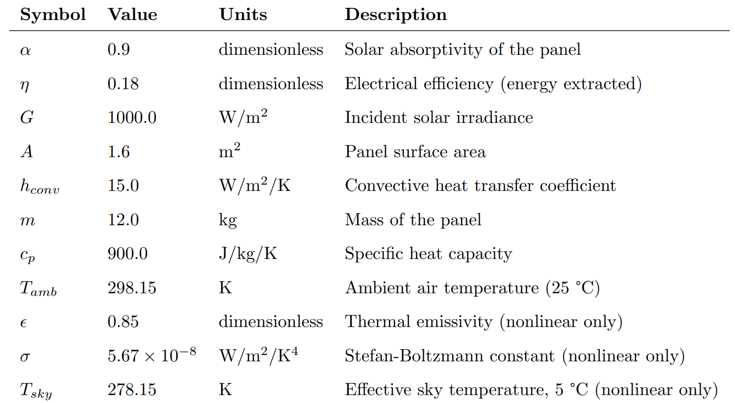
PHYSICAL PARAMETERS
Notes:
Key insight: α − η = 0.9 − 0.18 = 0.72 is the net fraction of absorbed solar energy that becomes heat.

Slide 3
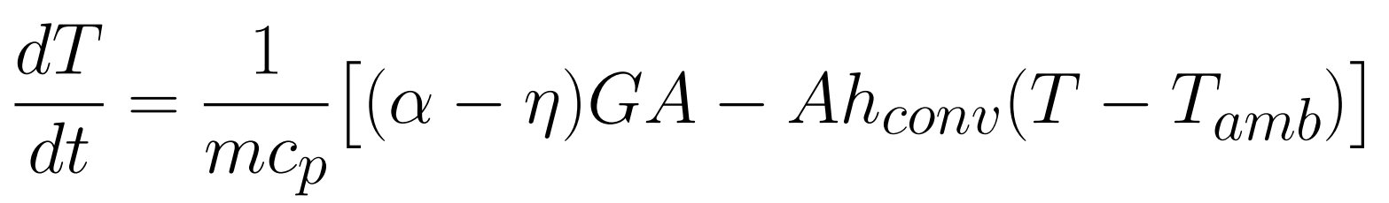
EQUATION FOR LINEAR ODE
Temperature change over time
Thermal Inertia
Net solar power absorbed as heat
Convective heat loss
Notes:
d-T-d-t equals one over m-c-p, times the net solar input minus the convective loss

Slide 4
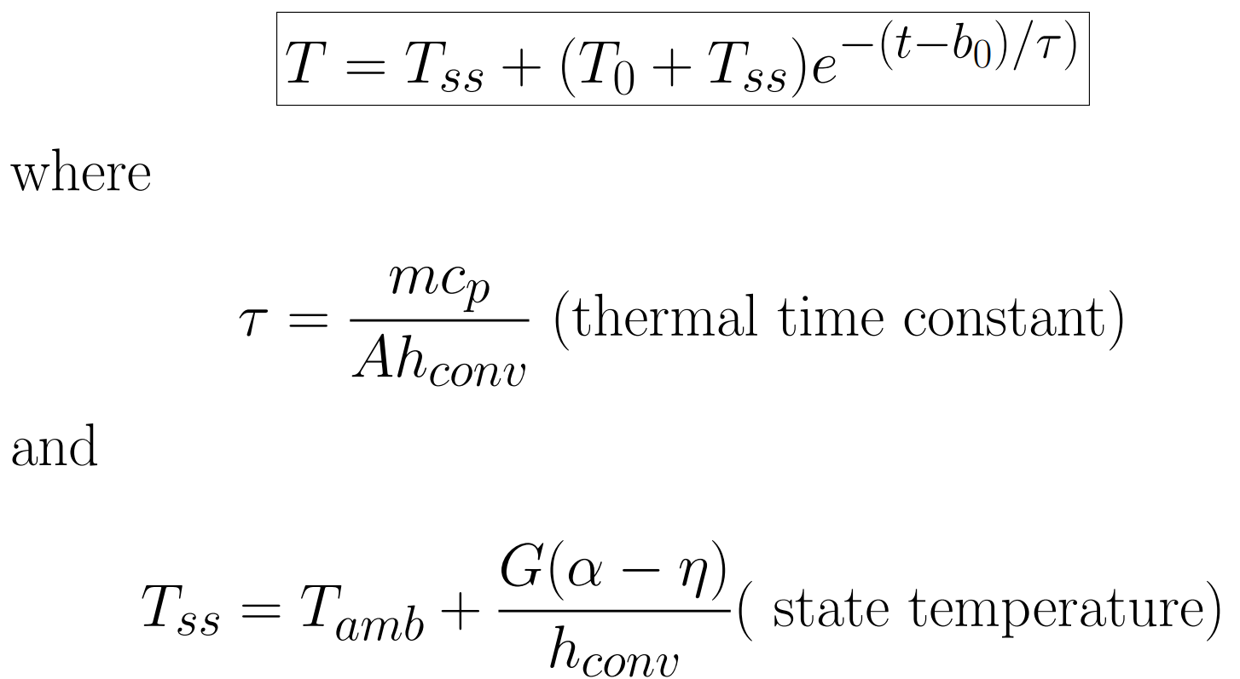

EXACT SOLUTION
Notes:
The exponential term represents the transient: it starts at (T₀ − T_ss) and decays to zero

Slide 5
EQUATION FOR NONLINEAR ODE
Stefan-Boltzmann radiative cooling
Notes:
The T⁴ dependence makes this nonlinear — no closed-form solution exists.

Slide 6
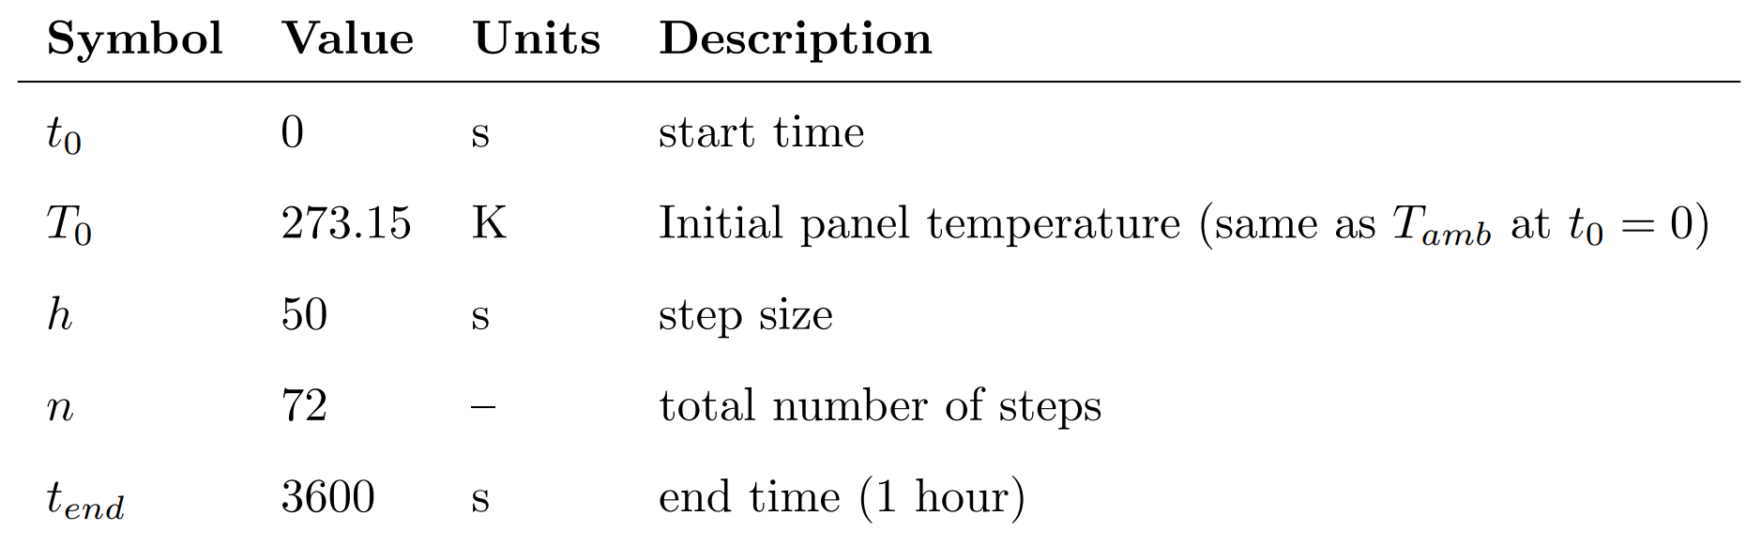
NUMERICAL PARAMETERS
Notes:
h = 50 s, n = 72 steps → 1 hour of simulation. We also tested h ≈ 100 s (37 pts) and h = 10 s (361 pts).

Slide 7
LINEAR ODE CODE
do i = 0, n_steps
y_exact_val = exact_solution(x, y0, x_start)
write(10,'(6F15.6)') x, y_lin_e, y_lin_ie, y_exact_val, abs(y_lin_e - y_exact_val), abs(y_lin_ie - y_exact_val)
! Forward Euler (linear)
y_lin_e = y_lin_e + h * f(x, y_lin_e)
! Improved Euler / Heun (linear)
! k1 = slope at (x, y), k2 = slope at predictor (x+h, y + h*k1), y_new = y + h/2 * (k1 + k2)
k1 = f(x, y_lin_ie)
k2 = f(x + h, y_lin_ie + h * k1)
y_lin_ie = y_lin_ie + (h / 2.0d0) * (k1 + k2)
x = x + h
end do
Notes:
Forward Euler: one slope evaluation per step — O(h) accuracy. Improved Euler (Heun): k1 predicts, k2 corrects — O(h²). Same computation but one extra function call per step.

Slide 8
NON-LINEAR ODE CODE
do i = 0, n_steps
write(11,'(3F15.6)') x, y_nlin_e, y_nlin_ie
! Forward Euler (nonlinear)
y_nlin_e = y_nlin_e + h * w(x, y_nlin_e)
! Improved Euler / Heun (nonlinear)
k1 = w(x, y_nlin_ie)
k2 = w(x + h, y_nlin_ie + h * k1)
y_nlin_ie = y_nlin_ie + (h / 2.0d0) * (k1 + k2)
x = x + h
end do
Notes:
identical loop structure; only the function w(x,y) changes to include the radiation term. No exact solution available, so errors are measured as the difference between the two methods.

Slide 9
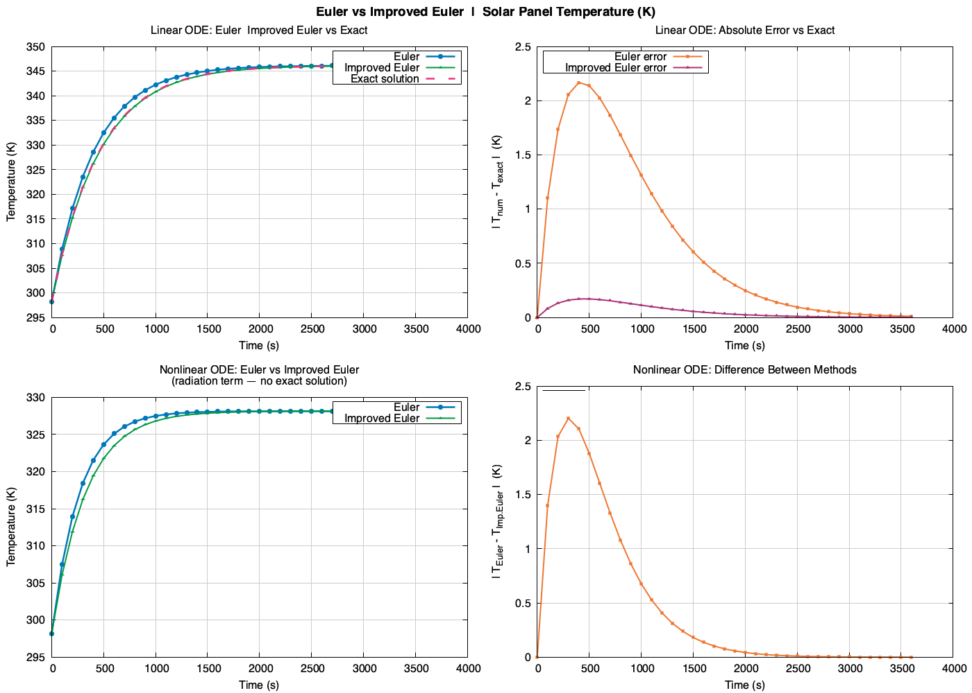
37 POINTS

Slide 10
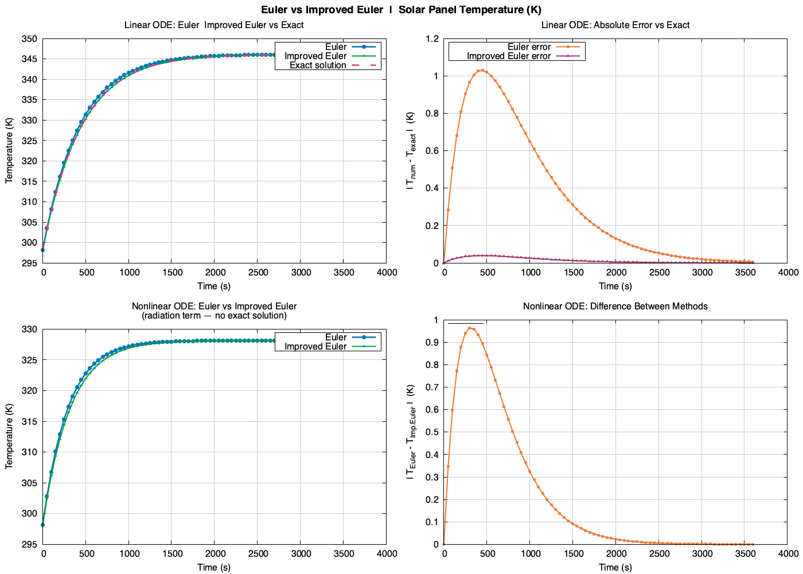
73 POINTS

Slide 11
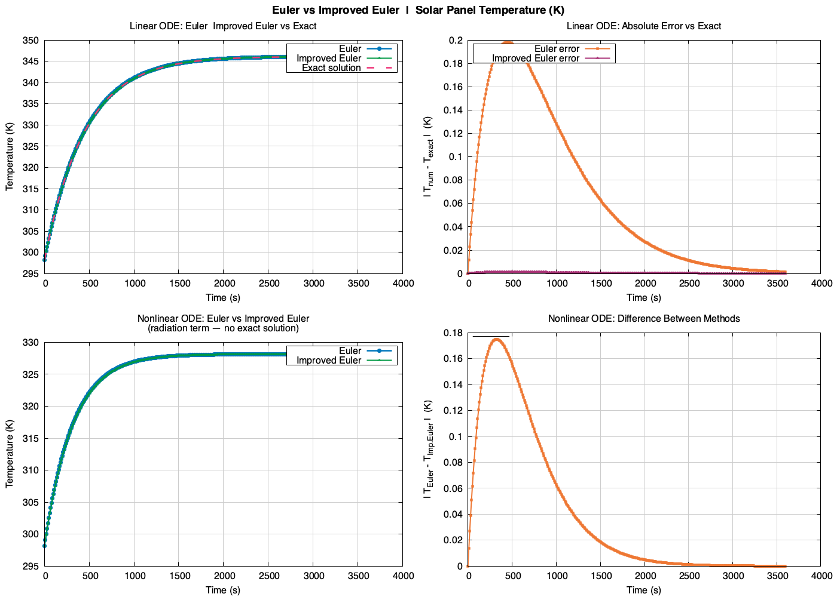
361 POINTS

Slide 12
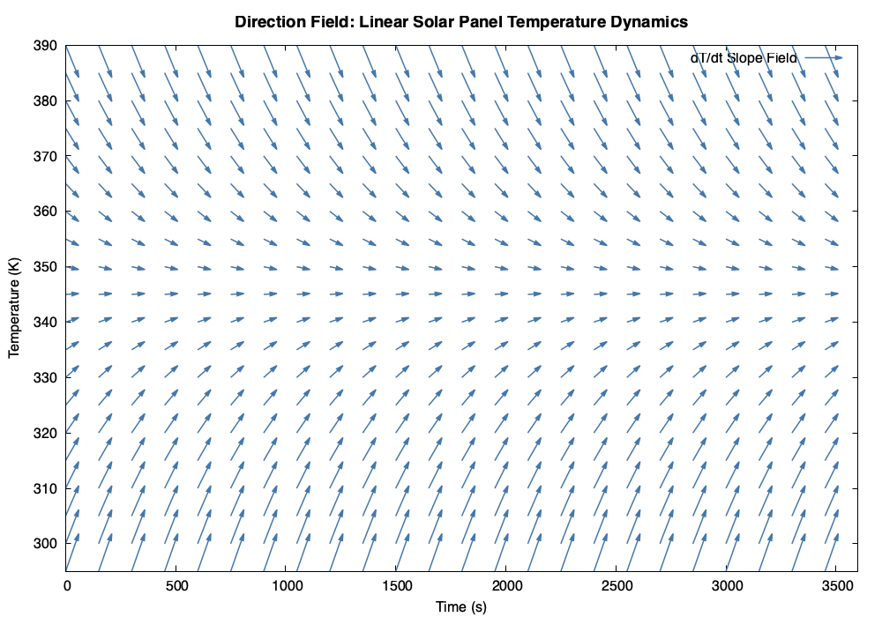
Notes:
The horizontal band is the equilibrium — this visually confirms T_ss without solving anything

Slide 13
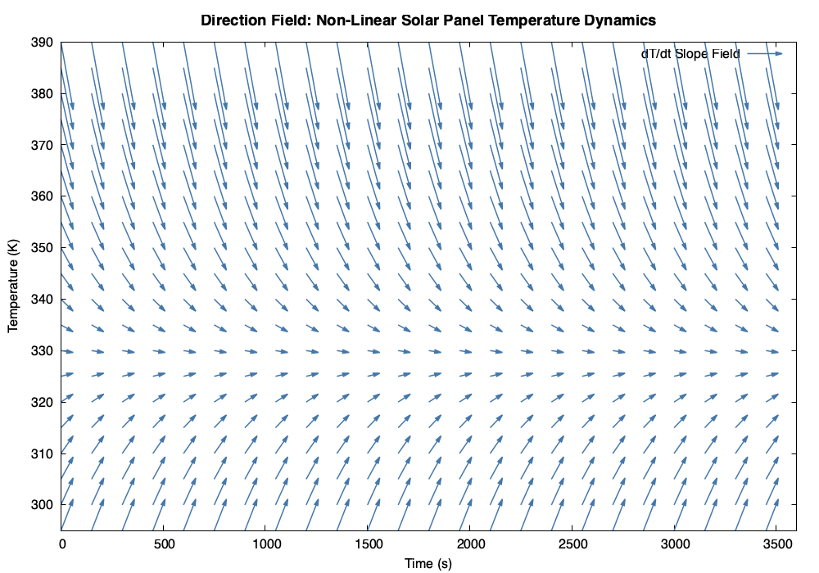
Notes:
The nonlinear field is qualitatively identical; radiation only shifts the equilibrium value, not the stability.

Slide 14

Future Research into Computational Solutions
Notes:
we identified five potential avenues for future investigation:
Runge Kutta-4, Monte Carlo Quantification, A Coupled Thermal Electrical Model, Time-varying irradiance, and lastly A coupled model of atmospheric properties

Slide 15
Higher-Order Numerical Methods (RK4)
Implement the classical 4th-order Runge-Kutta method (RK4).
Uses four slope evaluations per step and achieves O(h⁴) global error.
RK4 would provide a near-exact benchmark for the nonlinear ODE, where no analytical solution is available, and allow a complete three-way comparison of accuracy vs. computational cost across all step sizes tested here.

Slide 16
Monte Carlo Uncertainty Quantification
The physical parameters used in this study (hᴀ, ε, G, α, η) each carry real-world uncertainty.
Convection coefficients can vary by ±20–50% depending on wind speed; solar irradiance fluctuates with cloud cover; emissivity degrades over panel lifetime.
Notes:
A Monte Carlo approach would draw random samples from probability distributions for each parameter, run the nonlinear ODE thousands of times using Improved Euler, and construct probability distributions for the predicted temperature trajectory.

Slide 17
Coupled Thermal–Electrical Model
Currently, the electrical efficiency η is treated as a constant 18%.
In practice, η decreases linearly with temperature: η(T) = ηₛᵗᶜ [1 − β(T − Tₛᵗᶜ)], where β ≈ 0.0045/K ≈ 0.45%/K for silicon.
Notes:
efficiency drops ~0.45%/K for silicon — creates a positive feedback loop raising equilibrium temperature.
Substituting this into the ODE creates a feedback loop: higher T reduces η, which increases net heat absorption, which further raises T.

Slide 18
Time-Varying Irradiance and Diurnal Modeling
The current model assumes constant peak irradiance G = 1000 W/m², which is only achieved at solar noon.
A more realistic model would replace G with a time-dependent function such as G(t) = G₀ sin²(πt/Tᴀᴀᵧ), where Tᴀᴀᵧ is the day length.
Notes:
Night cooling and morning warm-up cycles could be simulated, and integration over the daily temperature profile would allow direct prediction of daily energy harvest.

Slide 19
Accounting for Changes in Atmospheric Properties with Boltzmann Transport Equations and Navier Stokes
The current model ignores how atmospheric composition such as humidity, aerosols, and air density modifies both radiative input and convective heat loss.
Coupling both to the ODE would require a full multi-physics solver (FEM or FVM) but would yield the most physically accurate temperature predictions under real-world deployment conditions.
Notes:
The Boltzmann Transport Equation (BTE) governs photon transport through scattering/absorbing media and could model how clouds, aerosols, and water vapor attenuate G before it reaches the panel surface.
The Navier-Stokes equations could replace the h_conv with a spatially-resolved convective boundary layer model, capturing how wind speed, temperature gradients, and local air density vary across the panel surface.

Slide 20
Conclusion
Both Forward Euler (O(h)) and Improved Euler (O(h²)) converge to the closed-form exact solution for the linear ODE; Improved Euler consistently outperforms Forward Euler at every step-size tested (37, 73, 361 points), requiring far fewer points for the same accuracy.
The nonlinear ODE (Stefan-Boltzmann radiation term) has no closed-form solution; both methods still converge as step-size decreases, and direction-field analysis confirms the same qualitative equilibrium temperature as the linear case.
Future work would progressively close the gap between this model and real-world PV cell behavior.
Citations:
[1] Boyce, W. E., DiPrima, R. C., & Meade, D. B. (2017). Elementary Differential Equations and Boundary Value Problems (11th ed.). Wiley.
[2] Williams, T. & Kelley, C. (2023). Gnuplot 5.4: An Interactive Plotting Program. http://www.gnuplot.info
[3] Chapman, S. J. (2018). Fortran for Scientists and Engineers (4th ed.). McGraw-Hill.
[4] Skoplaki, E. & Palyvos, J. A. (2009). On the temperature dependence of photovoltaic module electrical performance. Solar Energy, 83(5), 614–624.
[5] Campagna, W. (2025). Atmosphere-Unified Radiation Assessment with Multi-Fidelity for Photovoltaics. https://github.com/THMSCMPG/AURA-MFP
Notes:
Three takeaways: both methods converge; Improved Euler consistently outperforms Forward Euler; nonlinear ODE shows the same qualitative stability.

