Slide 1


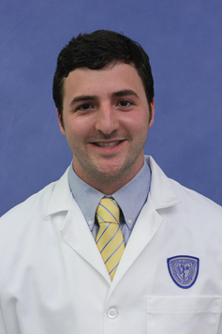
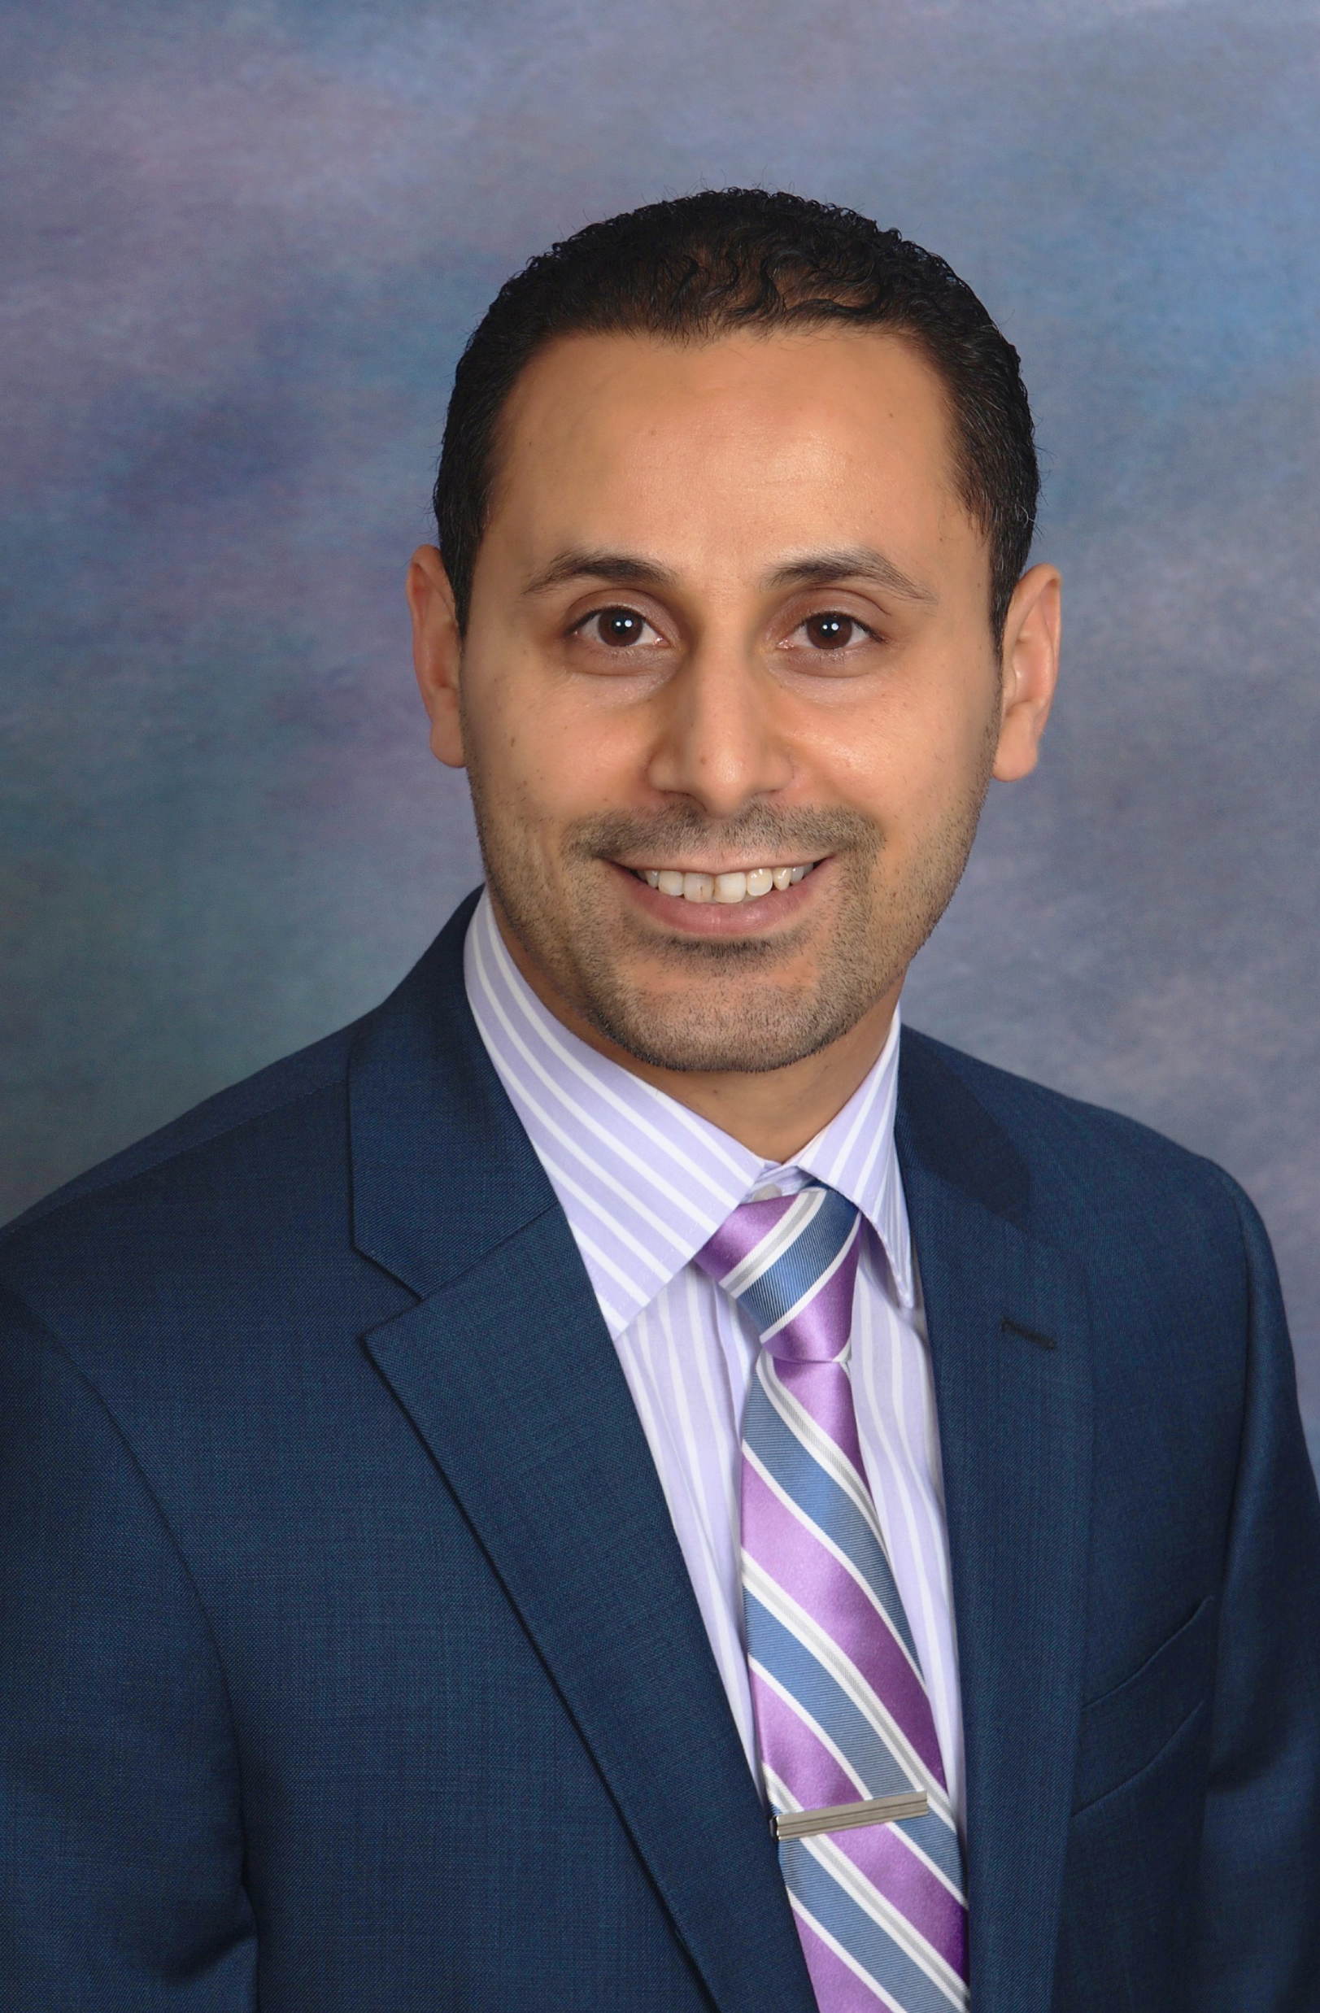
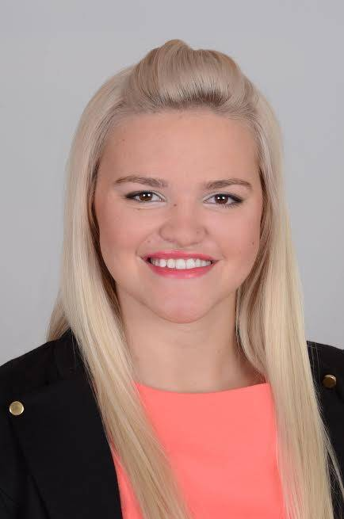
431: 2017 Teaching Assistants 431-help@case.edu
Claudia Cabrera, MD
Lead TA, Section 1
Kara Quaid
Robert (Bob) Winkelman
Omar Alaber, MD
Lead TA, Section 2
Ruzica (Rosie) Conic, MD

