Slide 1
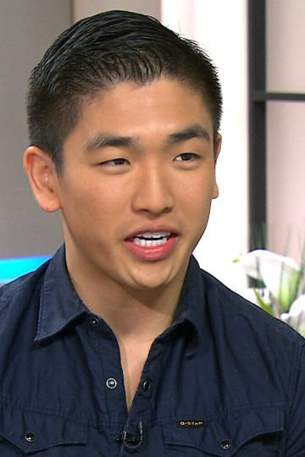
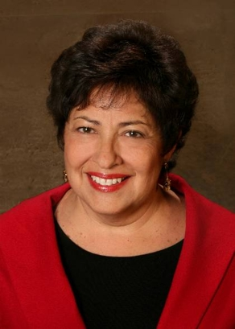
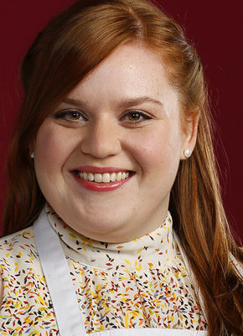
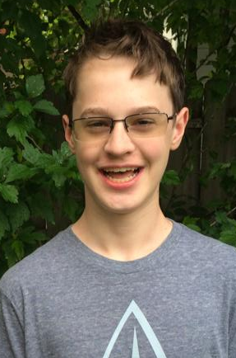

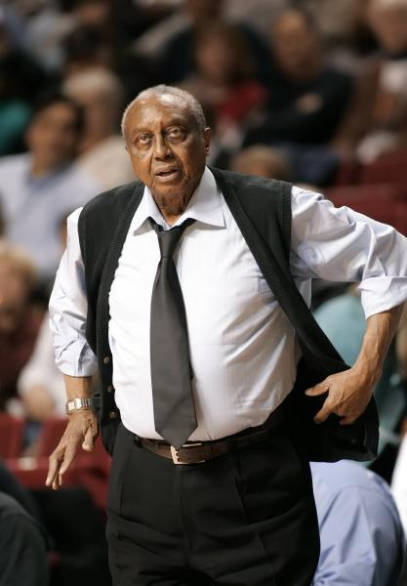



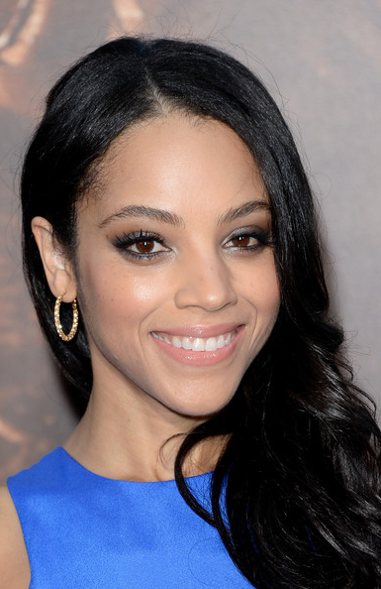
#1 Age 21 #2 Age 64 #3 Age 28 #4 Age 14 #5 Age 54
2014-16 Mean Guesses
25.6
52.2
27.5
14.4
52.8
69.0
46.6
74.9
34.3
26.7
#6 Age 74 #7 Age 44 #8 Age 83 #9 Age 24 #10 Age 34

Slide 2
#1 Age 21 #2 Age 64 #3 Age 28 #4 Age 14 #5 Age 54
2014-16 Errors
+4.6
-11.8
-0.5
+0.4
-1.2
-5.0
+2.6
-8.1
+10.3
-7.3
#6 Age 74 #7 Age 44 #8 Age 83 #9 Age 24 #10 Age 34

